Slide 1
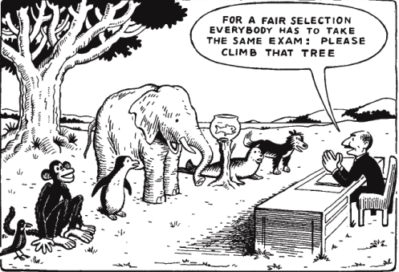
Graduation project Occupational Therapy
Universal Design for Learning
Hendrickx Karen
Luyck Carolien
Meerten Elke

Slide 2
Overview content
Introduction
  Formulation of the problem
  Preview
  Background information
Method
  Literature study
  UDL-checklist
  Education aspects
Results
  Analysis study-material
  Analysis education-forms
  Analysis assessment
  Analysis survey
Conclusion
References

Slide 3
Introduction
Formulation of the problem
Preview
Background information
Occupational therapy (OT)
UD
SIHO
UDL
CAST
Charter

Slide 4
Formulation of the problem
Research question
“Assessing the degree in which the UDL-principles are implemented in the OT-curriculum at University college Hasselt.”
Purpose
  UDL → curriculum of occupational therapy
  UDL-suggestions → optimization
Onset
Student diversity
  (un)-identified problems
Allowance → generalization
  Content
  Shape
➔ Benefits every student
Overview content
Introduction
  Formulation of the problem
  Preview
  Background information
Method
  Literature study
  UDL-checklist
  Education aspects
Results
  Analysis study-material
  Analysis education-forms
  Analysis assessment
  Analysis survey
Conclusion
References

Slide 5
Formulation of the problem
Universal Design for Learning
Equal opportunities
Flexible lesson presentment
Design
Screening
Survey
Visual equipment → education forms
Interview Prof. Froyen
Micro level
Overview content
Introduction
  Formulation of the problem
  Preview
  Background information
Method
  Literature study
  UDL-checklist
  Education aspects
Results
  Analysis study-material
  Analysis education-forms
  Analysis assessment
  Analysis survey
Conclusion
References

Slide 6
Preview
Occupational therapy curriculum (PHL) → optimization?
Inspiration → extend research
Concrete implementation
UDL-charter
Overview content
Introduction
  Formulation of the problem
  Preview
  Background information
Method
  Literature study
  UDL-checklist
  Education aspects
Results
  Analysis study-material
  Analysis education-forms
  Analysis assessment
  Analysis survey
Conclusion
References

Slide 7
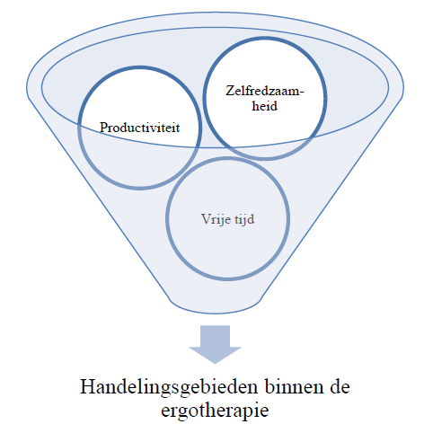
Background information
The importance of OT within higher education
Concept Universal Design (UD)
  Architecture
    Evolution
    Purpose
    Environment
Overview content
Introduction
  Formulation of the problem
  Preview
  Background information
Method
  Literature study
  UDL-checklist
  Education aspects
Results
  Analysis study-material
  Analysis education-forms
  Analysis assessment
  Analysis survey
Conclusion
References

Slide 8
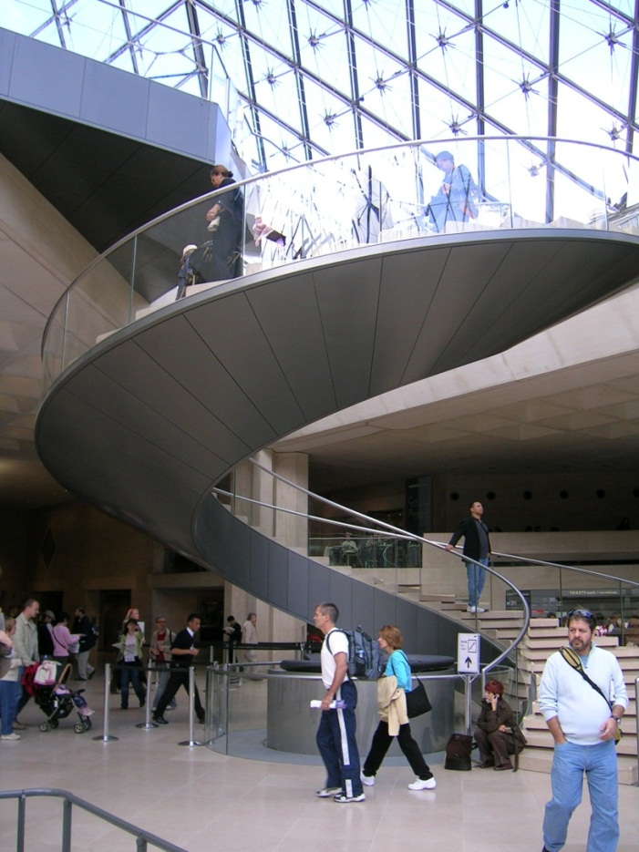
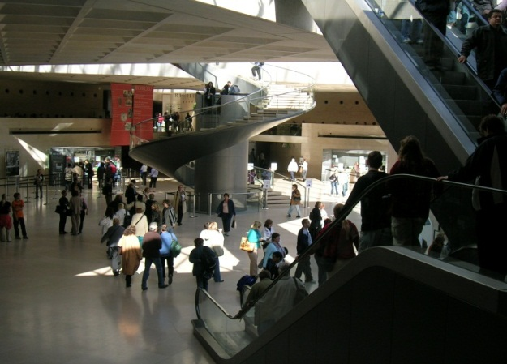
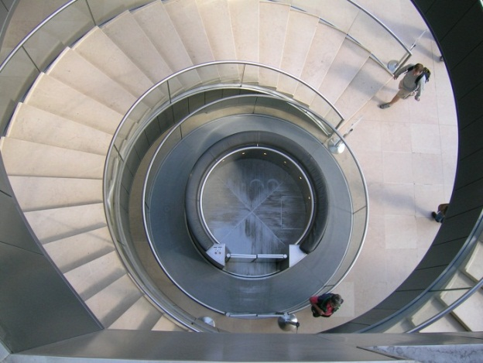
Link between UD and UDL
Photo © 2005 Ria Ceyssens
Louvre Museum, Architects Pei Cobb Freed & Partners, 1989
Overview content
Introduction
  Formulation of the problem
  Preview
  Background information
Method
  Literature study
  UDL-checklist
  Education aspects
Results
  Analysis study-material
  Analysis education-forms
  Analysis assessment
  Analysis survey
Conclusion
References

Slide 9
UDL
Origin
  UD
  Education
  CAST
  Rose & Meyer
Purpose
  Present talents ↗
  ➔ everybody studying
  Shift: view at diversity
Overview content
Introduction
  Formulation of the problem
  Preview
  Background information
Method
  Literature study
  UDL-checklist
  Education aspects
Results
  Analysis study-material
  Analysis education-forms
  Analysis assessment
  Analysis survey
Conclusion
References

Slide 10
UDL
Vision
  Flexibility → ≠ lesson design
  › physical barriers
  Large public as possible
  Multimedia-tools, digitalization,…
Principles → guideline
  Representation
  Action & expression
  Involvement
Diversity & flexibility
Overview content
Introduction
  Formulation of the problem
  Preview
  Background information
Method
  Literature study
  UDL-checklist
  Education aspects
Results
  Analysis study-material
  Analysis education-forms
  Analysis assessment
  Analysis survey
Conclusion
References

Slide 11

UDL
UDL-framework
Overview content
Introduction
  Formulation of the problem
  Preview
  Background information
Method
  Literature study
  UDL-checklist
  Education aspects
Results
  Analysis study-material
  Analysis education-forms
  Analysis assessment
  Analysis survey
Conclusion
References

Slide 12
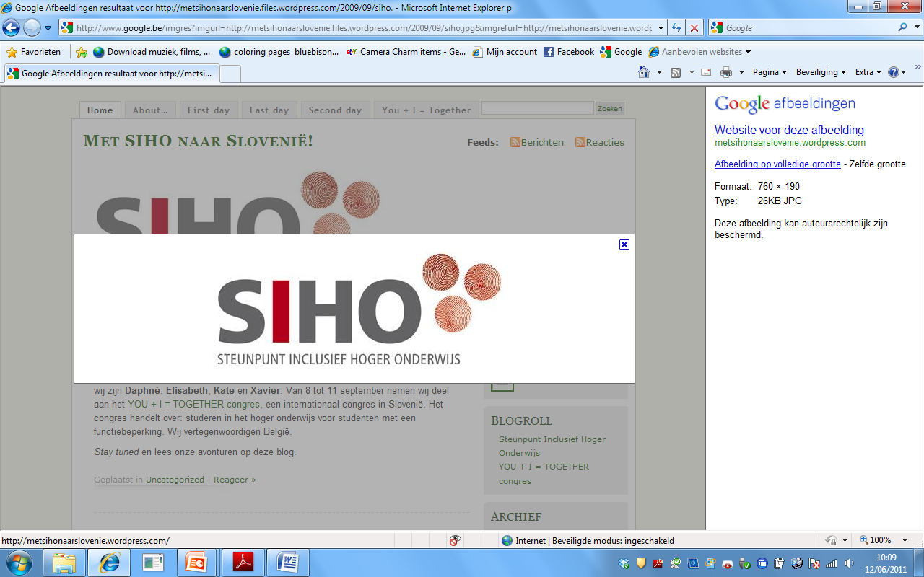
  Realization inclusive higher education
  Equal opportunities and full participation
  Guide: Art. 24 VN-convention for inclusive higher education
  Inclusion
  Reasonable adaptations
Overview content
Introduction
  Formulation of the problem
  Preview
  Background information
Method
  Literature study
  UDL-checklist
  Education aspects
Results
  Analysis study material
  Analysis education forms
  Analysis assessment
  Analysis survey
Conclusion
References

Slide 13

Center for Applied Special Technology
  Barriers in education
  UDL ➔ principles
  UDL-checklist
Overview content
Introduction
  Formulation of a problem
  Preview
  Background information
Method
  Literature study
  UDL-checklist
  Education aspects
Results
  Analysis study-material
  Analysis education-forms
  Analysis assessment
  Analysis survey
Conclusion
References

Slide 14
Method
Literature study
Education aspects
Problem based learning (PBL)
Material of education
UDL- checklist
Education group (EG)
Lecture &
Response lecture
Assessment

Slide 15
Literature study
  CAST-modules
  Scientific databases
  Micro level
    Education aspects
      Study-material
      Education-forms
      Assessment
Overview content
Introduction
  Formulation of the problem
  Preview
  Background information
Method
  Literature study
  UDL-checklist
  Education aspects
Results
  Analysis study-material
  Analysis education-forms
  Analysis assessment
  Analysis survey
Conclusion
References

Slide 16
UDL-checklist
Checklist CAST – Checklist SIHO
Principles – guidelines
Screening education aspects
  Study-material
  Education-forms
  Assessment
Overview content
Introduction
  Formulation of the problem
  Preview
  Background information
Method
  Literature study
  UDL-checklist
  Education aspects
Results
  Analysis study-material
  Analysis education-forms
  Analysis assessment
  Analysis survey
Conclusion
References

Slide 17
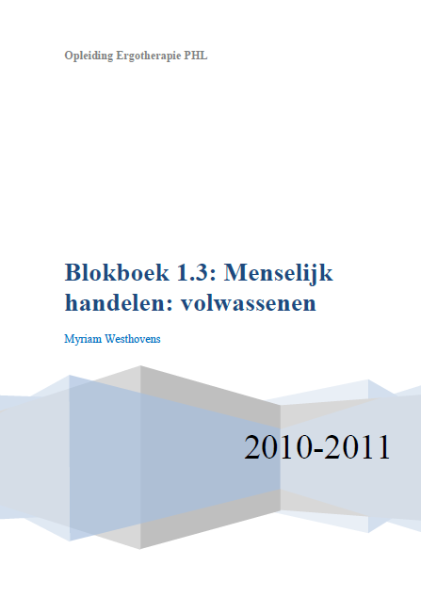
Education aspects
Problem-Based Learning (PBL)
  Student centered education
  In groups
    Tasks / ‘problems’
  7 steps
Education material
  studybook
  Literature
Overview content
Introduction
  Formulation of the problem
  Preview
  Background information
Method
  Literature study
  UDL-checklist
  Education aspects
Results
  Analysis study-material
  Analysis education-forms
  Analysis assessment
  Analysis survey
Conclusion
References

Slide 18
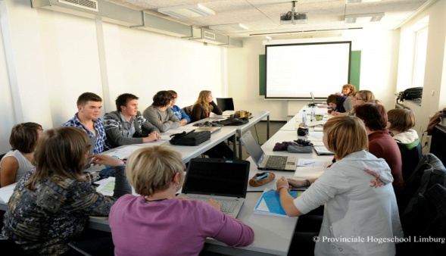

Education aspects
Education-forms
  EG
  Lecture & Response lecture
Overview content
Introduction
  Formulation of the problem
  Preview
  Background information
Method
  Literature study
  UDL-checklist
  Education aspects
Results
  Analysis study-material
  Analysis education-forms
  Analysis assessment
  Analysis survey
Conclusion
References

Slide 19
Education Aspects
Assessment
Overview content
Introduction
  Formulation of the problem
  Preview
  Background information
Method
  Literature study
  UDL-checklist
  Education aspects
Results
  Analysis study-material
  Analysis education-forms
  Analysis assessment
  Analysis survey
Conclusion
References

Slide 20
Education Aspects
Study-material
Assessment
Education-forms
Screening: UDL-checklist (Dutch)
Survey analysis
Overview content
Introduction
  Formulation of the problem
  Preview
  Background information
Method
  Literature study
  UDL-checklist
  Education aspects
Results
  Analysis study-material
  Analysis education-forms
  Analysis assessment
  Analysis survey
Conclusion
References

Slide 21
Results
Analysis study- material
Studybook
Literature
Analysis education- groups
Education group
Analysis Assessment
Analysis survey
Lecture & Response lecture

Slide 22
Analysis
study-material
Analysis studybook
Absent elements and alternatives
Overview content
Introduction
  Formulation of the problem
  Preview
  Background information
Method
  Literature study
  UDL-checklist
  Education aspects
Results
  Analysis study-material
  Analysis education-forms
  Analysis assessment
  Analysis survey
Conclusion
References

Slide 23


Analysis
Study-material
Analysis literature
Absent elements and alternatives
Overview content
Introduction
  Formulation of the problem
  Preview
  Background information
Method
  Literature study
  UDL-checklist
  Education aspects
Results
  Analysis study-material
  Analysis education-forms
  Analysis assessment
  Analysis survey
Conclusion
References

Slide 24
Analysis
Education-forms
Analysis Education group
Absent elements and alternatives
Overview content
Introduction
  Formulation of the problem
  Preview
  Background information
Method
  Literature study
  UDL-checklist
  Education aspects
Results
  Analysis study-material
  Analysis education-forms
  Analysis assessment
  Analysis survey
Conclusion
References

Slide 25
Analysis
education-forms
Analysis (response) Lecture
Absent elements and alternatives
Overview content
Introduction
  Formulation of the problem
  Preview
  Background information
Method
  Literature study
  UDL-checklist
  Education aspects
Results
  Analysis study-material
  Analysis education-forms
  Analysis assessment
  Analysis survey
Conclusion
References

Slide 26
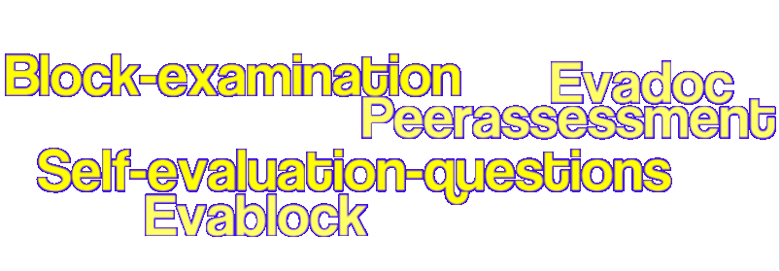
Analysis assessment
Absent elements and alternatives
Overview content
Introduction
  Formulation of the problem
  Preview
  Background information
Method
  Literature study
  UDL-checklist
  Education aspects
Results
  Analysis study-material
  Analysis education-forms
  Analysis assessment
  Analysis survey
Conclusion
References

Slide 27

Analysis survey
Certain elements already present
Positive ratification of most students
Overview content
Introduction
  Formulation of the problem
  Preview
  Background information
Method
  Literature study
  UDL-checklist
  Education aspects
Results
  Analysis study-material
  Analysis education-forms
  Analysis assessment
  Analysis survey
Conclusion
References

Slide 28
Conclusion
Occupational therapy curriculum (PHL) already complies to certain UDL-principles.
Onset to a concrete application of the UDL-principles within the occupational therapy curriculum.
Minor Dutch literature about the UDL-concept.
Insufficient question to student experience.
Overview content
Introduction
  Formulation of the problem
  Preview
  Background information
Method
  Literature study
  UDL-checklist
  Education aspects
Results
  Analysis study-material
  Analysis education-forms
  Analysis assessment
  Analysis survey
Conclusion
References

Slide 29
UDL- elements?

Slide 30
UDL-applications in this presentation
Constant presence ‘table of contents’
Keywords
Images
Presence concept-maps
Logical components structure
Hand-outs
Pointer
Demand for experience
Recurring items
Font: Verdana, min. 18
Highlighting

Slide 31
References
Achten, I. (13-12-2010). Problematieken binnen de studentenpopulatie aan de PHL Healthcare. 13-12-2010. Ref Type: Personal Communication
Cast, U. (2007). Universal Design for Learning. National universal design for learning task force . 9-10-2010. Ref Type: Online Source
Cast, U. (2010). Transforming Education through Universal Design for Learning. CAST . 9-10-2010. Ref Type: Online Source
Coyne, P., Ganley, P., Hall, T., Meo, G., Murrey, E., & Gordon, D. (2006). Applying universal design for learning in the classroom. In D.Rose & A. Meyer (Eds.), A practical reader in universal design for learning (pp. 1-13). Cambridge, MA: Harvard Education Press.
De Munck, K. & Verstichele, M. (2010). Hoe kom ik tegemoet aan de diversiteit van mijn studenten? In Studiedag AUHL.
Edyburn, D. L. (2005). Universal Design for Learning. Special EducationTechnology Practice, 7, 16-22.
Froyen, H. (31-3-2009). Universal Design voor fysieke, sociale en virtuele omgevingen. 11-5-2011. Ref Type: Slide
Froyen, H. (11-5-2011). Universal Design voor Fysieke, sociale en virtuele omgevingen. 11-5-2011. Ref Type: Personal Communication
Gabel, S. (2010). The changing policy ecology of postsecondary Education. In We are all a limited edition SIHO.
Hadjikakou, K. & Hartas, D. (2007). Higher education provision for students with disabilities in Cyprus. Higher Education, 55, 103-119.
Heijne, R. A. M. (2000). Uitgangspunten van probleemgestuurd onderwijs: opvattingen over leren en doceren. In Handleiding voor de tutor in probleemgestuurd onderwijs (pp. 13-14).
Izzo, M. V., Murray, A., & Novak, J. (2008). The Faculty Perspective on Universal Design for Learning. Journal of Postsecondary Education and Disability, 21, 60-72.

Slide 32
Kuiper, C. & Satink, T. (2007). Het kennis domein van de ergotherapie. In A.Kinébanian & M. le Granse (Eds.), Grondslagen van de ergotherapie (pp. 117-152). ELSEVIER gezondheidszorg.
Mullins, L. J. (2007). Belonen en motivatie. In Management van gedrag (pp. 170-174).
Onderwijs Vlaanderen. (2011). VN-verdag. Vlaams Ministerie van Onderwijs en Vorming . 16-5-2011. Ref Type: Online Source
Pace, D. & Schwart, D. (2008). Accessibility in post secondary education: Application of UDL to college curriculum. US-China Education Review, 5, 20-26.
PHL, I. (2010). ICTO website. PHL University College . 14-5-2011. Ref Type: Online Source
Robbins, S. P. & Coulter, M. (2007). Werknemers motiveren. In Management in sociaalagogische beroepen (pp. 281-282).
Rose, D. H. & Meyer, A. (2002). Teaching Every Student in the Digital Age: Universal Design for Learning. Alexandria: Association for Supervision and Curriculum Development.
SIHO, U. (2009). Steunpunt Inclusief Hoger Onderwijs. SIHO . 2-2-2011. Ref Type: Online Source
Smeets, C., Gielen, C., & Lemmens, O. (2009). Probleem Gestuurd Onderwijs in gezondheidszorg. Hasselt, PHL-Dept. Healthcare. 12-12-2010. Ref Type: Catalog
Steunpunt recht en onderwijs. (2009). Advies over de specifieke bepalingen met betrekking tot onderwijs in het VN-Verdrag van 13 december 2006 inzake de rechten van personen met een handicap. Steunpunt recht en onderwijs . 11-5-2011. Ref Type: Online Source
Trant, M. L. (2009). Charter for Inclusive Teaching and Learning. Ierland: Dublin, AHEAD. 2-2-2011. Ref Type: Pamphlet
UNESCO. (2009). Education for All (EFA). UNESCO and Education . 12-3-2011. Ref Type: Online Source
United Nations. (2011). UN at a Glance. United Nations . 12-3-2011. Ref Type: Online Source
Usher, A. & Cervenan, A. (2005). Global Higher Education Rankings. Global Higher Education Report 2005, 1-73.
van Til, C. & van der Heijden, F. (2011). Studievaardigheden PGO, een overzicht. Maastricht: Universitaire Pers Maastricht.

Slide 33

Thanks for your attention!
Graduation project
“Assessing the degree in which the UDL-principles are implemented in the OT-curriculum at the PHL.”

