Slide 1
Deconstructing the curriculum.
A stepping stone towards inclusion in higher education
beno.schraepen@plantijn.be

Slide 2
Deconstruction?
What deconstruction is not?
Everything of course
What is deconstruction?
Nothing of course?
(Derrida 1991b p275)

Slide 3
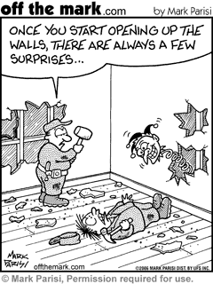
Deconstruction ?
It’s about justice, it’s a philosophy of hesitation because decidability and closure create injustice
  It’s a responsability towards thinking the impossible, the most inconceivable
  It’s inventive and creative
  It gives the commonplace and taken for granted an new bent or twist

Slide 4
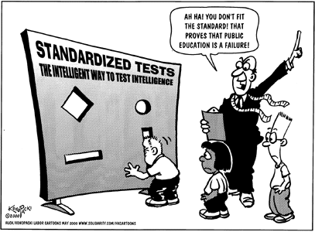
Deconstruction and inclusion?
  Education
  is full of closures, certainties and pronouncements that create exclusion (ex?)
  Inclusive education
  Eliminating barriers that create exclusion
  Questioning power relationships

Slide 5
Higher education
(Higher) education has been put in an economical space (Masschelein)

Slide 6
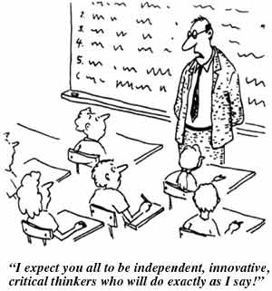
The curriculum in higher education?
Looking for certainties ...
Questioning what‘s taken for granted ...
Opening the closures ...
What do we want ...

Slide 7
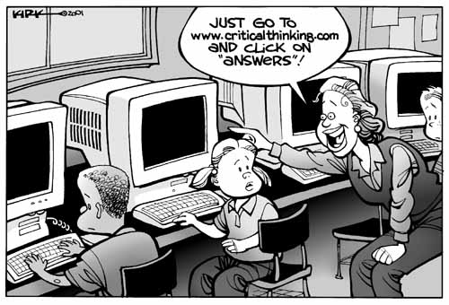
The curriculum as a steppingstone towards inclusion ...
Based on values that reflect diversity and inclusion ...
Questioning the power of social structures ...
Free the overcrowded curriculum from too many obligations
Attack the rigid spaces of schooling so it can lead to new ways of thinking and acting

Slide 8
The curriculum as a steppingstone towards inclusion ...
Are escape ways created is the curriculum in control of everything
What about rescuing education from the ‘tyranny of the technical’ which has locked teachers in impossibility and exclusion?
How does is make inequality in society visible?
How does the student learn about social relations thru the curriculum?
Is it open and based on human values or are economical values prevailing?

Slide 9
The curriculum as a steppingstone towards inclusion ...
Focus on becoming through knowing?
How does is make inequality in society visible?
How does the student learn about social relations thru the curriculum?
Is it open and based on human values or are economical values prevailing?
Does the curriculum makes changes possible?
Is it sufficiently demanding?
Does it offer contrasting insights and perspectives?
Does it require presence and commitment?
...

