Slide 1

LINK Conference,
Antwerp, July 2011
Niamh Hayes

Slide 2
Background
To hear directly from students about their experiences in third level
Provide students with an opportunity to explore careers with successful professionals in an informal setting
Notes:
Twofold rationale: Hear from students; support students to explore career options in a unique setting

Slide 3

What did we do?
Emails
Phonecalls
Social Media
Websites
Letters
Everything!
Notes:
All HEIs contacted via Disability/Access Services and Student Unions
Guests from all areas of business, media & politics invited
World Cafe Event

Slide 4
Who attended?
65 students initially expressed interest
37 students attended
19 HEIs represented
A good mix
  Gender, geography and student type; Predominantly undergraduate students, but representation from postgraduate students, part time and higher certificate students, adult learners, distance learners as well as some recent graduates
Notes:
Point out the reason for fall off was due to exams/distance/illness
Reason to point out 65 is it shows high level of interest

Slide 5
Breakdown of students according to ‘Year in University’
Breakdown of Student according to Subject Area Studied
Notes:
Obvious gap in medicine and health sciences but other than that broad spread of courses

Slide 6
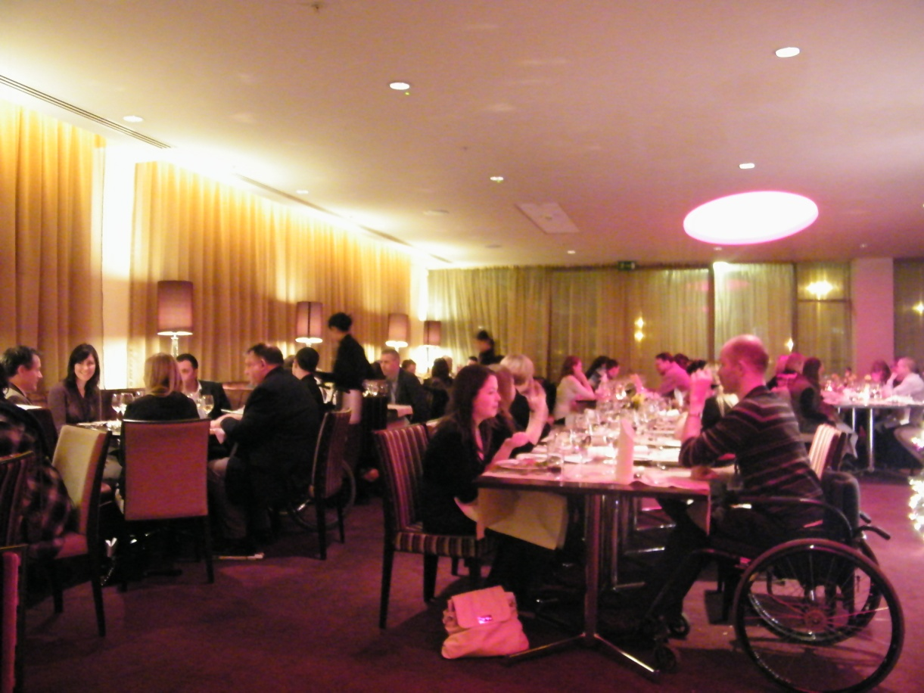
The Art of Conversation

Slide 7
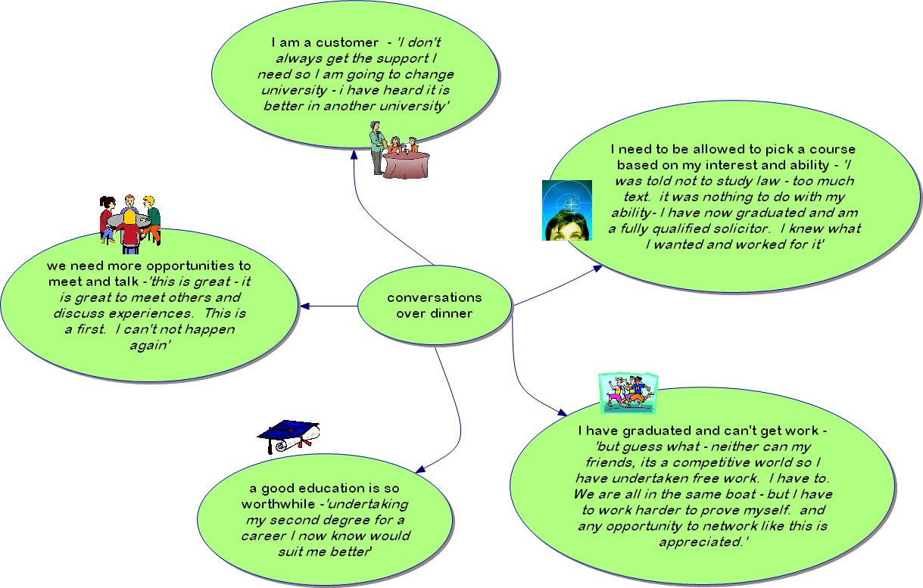

Slide 8
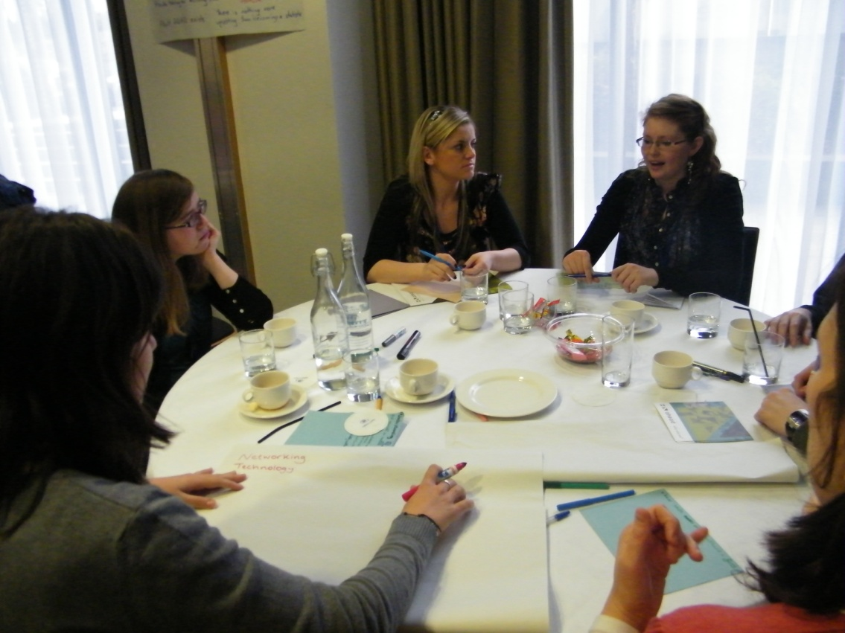
The Student Voice

Slide 9
What would make your education amazing?
What is happening that’s good?
    Staff
    Technology
    Attitudes
Describe your agenda for change?
    Service Provision & Funding
    Communication & Attitude
    Student Empowerment
Notes:
Run through the first part of the day – specify that the first session which looked at the big questions – these questions have been displayed and we would encourage everyone to look at them during the break

Slide 10
Conversations
  Where to Now
  Networking
  How it Feels
  Student Societies
  Social Challenges
Themes that emerged:
  “More events like this”
  “Where can I get supports in employment”
Notes:
Explain the format of Seven conversations
Focus on students wanting more events like this, more student networking etc

Slide 11

IRL
http://www.youtube.com/watch?v=Ak3r57Emt3c

Slide 12
What now?

Slide 13

Contact Details
Ph: +353 1 2789325
E: getahead@ahead.ie
W: www.ahead.ie
getaheadblog.wordpress.com
facebook.com/getaheadforum
twitter.com/get_ahead

