Slide 1

STIP – The dot: one door opens alle possibilities
Mrs. Laurence Dhaene
Talent coach
Mr. Chris Mestdagh
Co-ordinator diversity policy

Slide 2

Overview
Howest University College
The beginning
The implementation
The conclusion

Slide 3
1. Howest University College
Belgium: a federal state
Dutch-speaking Flemings of the North
2 cities (Bruges – Kortrijk) – 4 campuses
> 5500 students: bachelors and masters

Slide 4
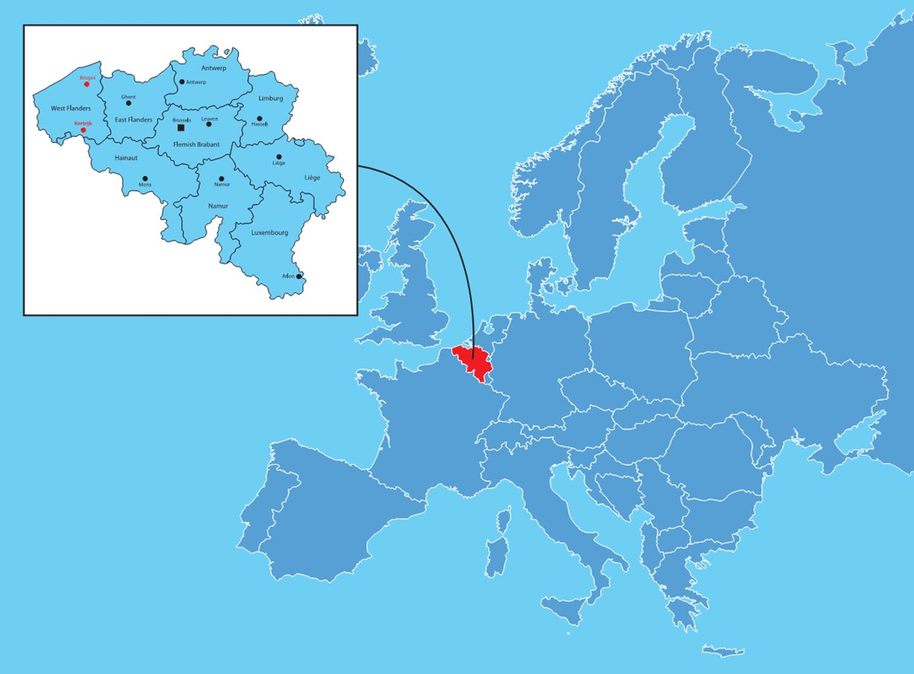

Slide 5
2. The beginning
2007: large-scale survey
2008: conclusions in strategic plan:
  every student should get the opportunity to receive individual coaching
  in all communication with lecturers and facilities, the emphasis is on easily accessible services

Slide 6
3. The implementation
Involvement of actors at all policy levels had led to the creation of an easily accessible service point
Research of possibilities

Slide 7
studiecoach
Stuvo medewerker
monitor/
docent
student
trajectbegeleider
talent coach
studenten-
secretariaat
ombudspersoon
mentor
onthaal
opleidings-coördinator
netwerkbeheerder

Slide 8
Student in the middle
Easily accessible services
Low threshold
facilities

Slide 9
3. The implementation (2)
STIP = STudent Informatie Punt – inclusive approach
The dot:
  Physically joined student services
  Digital dot
LEHO connection

Slide 10
4. The conclusion
Transparancy, clarity and easily accessibility of student services
Inclusive approach: a good practice
Expertise network: specific needs are getting specific attention

Slide 11

Questions?

