Slide 1
The Student Advisory Board at the University of Vienna
Birgit Virtbauer
Kornelia Götzinger

Slide 2

The University of Vienna

Slide 3
The University of Vienna
Oldest university in the German-speaking world
One of the largest in Central Europe
88.000 students, 9.400 employees
180 study programmes

Slide 4
Students with Disabilities
500 registered students with Disabilities
(0,5% of all students)
57% women, 43% men
Favourite study programmes:
17% law
14% psychology
10% history

Slide 5
Support: University of Vienna
Disability officer since 1994
Austrian Students‘ Union: departement for students with Disabilities
Admission of all students for all study programmes

Slide 6
Support: University of Vienna
Exam accomodations
Grant for students with disabilities
Remission of tuition fee (380€ per semester)

Slide 7
Support: State
Family allowance, study grants
special conditions for students with disabilities
Grant of the Austrian Students‘ Union
Technical Assistance
Personal Assistance

Slide 8

Topics at Consultation Disability Officer
Tuition Fees & Remission
Organization of semester and studying
Right of exam accomodation

Slide 9
Relevance of measures (Survey)
38% information events
55% would join information event
25% mailing lists
17% coaching groups
15% meetings between students

Slide 10
Challenges
Students with mental health issues, learning disabilities:
low awareness, few support
Students with mobility impairment:
Accessibility of buildings
Deaf students:
Funding of sign language interpreters

Slide 11
The Student Advisory Board

Slide 12
History of the Board
Autumn 2009: students protesting
Demands:
  Increase funding for education
  Equality for students with disabilities
  Increase participation for all students

Slide 13
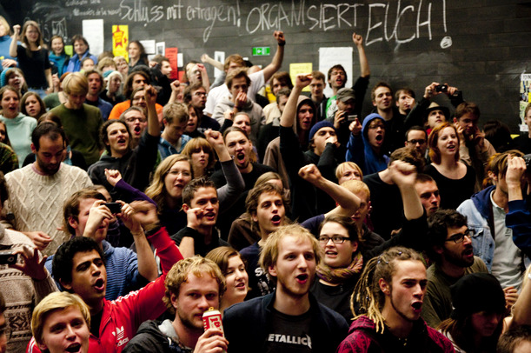
History of the Board
Minister of Education gives money to universities
March 2010
Foundation of the Board
at the University of Vienna

Slide 14
8 Members of the Board
4 students with disability
1 member of the Austrian Students Union
1 disability officer
1 member of the Equal Opportunities Working Party
1 member of the bureau of the rectorate

Slide 15
How the board works
Head of the board: Vice Rector for Student Affairs and Continuing Education
Coordination: Disability officer, student coordinator
Eligible to vote: 8 members

Slide 16
Meetings
meetings 3 times per semester
(10 meetings so far)
Discussion, evaluation of measures, input from external experts
votings concerning the usage of the budget

Slide 17
Results
Website for lecturers (german only)
http://barrierefreielehre.univie.ac.at
Recommendations for public places for students at the university
Infoclip for student beginners

Slide 18
Infoclip for student beginners
Will be shown to all student beginners at the University of Vienna in the first semester
Actors are students of the University of Vienna with disability
Is fully sponsored by enterprises

Slide 19
Infoclip: content
Welcomes all new students
Tells about exam accomodations
Gives information about support services
….in 3 minutes

Slide 20
Infoclip: Accessibility
Subheadings in german and english
Translation into Austrian Sign Language (picture-in-picture)
Transcription will be available

Slide 21
Infoclip: Making of

Slide 22
Infoclip: Aims
We want to…
Raise awareness among students and lecturers
Present role-models
Give information (increase visibility of support services)

Slide 23
Future projects
Folder for lecturers (german/english) about inclusive teaching
Pictures for websites, publications etc. showing people with disability at the University of Vienna
Facebook-group
Sign language videos for website

Slide 24
Benefits for the students
Get an insight in decision-making processes in a big institution
Get the opportunity to share their experiences
Initiate change

Slide 25
Benefits for the university
Rising awareness at the management level of the university
direct link to students with disabilities who evaluate measures

Slide 26
Limitations
No lecturers included
Low visibility
Budgetary limitations

Slide 27
Is it participation?
HEI student partnership
Student Involvement
Consultation with students
Provision of information
Delegated control
May. H. (2010): Strategic Approaches to disabled student engagement, p5

Slide 28
Partnership
Partnership:
a collaboration involving joint ownership and decision-making over the process and outcome
Student members of the board are part of a partnership with decision makers at the University of Vienna

Slide 29
Other forms of engagement
Information: website for students, mailing-lists, brochure, annual report
Consultation: surveys among students
Partnership/ Delegated control: 2 student employees working with the disability officer

Slide 30
For the future
Find a way to engage a wider range of individuals
Institutionalize existing strategies

Slide 31
Contact us
University of Vienna
Birgit Virtbauer – disability officer
E: birgit.virtbauer@univie.ac.at
http://barrierefrei.studentpoint.at
Kornelia Götzinger – student member of the board

Slide 32

Students with visual impairments
Adaptation of documents
Tactile orientation system for blind students
Accessible websites

Slide 33


Students with hearing impairments
Induction loops in some lecture halls
Organization of exchange of notes
No funding of sign language interpreters, realtime captioning or note-takers

Slide 34

Students with mental health conditions
Exam accomodations
Psychological Counselling Center offers support for free
Low awareness

Slide 35

Students with Mobility Impairments
Accessibility of buildings
Accessible rooms in student halls
Accessible public transport system

Slide 36
Students with Learning Disabilities
Low awareness
Few support possibilities

