Slide 1
Digital Archive Access to Course Literature in
Swedish Higher Education
Students access to instant download
Pia Hasselrot
www.tpb.se

Slide 2
TPB – The Swedish Library of Talking Books and Braille
TPB is a government body that, in collaboration with local libraries, provides access to printed materials for people with print disability.

Slide 3
TPB and the University
Library
Coordinator
Coordinator Local services
Certify the right to accessible literature
Library Help with loans Order production of new books
TPB Produce student literature Responsible for the Digital Library
Samordnare
TPB

Slide 4
Student service at TPB
Borrowing talking books, braille books, and e-text
Producing of new books
Distributing software digital talking book player

Slide 5
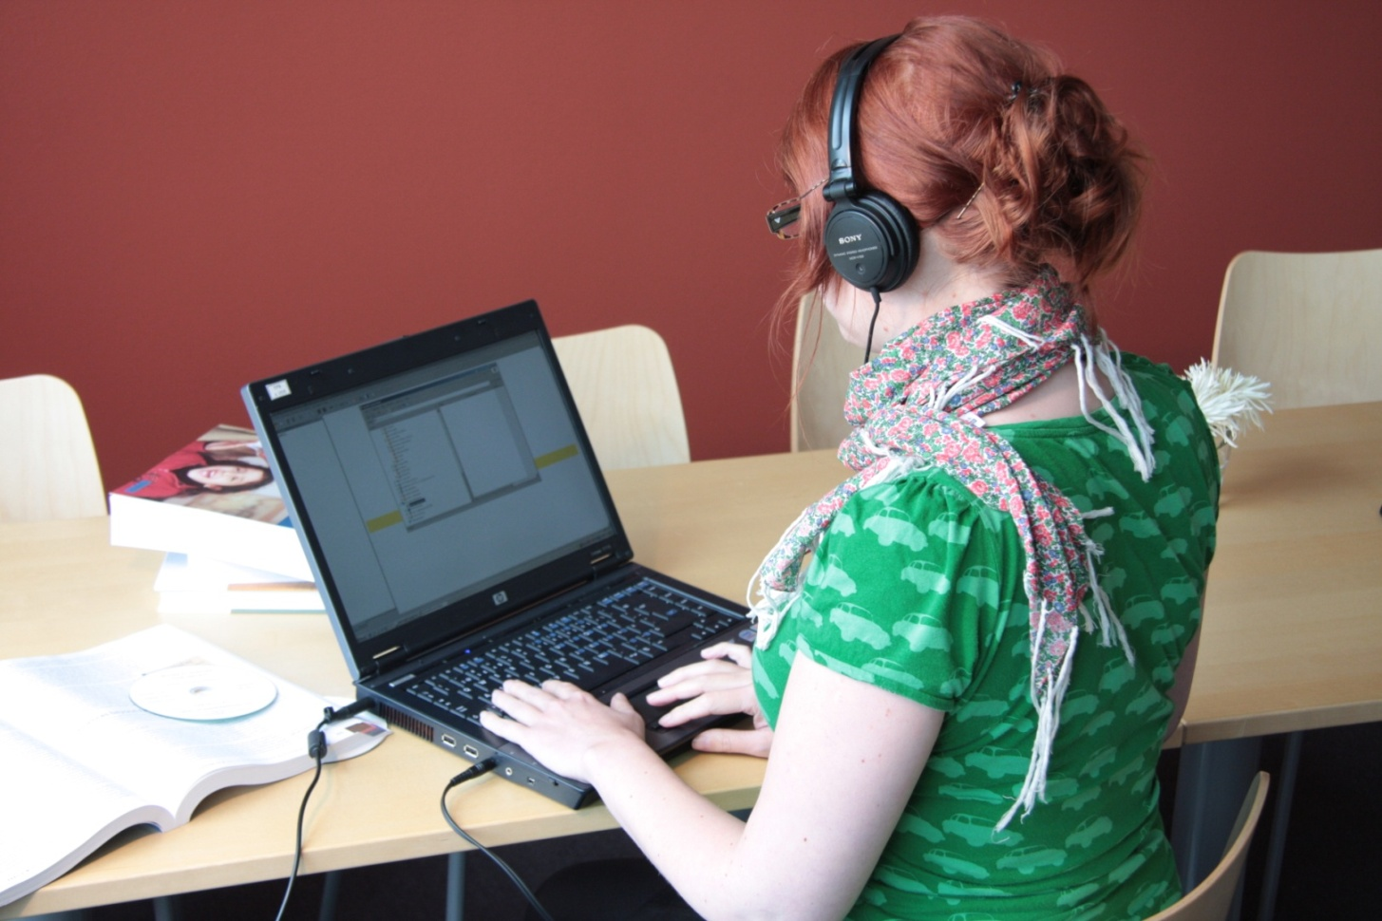

Slide 6
“It’s tough enough to simply manage time for studies that there is no time left to actually learn how you’re supposed to use all that adapted material.”
Student

Slide 7
Number of students

Slide 8
Production cost
Million Euro
Year

Slide 9
Strategy
Technology
  DTBook
  Speech synthesizer
  Download Service
Cooperation with staff at the Universities

Slide 10
Personal Download Service
Digital Library
Competent staff
Student with a computer and
access to Internet

Slide 11
To download talking books
Find a book in Digital Library
Download
Read the book on the computer, burn a CD or transfer to a mp3-player
Erase the files after 6 month or when the book is not needed anymore

Slide 12
Areas of responsibility
The Swedish Library of Talking Books and Braille
  Produce books and make them available through the Digital Library
  Support staff at the Universities
The University Library
  Register the student for the service
  Give information and support
The student
  Sign an agreement
  Borrow

Slide 13
Effects
Good for the economy
Good for the environment
Librarians are positive to the service and the decreased time spent on handling the loans
Students loan more books and are very positive for the self service

Slide 14
“Thanks to the Personal Download Service I’ve finally started reading and I read more books than ever before, which makes me very happy!”
Student

Slide 15
Thank you!
Pia Hasselrot
pia.hasselrot@tpb.se

