Slide 1
Disabled Allied Health Professionals: meeting the challenge
International Conference on Disability in HE
University of Antwerp
July 5th/6th 2011
Presenters: Jane Owen Hutchinson and Karen Atkinson

Slide 2
Session outline
Setting the scene
Challenges affecting disabled people in the Allied Health Professions in the UK
RNIB’s Allied Health Professions Support Service (AHPSS)
A resource to improve support for disabled AHP students

Slide 3
NHS Employers state :
“Equality and diversity are at the heart of the NHS strategy. Investing in the NHS workforce allows us to deliver a better service and improve patient care in the NHS.”

Slide 4
“Equality is about creating a fairer society in which everyone has the opportunity to fulfil their potential. Diversity is about recognising and valuing difference in its broadest sense.”

Slide 5
The reality
“I felt…totally disarmed and disempowered and just 2nd class”
“…it just took forever to get my ZoomText…so I was just struggling…and asking people for help…and then my laptop didn’t arrive”
“I was supposed to have a support worker, just 1 or 2 hours a day but that didn’t happen either for about 3 months”

Slide 6
AHP Educational Context
Majority of programmes are 3 year BSc (Hons) degrees
Increasing number of accelerated 2 year Pre Registration MSc courses
Less part time opportunities
Universities generally becoming more inclusive

Slide 7
Educational Context
Significant proportion of the education of health care professionals takes place in the clinical setting
Clinical placements – educational experiences very variable for students

Slide 8
Professional Context
  Professional socialisation – “a subconscious process whereby persons internalise behavioural norms and standards and form a sense of identity” (Weidman et al 2001)
Stereotypical responses

Slide 9
Disability Context
Perceived limitations
Less equal
Defined in terms of problem
Disabled students – unintentional collusion

Slide 10
Challenges
Increased numbers of disabled students in HE
Disabled people:
  10 million in UK
  6.8 million - of working age (20% of working age population)
  50% are in work (compared to 79% of non – disabled population)
  Graduates 42.4% in work (compared to 46.2% of non-disabled population)

Slide 11
Challenges
Lack of awareness of disability issues in the NHS
Lack of awareness of resources and sources of support
Attitudinal issues
Fear and anxiety:
  Staff don’t know what to do to support, don’t want to offend
  Applicants think that if they disclose their disability they will not be successful

Slide 12
One clinical manager actually formally asked the programme to stop recruiting disabled students as they “could not be fit for practice”
One clinician was reported as saying: “How can you be a physiotherapist if you can’t see?”
“..the person who was going to be my supervisor…was absolutely scared out of her mind about what to do with me…

Slide 13
Change

Slide 14
AHPSS
Background
Evolution of service
Recognition of need
Service development – pan disability and other AHPs

Slide 15
Mission
Challenging
Empowering
Raising awareness
Enabling

Slide 16
The Resource
Newly written/designed resource - joint CSP/RNIB publication
Target customers:
  Academic and placement based staff
  Disability advisers in HE
  Other AHPs

Slide 17
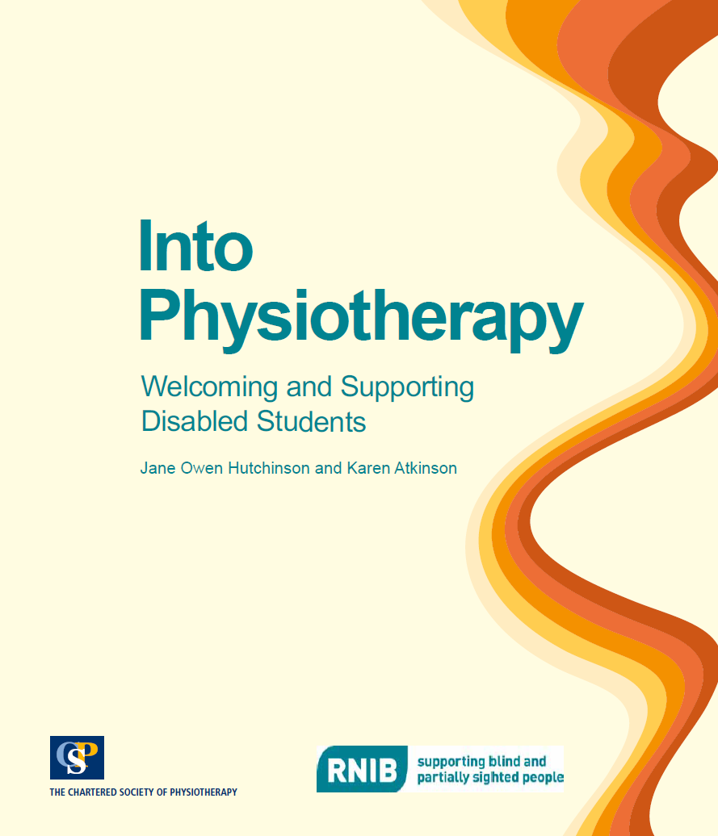
Notes:
Talk about sections

Slide 18
Conclusions
Expectations of success
Partial fulfilment
Some impairments – greater barriers
Impact of resource
Working towards challenging the barriers and promoting changes

Slide 19
Thank you for your attention
Any questions?

Slide 20
Contact details
Jane Owen Hutchinson, Manager Allied Health Professions Support Service (RNIB)
Mob: 07748657457
Email: jane.owenhutchinson@rnib.org.uk
Karen Atkinson, Manager RNIB Resource Centre, Senior Physiotherapy Lecturer, School of Health and Bioscience, University of East London
Tel: ++44 (0)2082234950
Email: k.a.atkinson@uel.ac.uk

