Slide 1

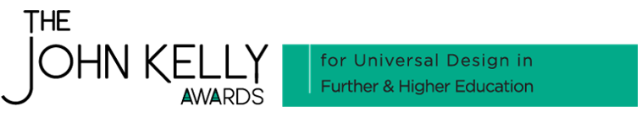
Sustaining Momentum in
Universal Design in
Tertiary Education
Dr. Trish O’Connell
ATU Galway City

Slide 2
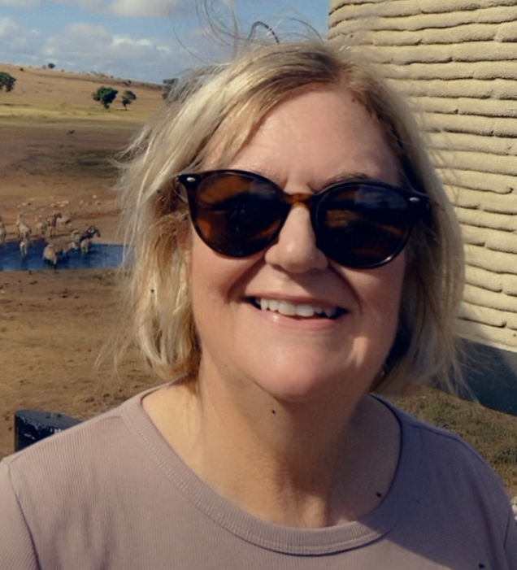
My Context…
B.Sc.in UCD; B.Eng. in OU; M.Sc. in Regis & NUIG; PhD in NUIG
Lecturing in ATU for 10 years..prior to that various senior engineering roles including consultancy
Programme coordinator for the MSc in Biopharmaceutical Manufacturing
Lecturer & Programme board member on 10 programmes in School of Science
Lecture seven different modules
UDL used across ALL modules…
…WHY? Because it works!!
2

Slide 3

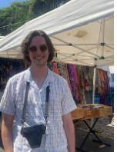
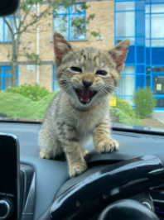
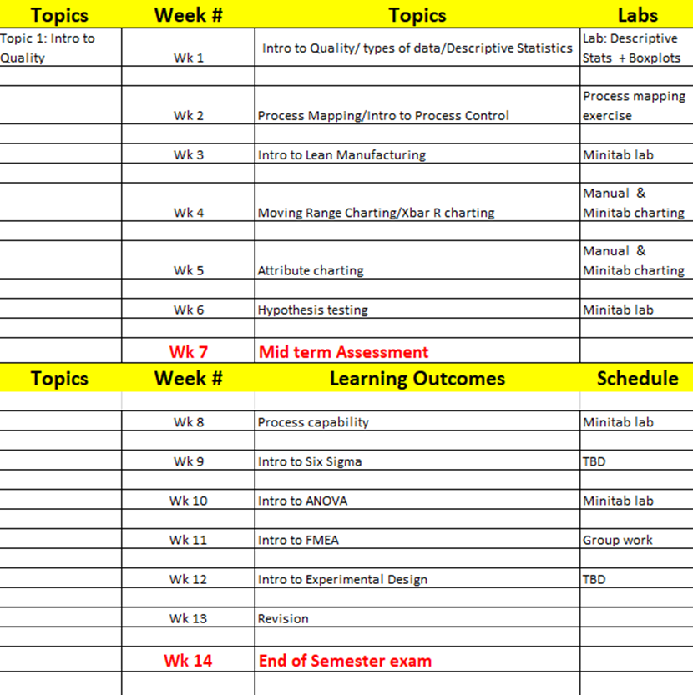
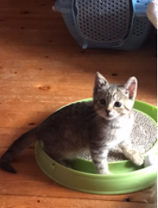
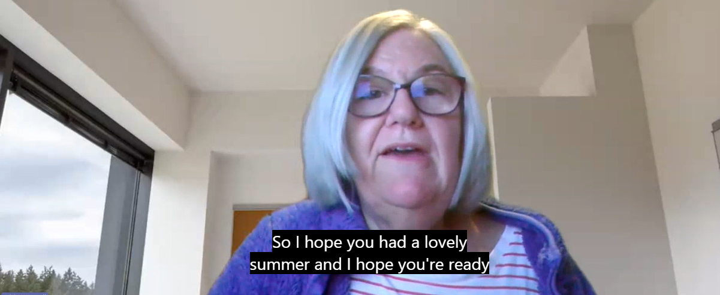
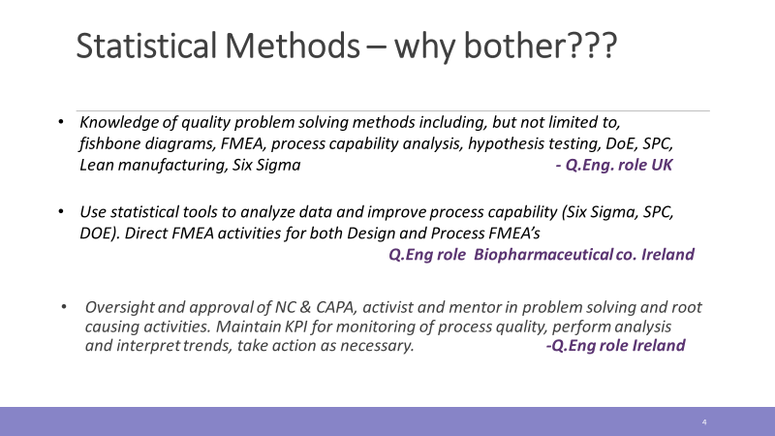
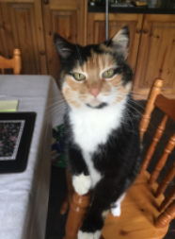
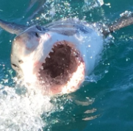
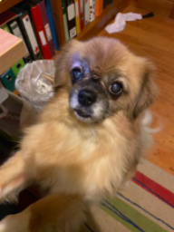
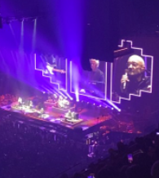

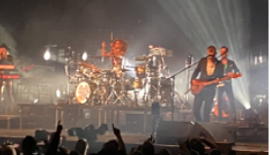
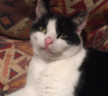
UD Implementation –Engagement…
Welcome video…setting the scene!
Focus on the end game…paid employment!!!!
Personal connection…
Biopharma Showcase…
Signposting & Lesson Planning
Fun
4

Slide 4
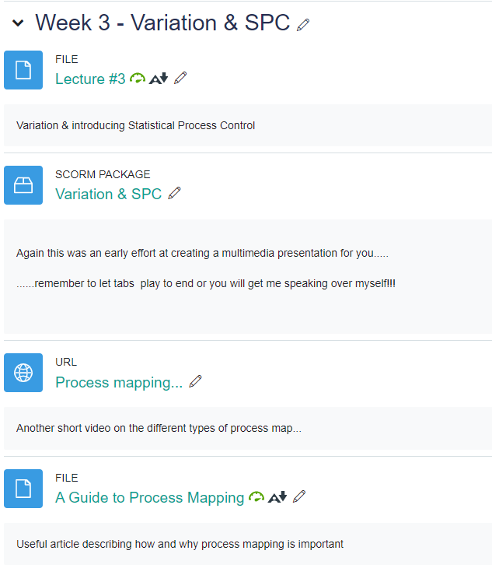
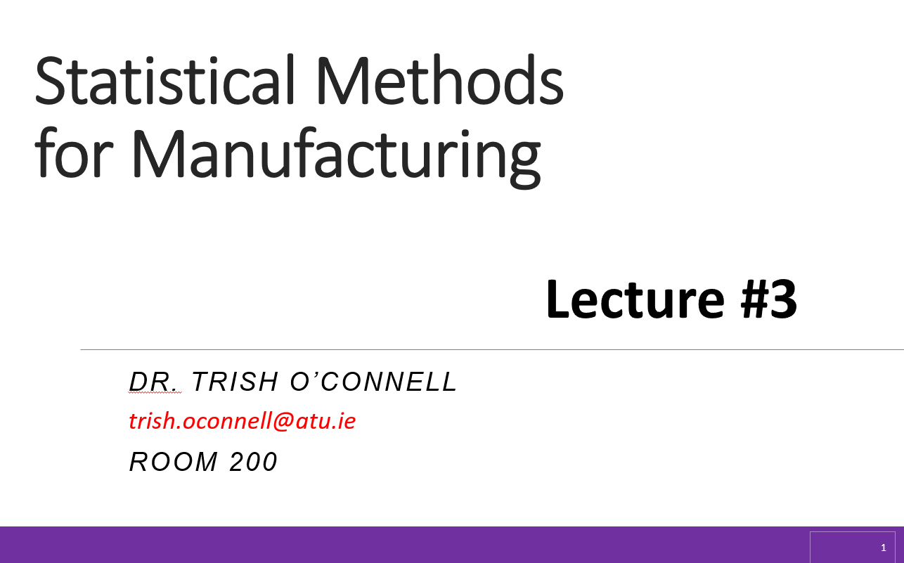
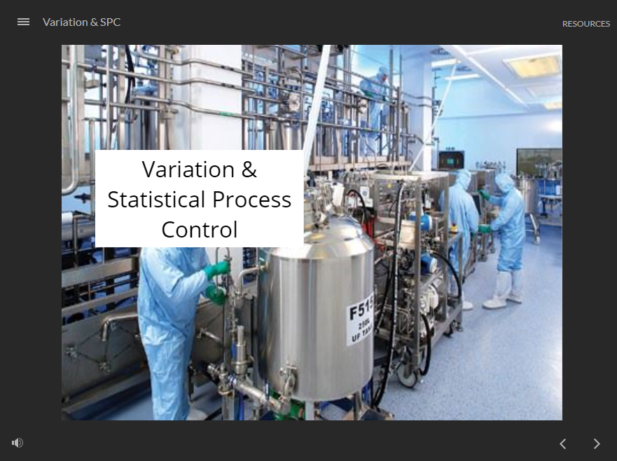
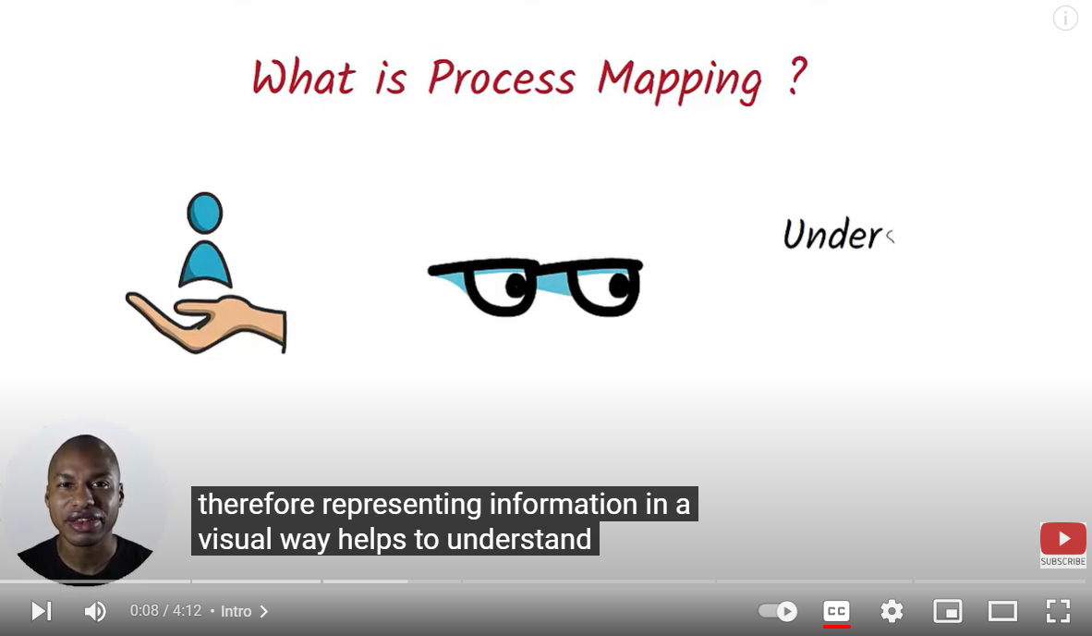
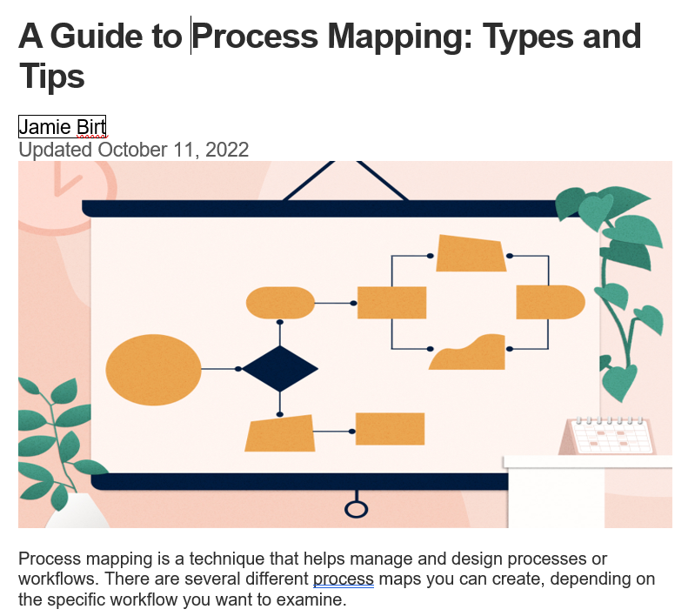
UD Implementation…Representation
5

Slide 5
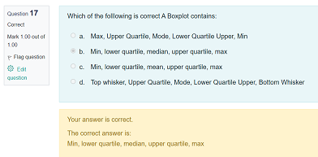
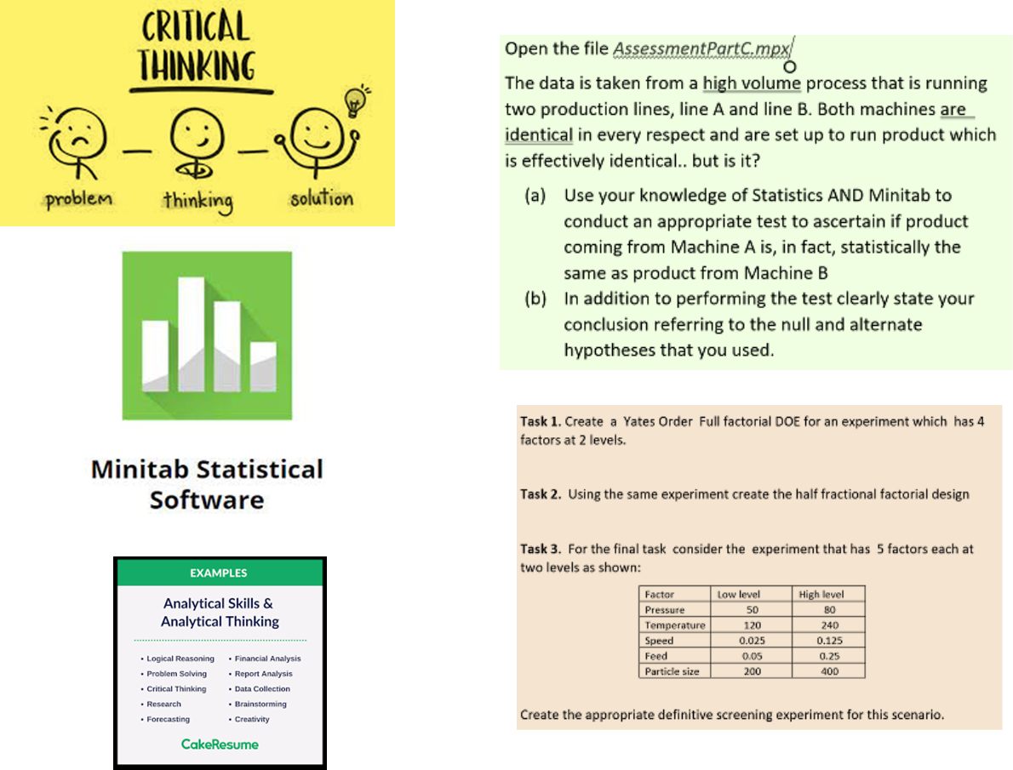

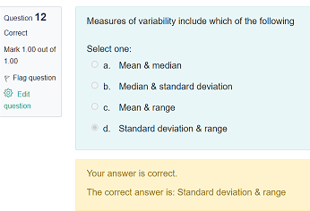
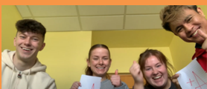
UD Implementation…Action & Expression
6

Slide 6
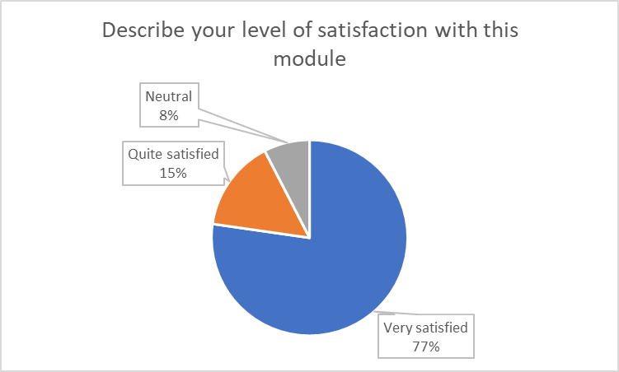
Learner Impact of UD
What is your preferred way of studying the content for this module?
“I found it helpful that lecture slides were uploaded prior to lectures so I could print them out and write down notes. It helped me to engage more with the material.”
7

Slide 7
Learner Feedback on Delivery...
“I really enjoyed this module. Live lectures plus screencasts & videos were a great help to learning and I really enjoyed the way the assessments were varied and organised…”
“The way this module was run really suited me.”
“The topics were a good mix of knowledge & practical”
“The module was well designed – plenty of choice in ways to engage with the content”
8

Slide 8
My Learner Feedback.. On Assessment
“I really enjoyed the practical CAs that required some hands-on analysis with explanations. The MCQs were tough but fair”
“CAs were designed very comprehensively and I found them good to test my knowledge and practical ability with the course material”
“I wish more modules were like this. I really enjoyed it”
“Trish, you’ve got it bang on!!”
“the mix of CAs was good and gave me the chance to show what I knew”
9

Slide 9

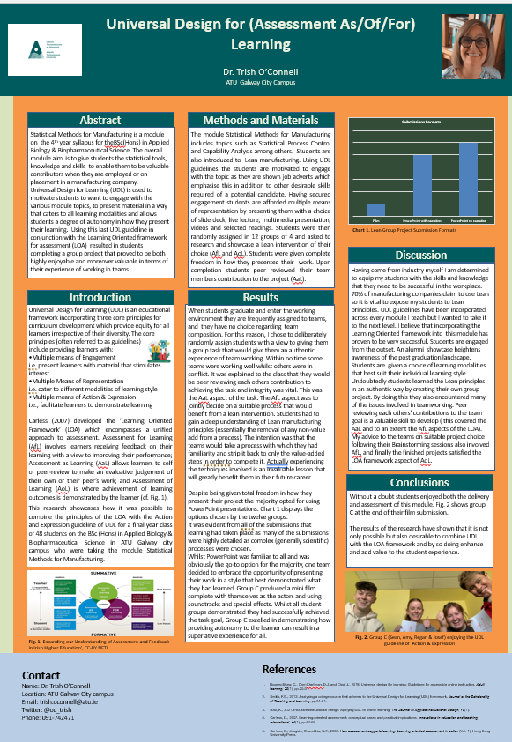
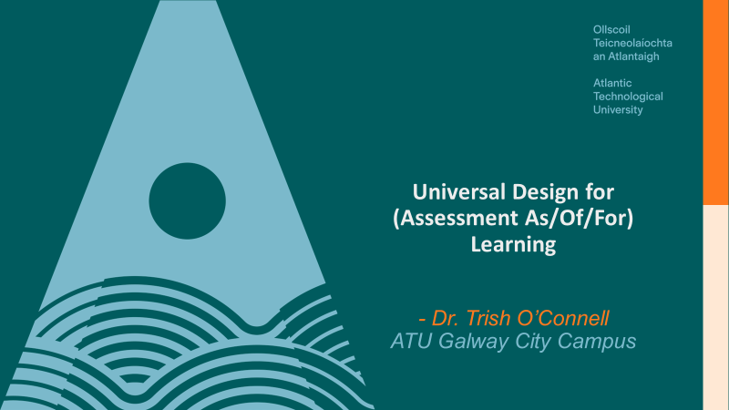
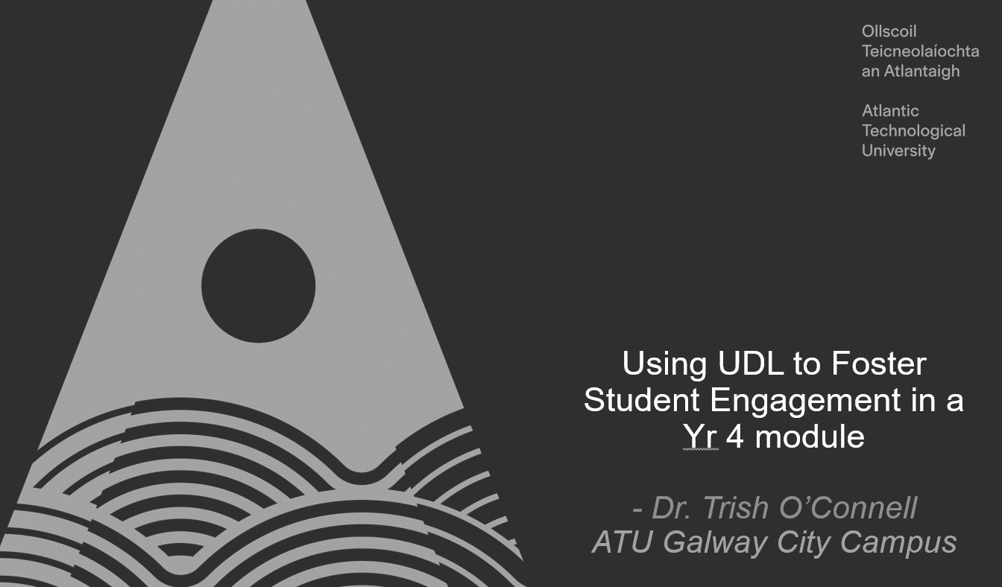

Contribution to wider recognition of UD in ATU
10

Slide 10
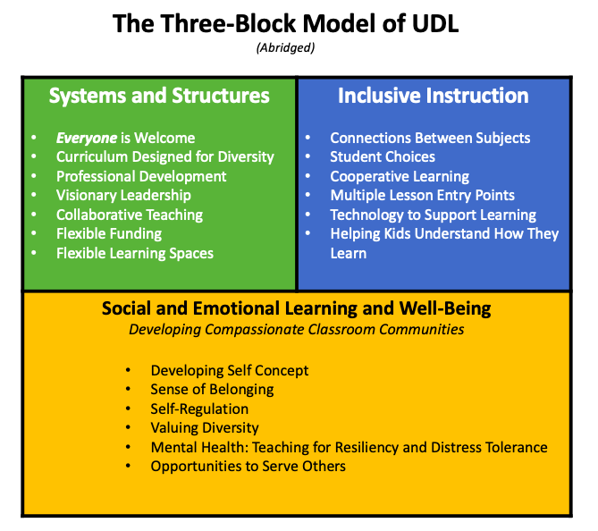
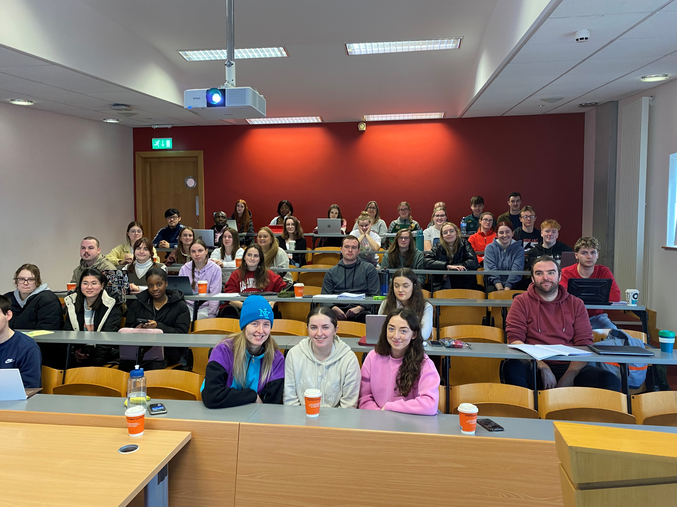
Future Plans
Keep spreading the word… Staff AND Learners!!
Facilitation!
Investigate Katz’s 3-Block model of UDL & the Plus One approach
Refine & implement Barriers to Learning class survey
11

Slide 11
Thank You
“You may have heard of the UDL framework, but until you have implemented it in your classroom, you will not see its power”
Katie Novak
Thank You!
12

Slide 12
References
Images courtesy of:
Cover slide: Adobe stock “fair use”
Slide #11: Dr. Jennifer Katz
All other images: presenters own
13

