Slide 1
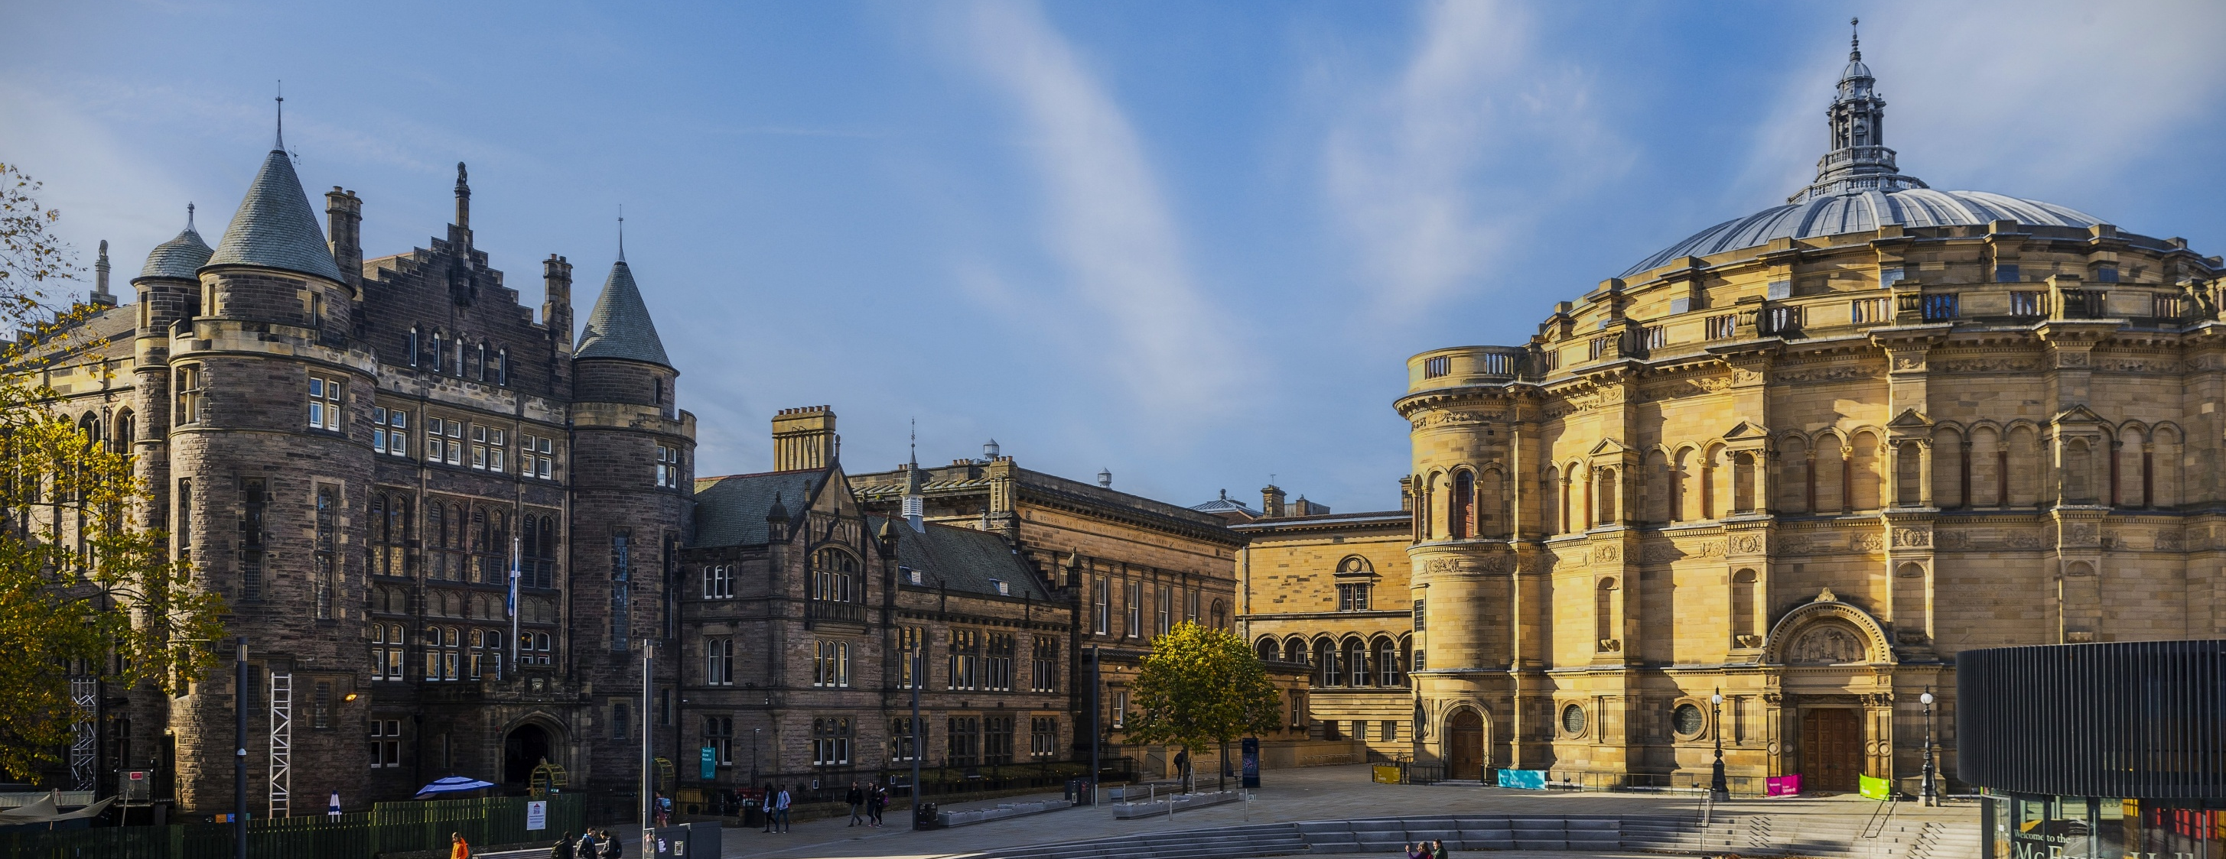

ALTITUDE Summit 2026
Victoria Buchanan – Director, Disability and Learning Support Service

Slide 2
Mainstreaming Adjustments: Universal Design Strategies in Action

Slide 3
Increase in Disability Disclosure – 10 year period

Slide 4
Current Sector Status
Disability Staff
Complex Disabled Students
1,000s Disabled Students
Feels like a Tick Box Exercise
Burnout
Over-compensating
Trying hard
Waiting for Support

Slide 5
Mainstreamed Adjustments Policy
Microphones - worn and used in all lectures.
Individual Audio Recording - permissible using student’s own equipment.
Key Material in Advance - lecture outlines and slides at least 24 hours in advance.
Key Technical Words in Advance - terms or formulae at least 24 hours in advance.
Advance Course Outlines and Reading Lists - at least 4 weeks before start of course.
Indicate Priority and/or Relevance of Reading Lists.
Change Notifications by Email - changes to any teaching arrangements, e.g. room changes or class cancellations.
Accessibility - all teaching materials and other electronic documents.

Slide 6
Baseline Standards vs Mainstreaming
Baseline Standard
Standard for ALL
Underpinned by Policy
Basic inclusive practice
Accessibility
Reduces need for some adjustments
Mainstreaming approaches
Common adjustments mainstreamed
Considered on course by course basis
Ongoing dialogue rather than exceptional effort
Reduces administrative burden
Reasonable adjustments
Addresses individualised needs
Generally more complex cases
Specialist support not met by UDL
Meets legal duties

Slide 7
Engaging Academics
Reassurance
Repetition
Respect
Two Way Street
Professional Knowledge
Listening Skills
Provide Guidance
Solution-Focussed
Collaborative
Consistency + Time

Slide 8
A final word from our disabled students:
“I have not been in education that has been as supportive as Edinburgh university”
“a friendly service that has positively influenced my academic experience and thus my overall time at university.”
“A great experience overall- the fast implementation and the caring environment really positively affected me”
“Invaluable. Hand on heart would not be able to survive university, never mind successfully reach this far without the incredible work of DLSS. They have a genuine desire to help and this shines through to students.”

Slide 9
Thank you
Victoria Buchanan
Victoria.buchanan@ed.ac.uk

