Slide 1
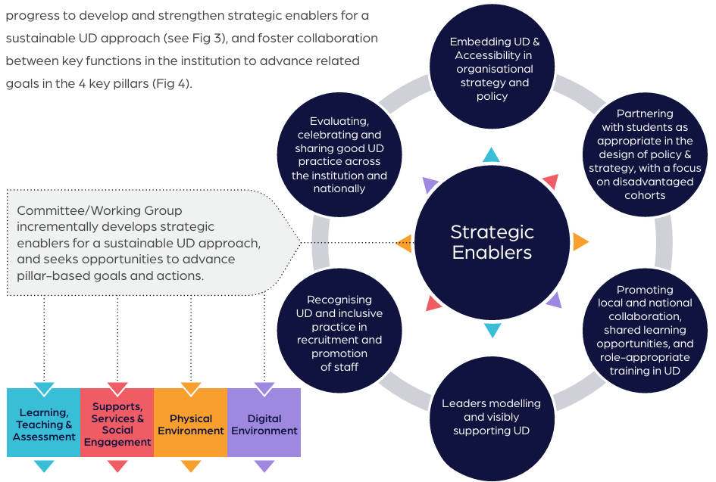
ALTITUDE In Your Context
Strategic Enablers & Pillar Based Actions
The established committee/ working group will oversee incremental progress to develop and strengthen strategic enablers for a sustainable approach, and foster collaboration between key functions in the institution to advance related goals in the 4 key pillars.

