Slide 1
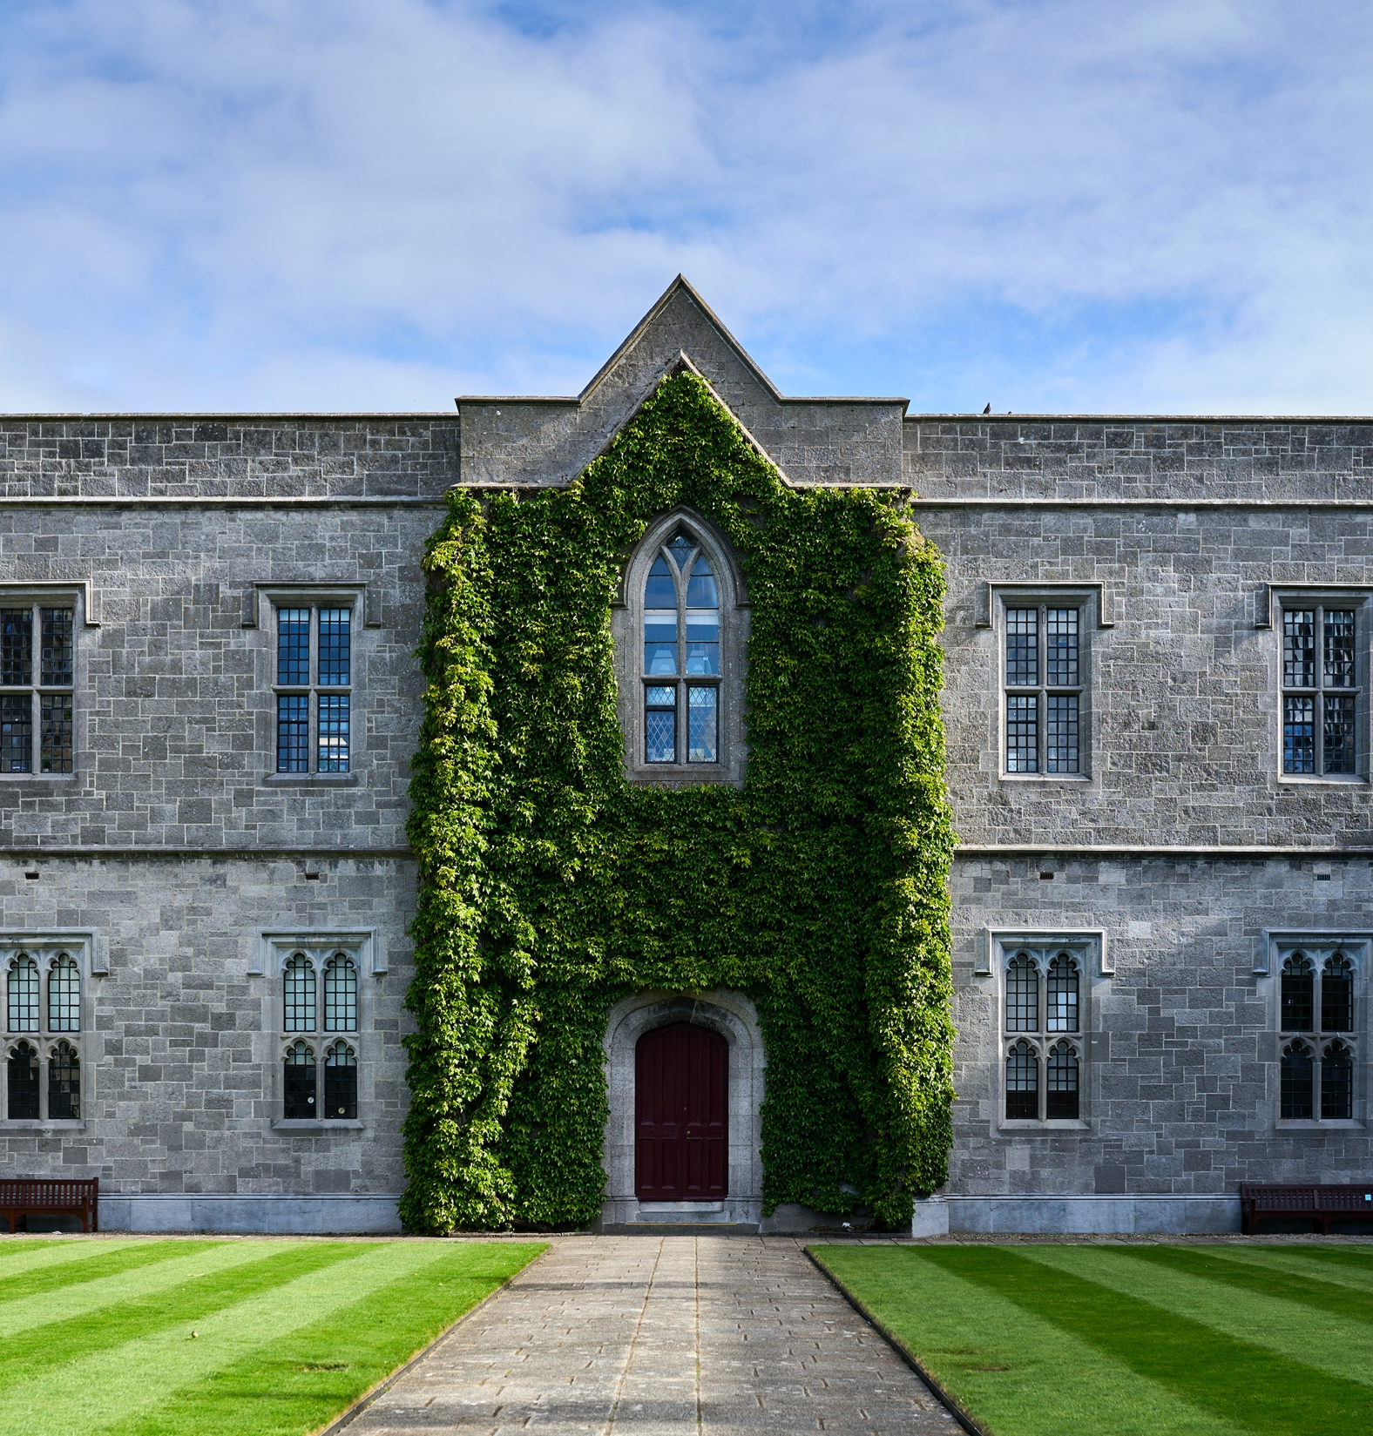
University of Galway’s ALTITUDE Journey
Dr Deirdre Mc Hugh
Universal Design Manager
University of Galway
ALTITUDE Summit
19 March 2026

Slide 2
University of Galway Strategy and Policy
“We will adopt the Principles of Universal Design in our learning and working environment to increase accessibility, accommodate different approaches to learning and enable students to fulfil their potential (University Strategy 2020-25).”
QA182: Universal Design and Accessibility Policy
Universal Design and Accessibility Action Plan and Working Group
Equality, Diversity and Inclusion Strategy
Academic Strategy
Campus Masterplan
Notes:
Only institution to have a UD and Accessibility Policy
Woven through a range of strategies
We are national leaders in this and this is an opportunity to showcase our good work and share practice across the sector.

Slide 3
Universal Design in Education (UDE)
‘… a whole system design so that the physical and digital environments, the educational services and the teaching and learning can be easily accessed, understood and used by the widest range of learners and all stakeholders, in a more inclusive environment.’ (CEUD, 2024, emphasis added)
‘Universal Design for Learning (UDL) is an extension of, and is underpinned by, Universal Design.’ (CEUD, 2024)
PATH 4, Phase 1 – HEA/NDA collaboration
Learning
Services
Digital
Physical
Notes:
T&L domain added to physical and digital environments, products and services
Significant national movement around UDL
PATH 4 feedback to all HEIs – “Overall, project plans presented a narrow view of Universal Design in Education (UDE), limiting their understanding and approaches to Universal Design for Learning (UDL).”
UDL does not address the other three domains or the needs of staff and visitors

Slide 4
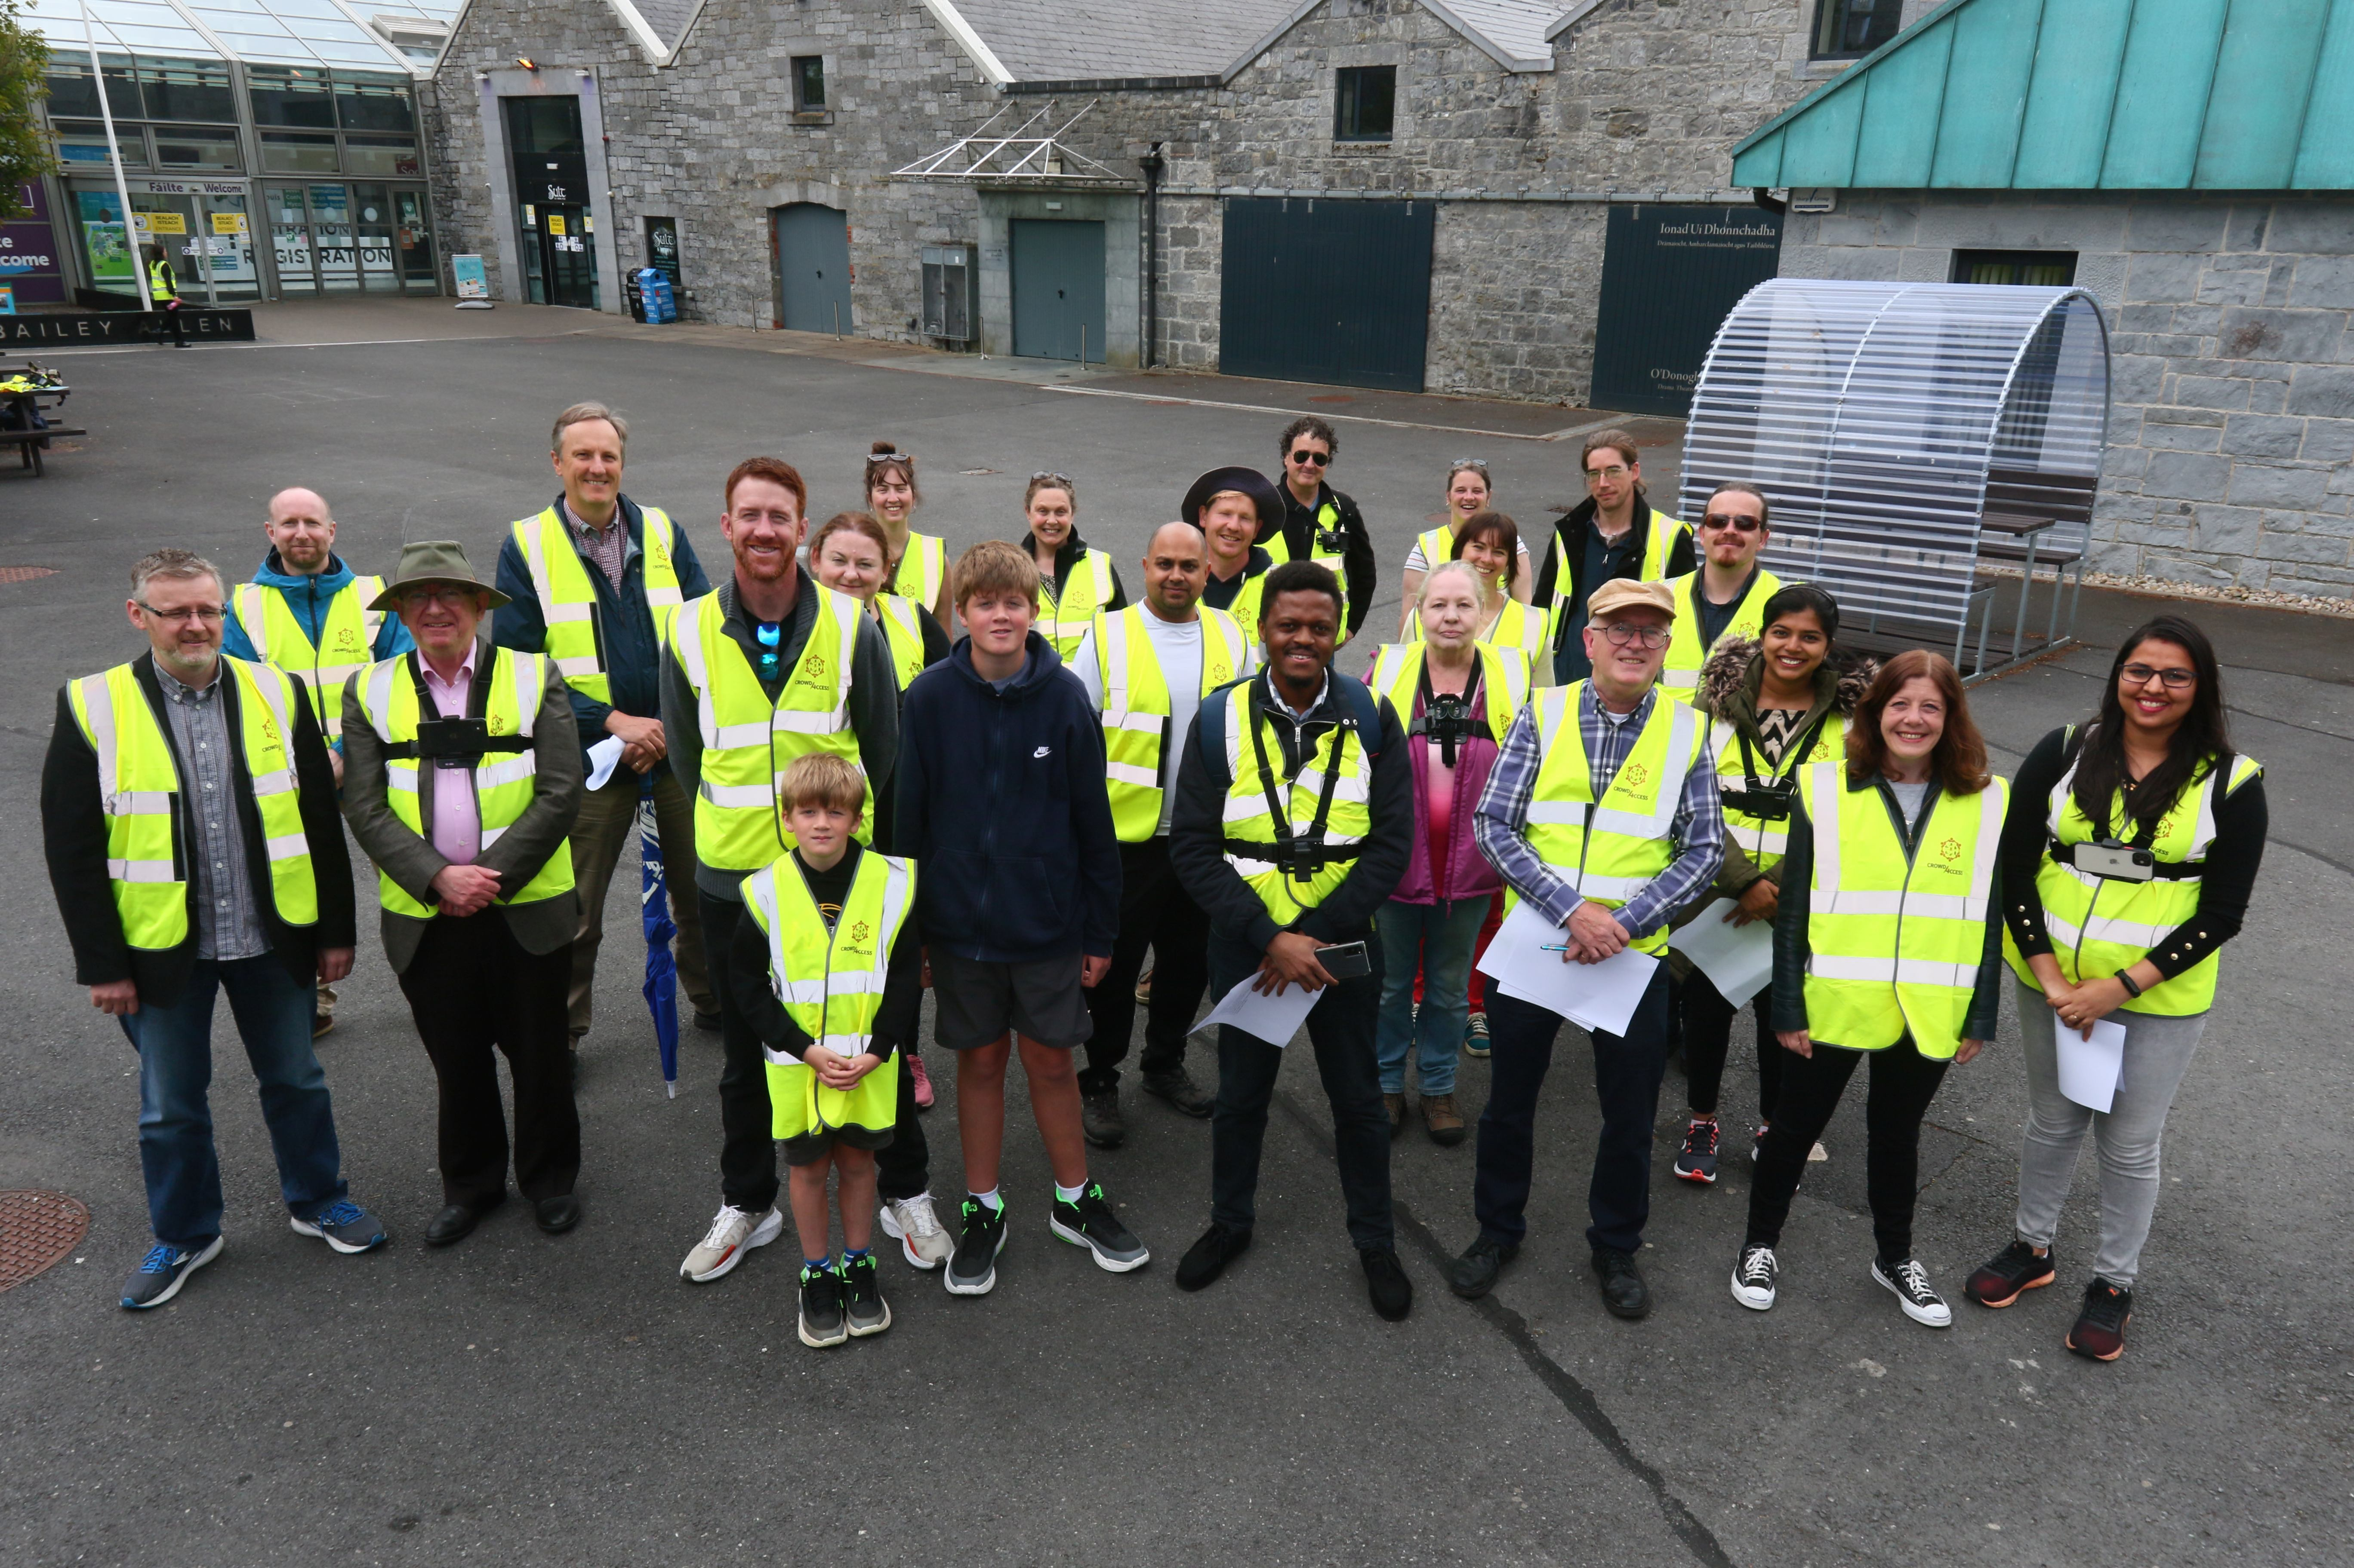


Engaging the Community with Universal Design

Slide 5
Engaging the Whole Sector with Universal Design
AHEAD Conference 2023 – whole conference consultation
4 Higher Education Partners
6 National collaborators
17 regional collaborators
Learner consultation
Staff consultation
Senior stakeholder consultation

Slide 6
University of Galway adopts ALTITUDE Charter
From left to right: Dr Bairbre Fleming (UCD), Dr Maureen Haran (ATU) Dr Deirdre Mc Hugh, Prof. David J. Burn, Dr Helen Maher, (University of Galway), Dr Lisa Padden, (UCD)

Slide 7
Action Planning with ALTITUDE
Universal Design (UD) an underpinning methodology for progressing Equality Diversity and Inclusion (EDI)
EDI Strategy to 2030
Universal Design and Accessibility Action Plan
Universal Design and Accessibility Working Group

Slide 8
Thank you

