Slide 1
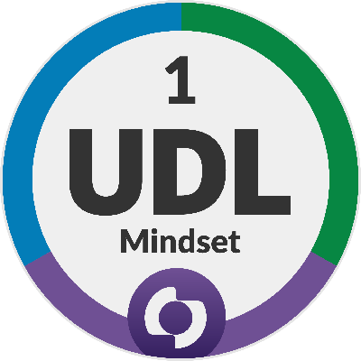
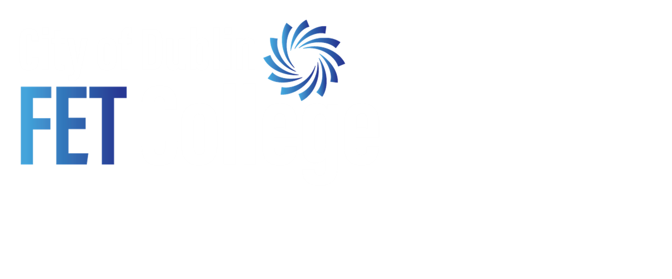
UDL: Breaking Down Barriers in the
Multi-Cultural Classroom
__________________________________
Pillars in Practice: Applying UDL Principles to Enhance Learning for All
Notes:
Welcome! Today, I going to talk about how embracing the diversity of our FE student body—a source of challenge and opportunity—can be enhanced by the framework of Universal Design for Learning (UDL).* The focus is on how UDL helps us move beyond simple accommodation to proactive design that benefits every student.

Slide 2
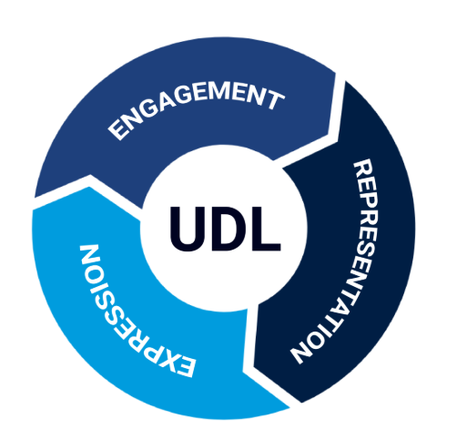
Multiple Options
+1 Approach

Slide 3
Business Term Matching Exercise (English - Russian)
Column A (English Term) | Column B (Russian Translation) | Match (A-?)
1. Contract | A. Прибыль (Pribyl)
2. Market | B. Бюджет (Byudzhet)
3. Profit | C. Контракт/Договор (Kontrakt/Dogovor)
4. Budget | D. Рынок (Rynok)
5. Investment | E. Инвестиция (Investitsiya)

Slide 4
Solution (English - Russian)
Column A (English Term) | Column B (Russian Translation) | Match (A-?)
1. Contract | C. Контракт/Договор (Kontrakt/Dogovor) | 1-C
2. Market | D. Рынок (Rynok) | 2-D
3. Profit | A. Прибыль (Pribyl) | 3-A
4. Budget | B. Бюджет (Byudzhet) | 4-B
5. Investment | E. Инвестиция Investitsiya$) | 5-E

Slide 5
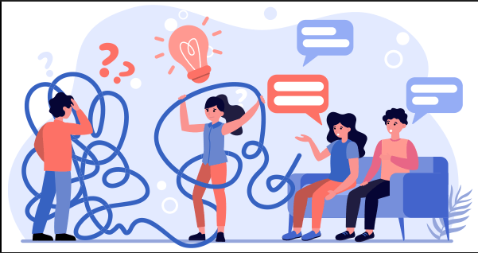
The Multi-Cultural/Multilingual Classroom: A UDL Imperative
Language & Cultural Barriers:
Principle III: Provide Multiple Means of Engagement
Representing a Diversity of Perspectives & Identities
Guideline 7: Recruiting Interest
Notes:
* The challenge isn't just translation; it's about relevance and belonging. If a student never sees their background reflected in the curriculum, engagement suffers. UDL gives us the roadmap to fix this.* We are applying UDL's engagement principle: How do we make the learning goal relevant, valuable, and authentic to a student from a different culture?

Slide 6

Pillar 1: ALTITUDE Building a Foundation of Respect
Creating a Dialogue to Influence Content: Learner Voice
Anonymous Surveys and Polls
Tailored content to incorporate global examples
Notes:
* This starts with me, the educator. I intentionally created a culture of respect where students feel safe enough to share their perspective, even anonymously.* The goal is to ensure full access—not just physical access, but cognitive and emotional access to the content. Example: I used a poll to find out what industries my international students were most interested in, then tailored my case studies in marketing to those areas.

Slide 7

Initiatives
Initiative 1: Multilingual brainstorming
Cross-Module Moodle Glossaries
Notes:
Tapping the Resource: Facilitating Multilingual Brainstorming
UDL Principle Principle I: Provide Multiple Means of Representation (The "What")
Guideline 2: Clarify Vocabulary and Symbols
Strategy Allow students to use their native language for initial conceptual brainstorming in group work (e.g., first 5 minutes).
Outcome* Reduces cognitive load: Students can articulate complex ideas immediately.
Enhances collaboration: Non-English speakers can fully contribute to the knowledge creation.
* Deepens understanding: The subsequent translation back to English reinforces the precise terminology.
Our students are often studying business law, marketing, and finance simultaneously. The terminology load is massive.* By using a centralized Moodle glossary, we give them one place to find consistent, cross-referenced definitions. More importantly, when they add their language, they are actively constructing meaning and helping their peers. This initiative directly addresses the challenge of understanding terms like Balance Sheet vs. Balanço Patrimonia

Slide 8
UDL + Technology
UDL
+
Technology
=
Maximising Engagement
Notes:
Technology is crucial here. It gives us the flexibility to embed multiple supports directly into the content.* It moves us away from the one-size-fits-all lecture and toward an environment where students can use the tools they need to access the curriculum—be it an instant translator, a video transcript, or a collaborative space
Technology allows us to personalize the pathway to learning, offering choice in how information is consumed, processed, and expressed.

Slide 9
Summary
Incorporating diverse perspectives is an effective way to implement UDL
Improved Outcomes for All
Designing for the margins benefits the centre.
Notes:
* This project has shown that when we give learners a voice, when we respect their linguistic and cultural identity, we are not just doing the 'right thing'—we are employing the most effective pedagogical strategy.* The key takeaway is that UDL, particularly in engagement, is about designing for the margin, which benefits the center. Thank you. I'd love to hear your thoughts on the call to action.

