Slide 1


“Why Can’t You Do It For Me?”
Fostering autonomy in FET learners accessing the WWETB Learning Support Service, through a UDL lens.
Margaret Howard &
Margaret Stafford

Slide 2
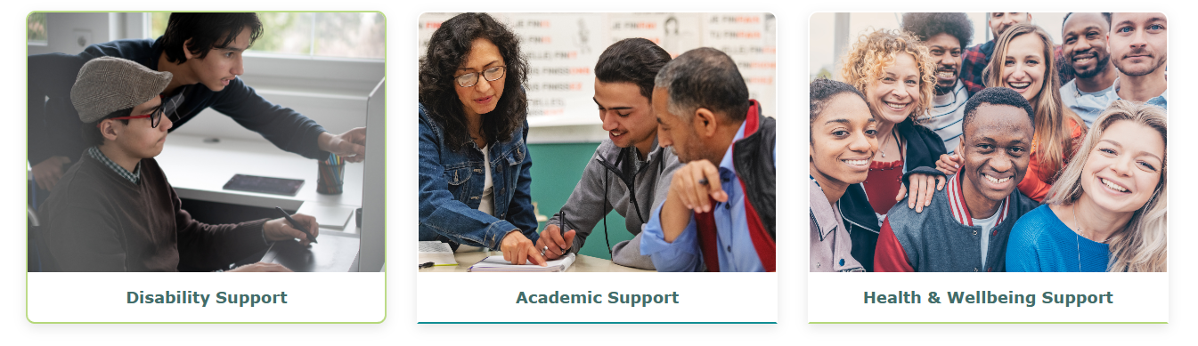
WWETB Learner Support Service
Waterford Wexford Learner Support Website Link

Slide 3


Learner Support
Focus on raising awareness & reducing barriers
Deliver and / or complement subject specific supports
Service is underpinned by UDL
Flexible and adaptable
Continuous reflection

Slide 4
Support delivery promotes independence
Skills based support.
Empower the learner.
Encourage the learner to take charge of their own learning.
Issues are addressed in partnership with the learner.

Slide 5









Learner seeks support
Engagement
Welcome identities
Sustaining effort & persistence
Emotional capacity
Representation
Perception
Language
Call or text
QR Code
Action & Expression
Communication
Strategy Development
Support Staff
Email
Website
Remotely or In-person

Slide 6

Learner outlines their needs and learning preferences
Engagement
Welcome identities
Sustaining effort & persistence
Emotional capacity
Action & Expression
Interaction
Communication
Strategy Development
Support service meets with learner to compile Needs Assessment & Support Plan

Slide 7

Learner sets goals
Engagement
Sustaining effort & persistence
Emotional capacity
Representation
Perception
Building knowledge
Action & Expression
Expression & Communication
Strategy Development
Learner outlines Goals at the beginning of Learner Support and assesses progress as support continues.

Slide 8
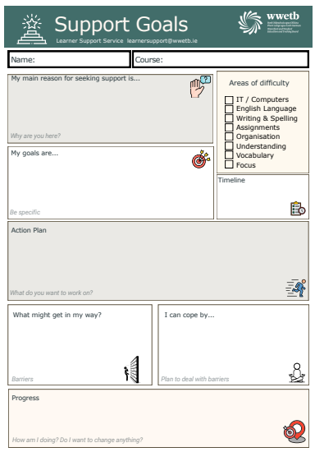
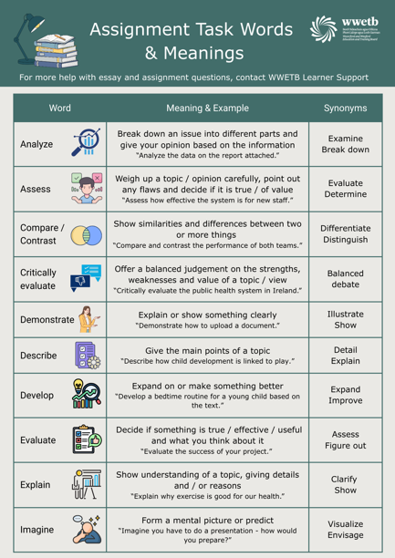
Resource Development
Goal Setting Template
Assignment Task words

Slide 9
What do we mean by Autonomy?
Autonomy is not doing it alone
Start tasks
Structure thinking
Make decisions
Stand over your work

Slide 10
Building on WWETB learning support approach
Needs Assessment conversations
Learner-led goal setting
Structure scaffolding

Slide 11
The move to FET
Portfolio-based assessment
Planning for assignments
Self-management expectations
Fewer built-in prompts and reminders
Autonomy is expected – but not always developed

Slide 12
Shane’s story from dependence to independence.
1:1 support throughout school.
Highly structured guidance.
Re-assurance needed before starting tasks.
Tendency to write everything he knew
This was external regulation – not inability
1)

Slide 13
Designing for Autonomy: Scaffolding self-regulation
Scaffolded task design
Modelling how to approach tasks
Gradual release of reassurance
Goal review conversations
Prompting planning before answering
CAST (2024); AHEAD (Heelan, 2021)

Slide 14
Shane’s story continued
Initiated tasks independently.
Edited and refined responses.
Managed deadlines more confidently.
Needed less reassurance
Shift: External Co-regulation Self-regulated

Slide 15
A Necessary Tension
Systems can prioritise completion over capacity
Deadlines create pressure to “do for”
Autonomy requires intentional design.
Heelan (2021); SOLAS (2023a); CAST (2018)

Slide 16
The work of Learning Support
As AHEAD and CAST remind us,
Autonomy is not an individual trait to be proven.
It is an outcome of inclusive design.
Our role is not to prove learners can achieve —
but to design environments where they recognise that they can.

Slide 17
References
AHEAD (via Heelan, 2021). UDL for FET practitioners. SOLAS Learning Works.
Baynham (2006); Broad (2006).
CAST (2018). Unlocking learner agency with UDL Guidelines 3.0.
Dörnyei (2003); Dörnyei & Ushioda (2009).
Ernest & Hopkins (2006).
Sewell (2022); SOLAS (2023a); Walsh et al. (2009).
Ushioda (2016, 2020).

