Slide 1

Open Doors, Barriers and Potential Brick Walls: Exploring Stakeholder Insights to Optimise Strategic Enablers
Dr Suzanne Stone
University of Limerick

Slide 2
Overview
01.
Introduction
Background and context
02.
Methodology
Data collection and analysis
03.
Findings
Key findings from initial analysis
04.
Next steps
Where to from here?

Slide 3
Introduction
01.

Slide 4
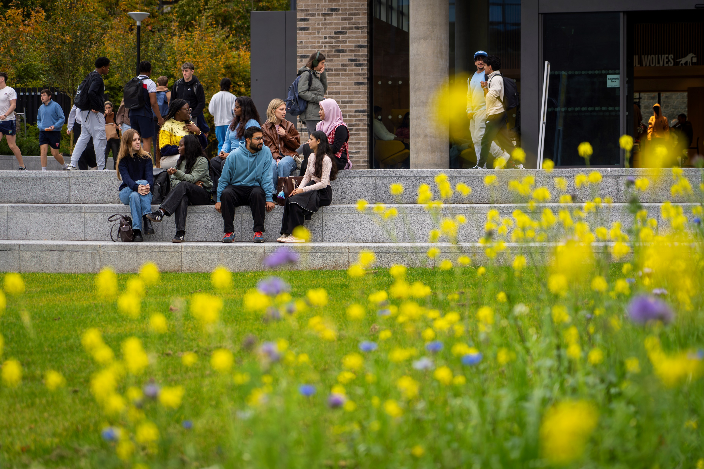


Research context
South-west Ireland
19,740 students
2,121 staff
UDL embedded in Learning, Teaching & Assessment strategy Inclusive (UL, 2023)
Universal Design & Practice Committee (UL, 2025)

Slide 5
Researcher
Dr Suzanne Stone
Educational Developer (UDL Lead)
University of Limerick.
SATLE funded role
July 2023 start date
Role: to embed UDL (and UD) across UL.

Slide 6
Aim of research
To investigate the impact of strategic Enablers* provided by SATLE funding on:
staff practices
student experience
Focus group data collection explored barriers to:
engaging with strategic Enablers
embedding UDL in practice
*UDL initiative at UL focused initially on UDL and teaching staff, i.e. Pillar 1 of Altitude Charter (2024) but has diversified to include non-teaching staff based on feedback from staff and therefore provides support to staff connected to all four pillars.

Slide 7
Strategic Enablers – SATLE funded UDL initiative
Professional learning
Community of Practice
Open Educational Resources
Student awareness
Badges - Support national badge, local rollouts.
Stand-alone workshops – introductory, advanced.
Integration in PgCert & Diploma in learning, teaching and assessment.
Input for programmes on request e.g. Digital Communications, Clinical Psychology.
Integration of UDL prompts into curriculum design processes.
UD Café – informal monthly, themed.
Formal sharing events badge completion focus.
Collaboration with SETU, DCU & MICE.
Case studies – video, text-based, multimedia.
Accessibility tools.
Toolkit for Brightspace.
Podcast series.
Student co-design –inclusive GenAI and academic integrity resources.
Accessibility awareness events.
Universal Design badge for students – co-design.
Student internships.
Digital accessibility workshop.
*Strategic Alignment of Teaching and Learning Enhancement, Higher Education Authority.
Notes:
a

Slide 8
Methodology
02.

Slide 9
Research Methodology
Case study of specific university context. Focus on strategic Enablers for embedding Universal Design for Learning in practice. Impact on staff practice, impact on student experience.
Original focus – teaching, learning and assessment. Expanded to include staff in non-teaching roles and students based on stakeholder feedback.
Data collection: Focus groups with staff and students survey.

Slide 10
Focus group data collection
Timing: November & December 2024; February/March 2025.
Number of participants: tbc
Method: online
Analysis: Reflexive thematic analysis Braun & Clarke (2006,2021)
Focus for this presentation – initial analysis of focus groups with staff

Slide 11
Findings
03.
Initial analysis of focus groups with staff

Slide 12
Benefits/impact of Enablers
Universal Design badges
Badge peer groups provide opportunity to network/build relationships for new staff.
Continuing support from Peer group beyond duration of badge as advisors/sounding board for UDL/inclusion/accessibility.
Ensuring student point of view is considered in university systems e.g. the library.
Ripple effect of engaging with badge on creation of resources/practice within and beyond UL (e.g. work at national level).

Slide 13
Benefits/impact of Enablers ctd
Community of Practice
Practice sharing through Community of Practice events - great to find out what has worked/not worked for others.
Open Educational Resources
Useful as first point of reference for UDL resources post completion of badge.
Useful for those who have not completed the badge.
Plus One approach/one small thing very valuable for applying UD/UDL in practice.

Slide 14
Barriers: the usual ‘suspects’
Time/workload
Scheduling conflicts
Conflicting priorities
UDL framework overwhelming
General reticence amongst staff to add more meetings/events to working week
Guilt over spending time on professional learning

Slide 15
Imposter syndrome in Community of Practice
“It is probably a bit of fear of like, jeez, I don't know what I'm doing at all…. I just don't feel like I have the expertise, despite having done the badge. I've done the facilitator badge as well. I still… feel like an imposter.”
Optimise Enabler:
New label for community of practice. Currently exploring ‘Universal Design Café’ in 2025/26.
Formal practice sharing framed as ‘UD-in-three’ and celebration event for badge completers.

Slide 16
Lack of connection with Community of Practice
“I'm new to the university. I don't know that many. I'm beginning to know people, but to get to the point of being comfortable, to have very informed conversations with people on these kinds of things… to discuss my practice that’s a whole different thing”
“I think I would only feel comfortable going to a coffee and chat if I had built up relationships in a Community of Practice where I feel comfortable… because practice, even though informal, provides a certain scaffold for discussion.”
Optimise Enabler:
Improve marketing of CoP as welcoming space.
Creating a critical friend circle to touch base on UDL issues.

Slide 17
Limiting practice sharing to badge participants
“There's a huge number of teaching staff and teaching support staff in UL doing wonderful, amazing work……and they could teach a thing or a thing or two to other people. So I think there's a huge body of work there to do around recognition of existing practice. So it's not always about doing something new and you don't have to do the badge to do UDL.”
Optimise enabler:
Target staff who have not completed the badge but engage with UDL to share practice.

Slide 18
Not informed of Community of Practice events
Staff uninformed re: the calendar of Community of Practice events.
Optimise Enabler:
Establish a pattern of events.
Allow time for pattern of events to establish, not just one semester/year.*
Send calendar invites to staff who sign up to mailing list (used successfully by another Community of Practice at UL).

Slide 19
Marketing of events/resources
Overwhelming number of marketing emails re professional learning/other.
Optimise Enablers:
Using Brightspace page (VLE) for communication and resource sharing rather than MS Teams/UL Connect (Intranet Workvivo) - too many messages on other platforms.

Slide 20
UDL framework overwhelming
“It’s (UDL framework) overwhelming and it can be off putting, I'd imagine, for anybody who's considering doing the badge. Before signing up, they probably will google UDL and they'll come across the cast website and just go eh! You know, whereas your redesign project, you only have to take one very, very micro aspect of that and explore it in depth in your own teaching.”
Optimise Enablers:
Better communication regarding the badge and framework, additional information sessions.
Emphasise UDL as an approach and framework as a tool.
Faculty colleagues communicating experience of badge participation.

Slide 21
UDL framework overwhelming ctd
“You see all of these options and, and that's the initial thing. And then you realize, OK, no, you only. Have to tweak one…..and realising that you know taking that Plus One (approach)”
Optimise Enablers: Emphasising Plus One Approach from the outset, even in promoting the badge.

Slide 22
Language, labels and terminology
“I know there's overlap between accessibility and UDL, and just when you said barriers that can cause some confusion as well. Where does accessibility stop and UDL start? Maybe it's not that clear.”
Optimise Enablers:
Use the Universal Design and Inclusive Practice Committee work to create a shared understanding of terminology.

Slide 23
Language, labels and terminology ctd
“So they (UDL label) just to an outsider, seem like just jumble of words.. it's like you just open dictionary…. let's take 4 words together, whereas ‘student centred learning’, that was something people could grab onto and say, ‘Oh yeah, I can make the students the centre of this’…. That's doable..”
Optimise Enablers:
Demystify terminology by engaging staff in brief professional learning e.g. UD Café (45 minutes) or intro to UD/UDL (60 minutes)

Slide 24
Lack of clarity at institution level on value of UDL?
“Is there an understanding of UDL in terms of it being a requirement or not? So accessibility, obviously there is a requirement there's a legislative requirement for us. But UDL? Is there a perception that because it's not required, it's not important? Potentially….”
Optimise Enablers:
Use the Universal Design and Inclusive Practice Committee work to emphasise importance of UD at institutional level.
Continue to engage with senior management ‘sponsorship’ e.g. Associate Deans for Academic Affairs communicating value at faculty meetings.

Slide 25
Perceived lack of evidence
“Just in terms of more engagement, I know there's been some conversation, not necessarily in UL (University of Limerick), but around UDL and lack of evidence for universal design for learning.”
Optimising enablers:
Further embedding research studies into professional learning.
Creating space to discuss the discourse on lack of evidence.
Supporting staff to engage with small scale research building on badge work and disseminate findings.
Creating opportunities to share practice.

Slide 26
Career break return
Career break (e.g. maternity leave) means returning to new areas of focus in sector, new and unfamiliar terminology.
“I felt like because like was away and I came back, there was this massive shift. In everything in, in everything to do with teaching……you know, you're talking about like accessibility and everything like that. I mean, that wasn't even a thing. It's a different world, and when you're when you're out of it for four years, you actually see the massive difference that happened….”
Optimise Enablers:
Glossary not considered a solution.
Introductory professional learning, quick guides for beginners.
Provide specific ‘returning to work’ sessions.

Slide 27
Next Steps
04.

Slide 28
Next steps for Study
Deeper analysis of current data.
Apply recommendations emerging from findings – currently underway.
Continue to investigate barriers
Survey to be disseminated April/May 2026 - to capture views of wider staff community.
Ctd focus groups each year

Slide 29
References
ALTITUDE Project (2024) - The National Charter for Universal Design in Tertiary Education. AHEAD Educational Press. Retrieved at https://www.itsligo.ie/wp-content/uploads/2024/03/ALTITUDE-Charter-supplied-digital-2 Accessed on: February 16th 2026.
Braun, V., & Clarke, V. (2006). Using thematic analysis in psychology. Qualitative Research in Psychology, 3(2), 77–101. https://doi.org/10.1191/1478088706qp063oa
Braun, V. & Clarke, V. (2021) Thematic Analysis: A Practical Guide. Sage: London
University of Limerick (2023) Action for Wisdom: Learning, teaching and assessment strategy 2022-2027 Retrieved at https://www.ul.ie/media/29887/download?inline Accessed on: February 16th 2026.
University of Limerick (2025) Universal Design & Inclusive Practice Committee UL Retrieved at: https://www.ul.ie/equality-diversity-inclusion/universal-design-inclusive-practice Accessed on: February 16th, 2026

Slide 30
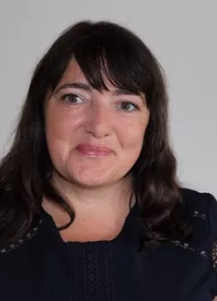
Contact
Dr Suzanne Stone
Centre for Transformative Learning, University of Limerick
Suzanne.stone@ul.ie
@linkedin.com/in/suzielearning
@suzielearning.bsky.social
https://www.ul.ie/ctl/staff/universal-design-learning

