Slide 1
Embedding UDL in Further Education: Promoting A Strengths –Based Model of Inclusive Practice
Aideen Hunter | ALTITUDE Summit 2026
Notes:
Good morning/afternoon everyone. My name is Dr Aideen Hunter from Ulster University, and today I’m sharing work from the NeuroBridge initiative—a leadership-led approach to embedding Universal Design for Learning across all Further Education colleges in Northern Ireland. This project is funded and supported by the Department for the Economy and is focused on moving UDL from policy into lived, everyday practice.

Slide 2
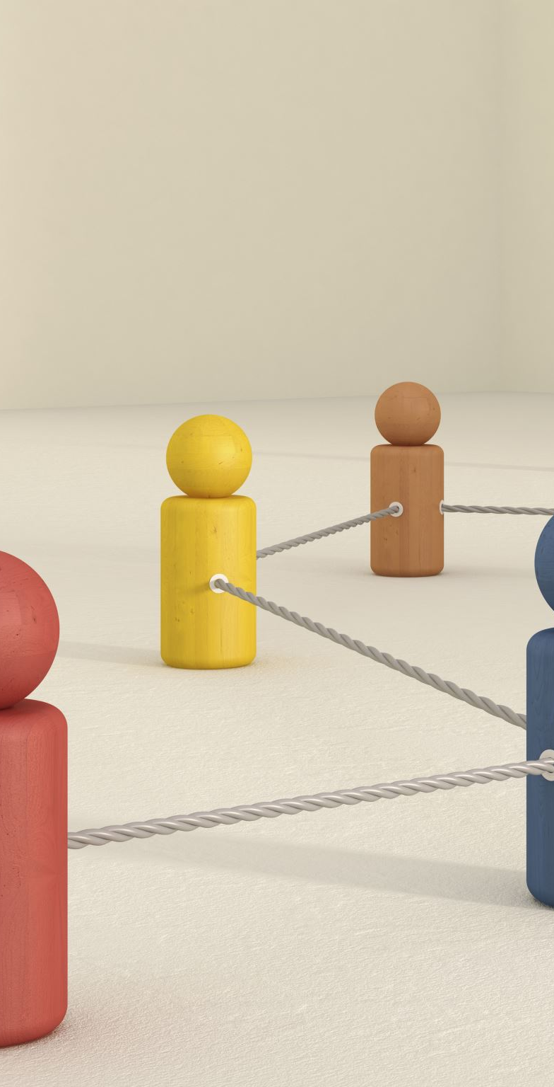
Overview
Inclusive change NeuroBridge initiative embedding UDL across FE in NI.
Development of a New Model for UDL practice
Notes:
NeuroBridge has two core aims: First, to build confidence and capability among FE educators and support staff through structured professional development. Second, to expand the impact of inclusive practice through media‑based dissemination—supporting practitioners to create digital stories, reflective videos, and demonstrations that can be shared across the sector. Together, these elements create a model that is both scalable and sustainable

Slide 3
Why UDL in FE?
Supports diverse learners.
Strengths-based inclusive practice.
Moves FE beyond compliance.
Relatively new concept within FE in NI
Notes:
We know FE serves incredibly diverse learners—adult returners, apprentices, people with caring responsibilities, and neurodivergent students. UDL offers a strengths‑based approach that ensures the system adapts to learners, rather than expecting learners to adapt to the system. In practice, this means shifting FE away from a compliance mindset and towards a proactive, anticipatory model of inclusion rooted in flexibility and representation.

Slide 4
NeuroBridge Project Approach
Phase 1: Professional development on neurodiversity led by neurodiverse international experts
Training grounded in real FET contexts
Phase 2: Practice‑based intervention to embed UDL and develop innovations for ND learners and colleagues
Strong cross‑college collaboration building shared language and shared understanding of inclusive practice
Phase 3: Co‑created media assets capturing UDL‑aligned strategies and innovations
Growing community of practice and regional digital asset repository to sustain long‑term change
Notes:
The programme began with a sector-wide professional development phase focused on neurodiversity, led by neurodiverse international experts whose lived experience and specialist knowledge grounded the training in authenticity and relevance. This phase equipped practitioners with a deeper understanding of neurodiversity across real‑world FE contexts—including vocational learning, adult literacy, SEN support roles, apprenticeships, and workplace learning—ensuring the learning was immediately applicable to everyday practice.
Phase two moved from awareness to action through a structured intervention designed to support educators in embedding UDL principles and implementing innovative strategies to better meet the needs of neurodivergent learners and colleagues. Collaboration across colleges remained central throughout, helping to build a shared vocabulary and a common understanding of inclusive practice that could be scaled across the FE sector.
In phase three, practitioners co‑created media assets documenting their inclusive strategies and UDL‑aligned innovations. These digital stories contributed to a growing community of practice and formed the foundation of a regional repository of accessible resources, strengthening knowledge exchange and sustaining long‑term cultural change.

Slide 5
Media Dissemination
Practitioner-created videos.
Showcasing inclusive strategies.
Catalyst for institutional learning.
New Model- “Participatory Practice Network”
Notes:
A distinctive feature of this initiative is the focus on creative media. Practitioners worked with Ulster’s media team to produce short videos capturing their inclusive practices—everything from mobile phone reflections to more polished studio recordings. These digital assets did two things:
They became resources that other practitioners could learn from.
They created momentum—encouraging others to try, share, and adapt inclusive strategies. Media became a catalyst for institutional learning.

Slide 6
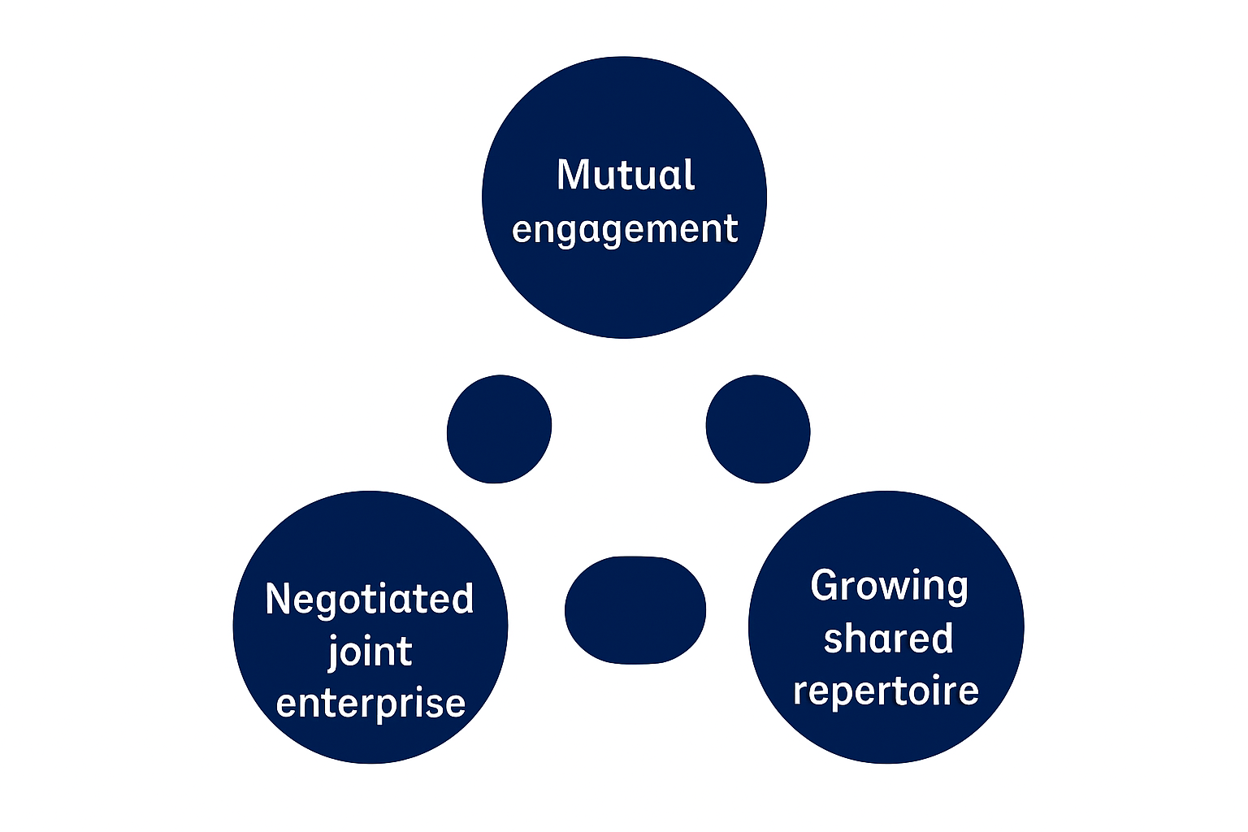
From CoP → Participatory Practice Network (PPN) to reimagine UDL
Participatory Practice Network (PPN): a practitioner‑led model that reconceptualises UDL through participatory creation, exchange, and refinement of digital artefacts of practice. Educators co‑produce and circulate evidence‑informed media (e.g., short videos, templates, micro‑cases), building a shared repertoire that accelerates inclusive pedagogy across FE. Drawing on Wenger, the PPN emphasises mutual engagement, a negotiated joint enterprise, and a growing shared repertoire, operationalised through sector‑wide collaboration rather than top‑down dissemination.

Slide 7
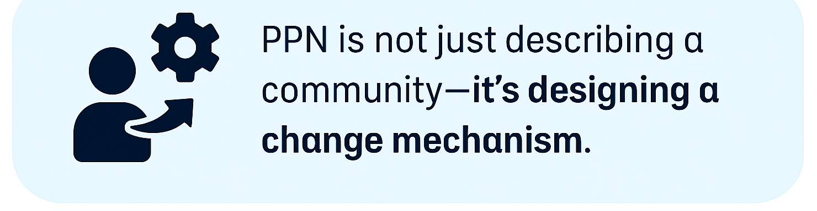
PPN Is Purpose‑Designed for Pedagogical Change, Not a Naturally Emerging Group
Wenger emphasises that CoPs often form organically around shared interests or problems and evolve informally over time
What’s new in PPN:
The PPN is intentionally constructed as an engine for UDL transformation, not a naturally‑occurring practitioner cluster.
Its purpose is explicitly change‑oriented, aiming to generate measurable shifts in inclusive pedagogy rather than simply support knowledge exchange.
Why this matters: PPN is not just describing a community—it's designing a change mechanism.
Notes:
The Participatory Practice Network (PPN) is distinctive because it transforms Wenger’s Communities of Practice from an emergent social learning group into a structured, participatory, media‑driven, sector‑wide engine for UDL innovation—grounded in neurodiverse expertise and designed to produce a shared digital repertoire that drives inclusive pedagogical transformation.

Slide 8
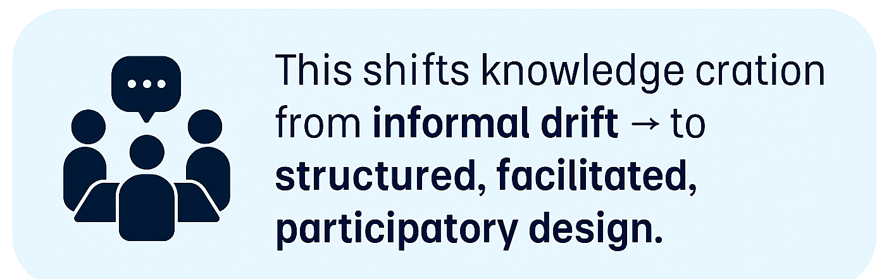
PPN Embeds Structured Participatory Production, Not Just Informal Repertoire Building
Wenger’s CoPs develop a shared repertoire through ongoing interaction—stories, tools, routines, and tacit knowledge gathered over time
What’s new in PPN:
PPN introduces deliberate co‑production cycles in which practitioners collaboratively develop:
media artefacts, filmed practice examples; templates; narrated pedagogical reasoning
This shifts knowledge creation from informal drift → to structured, facilitated, participatory design.
Why this matters: PPN treats digital artefacts as designed products of social learning, not incidental by‑products.

Slide 9
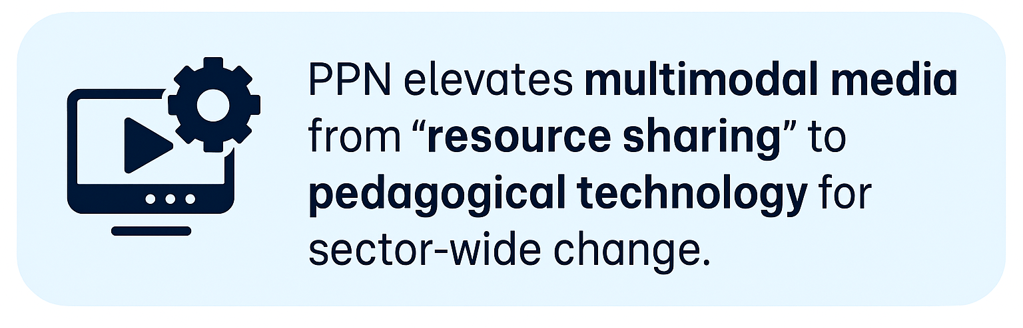
PPN Uses Media as a Core Mechanism for Knowledge Mobilisation
CoPs may reuse assets and share tools, but media production is not a central mechanism in Wenger’s model.
What’s new in PPN:
Media creation is a defining feature, not a side activity.
Digital artefacts intentionally make UDL visible, scalable, and transferable across the FE sector.
A digital repository becomes the network’s shared practice infrastructure.
Why this matters: PPN elevates multimodal media from “resource sharing” to pedagogical technology for sector‑wide change.

Slide 10
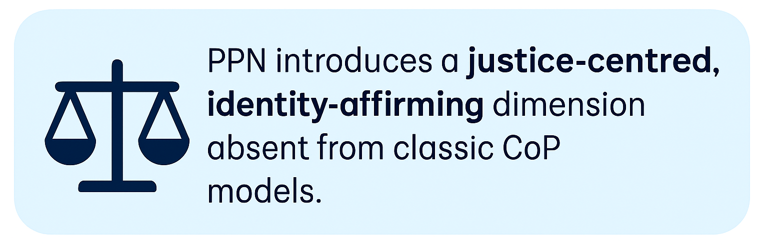
PPN Integrates Neurodiverse Leadership and Lived Experience as Foundational
Traditional CoP theory does not specify who leads or how identities shape participation.
What’s new in PPN:
Neurodiverse experts lead professional development.
Lived experience is treated as epistemic authority.
This diversifies “whose knowledge counts” within the professional learning system.
Why this matters: PPN introduces a justice‑centred, identity‑affirming dimension absent from classic CoP models.

Slide 11
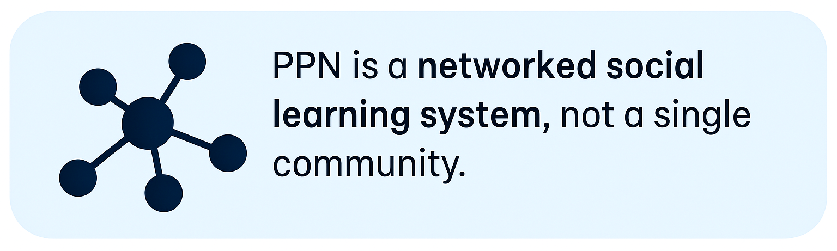
PPN Moves Beyond Local Communities to a Cross‑College, Sector‑Level Network
Wenger notes that CoPs can be local, distributed, or global, but they often evolve within a single organisation or cluster
What’s new in PPN:
PPN is explicitly multi‑institutional, crossing all FE colleges in NI.
It creates a sector‑wide shared repertoire, not a localised one.
Why this matters: PPN is a networked social learning system, not a single community.

Slide 12
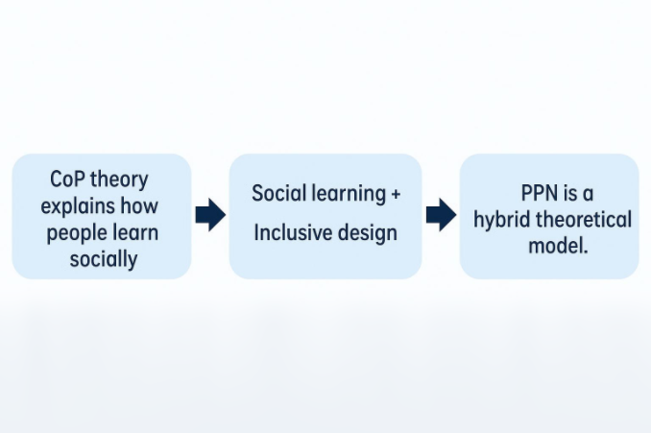
PPN Blends CoP Theory With UDL as a Design Framework
CoP theory explains how people learn socially; UDL explains how environments can be designed inclusively.
What’s new in PPN:
PPN integrates the two: social learning + inclusive design.
UDL becomes not just content but a design principle for the network itself.
Why this matters: PPN is a hybrid theoretical model, reconceptualising UDL through CoP logic.

Slide 13
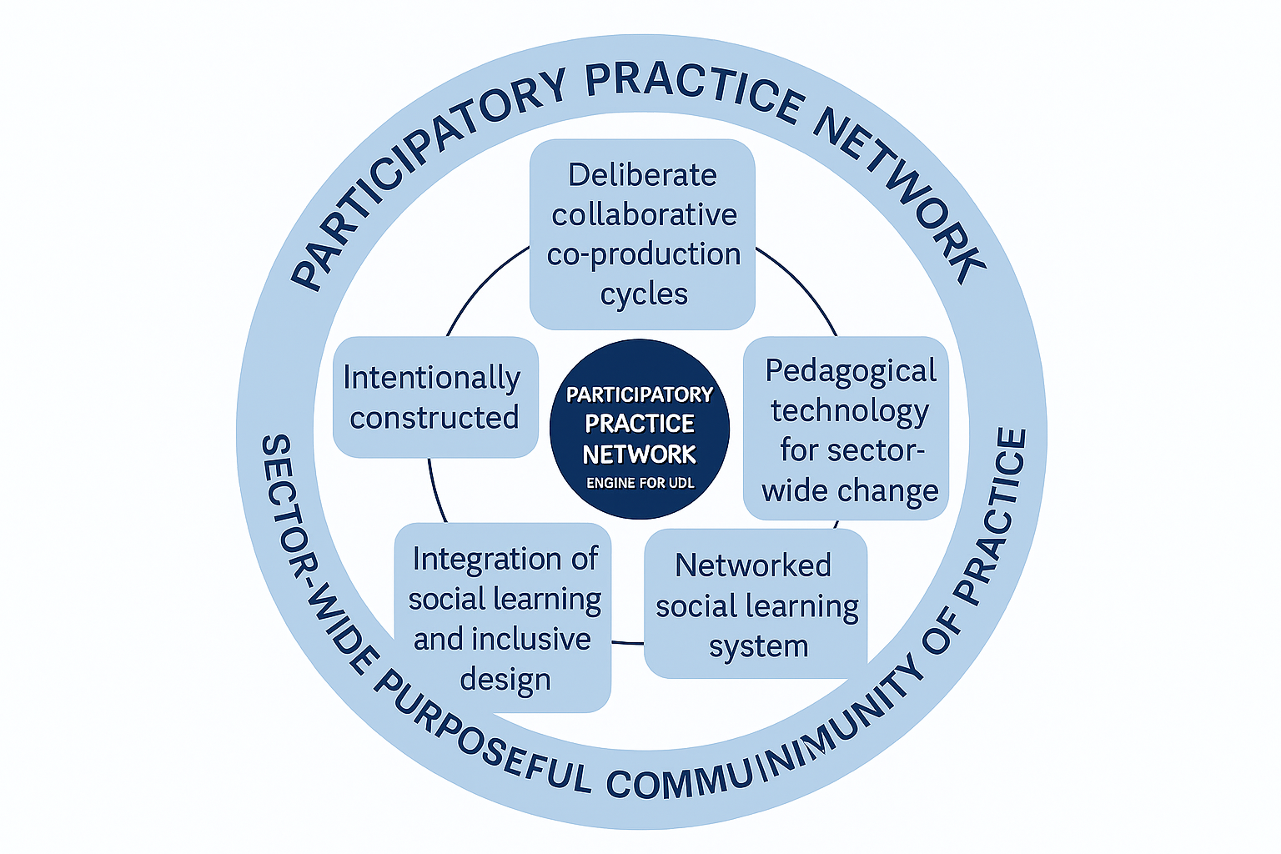
Key Takeaway
PPN moves UDL beyond top‑down guidance by empowering educators to collaboratively design, test, and share digital artefacts of practice—building a sector‑wide shared repertoire that drives sustained inclusive transformation.

