Slide 1
Mapping Inclusive Practice and Universal Design Initiatives:
A Whole University Approach
Tracy McAvinue & Thomas O’Shaughnessy
University of Limerick

Slide 2
Mapping Inclusive Practice
Aims, Context and Approach
Results
Insights

Slide 3
Mapping Aims:
Building a map of current inclusive initiatives across all areas of the university, and identifying the ‘pockets’ of great work
Aim is for broad representation, documenting what is there in terms of inclusive practice, not what is not there
Creating the first repository of its kind in UL

Slide 4
Project Context
The Universal Design and Inclusive Practice at UL (UDIPUL) Committee takes a systemic approach to supporting UL in meeting its goals for inclusion.
Informed by Altitude Charter and Unlocking Inclusion Toolkit.
PATH 4 funding for Project Officer role, responsible for:
Mapping current inclusive practice
Applying the UCD Toolkit for Inclusion self-assessment
Conducting benchmarking and a gap analysis
Developing a roadmap to guide future universal design and inclusive practice actions

Slide 5
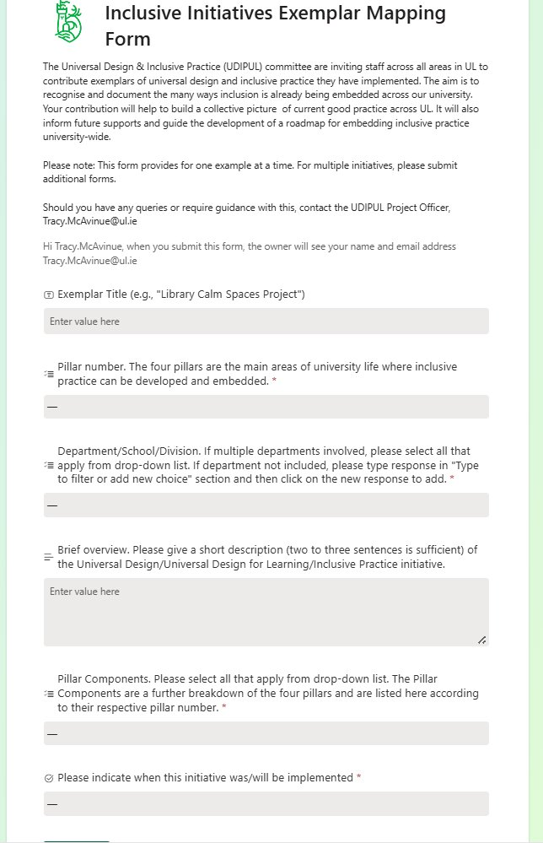
Exemplar Mapping Form
SharePoint List, capturing:
Title of initiative
Pillar Number
Department
Description
When implemented
Pillar Component

Slide 6
Initiatives Mapped
As of 1 February 2026: 323 submissions
Duplicates removed: total of 319 submissions
Form will remain open

Slide 7
Pillars
Pillar | Initiatives | %
1: Learning Teaching & Assessment | 109 | 25
2: Supports Services & Social Engagement | 177 | 40
3: Physical Campus & the Built Environment | 68 | 15
4: Digital Environment | 86 | 20
Examples with Multiple Pillars
Two Pillars: 61 Initiatives
Three pillars: 12 Initiatives
Four Pillars: 10 Initiatives

Slide 8
Pillar Components
Components | Initiatives | %
2 Student Engagement | 140 | 13
2 Accessing services | 106 | 10
2 Advice & guidance | 77 | 7
2 Student and Staff Health and Wellbeing | 72 | 6
1 Classroom practices | 53 | 5
1 Teaching materials | 46 | 5
1 Research | 43 | 4
4 Digital Communication | 43 | 4
4 Virtual Learning Environment | 38 | 4
4 Assistive technologies and digital literacy | 31 | 3
3 Built campus | 29 | 3
2 Communications and promotional materials | 28 | 3
Highest submissions from 32 overall Pillar Components
Of 319 submissions, initiatives reached 1025 components

Slide 9
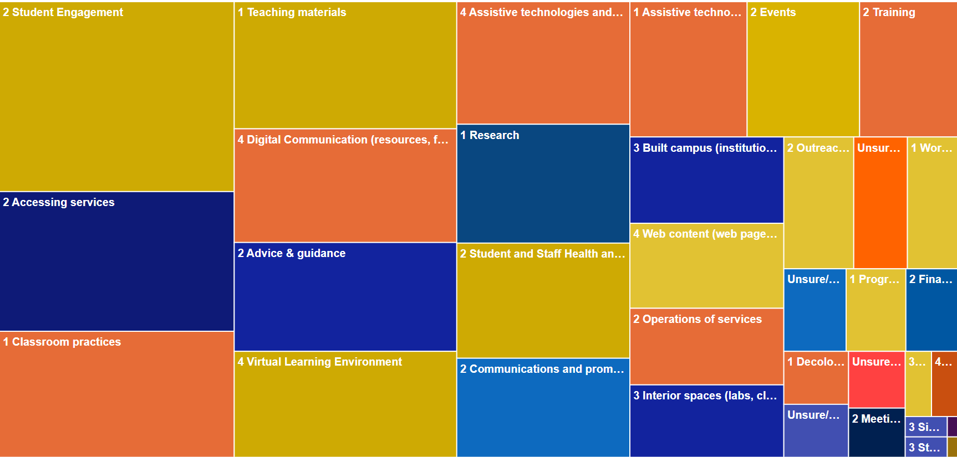
Mapping the Prevalence of Pillar Components

Slide 10
Insights…
Learnings:
Dissemination/engagement, challenges and solutions
Strategy: Feedback, additional resources, and existing connections
Importance of information captured
Findings:
Respondents eager to have work represented
Staff using inclusive practices implicitly and creatively across all areas
Inclusive initiatives are largely sustainable once implemented
While largely locally driven, the range of exemplars demonstrates solid evidence of institutional capability

Slide 11
The Benefits of Mapping Inclusive Practice
Building awareness of UDIPUL
Participants: helpful in identifying inclusion strengths and gaps
Creation of a live repository of inclusive practices
Cultural – a celebration of good practice
Collaboration – current, and future potential
Lays groundwork for further development and actions for systemic inclusion

