Slide 1

UDL 3.0 in Action: Reducing Stress and Enhancing Inclusion for Students in Higher Education
Elizabeth Hitches, Stuart Woodcock, Melissa Johnstone & Dean Dudley

Slide 2
Outline
What’s the challenge?
Knowledge seeking
What next?

Slide 3

Students’ academic stress
Stress experienced in relation to academic studies, for example:
learning
achievement
navigating university life
managing study alongside other commitments

Slide 4
What’s the challenge?

Slide 5

Effects of high academic stress
For higher education students, on its own, high academic stress can impact:
Physical health
Mental health
Quality of life
Learning capacity
Academic achievement
(see Pascoe et al., 2020; Ribeiro et al., 2018)

Slide 6

Context
Pre- COVID-19 pandemic
84% of students reported high stress compared to 29% of the general population (Stallman, 2010)
Since the onset of the pandemic
Increased stress (von Keyserlingk et al., 2022)
Decreased ability to cope (headspace, 2021)

Slide 7

Emerging research
  Students with accessibility requirements or disability may experience higher stress than their peers
  No statistically significant difference in stress between those who have and have not sought support from student support services (Ardell et al., 2016; Hitches et al., 2023; 2025 forthcoming)
  Overall, we know very little about the experiences of students who aren’t registered with student support services

Slide 8
Knowledge seeking

Slide 9
Current doctoral research
A systematic literature review of stress reduction interventions for students with ARD in Higher Education internationally
Findings: a UDL approach is lacking!
Stage 1. Information Gathering:
Understanding students’ academic stress
Goal: Viewing stress through a UDL lens
Stage 2. Designing:
Co-designing an accessible and inclusive intervention
Goal: Design ways to reduce high stress and stressors through a UDL lens
ARD = accessibility requirements and/or disability

Slide 10
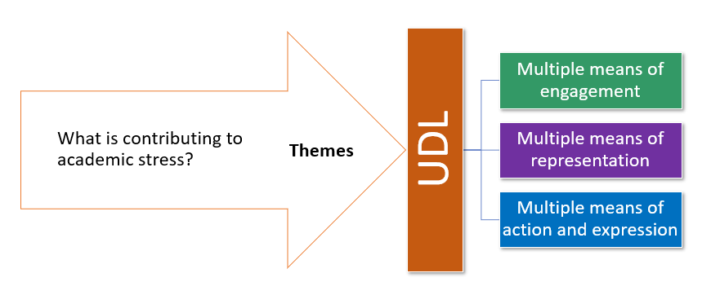
Students’ voices through the lens of UDL

Slide 11
Assessment with barriers to engagement
“there was not any feedback on my assessment, just a mark. I emailed the subject coordinator and the response I got was that if I wanted a remark (which I didn’t, I just wanted to know how I could improve for part 2) then this could reduce my mark. These things may seem small, but when combined they feel huge”
(Engagement: Action-oriented feedback is absent or inconsistent)
“Wasted our time on the meaningless/ repetitive assessments”
(Engagement: Relevance, value, and authenticity of assessment is not optimised)

Slide 12
Assessment with barriers to representation
“Assessment details are unclear and ambiguous requiring reading between lines or “winging it” and then teachers are surprised when neurodivergent students fail or perform badly repeatedly and as a collective”
(Representation: Assessment instructions that are difficult to comprehend)

Slide 13
Assessment with barriers to action and expression
“Having exams, being approved for use of computer[s] yet being made to write and hurt self or overwhelm student. No use of expected extra time.”
(Action and expression: Lacking access to accessible assessment, including assistive technologies and tools)
“all the assignments are writing essays which I think is terrible”
(Action and expression: Limited modes of assessment or modes that do not account for variability)

Slide 14
Assessment-related stressors through a UDL lens
Engagement | Representation | Action and expression
Action-oriented feedback is absent or inconsistent The relevance, value, and authenticity of assessment is not optimised | Assessment instructions that are difficult to comprehend | Lacking access to accessible assessment, including materials and assistive technologies and tools Limited modes of assessment or modes that do not account for variability

Slide 15
Participation and barriers to engagement
“Being a mature aged student, I feel quite isolated and don't fit in or belong due to my age. When it comes to group assessments, I am very worried about not finding a group to join”
(Engagement: Lacking belonging and connection)

Slide 16
Participation and barriers to representation
“I find it hard to focus…reading 30+ pages is frustrating as a lot of them readings do not have a defined point(s)…my attention span is taking a toll. ”
(Representation: One mode of media not optimised for perception and building knowledge)
“The lack of accessible course content has been an ongoing issue for me, white backgrounds on everything and no closed captions on lectures with poor sound quality meant I could not access course content”
(Representation: Information presented in inaccessible ways)

Slide 17
Participation and barriers to action and expression
“Not being offered online tutorials…Online tutorials worked better for me…More time for hospital appointments where I could watch the tutorial whilst getting treatment, whereas on campus, the distance, parking, walking to class, dealing with the social stress…too overwhelming.”
(Action and expression: Mode of participating does not align with student needs)
“Desks/Tables constantly changing/layout change every week = very stressful for an Autistic person!!”
(Action and expression: Physical spaces lacking accessibility)

Slide 18
Participation-related stressors through a UDL lens
Engagement | Representation | Action and expression
Lacking belonging and connection | one mode and not optimised for perception and building knowledge Information presented in accessible ways | Mode of participating does not align with student needs Physical spaces lacking accessibility

Slide 19
Impacts of academic stress
Health: “Due to academic stress I have had headaches, stomach ulcer/gastritis, poor sleep…small things feel bigger, I am teary and short fused. I isolate myself from my friends and family in order to concentrate more time on my studies. This can cause the academic stress to worsen as you have no other outlets or positive influences.”
Motivation: “it can go both ways, either [stress] motivates me to do better or i sometimes just give up”
Depth of learning and achievement: “[stress] makes me focus on getting assessment tasks done on time instead of really learning and exploring the content”; “I just shut down if it gets too much. This has resulted in two failing grades.”

Slide 20

What can we each take away?
There are many stressors which are contributing to students’ stress in higher education, with significant health and learning impacts
Some stressors could be reduced by UDL informed actions.

Slide 21
What next?

Slide 22
Current stage of doctoral research
A systematic literature review of stress reduction interventions for students with ARD in Higher Education internationally
Findings: a UDL approach is lacking!
Stage 1
Information Gathering:
Understanding students’ academic stress
Goal: Viewing stress through a UDL lens
Stage 2
Designing:
Co-designing an accessible and inclusive intervention
Goal: Planning to reduce high stress through a UDL lens
ARD = accessibility requirements and/or disability

Slide 23

Elizabeth Hitches (she/her)
Email:
e.hitches@uq.edu.au
LinkedIn: www.linkedin.com/in/elizabeth-hitches

