Slide 1
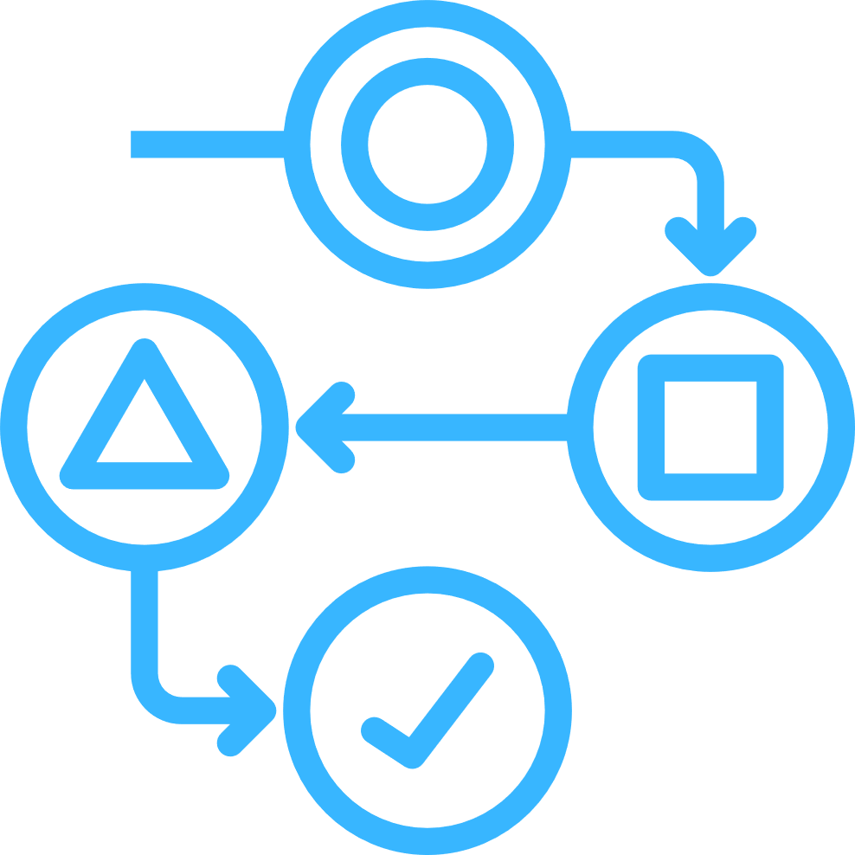




UDL- Does it Work? A Framework for Assessing the Impact of Universal Design
Dr Lisa Padden, Daniel Elliott, Kathie Orr
UCD Access and Lifelong Learning
19th March 2026

Slide 2


Outline
Context
Universal Design Baseline Impact Survey
Impact Measurement
New Universal Design Badge
Workshop Activity

Slide 3





UD Badge Uptake
National sector-wide uptake in Ireland
5,713
720
Universal Design
Digital Badges issued
Teaching & Learning: 5,033
Beyond the Classroom: 680
Both: 46
Have also received the facilitator badge

Slide 4

Universal Design Baseline Impact Survey
33 question survey about UDL implementation
Open March-April 2025
Captured both quantitative and qualitative data including:
educators’ continued use of the UDL framework
perceived benefits and challenges
the diversity of their student cohorts
and evidence of impact on student attainment and engagement.
resource implications (time, financial, and institutional) of implementing UDL in practice.

Slide 5
Survey Respondents
Sent to the 4,426 Badge holders at time of survey
Open March – April 2025
Higher Education
Further Education

Slide 6
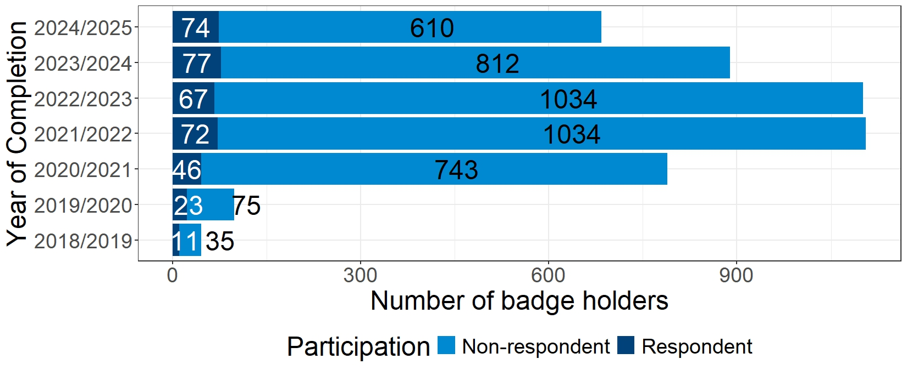
Response Rate by Year of Badge Completion
4,426 Badges at time of survey

Slide 7
Current Teaching Responsibilities and Use of UDL
84.6% of those still teaching and 70% of those who are not teaching are still using UDL.

Slide 8
Implementation Introduction
Thinking about one module/class in which you implemented Universal Design for Learning…

Slide 9
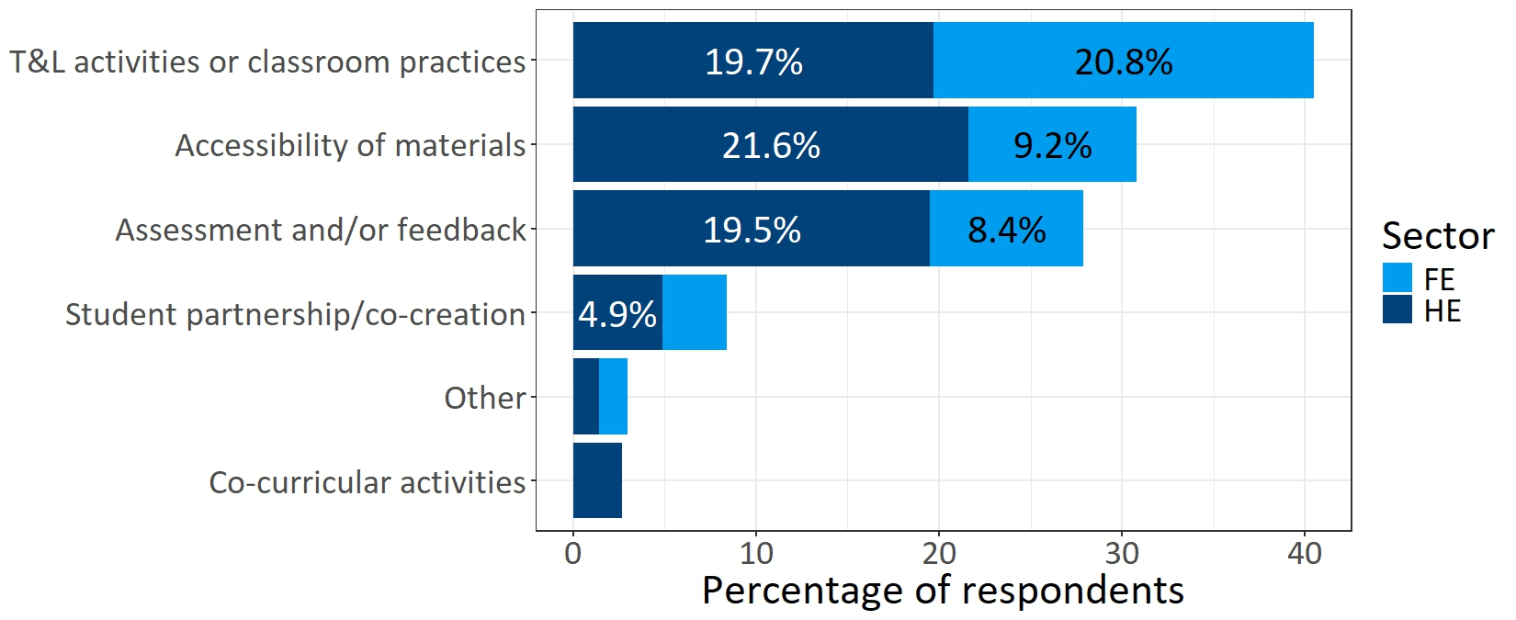
What did your implementation address?
5.1% of respondents selected multiple of the above options.

Slide 10
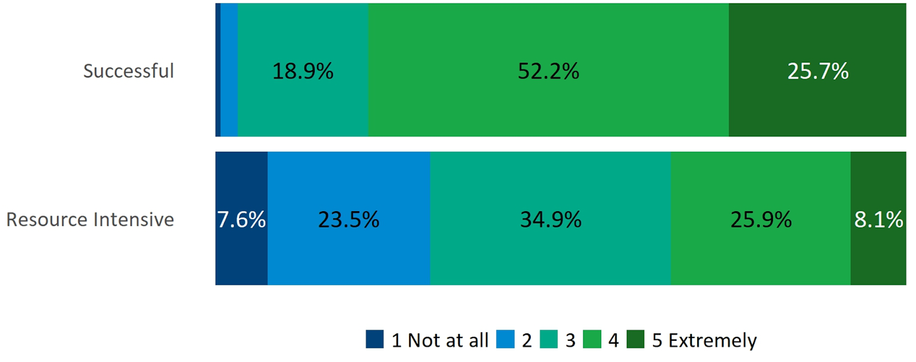
Respondents’ measurement of how successful and resource intensive their implementation of UDL was on a scale of 1 Not at all to 5 Extremely.

Slide 11
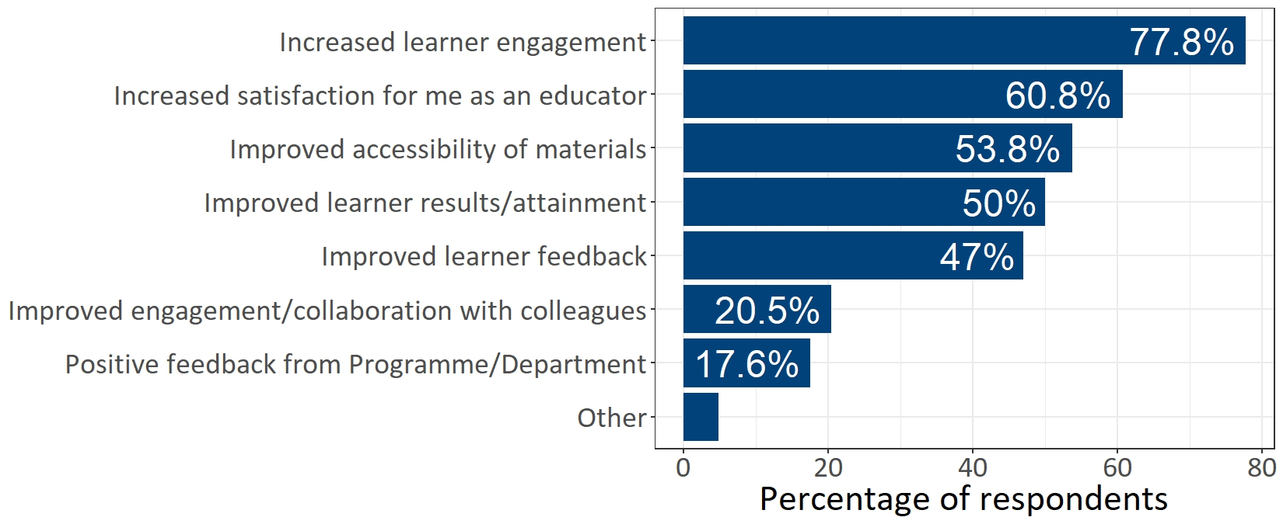
If you feel the implementation was successful please select the relevant success criteria
Notes:
Survey findings revealed that the Badge has had a transformative impact on teaching practice across Ireland. Educators identified clear benefits for student engagement, accessibility of learning materials, and student attainment.. Additionally, 133 respondents (36%) had measured the impact of their UDL implementation on learner attainment and none found a negative impact. Responses indicated professional learning in UDL leads to measurable positive changes in teaching practice.

Slide 12
Challenges
Time constraints
Lack of resources
Varying levels of institutional resources and support
need for UDL integration and continued systemic investment in inclusive teaching practices.
Institutional commitment to UDL was particularly critical for respondents working in further education to enable inclusive pedagogy.

Slide 13
Discussion of results
How can UDL practitioners be supported further, particularly in relation to measuring the impact of UDL?

Slide 14

One area that needs attention in UDL is evidence to support it and indeed critique it. UDL Baseline Impact Research survey respondent
“

Slide 15

I would like a framework or toolkit at institute level to encourage programme-level initiatives to embed UDL into the whole teaching, learning and assessment rubric. UDL survey respondent to the question ‘What would facilitate you to conduct, disseminate and/or publish research in the area of UDL?’
“

Slide 16
Action 1: Build an impact framework to support staff in measuring UDL impact.
Collate validated tools to measure:
Learner engagement
Educator satisfaction
Resource accessibility
Learner attainment
Learner feedback.

Slide 17


Action 2: Development of new Universal Design Digital Badge: Research and Impact
A new, third Digital Badge in Universal Design to support you to develop your skills and expertise to measure the impact of Universal Design on student engagement and success.
To be piloted January 2027
Workbook to scaffold reflection and assignment
1 assignment activity – develop research proposal

Slide 18
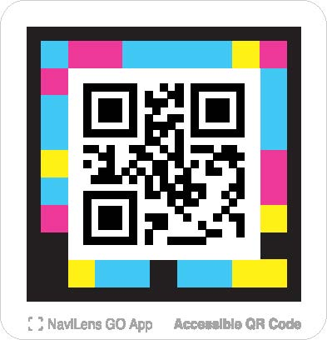
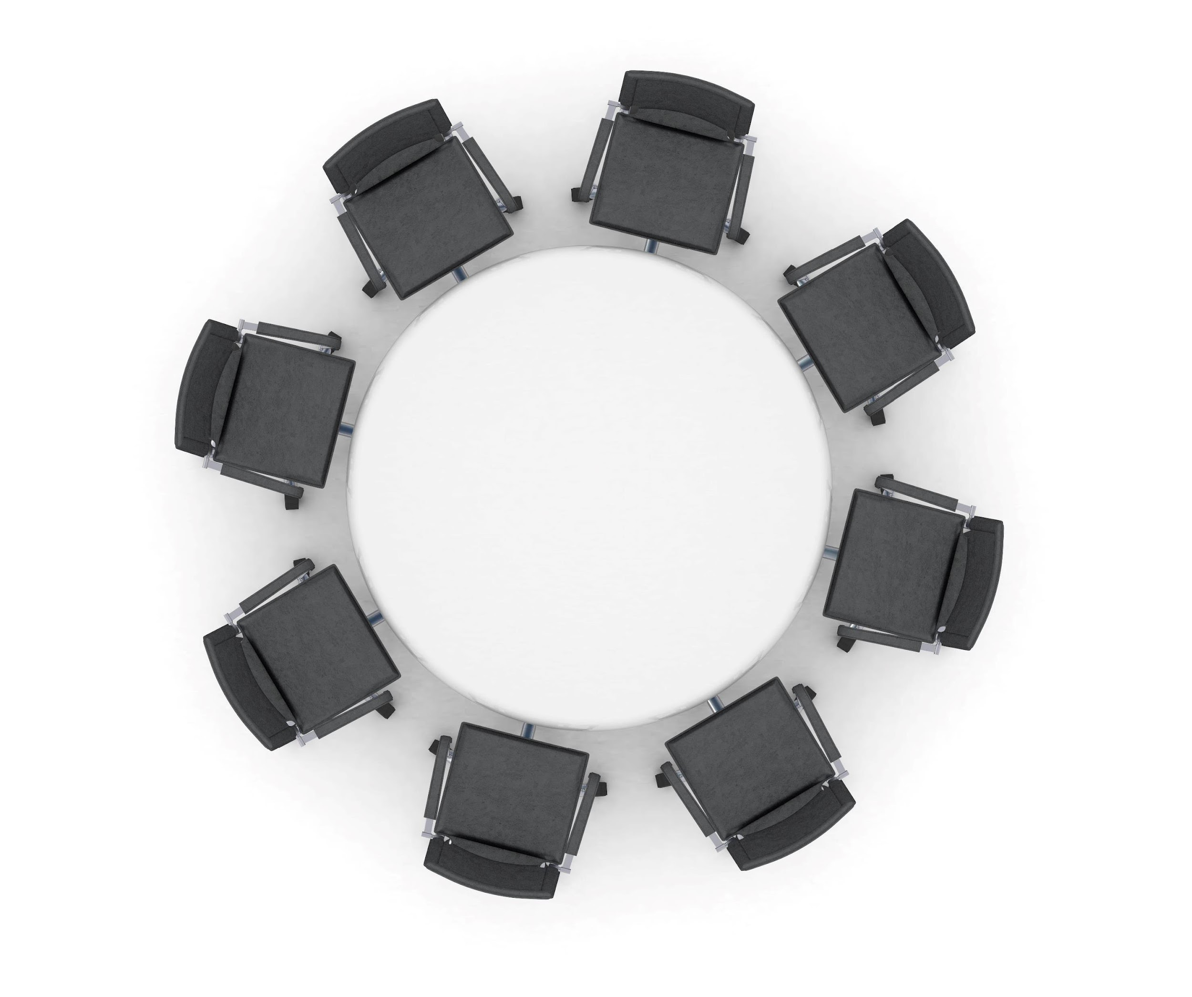
Workshop Activity
﻿
Workshop Activity link: https://forms.gle/WTh67mVuCxnyzYGj8

Slide 19
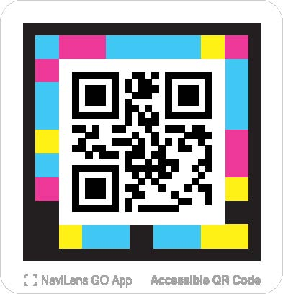
Next steps
Further consultation with the sector – you can submit feedback and/or a case study via project website. (https://www.ucd.ie/all/universityforall/universaldesign/universaldesignresearchandimpact/)
Development of UDL impact framework.
Pilot of new badge January 2026

