Slide 1



Bridging Innovation and Inclusion Emerging Technologies in Engineering Education Through UDL
Yvonne Sarsfield
UDL Specialist

Slide 2

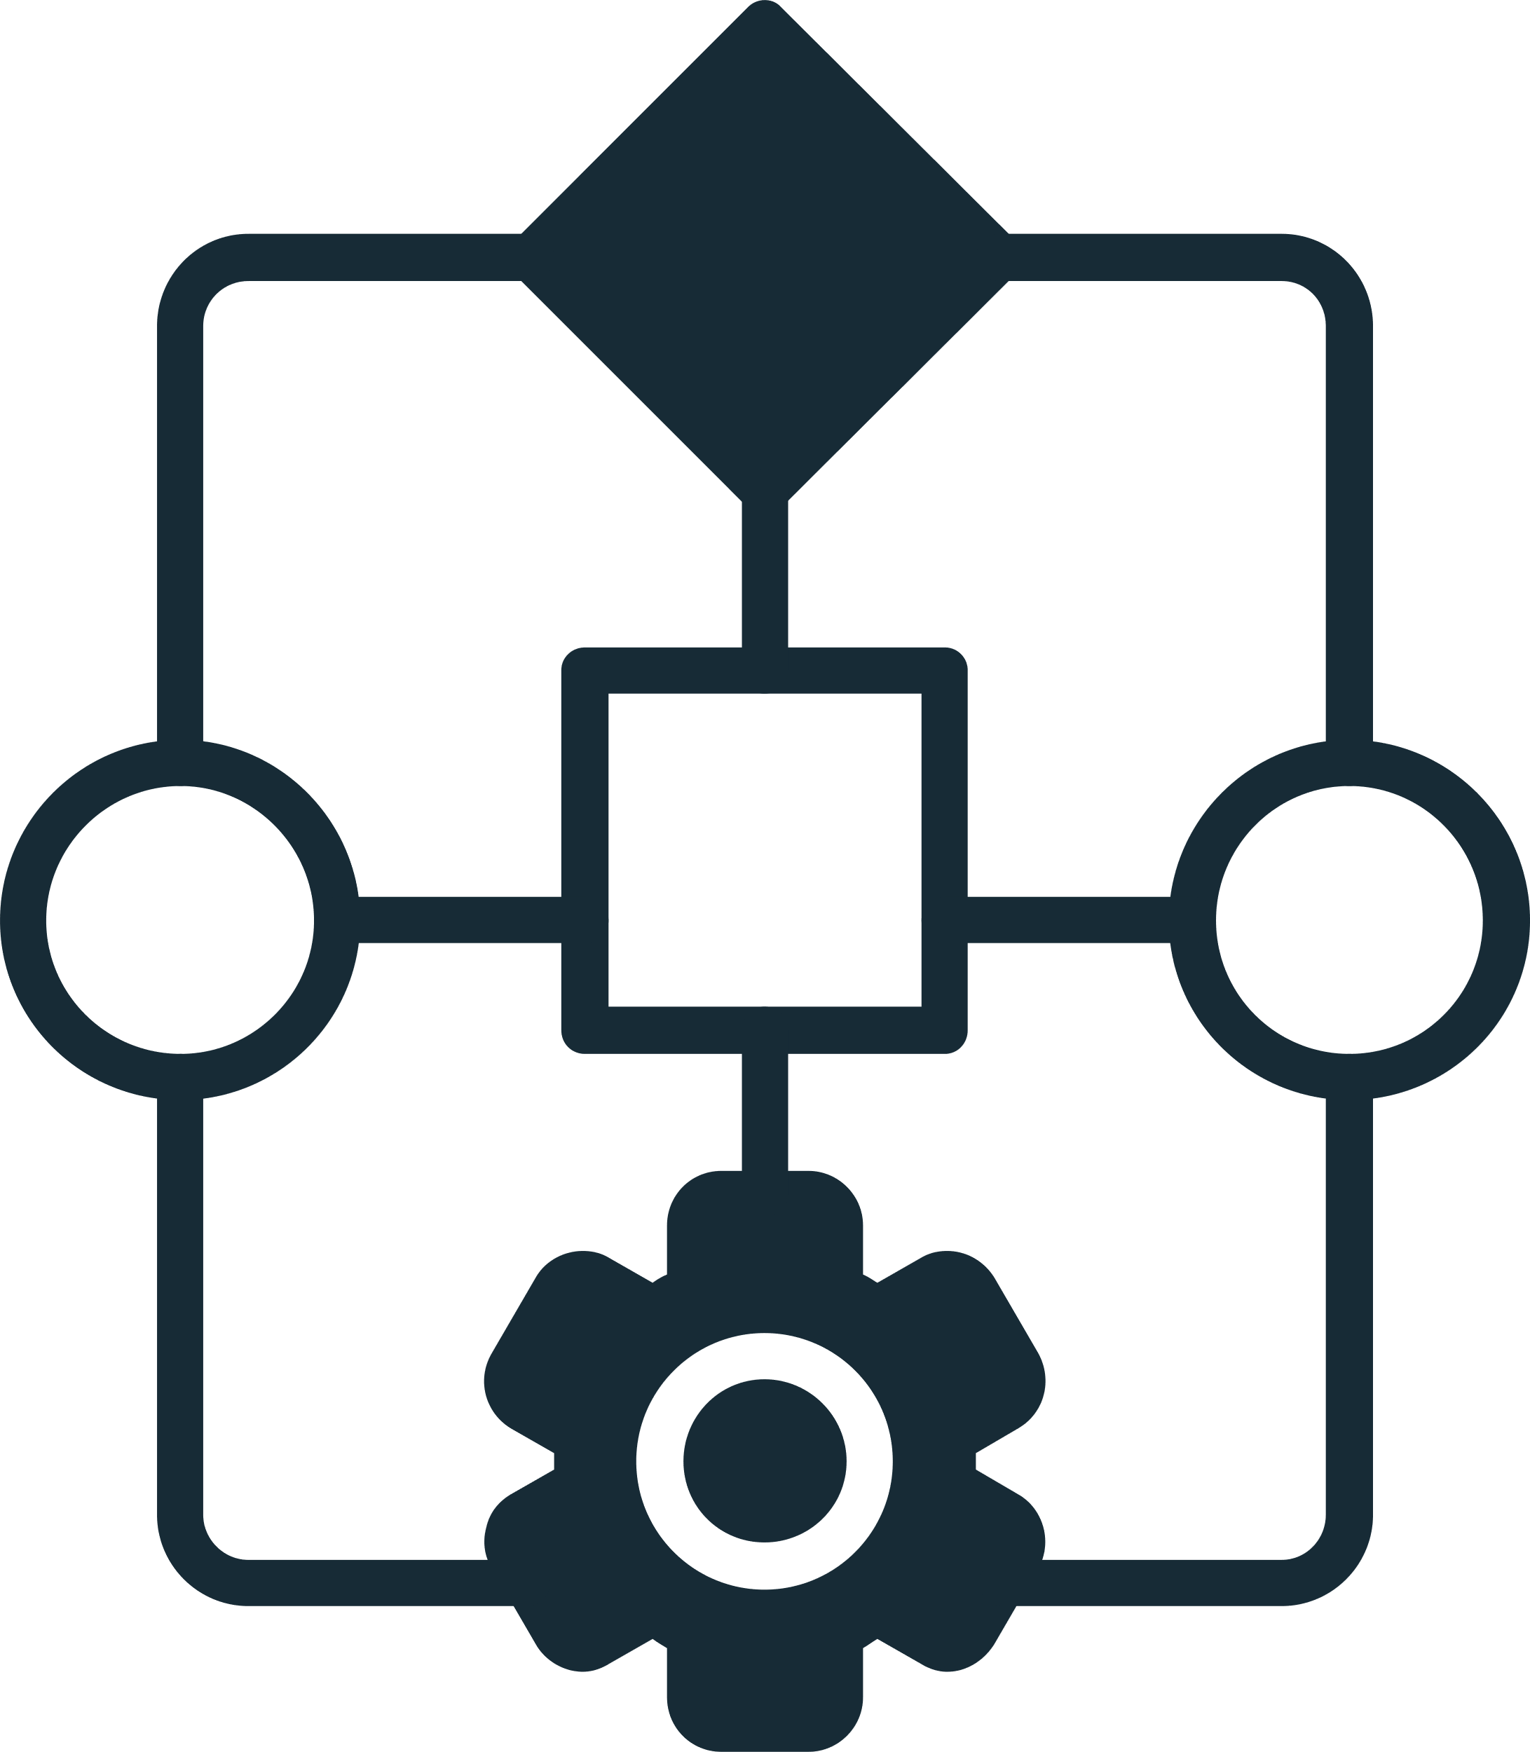




Why Innovation Must Be Inclusive
3
Framework
Universal Design for Learning (UDL) as framework
2
4
Innovation
Focus
Innovation alone does not guarantee inclusion
ATU engineering programmes
1
5
Growth
Goal
Growth of VR and AR in engineering education
Bridge innovation and inclusion

Slide 3
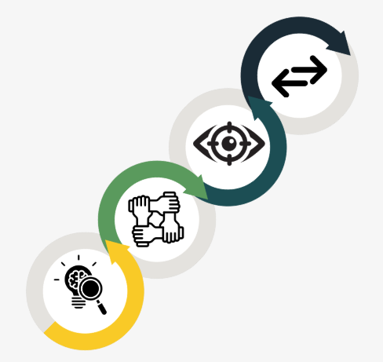





Research Aim
& Questions
Sequential explanatory
mixed-methods design
Focus on VR and AR
integration
Grounded
in UDL Principles
Explore institutional and
instructional design support
Examine educator preparedness

Slide 4

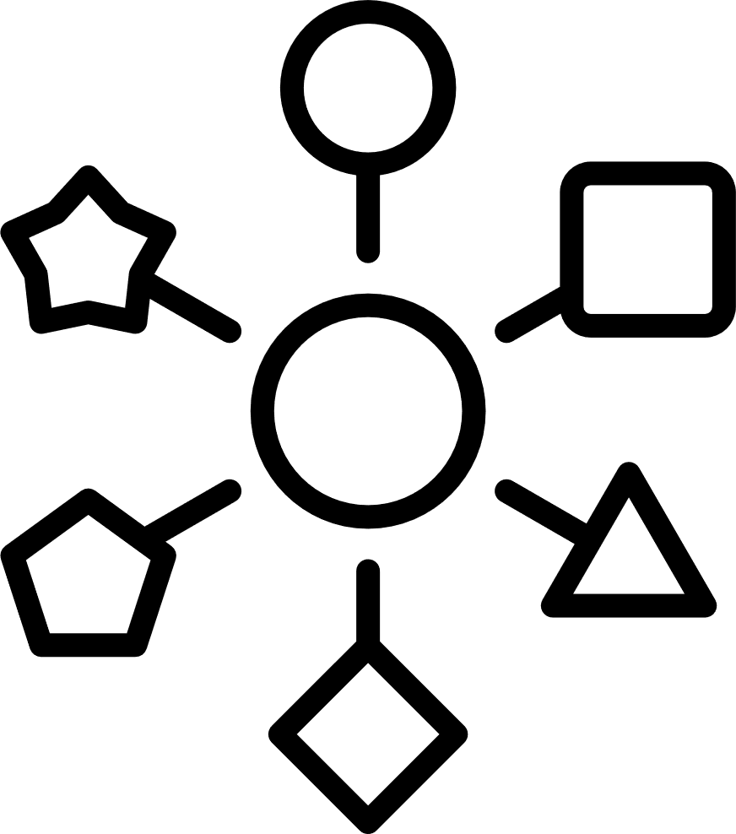

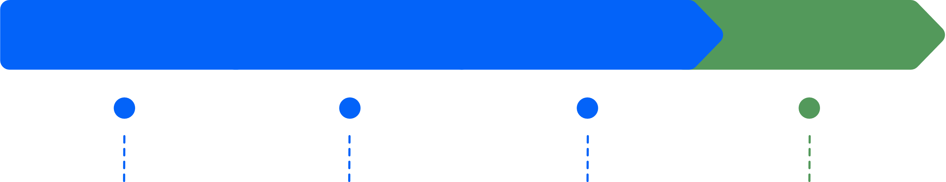


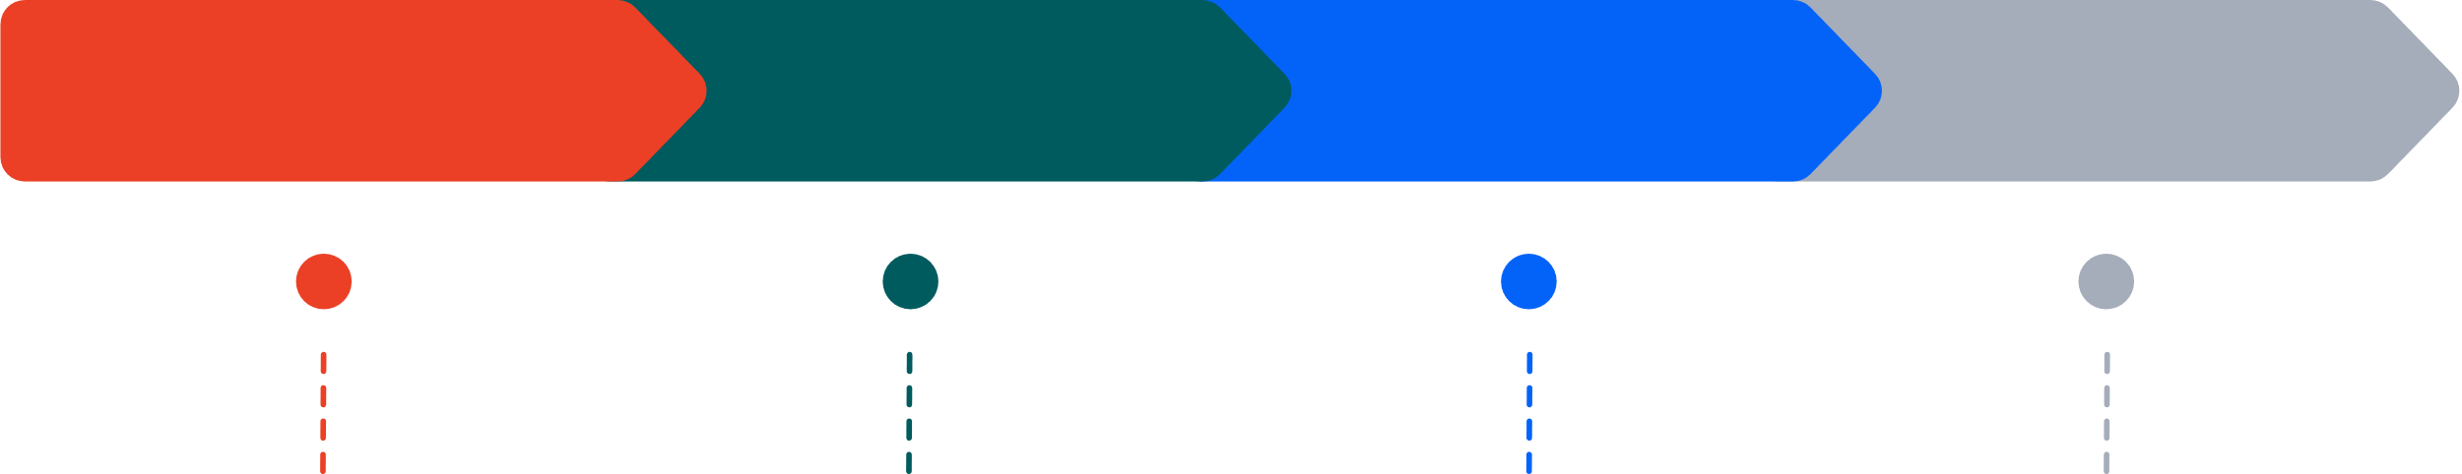
What the Study Revealed
Strong enthusiasm for immersive technologies
Wide variability
in educator confidence
Enthusiasm
Limited and inconsistent UDL understanding
Confidence
UDL Familiarity

Slide 5
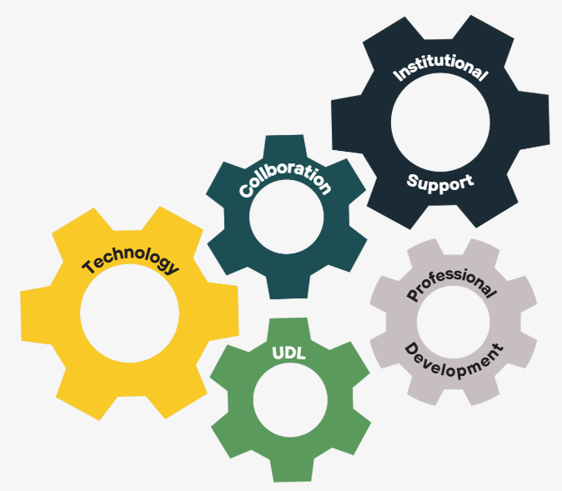





Aligning the
Moving Parts
Technology ≠ inclusion
Need alignment with UDL
Professional development
must integrate pedagogy
and technology
Cross-departmental collaboration essential
Institutional leadership matters

Slide 6

Evidence-Based Recommendations
Structured UDL-focused professional development
Joint training for educators and IDs
Embed UDL in immersive technology strategy
Clear institutional policy alignment
Ongoing evaluation
and reflection

Slide 7
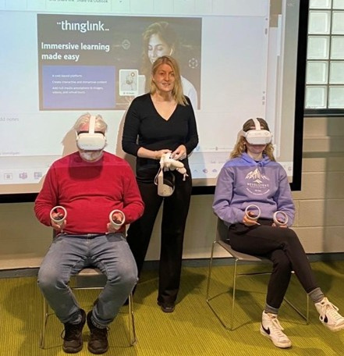
Key Takeaway
Innovation must be inclusive by design
Tools alone are insufficient
Sustained institutional support is essential
UDL strengthens impact and equity
Inclusive innovation benefits all learners

