Slide 1
Partnership in Practice: Student - Faculty Collaboration for Accessible Learning
By Eleanor O’Kelly, Kevin Landers, and Sofia Mashkantseva

Slide 2
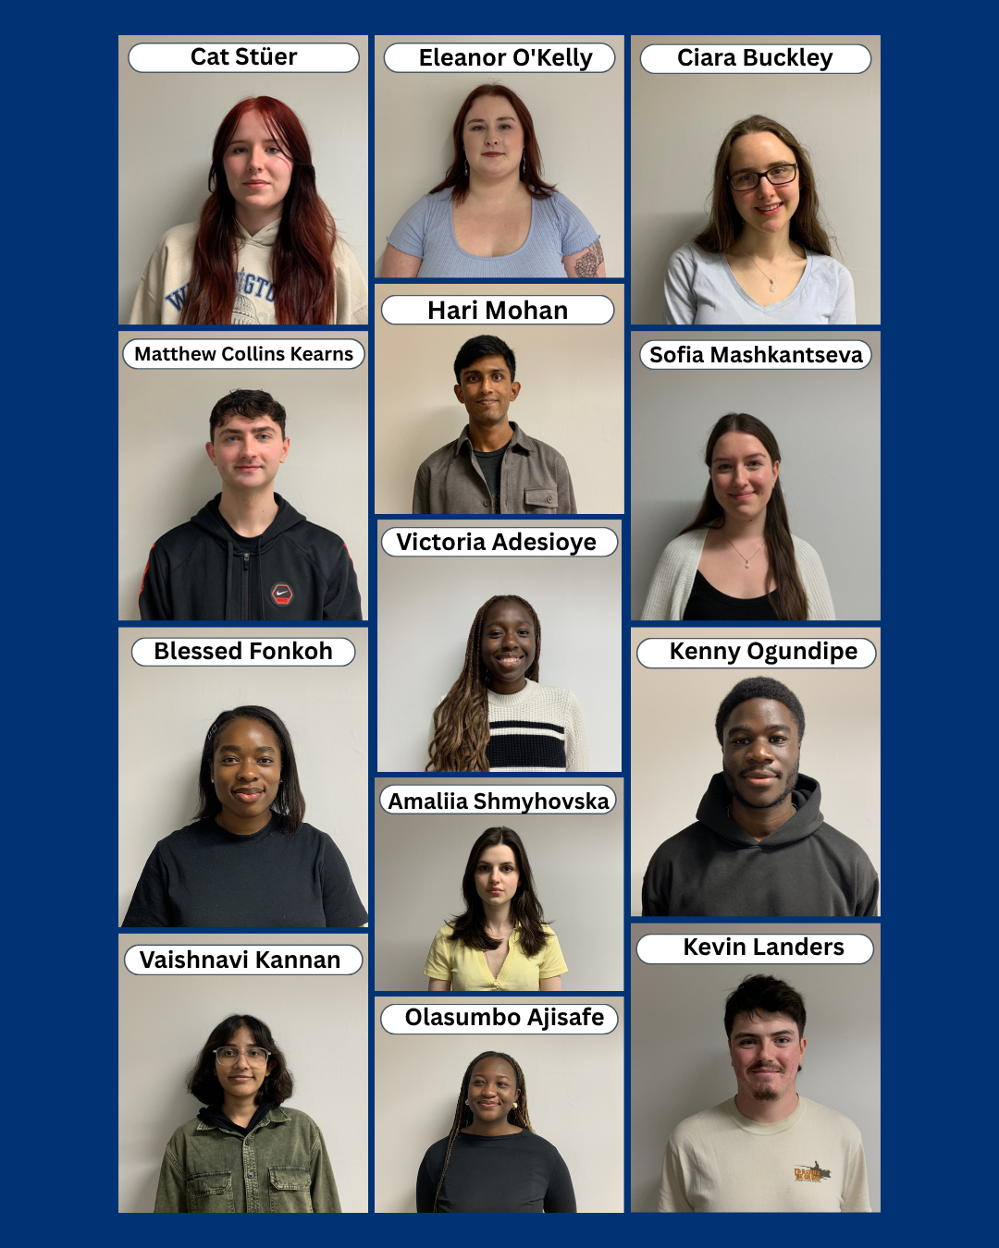
Who are the Student Partners?
University for All project
Student led
Collaborative
Bridge between students and UCD

Slide 3
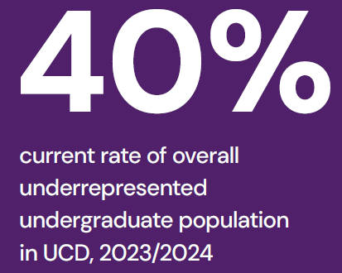
Aims of the Project
The Module Accessibility Review;
Creating change through dialogue
Meeting lecturers where they are
Practical Accessibility training
Mainstreaming Universal Design

Slide 4
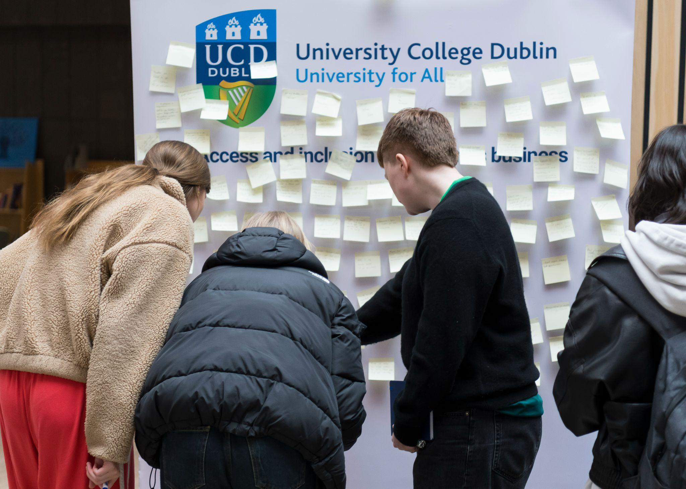

Methodology
Preparation
Initial draft checklist
Faculty Focus Group
Adjust approach
Approach potential candidates
In practice
1st Meeting
Timeline set in motion
fieldwork
Report findings
Implementation
reflection
Notes:
Kevin - drafted a plan of what were the issues that were faced and gave structure to the areas of interest in our scope. We used UDL to consider what makes modules optimal and what may be missing. A checklist simplifies the process and makes the findings factual rather than subjective. We got further feedback from a faculty focus group who helped us fine tune the approach to ensure it wouldn’t be too intrusive for potential candidates.
Sent potential candidates with a proposal - included timeline and checklist.
In practice - if they agree
Establish a dialogue, timeline enacted with necessary changes if needed. Fieldwork performed on module. Discuss findings and see what can be implemented, findings are not binding but more so useful suggestions to help improve accessibility. Then they can be implemented. Things can be reflected upon by partners to see what was done well and what could be improved in strategy.

Slide 5
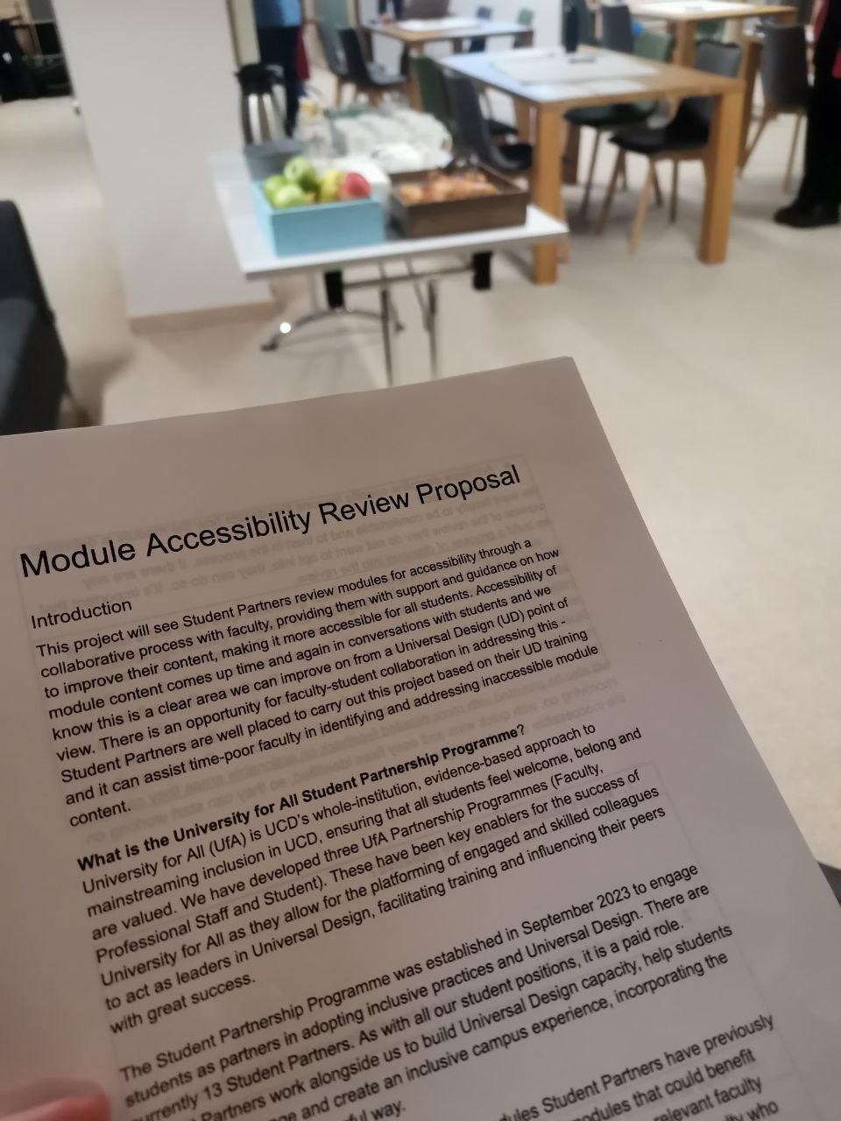
Initial Findings
Dialogue is important to ensure the review is collaborative rather than evaluative
Time constraints are significant for faculty
Clear communications increase trust between students and faculty
Main offenders from review:
Colour contrast
Inconsistent Brightspace navigation
Text size and font
Missing alternative text for images/graphs
Missing dates of assessment on Brightspace

Slide 6
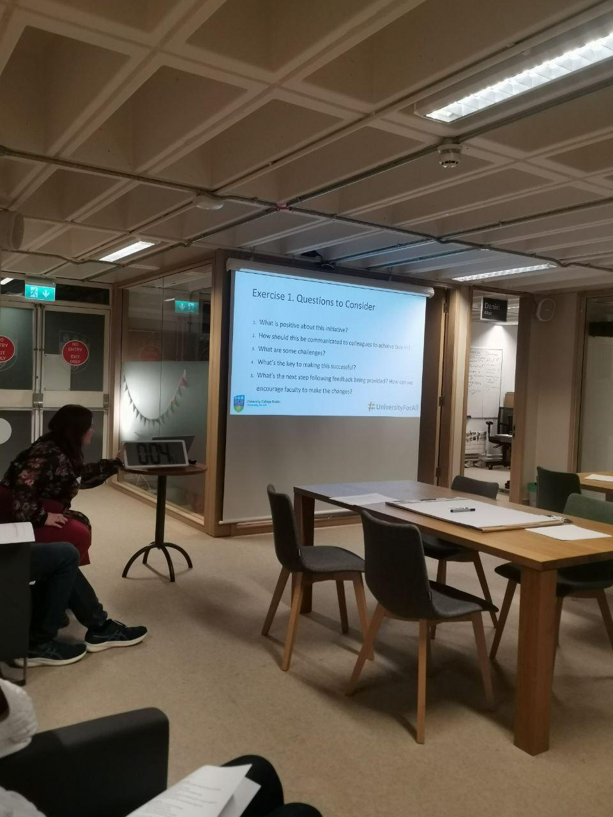
Next steps
Short term:
Follow up meeting with faculty
Establishing timeline for implementation of changes
Long term:
Increasing the scope of the review and assessing more modules
Creating general accessibility guidelines

Slide 7
Thank you

