Slide 1
Making UD Fun: Organising UCD's Incluza-Palooza
By Amaliia Shmyhovska, Blessed Fonkoh, Matthew Collins Kearns, and Vaishnavi Kannan

Slide 2
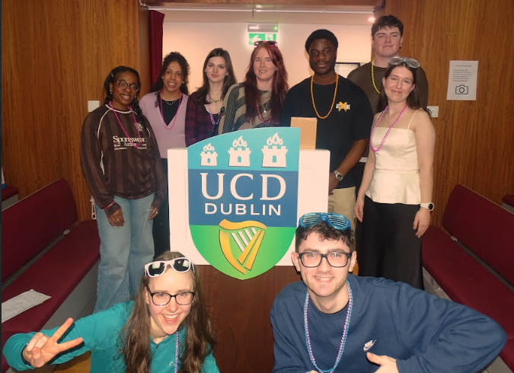
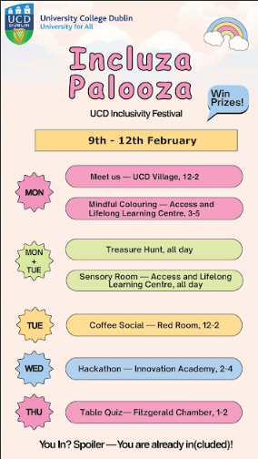
Introduction & Context
Who: UCD University for All Student Partners
What: Incluza-Palooza is a week-long event with fun, engaging, and inclusive activities
When: 9th-12th February 2026
Where: Across UCD Campus
Why: To make learning about Universal Design fun, engaging and accessible.

Slide 3
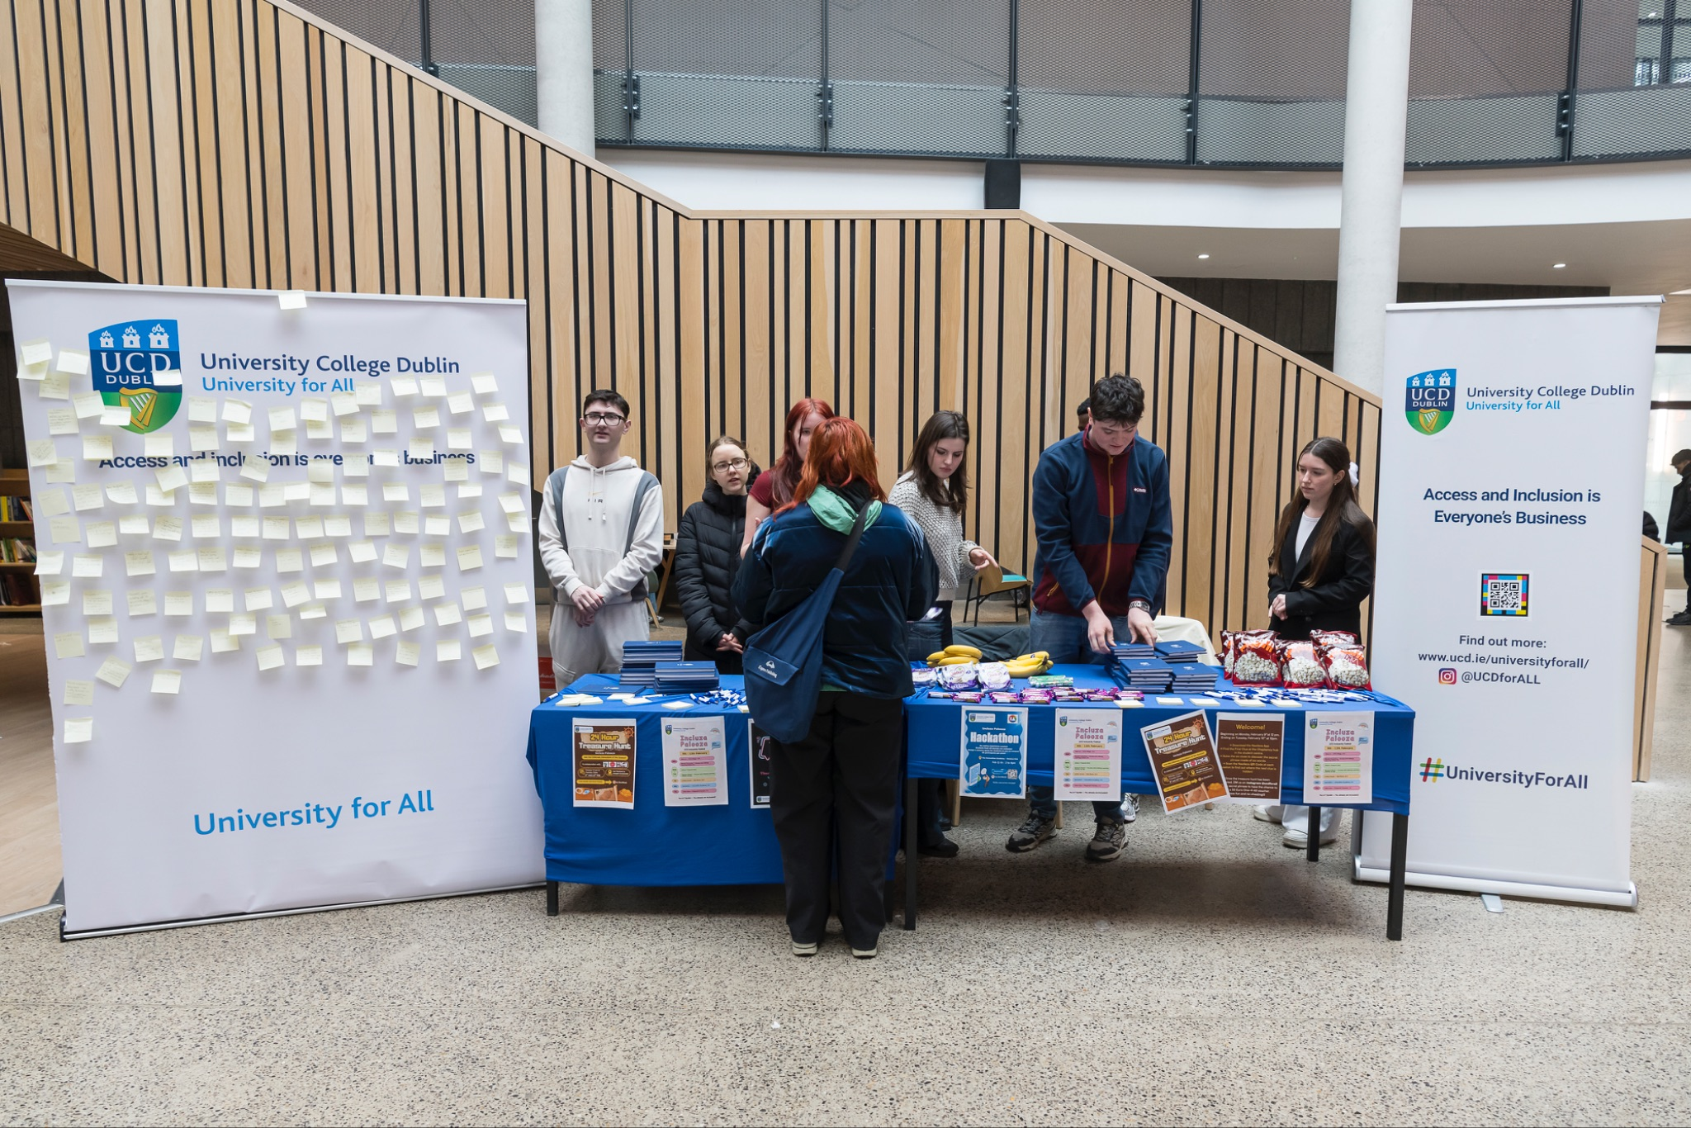
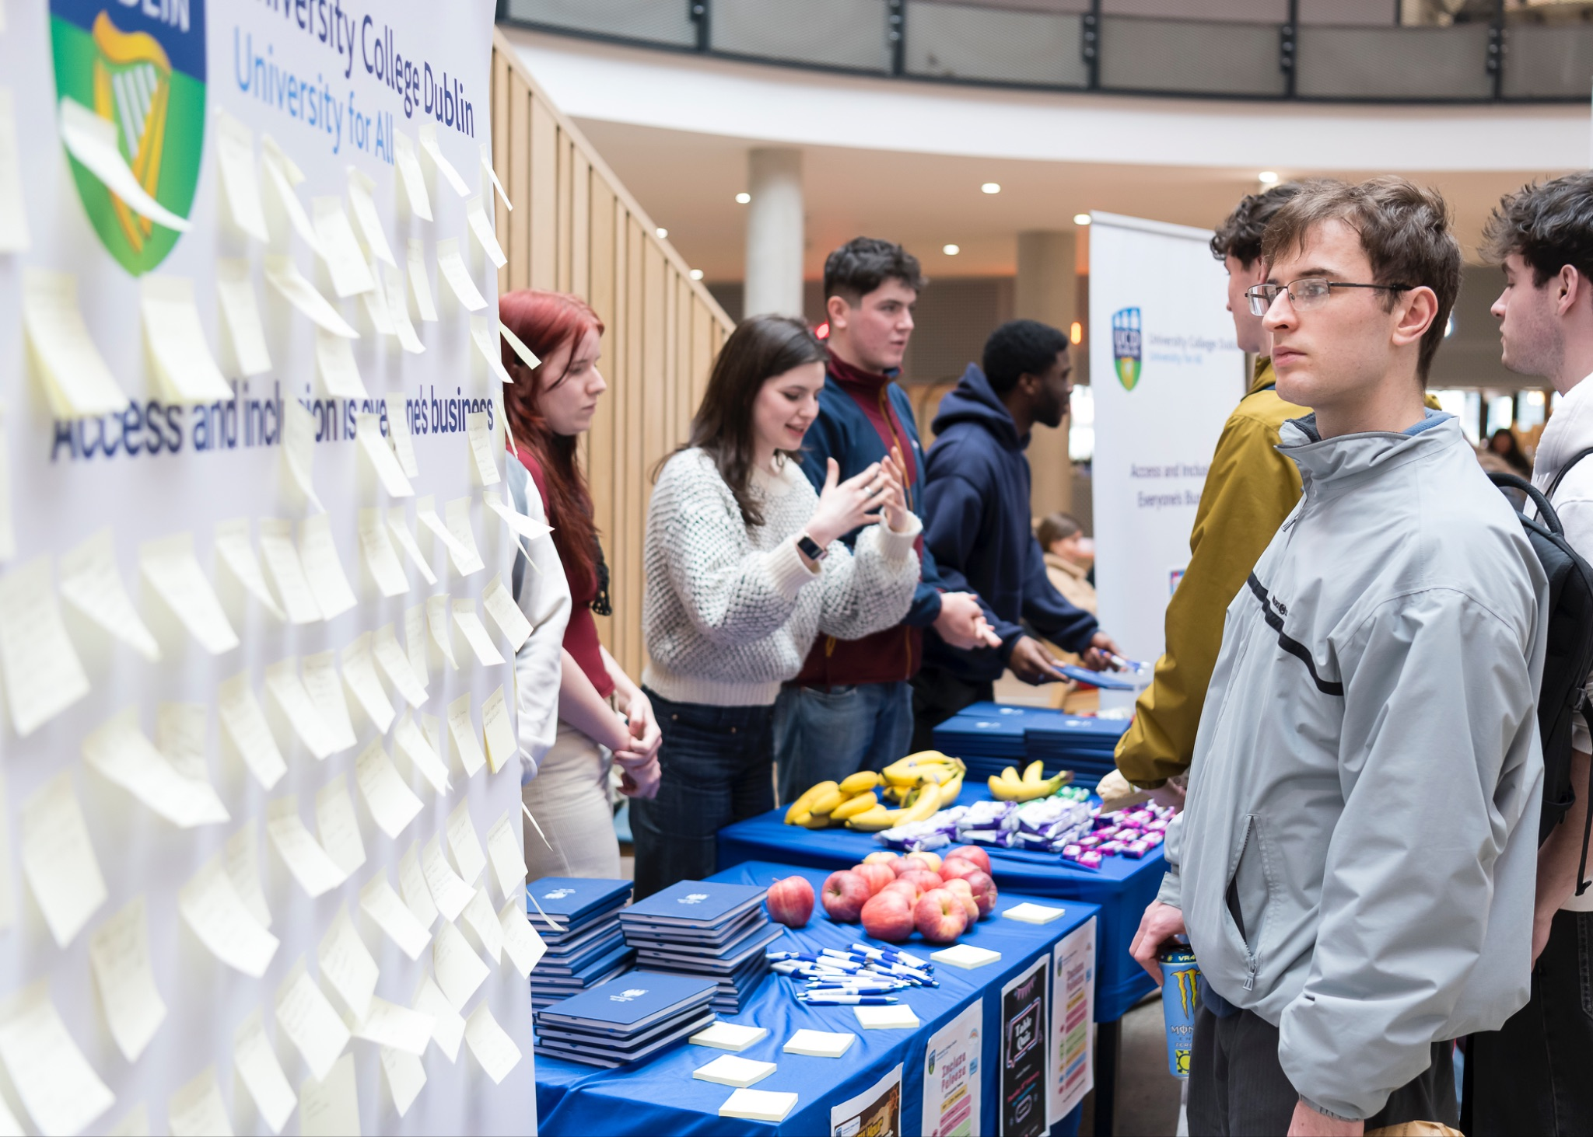
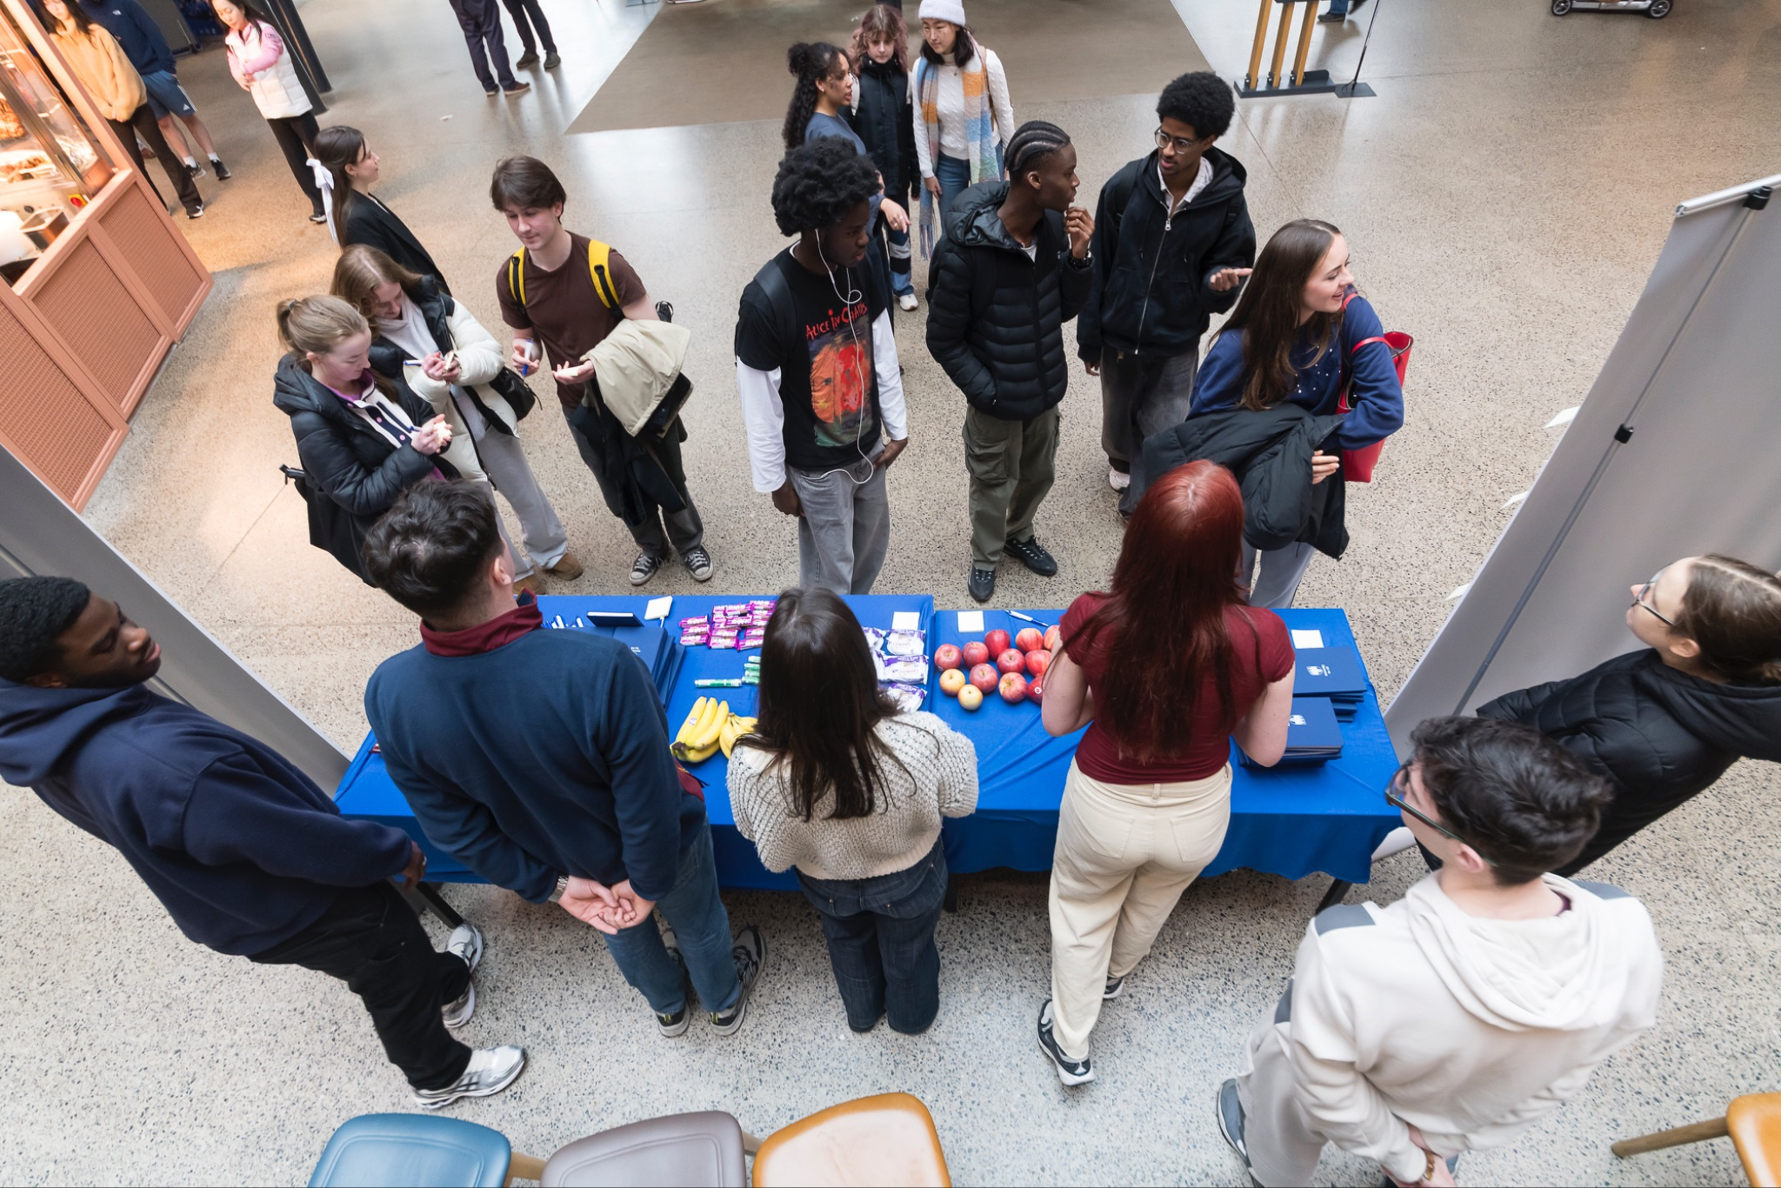
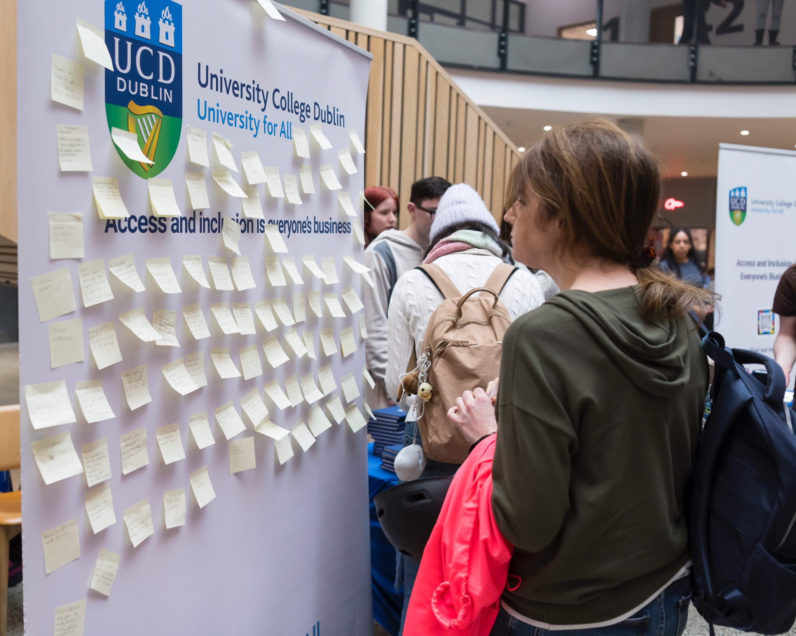
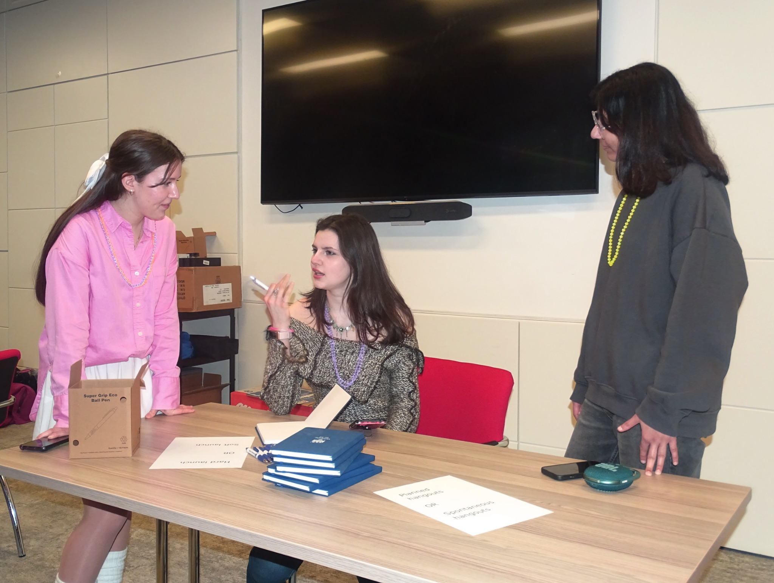
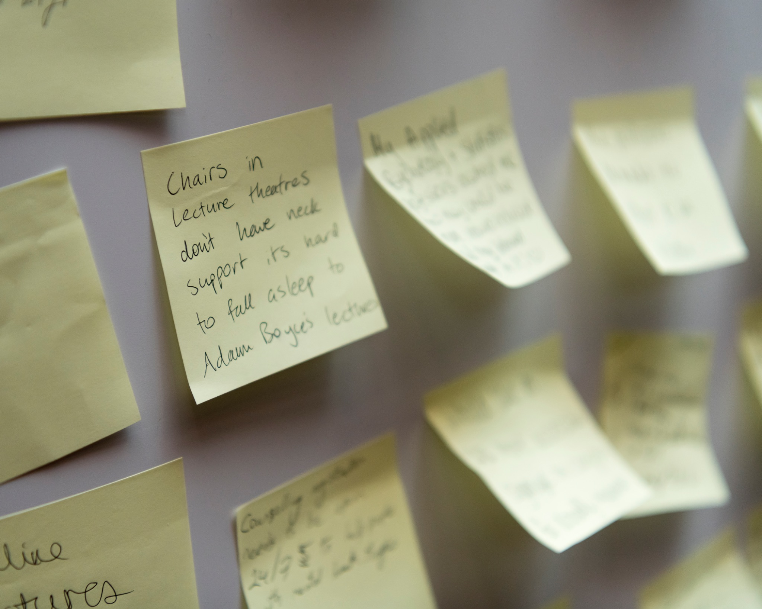
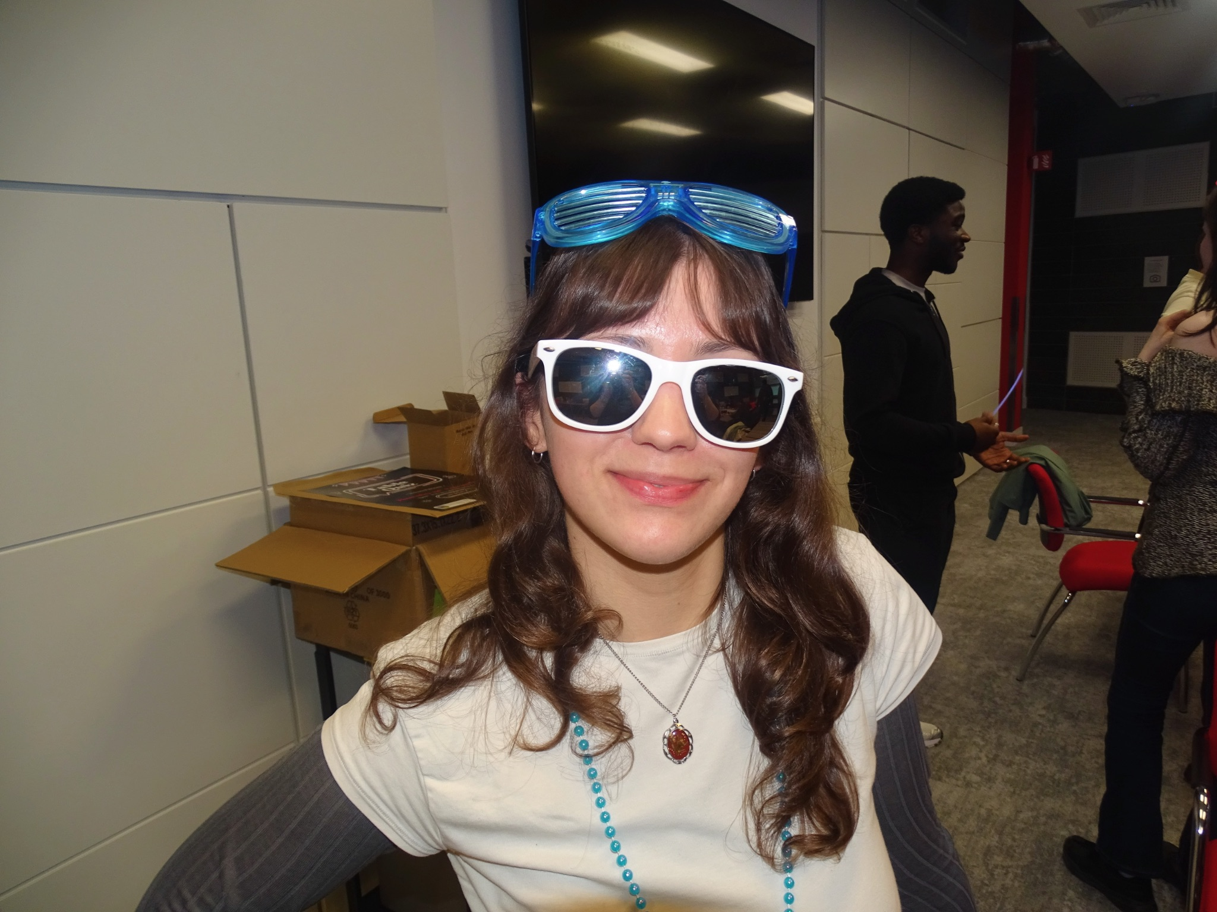
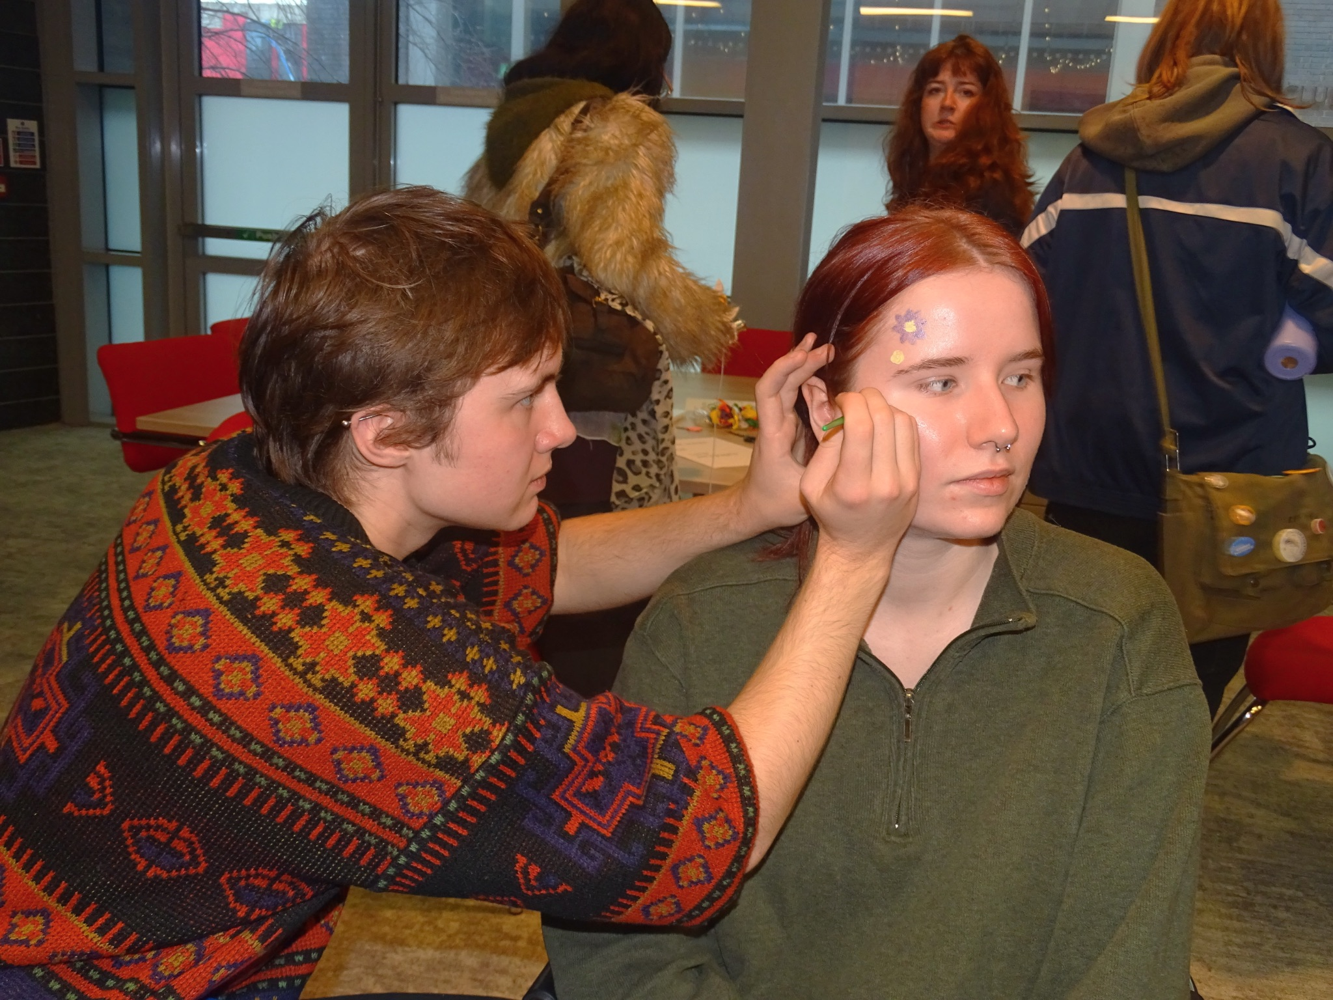
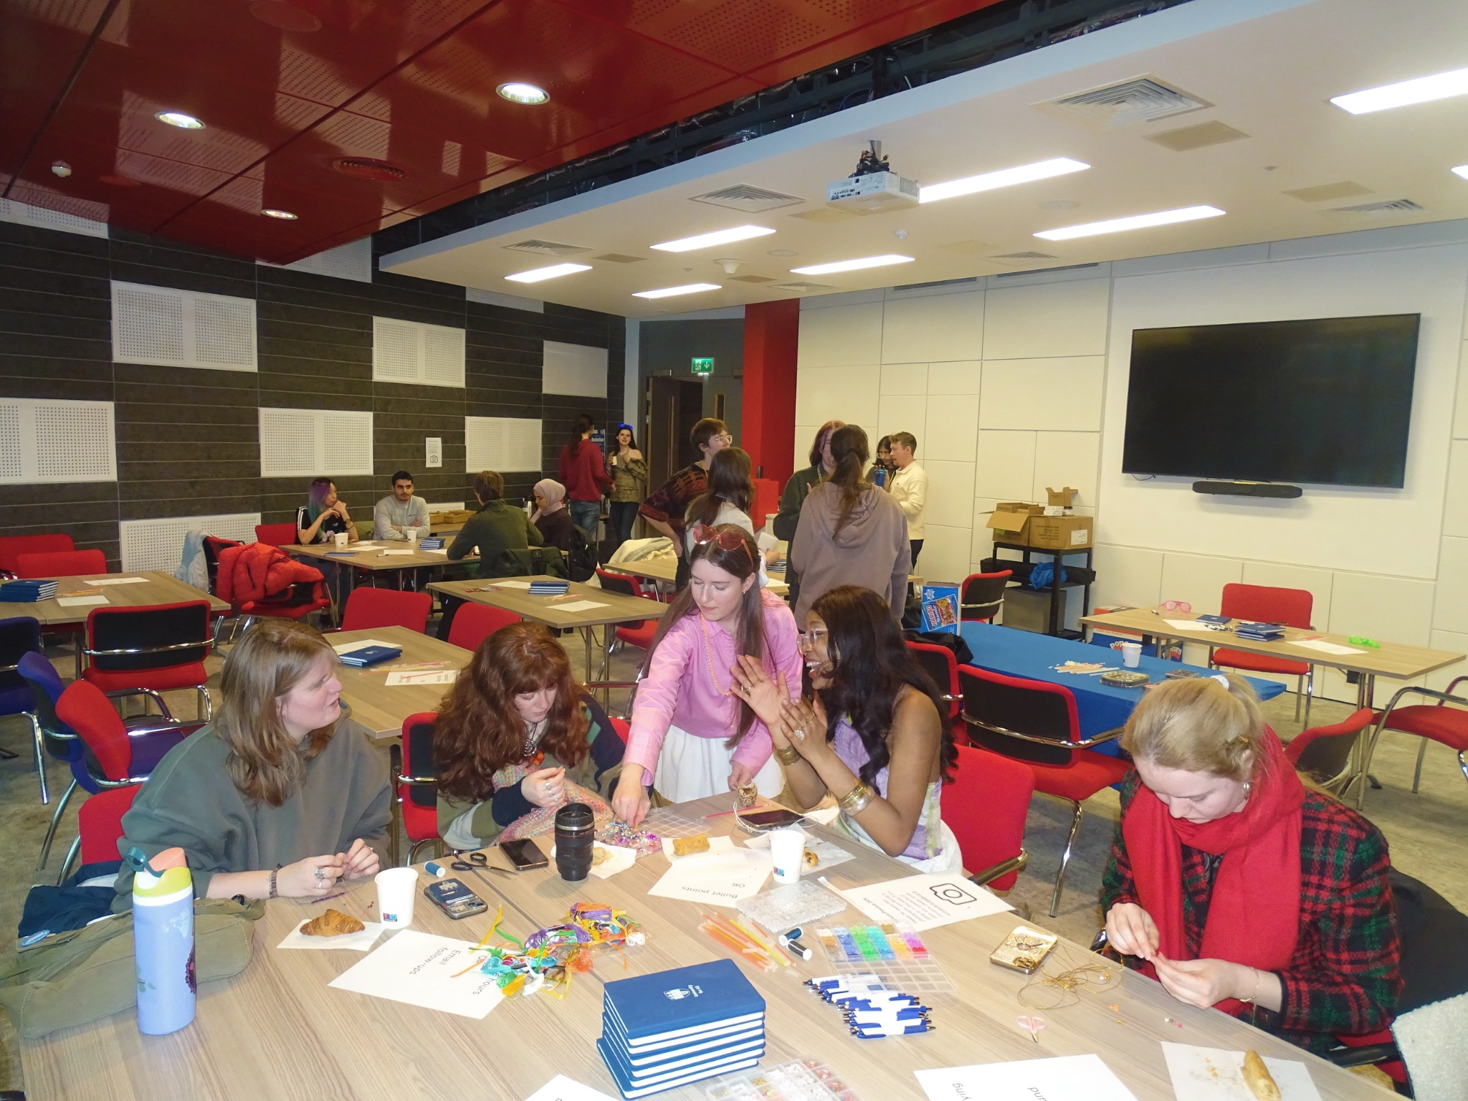
Student Partner Pop-Up & Coffee Friending
kickstarting incluza-palooza!
Student Partner Pop-Up
Meet the Student Partners! (SPs ) -> spread awareness about UCD for All
Share issues with inclusivity within courses
Promoting upcoming Incluza-Palooza events!
Coffee Friending
Socialise over coffee, tea and treats! Bond over face painting and making bracelets!
Promoting upcoming Incluza-Palooza events

Slide 4
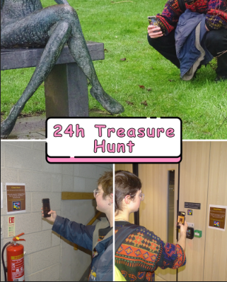
NaviLens Treasure Hunt
Treasure Hunt across the Sensory Spaces around campus
Solve clues at each location to uncover a phrase about Universal Design
Scan the NaviLens at each location to find the next clue.
Discover campus’ Sensory Spaces, learn how NaviLens works, have fun, win a prize!!

Slide 5
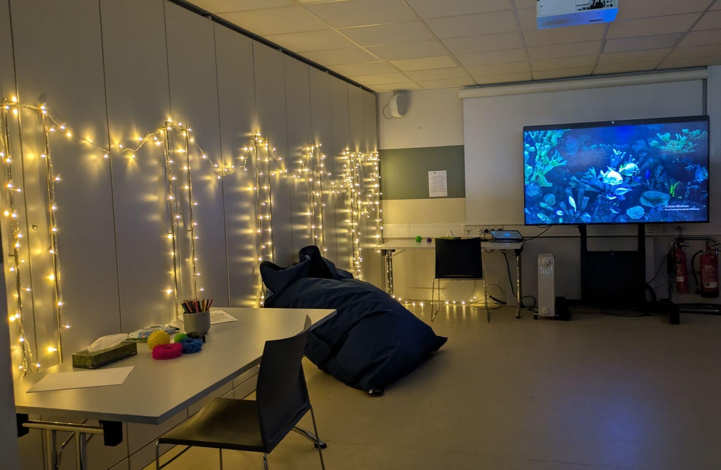
Sensory Space Pop-Up
Problem: limited no. of Sensory Spaces on campus.
Solution: Pop-Up, temporary Sensory Spaces.
  Allows more people to access Sensory Spaces.
  Trial Run of possible Sensory Space locations

Slide 6
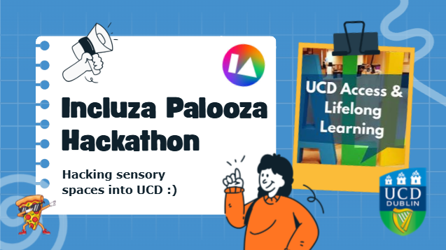
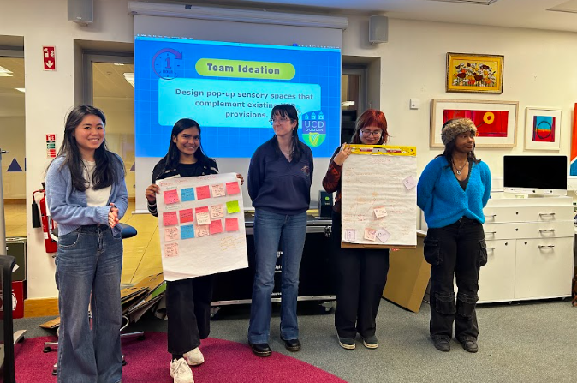
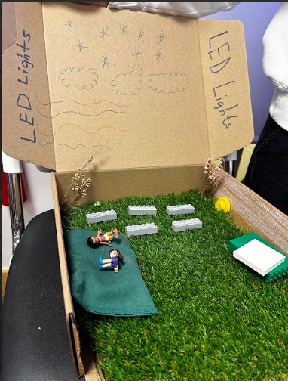
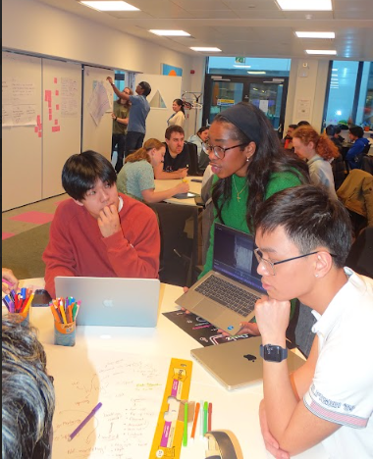
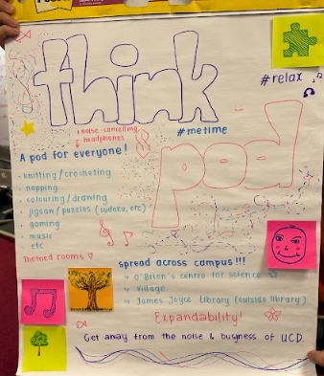
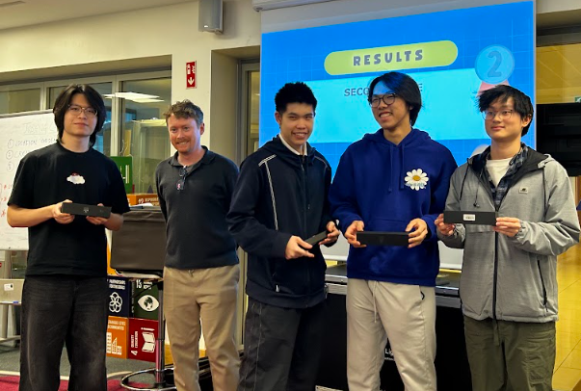
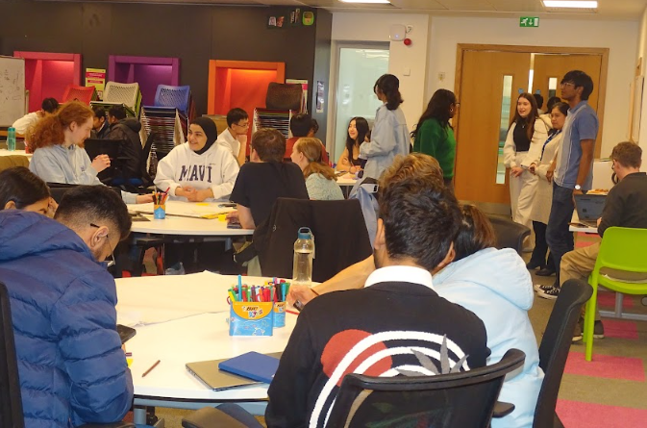
Universal Design Hackathon
taking inspiration from the sensory space pop-up….
Students were challenged to “Design pop-up sensory spaces that complement existing UCD provisions.”
Within their teams they had 2 hours to brainstorm, choose a viable pop-up location, create a prototype of its facilities and pitch their creations to our panel of judges.
The winning idea will be implemented with the help of the students involved!

Slide 7
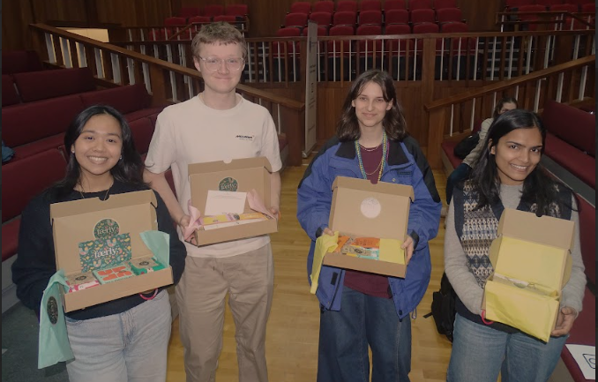
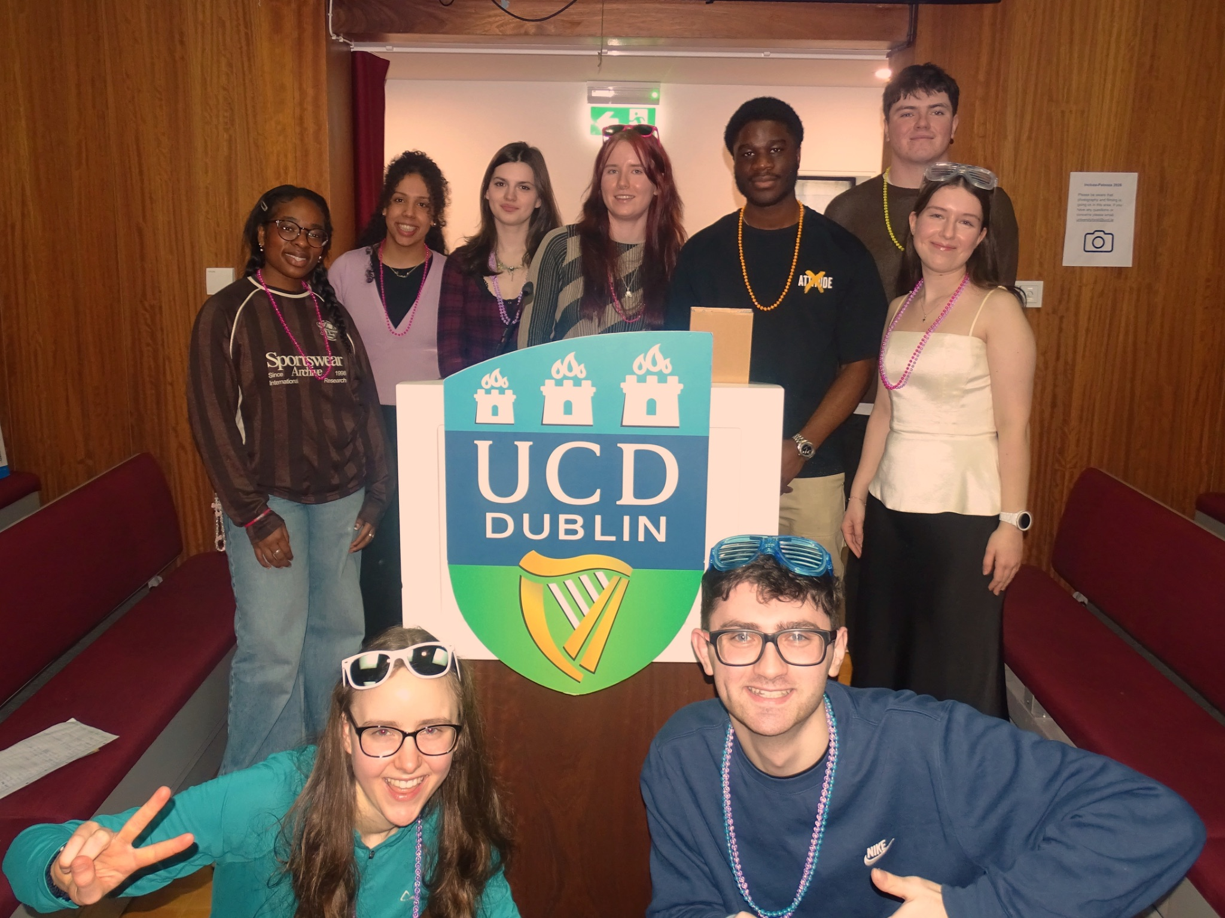
Inclusive Table Quiz
Fun Quiz using PollEV
Covering topics associated with accessibility and inclusivity
Lots of Participation and Music
Everyone Won Prizes!!

Slide 8
Conclusion
Did We Achieve Our Goal?:
Yes!
-> Spread awareness about UCD for All, and the UDL ✅
-> Did this through fun, engaging and inclusive activities ✅
-> Spread awareness about campus Sensory Spaces and the current challenges we face ✅
How Could We Improve?:
-> Further collaboration with societies (sports clubs) and other student initiatives
-> More offline promotion
-> Opportunities to engage with staff & faculty

