Slide 1

I-TeachLab:
Integrating Universal Design for Learning Across Teaching, Assessment and Space
Sanne Balendonck
Elke Emmers
Ruth Stevens
UHasselt
19 March 2026
sanne.balendonck@uhasselt.be
Notes:
https://docs.google.com/document/d/14GOWAstjVHuwjG7JAo5UwD7M-HRM3Tu5/edit
Pillars in Practice: UD application in one or more of the four pillars of ALTITUDE referenced above
Short Presentation (15 min)

Slide 2
Introducing the project
“If we create a learning context that enables every (young) person to unlock their potential – just imagine the kind of society we would live in.”
— Rosan Bosch
This is the dream that the I-TeachLab project wants to support — a learning environment that grows with people.
Notes:
Last May, Rosan Bosch visited UHasselt because she received a honorary doctorate for the inspiring work she is doing in the context of school environments. These words by Rosan capture our ambition. It’s not just about redesigning a classroom. It’s about creating the conditions in which every student—regardless of background, learning style, or talent—can truly thrive.
I personally am very inspired by Rosan Bosch as an Interior Architect and researcher in the educational field. I would like you to present the I-TeachLab project.

Slide 3



The three core pillars of the project
Inclusive
Evaluation
University-wide self-reflection tool for inclusive assessment
UpLift
professionalization
Professional development programme on inclusive pedagogy and spatial awareness
Architectural
Awakening
Increasing architectural awareness of the influence of spatial elements on well-being and learning
Notes:
The I-TeachLab project demonstrates how UDL can be translated into actionable frameworks across teaching, assessment, and spatial practice.
Through three interconnected strands;
UpLift: a professional development programme on inclusive pedagogy and spatial awareness;
InScape: an university-wide self-reflection tool for inclusive assessment;
Architectural Awakening: The Teacher’s Rider workshop on spatial literacy and agency—the project builds capacity among educators to choose, design and equip more equitable learning environments.
Evidence from surveys, interviews, and classroom observations informed the design of these interventions, which integrate UDL with theories of spatial competence and wellbeing. Initial findings highlight how educators’ awareness of physical and social learning spaces strengthens inclusive teaching and student wellbeing. The project bridges pedagogical, architectural, and policy domains to support lasting systemic change.

Slide 4
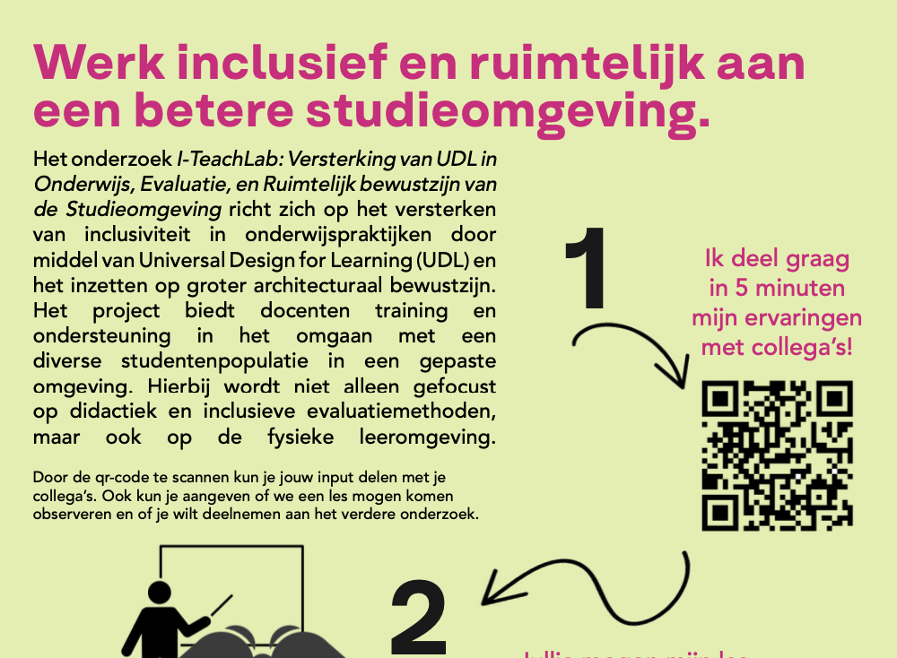
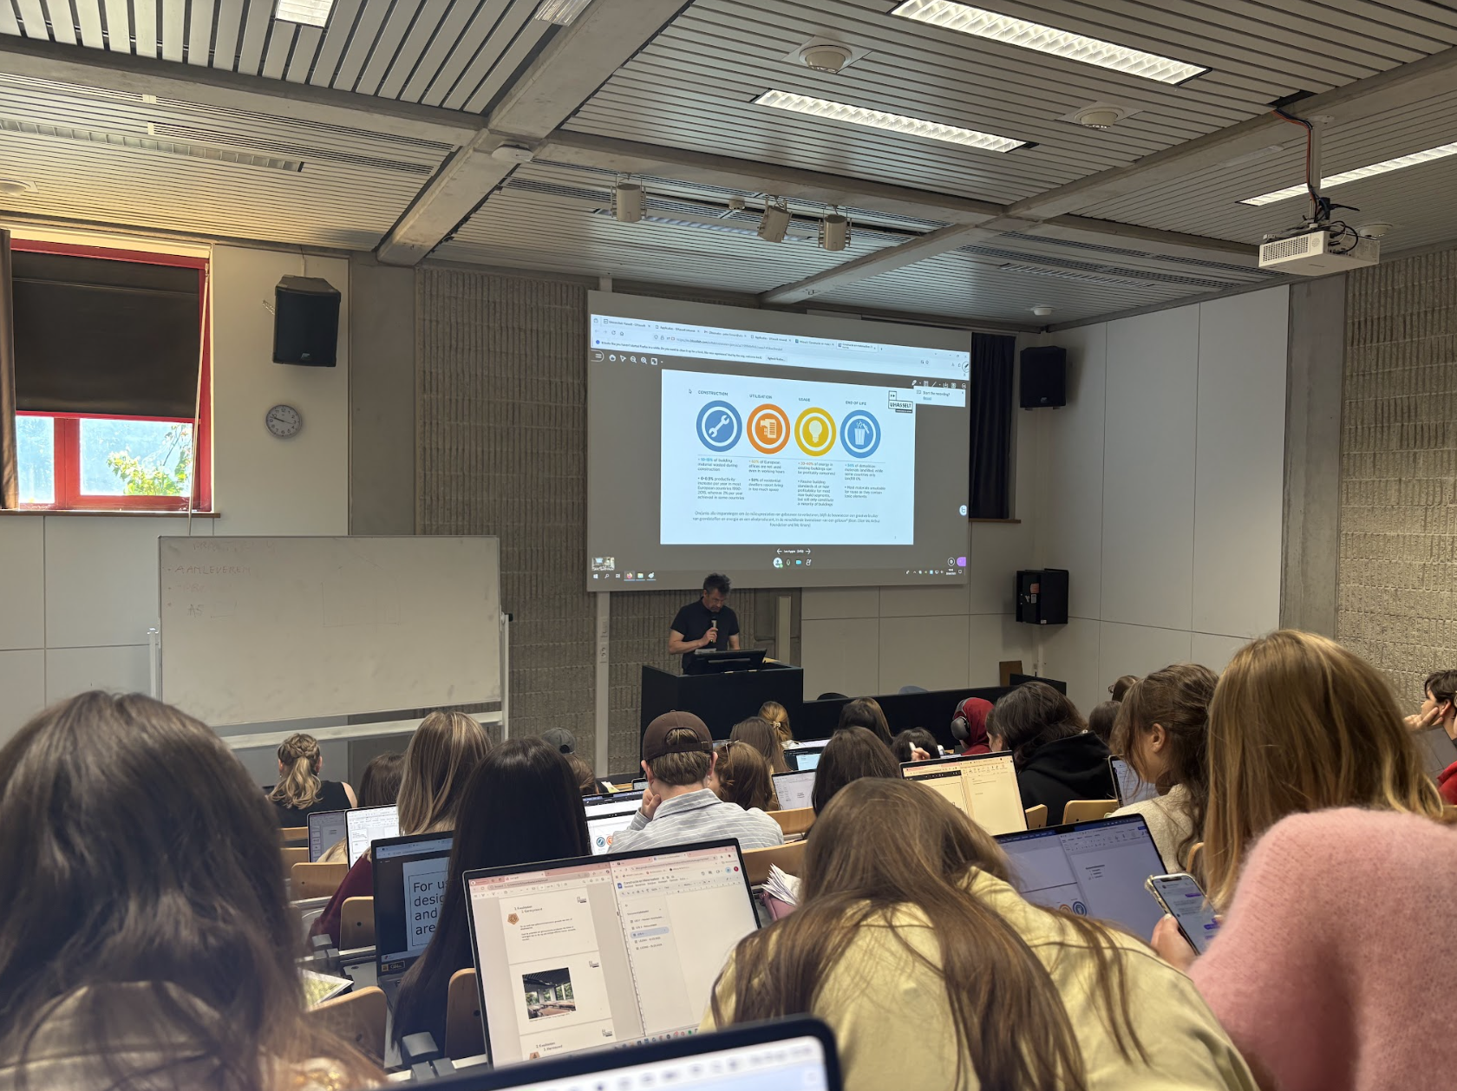
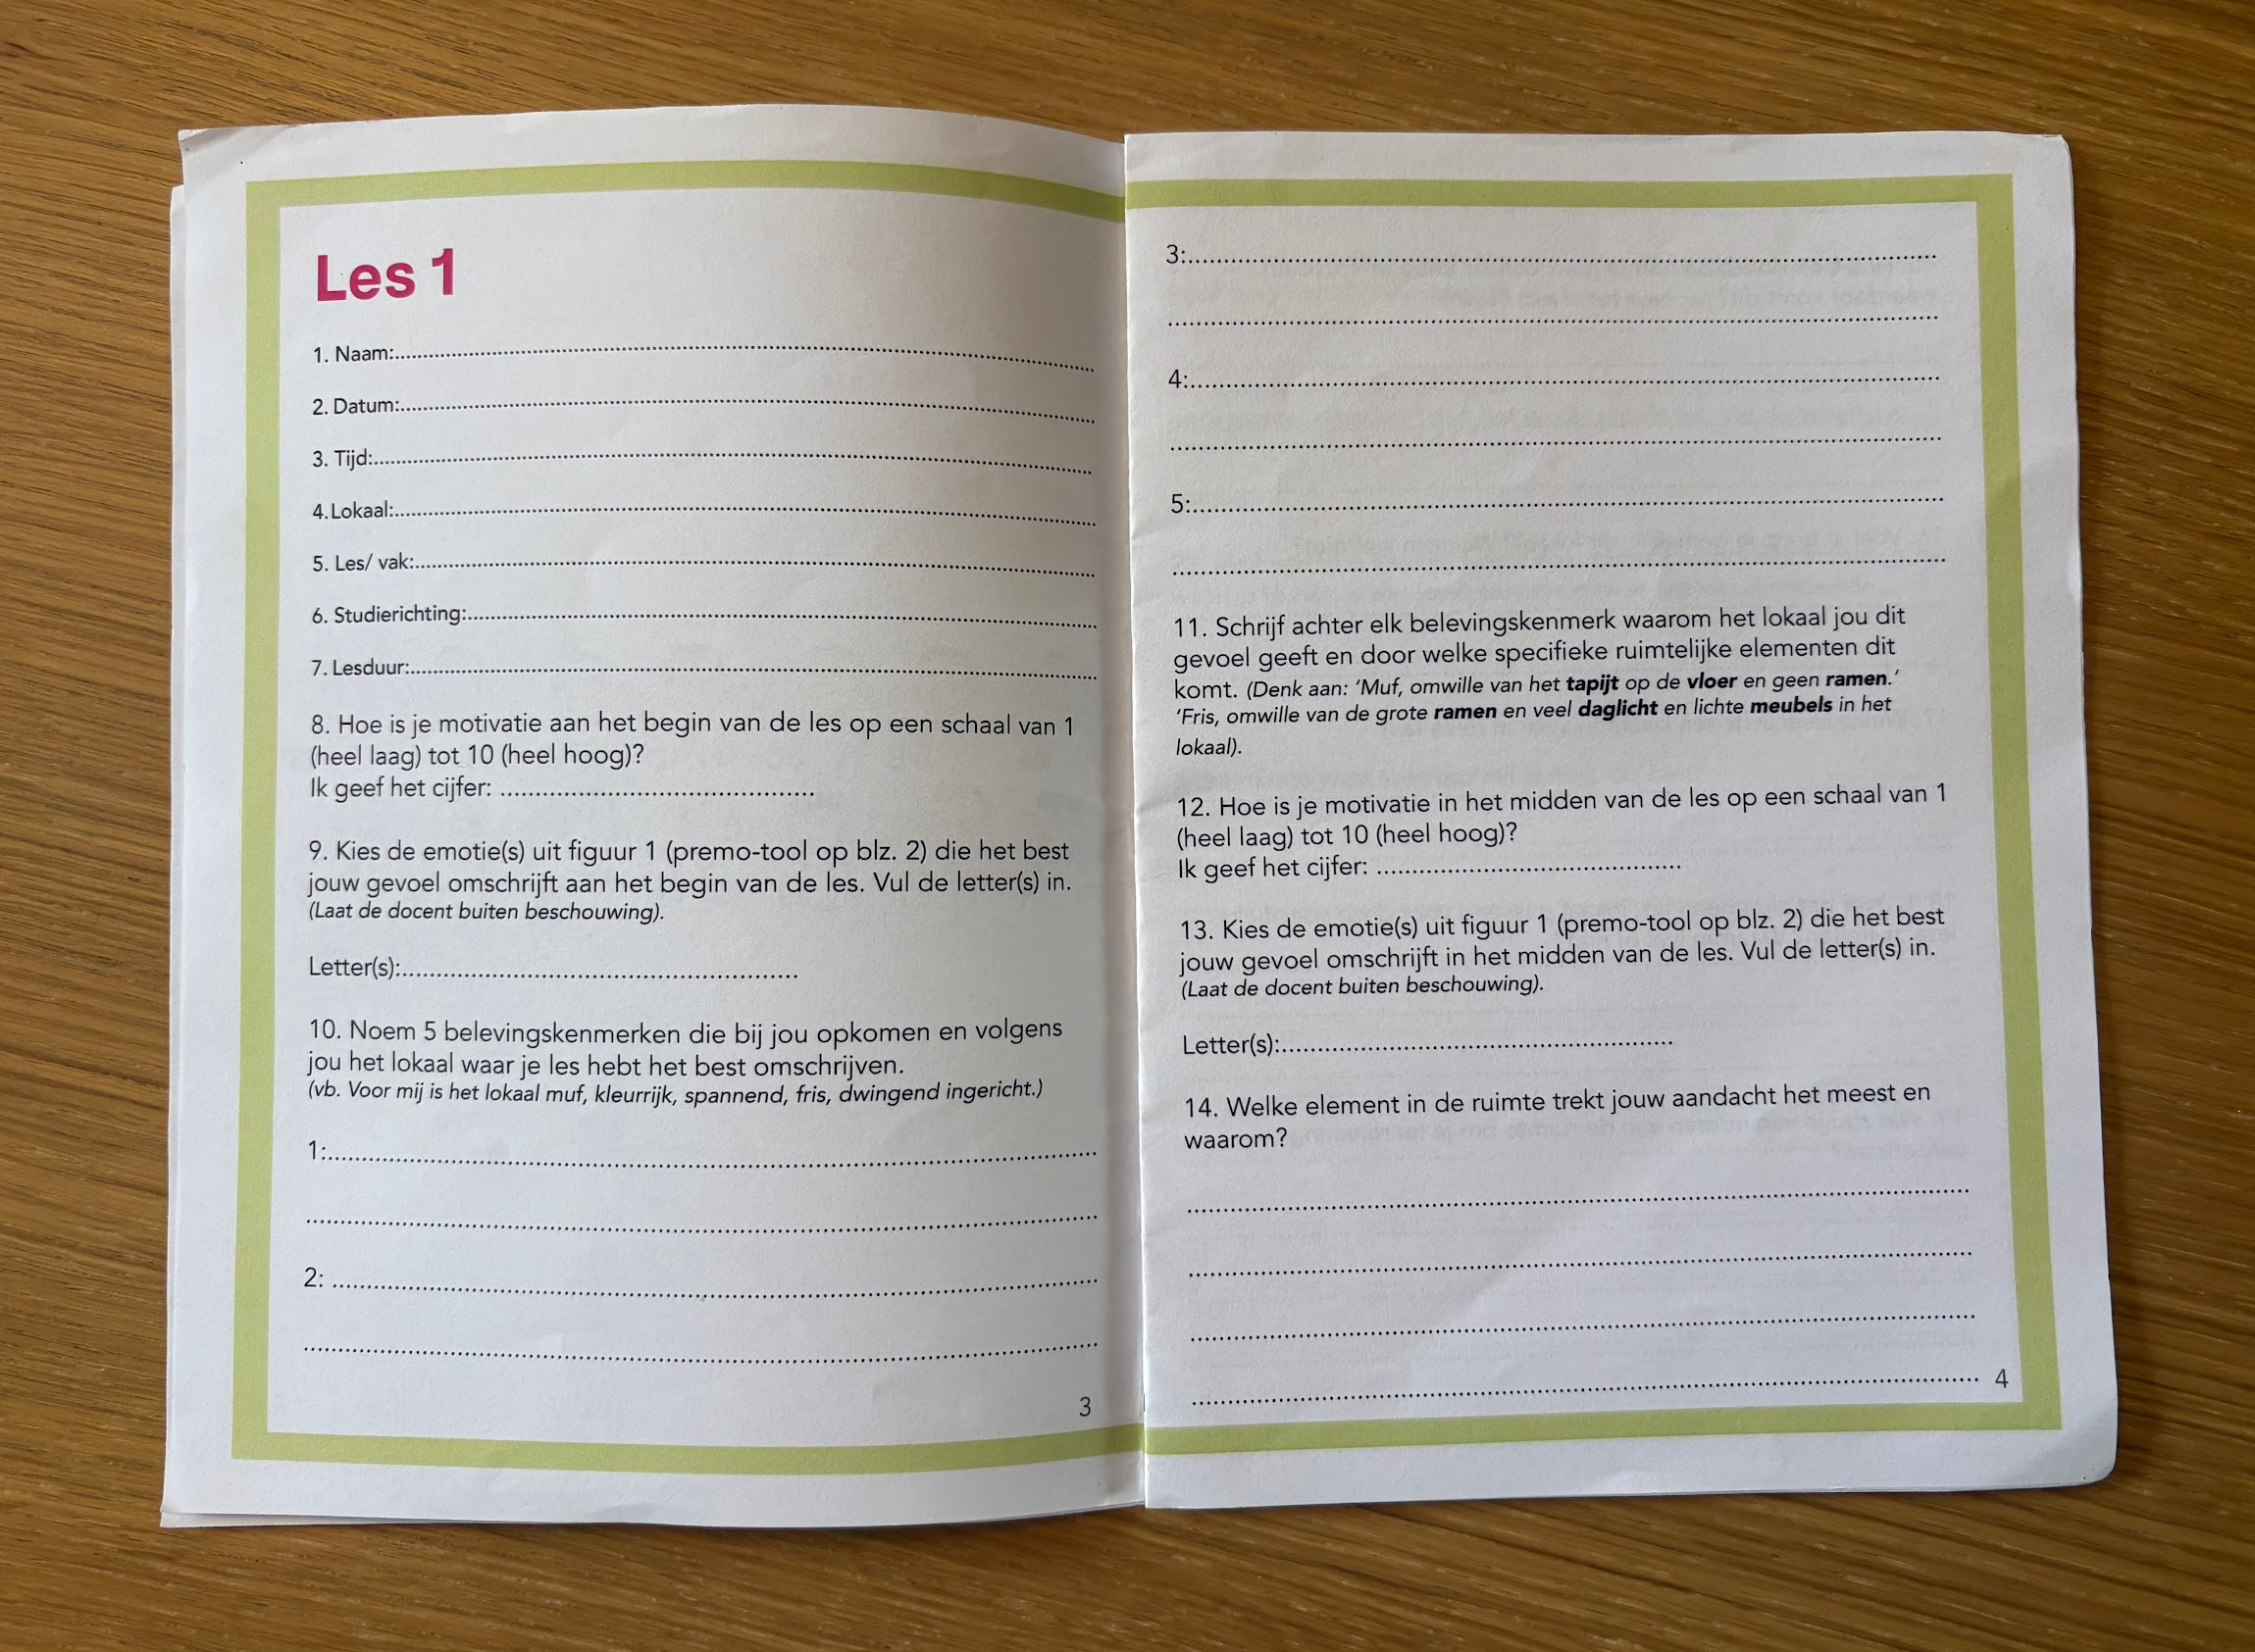
Data collection
Questionnaire &
Interview
Class observations
Diary methode
Image 1: Flyer Questionnaire
Image 2: Observation
Image 3: Dairy
Source: Created by the author (2025)
Notes:
The I-TeachLab is an innovative educational research project where the research of Ruth Stevens, on how spatial characteristics of learning environments reciprocally influence pedagogy and the research of Elke Emmers on UDL in learning environments are coming together.
The development of the workshops and tools was grounded in a mixed-method research design that mapped the initial competences of UHasselt lecturers in terms of spatial literacy, spatial agency, and spatial competence. Newly developed instruments were used to establish a robust baseline for further development and validation.
This baseline was informed by a combination of questionnaires and in-depth interviews, which together provided rich insights into lecturers’ awareness, attitudes, and practices related to the use of physical learning environments.
In addition, we conducted systematic classroom observations using a dual lens. On the one hand, we documented objective spatial characteristics such as layout, furniture, and available facilities. On the other hand, we captured subjective experiences, including comfort, atmosphere, and perceived usability of the space. These data are currently being used to extend the existing UHasselt classroom inventory with affective and experiential spatial attributes.
To complement the lecturer perspective, we employed a diary method with students, who recorded their daily experiences across different faculties and learning spaces. This approach generated unique insights into the everyday impact of learning environments on student motivation, engagement, and well-being, and directly informed the design of both the workshops and the developed tools.

Slide 5


Inclusive evaluation
InScape self-assessment tool
personal reflection and feedback
Built on I-TPACK, Universal Design for Learning (UDL) and insights into the Physical learning environment
Reflection across four domains: instructional design, social inclusion, learning environment and assessment
→ Ready to launch
Image 4: InScape tool
Source: Created by the author (2025)
Notes:
InScape is a self-scan developed to support lecturers in reflecting on inclusive didactics and evaluation practices across the university. Rather than functioning as an evaluative instrument, it is designed as a low-threshold professionalisation tool that encourages dialogue and critical reflection.
The scan is theoretically grounded in three pillars: the I-TPACK model, the nine guidelines of Universal Design for Learning, and research-based insights into the role of the physical learning environment. Together, these frameworks allow lecturers to reflect on inclusion from a holistic perspective.
InScape invites reflection across four dimensions: inclusive instructional design, social inclusion and classroom climate, digital and physical accessibility of the learning environment, and inclusive assessment practices. Each item is scored on a 0–3 scale and includes space for personal reflection and feedback, allowing the tool to function not only as a self-scan but also as a validation instrument that can evolve through dialogue with lecturers.
The development was informed by questionnaires, interviews, and classroom observations with lecturers, generating rich contextual data and best practices around UDL and learning environments. The tool is now complete and ready to be launched online.

Slide 6
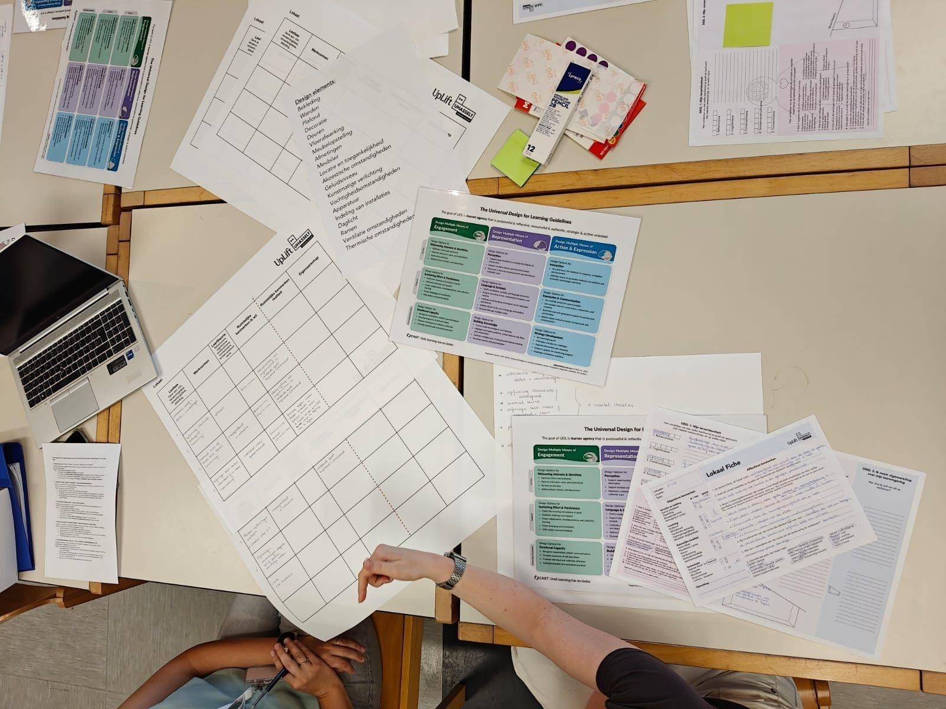
UpLift
Reflect, design, experiment
Connecting teaching style with teaching space
Image 5: UpLift workshop
Source: Created by the author (2025)
Notes:
We organize workshops under the general heading ‘UpLift’. UHasselt educators have the opportunity to learn about inclusive teaching, and engage in hands-on activities to analyze learning spaces and their own lesson design. They are invited to reflect critically on which classroom would best support a lesson they have designed. They consider not only how they want to teach, but also what kind of space aligns with that vision—and what they, as educators, can do to adapt the space accordingly. Depending on the demand and needs, we put together a package of exercises and tools specifically designed for the asking faculty. We have training tools related to our topics, ranging from basic to advanced. If they're interested, they can contact us to learn more.

Slide 7
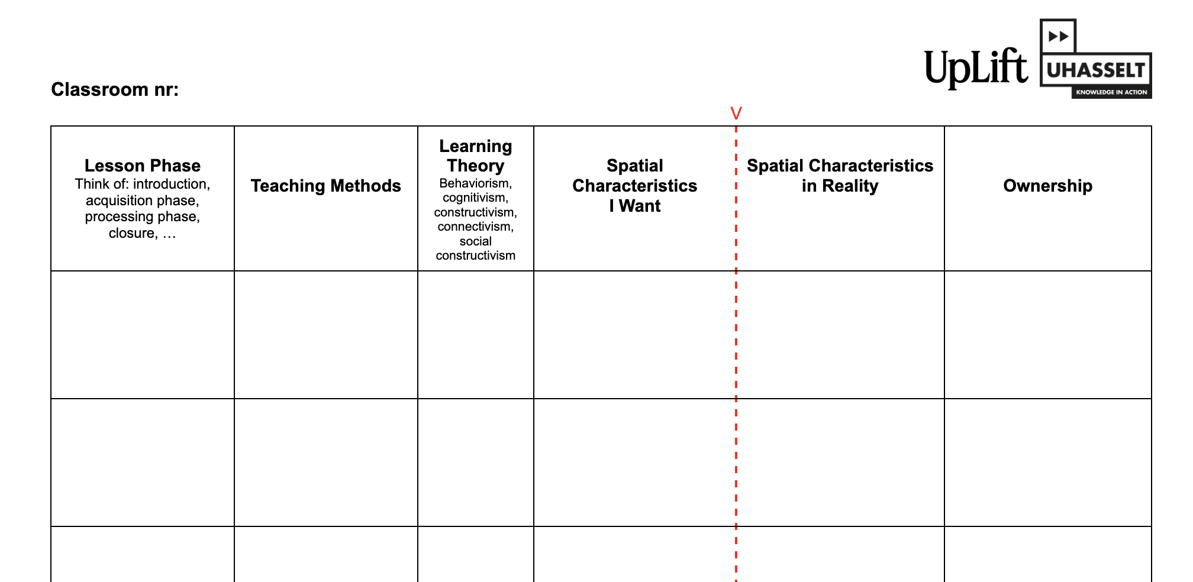
UpLift worksheet
The perfect match
Time-space organization
‘Which space strengthens your teaching?’
Figure 1: Worksheet - UpLift Workshop
Source: Created by the author (2025)
Notes:
We want to encourage teachers to strive for the perfect match between various elements: the choice of classroom, the duration of the lesson, and its structure. This includes deciding which teaching methods to use—whether it’s individual work with one-on-one guidance, or whether the real strength lies in peer learning in groups or pairs. We aim to make teachers more consciously aware of their time-space organization decisions and have a critical look at their own lesson design.
They begin to connect their personal teaching style with the spatial conditions they need. What kind of environment enhances their teaching? What could be done differently?
This brings me to the third core pillar of the project: Architectural Awakening

Slide 8
Architectural Awakening
Spatial literacy
Spatial agency
Spatial competence
Objectives
Affectives
Notes:
This work package focuses on strengthening architectural awareness in teaching practice by developing both spatial literacy and spatial agency among lecturers. Central to this pillar is the recognition that physical learning environments actively shape well-being, accessibility, and pedagogical choices, rather than merely serving as neutral backdrops.
We start from spatial literacy, understood as building a shared conceptual framework that helps lecturers recognise key spatial parameters and understand how these influence themselves, their students, and their teaching practices.
This awareness is then extended towards spatial agency: the willingness and capacity to appropriate space and to act upon it. Here, lecturers are encouraged to actively shape and adapt learning environments in response to pedagogical intentions and inclusive goals.
At a more advanced level, we speak of spatial competence, referring to a form of mastery in which lecturers strategically deploy spatial features to support learning objectives and make deliberate, informed design choices.
We assess both measurable factors (capacity, ventilation, daylight) and experiential qualities. ‘objectives’
We include sensory experience, stimulus sensitivity, and attention span. ‘Affectives’
Inspired by Pallasmaa’s seven senses.
We consider both the teacher’s and the student’s perspective.
Different users experience space differently.
Our strength lies in this holistic approach.
Under this pillar, we developed a dedicated workshop format — the Teacher’s Rider — which operationalises these concepts into a concrete, practice-oriented tool. I will introduce this workshop in more detail on the next slides.

Slide 9
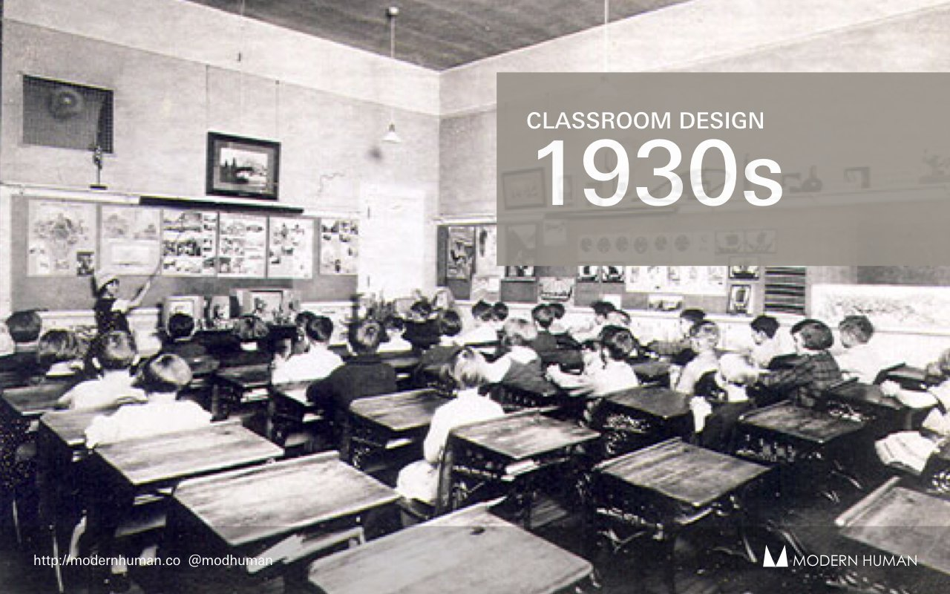
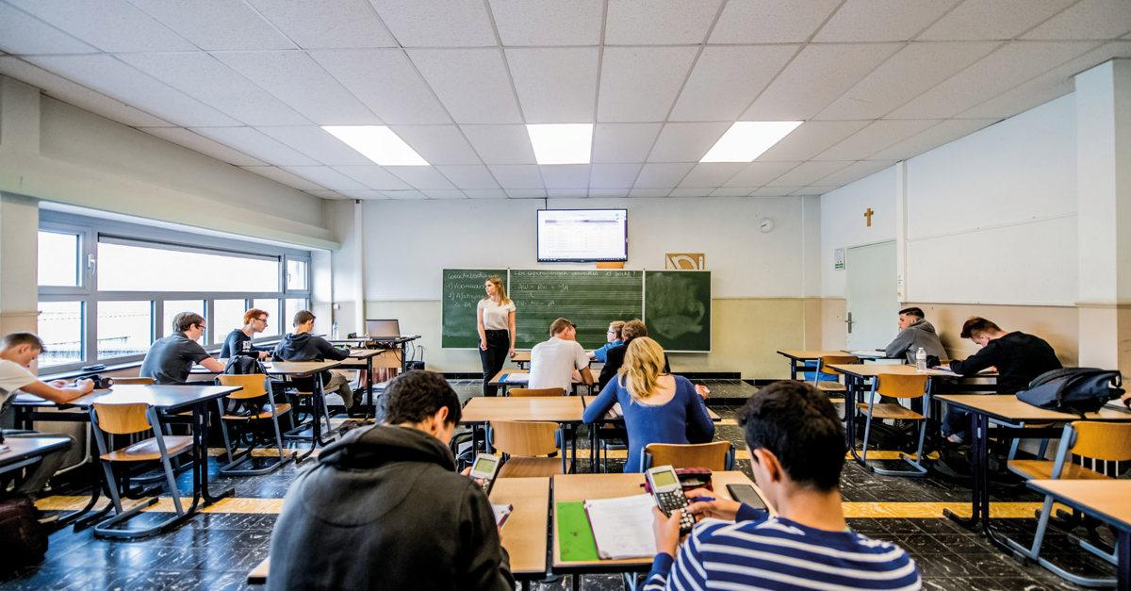
Classroom design
Notes:
Research shows that the physical learning environment has a significant impact on students’ performance, health, and well-being.
Barrett et al. (2015) identify three key dimensions of classroom design: physical comfort, individualisation, and stimulation.
Physical comfort includes light, acoustics, temperature, air quality, and connection to nature. Studies show that natural daylight, good ventilation, and appropriate thermal conditions improve concentration and cognitive performance.
Individualisation refers to ownership, flexibility, and connection. Classrooms that allow adaptation and personalisation foster a stronger sense of belonging and responsibility among students.
Stimulation relates to spatial complexity and colour. These elements influence emotions and attention, which in turn affect learning outcomes.
Research on green school environments shows that exposure to nature—through outdoor spaces or views of trees—improves academic performance, motivation, self-discipline, and overall well-being (Maxwell, 2025).
Despite this evidence, many classrooms have barely changed over the past 100 years. Learning spaces still prioritise efficiency over experience, while research clearly shows that both objective features (layout, light, acoustics, technology) and affective qualities (atmosphere, comfort, inclusivity) shape behaviour and learning.
.

Slide 10
This room
Notes:
I would like to do a little exercise. Maybe you will look different to a classroom in the future when you’re teaching and think about your time-space organisation.
Objective characteristics
Size and layout (number of seats, arrangement, circulation)
Furniture (movable or fixed)
Light, acoustics, ventilation
Technology (screen, projector, outlets)
Affective characteristics
First impression: this room feels …………………
Does it feel the same for teacher and student? Why?
Name 3–5 experiential qualities and their spatial causes
Are there distracting elements?
What would you change to improve learning?

Slide 11

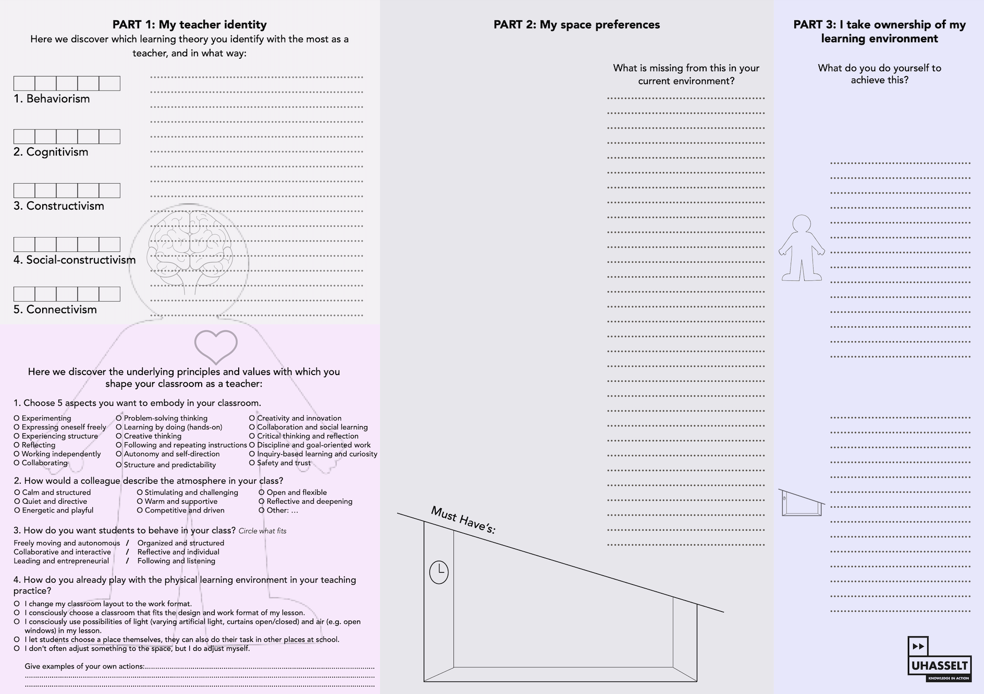
Example

Slide 12
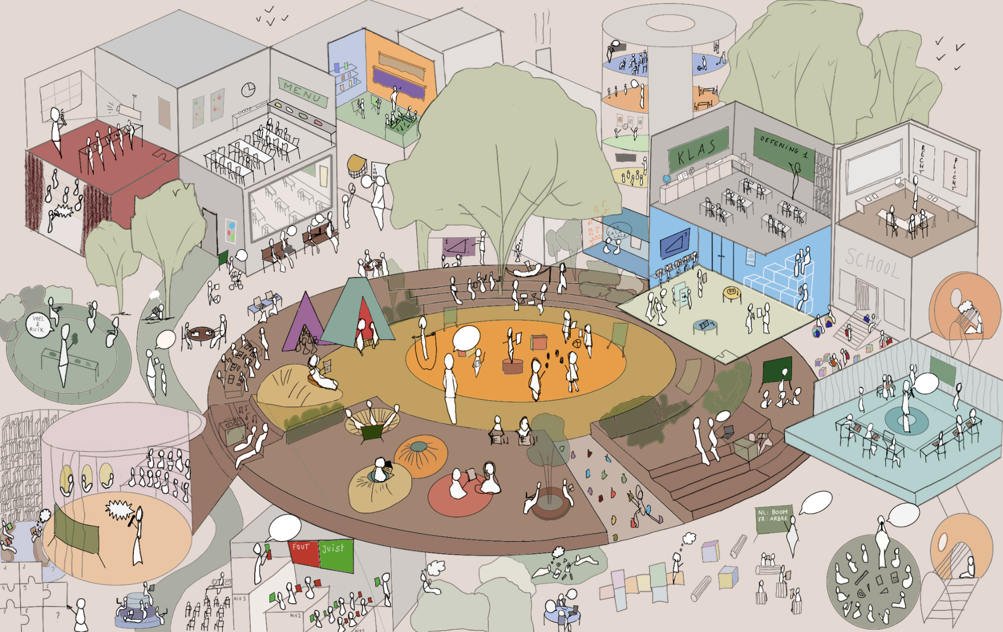
Teacher’s Rider
Figure 2: Poster - Utopian learning landscape
Source: Created by the author (2025)
Notes:
One of the tools we've developed is the 'Teacher’s Rider’. The rider is a workshop designed to reawaken and inspire architectural awareness among teachers. In this session, educators begin by exploring their own identity as teachers—how do I teach, and what values and principles do I want to uphold? We then invite them to engage with a utopian educational landscape and select their ideal setting, identifying which spatial elements resonate with them and why.
Next, we ask them to consider what they really need in order to ‘perform’ as educators—hence the name ‘Rider’, inspired by the performance industry: what do they require to deliver their best teaching experience? And equally important, where does their sense of ownership over the space begin?
Through this workshop, we aim to provoke deeper thinking about physical learning environments and, hopefully, inspire participants to take initiative in how they use and adapt their spaces—with the ultimate goal of improving the quality of their teaching.

Slide 13
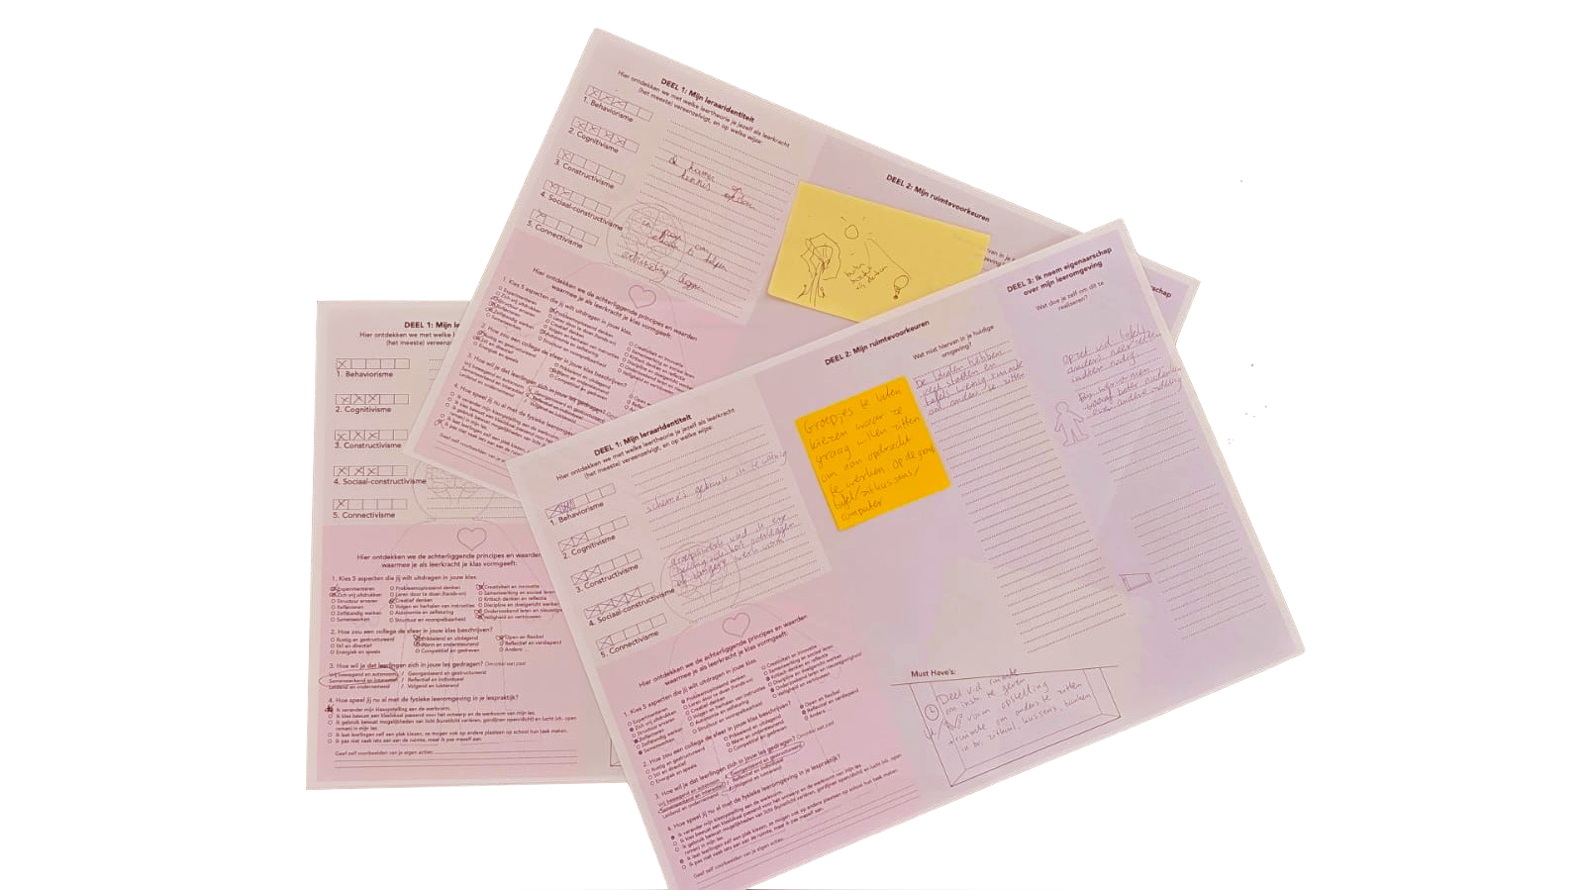
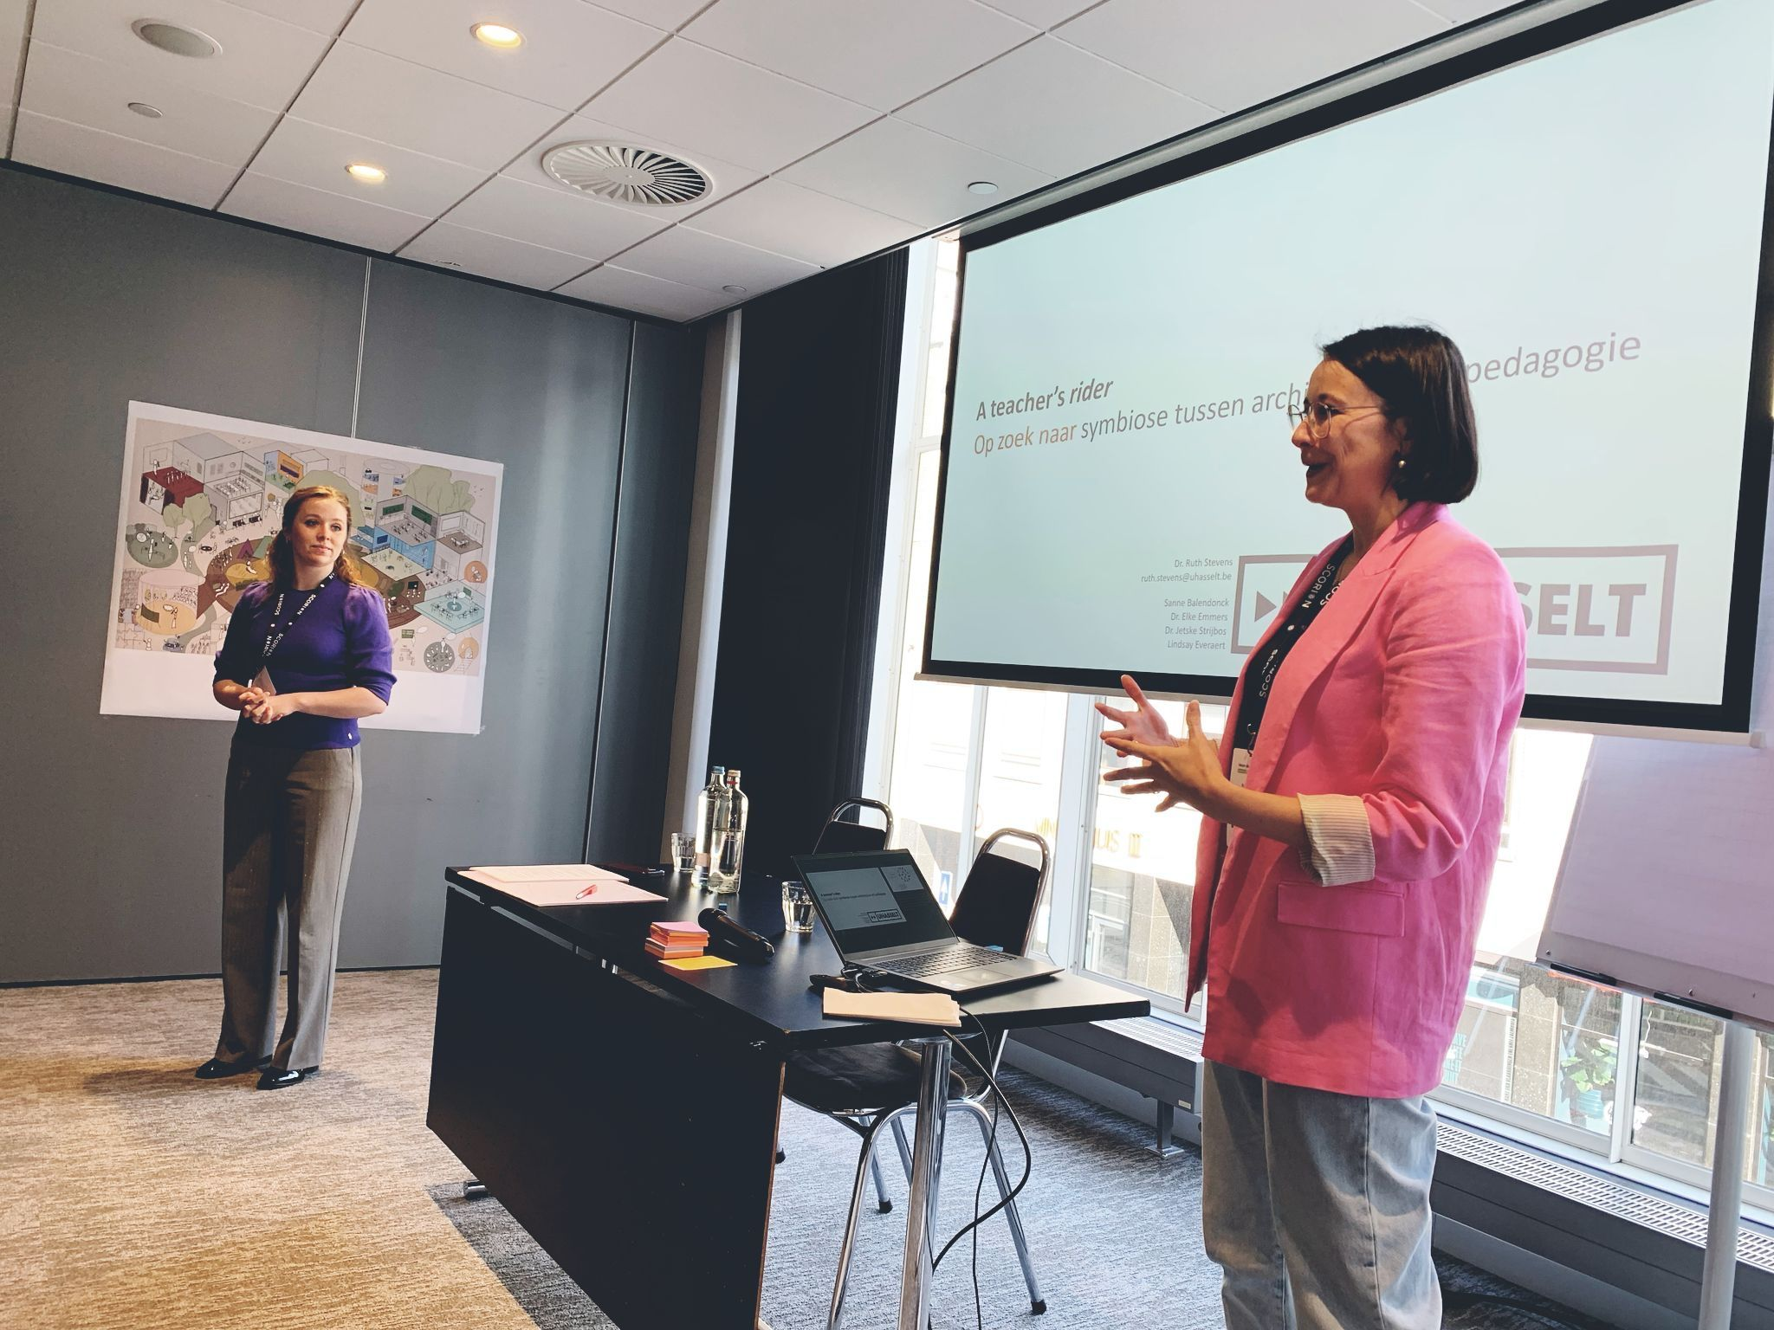
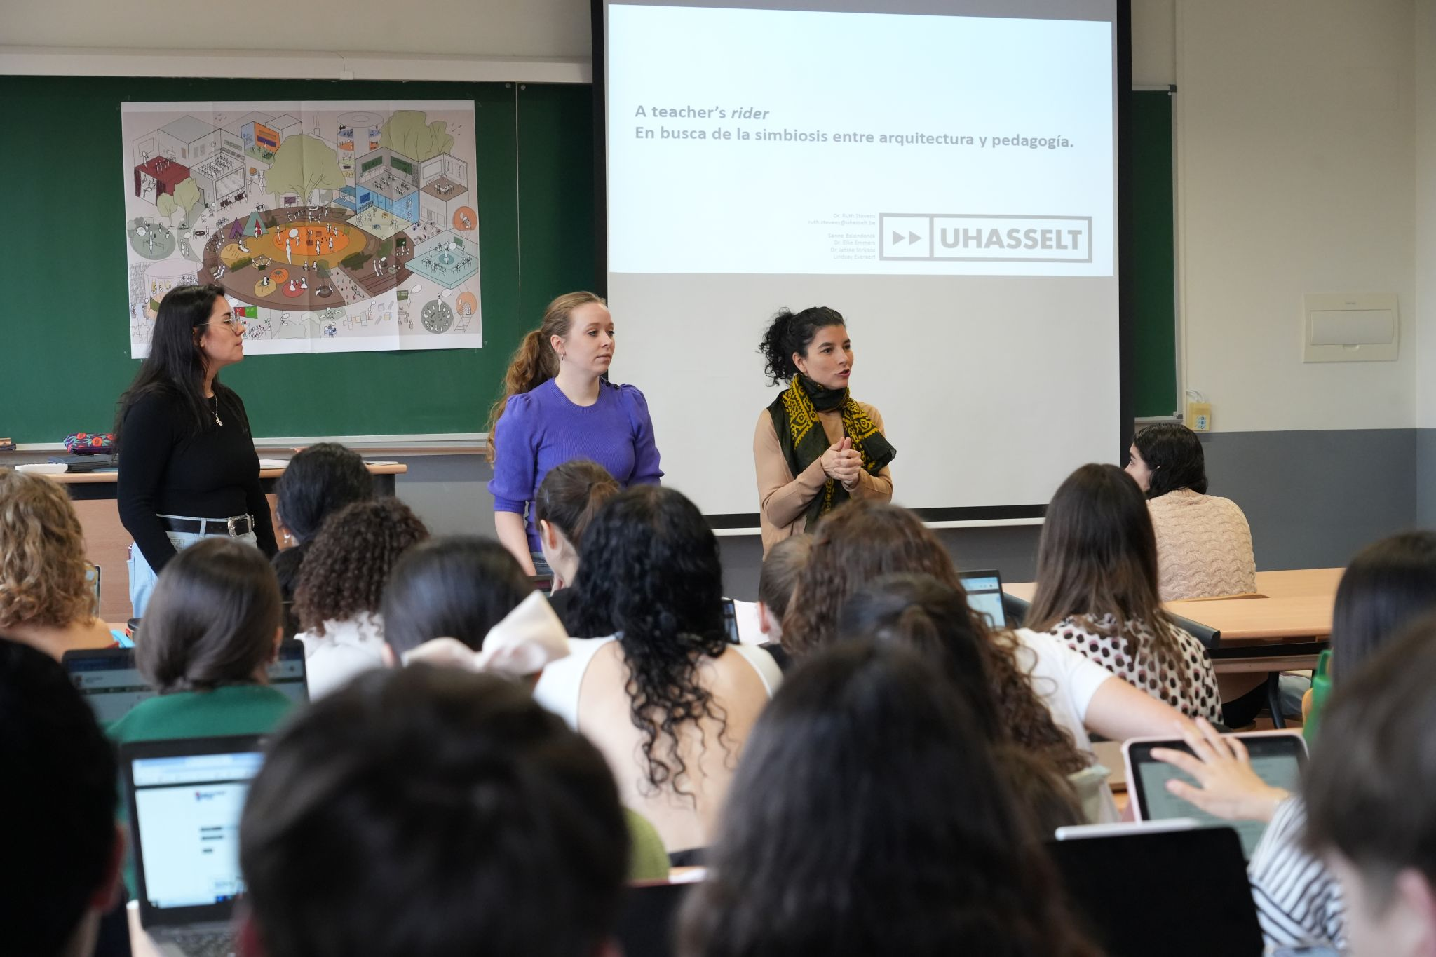
The Teacher’s Rider
Image 6: Workshop Velon - Velov 2025
Image 7: Workshop Faculty of Education Léon
Image 8: Filled in Riders
Source: Created by the author (2025)
The workshop has been incorporated into an A1 publication which is currently accepted for publication at IJAR-Archnet
Notes:
We delivered this workshop at the Velov-Velon conference last year in Rotterdam in the Netherlands, where it was very well received. Just a week later, we conducted the same workshop with pre-service teachers at the Faculty of Education in León, Spain, working with various groups. We strongly believe that a shift in mindset is needed—and that shift begins already in teacher training, with the educators of the future.
The feedback we received confirms it: there is a genuine need for this kind of awareness. The spark has been ignited.
Nice to mention: The workshop was tested in three national and international pilots and developed into an A1 publication, now accepted by Archnet-IJAR.

Slide 14
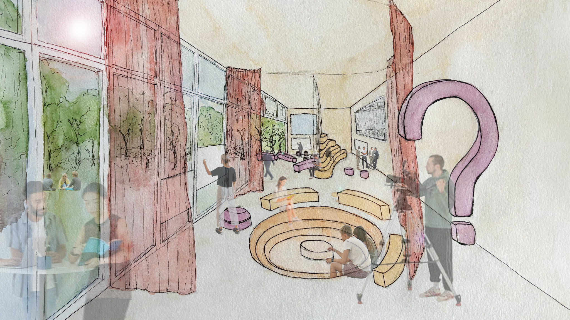
From research to space: the I-TeachLab
Figure 3: Sketch ITeachLab
Educators can use space as a tool
Source: Created by the author (2025)
Notes:
Our ultimate goal is to create a physical space where educators can experiment, practice, and reflect—the I-TeachLab; allowing teachers to test and refine their inclusive teaching approaches in a controlled yet dynamic setting.
A place that demonstrates: educators can use space as a tool. We’re not there yet, but we are at the beginning of something promising.
We need to research more. We are surfacing spatial teaching affordances through historical and contemporary architecture, we are on our way of developing a language in words and images that teachers and architects can understand, we are studying how the experiences of our meltingpot population will not disturb one another, but enstrengthen the atmosphere yielding the willingness to learn.
The I-TeachLab is still in its early stages, but the potential is there. We want to keep building, keep researching, and above all: keep imagining together how space itself can become a teaching partner.
Integrating UDL with spatial literacy and agency empowers educators to design inclusive learning and assessment environments. The I-TeachLab framework shows how pedagogical, digital, and physical dimensions can jointly advance universal design in higher education.

Slide 15

Questions?
Or more information about our trainingtools?
sanne.balendonck@uhasselt.be
Interior architect & Researcher at
University of Hasselt

