Slide 1
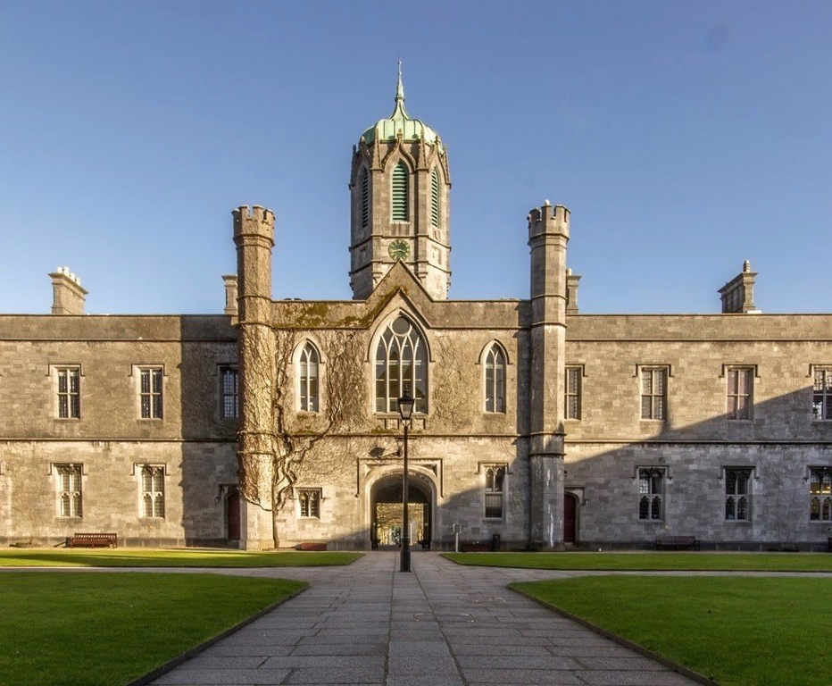
Are we all on the same EmPath?
AHEAD Conference 2026
Miriam Collins
Niamh Griffin
Izzy Tiernan
Róisín Birch

Slide 2
Introduction
Informed by lived experience of neurodivergent and disabled students
Focus on barriers in navigating the built environment
Altering sensory perception to encourage empathy through experience and dialogue
Designed with awareness and understanding that people experience the world differently

Slide 3
Development
Importance and benefit of co-creation between staff and students
Fostering an environment that allows for both lived experience and subject expertise to intertwine
Budget and resources kept to a minimum through creative planning and flexible development

Slide 4

Auditory
Different sound intensities and types of noise affect people differently
Difficulty filtering background noise and difference between natural/man made
Impacts on communication and engagement with the built environment
Sensory overload can inhibit meaningful participation in studies, social life etc.

Slide 5

Visual
Difficulty transitioning between sensory environments
Visual overwhelm and challenges filtering visual stimuli
Heightened visual sensitivity (e.g. seizures or migraine)
Impact of lighting on comfort and navigation

Slide 6

Motor
Touch and motor skills are taken for granted: tying shoes, typing, drawing
Different textures in the environment can be unpleasant or overwhelming
Proprioceptive input and tactile input vary widely
Reliance on writing for non-verbal communication

Slide 7
Conclusion
Empathy begins by asking 'what's life like for you?'
Sensory tasks designed for insight, not replication
Curiosity and dialogue at the centre of progress
Fostering shared experiences that encouraged respect and accommodate difference

Slide 8
Thank you
We hope you engage with each station, but please feel free to just have a conversation with us instead, we're happy to take any questions!

