Slide 1
The Pathways to Inclusive Practice Programme Dr John Harding: Head of the Inclusive Education Hub, the University of Cambridge

Slide 2

About the programme
Three years in duration (2025-2028)
Funded through a philanthropic donation
All levels of study: UG, PGT, PGR
Brings together related recommendations from:
Review of Teaching 2024-25
Review of the Approach to Provision for Disabled Students 2023-24
Access & Participation Plan (2025-29)
Notes:
APP = how we will improve equality of opportunity for students from disadvantaged or under-represented groups (to access, succeed, and progress in HE)

Slide 3
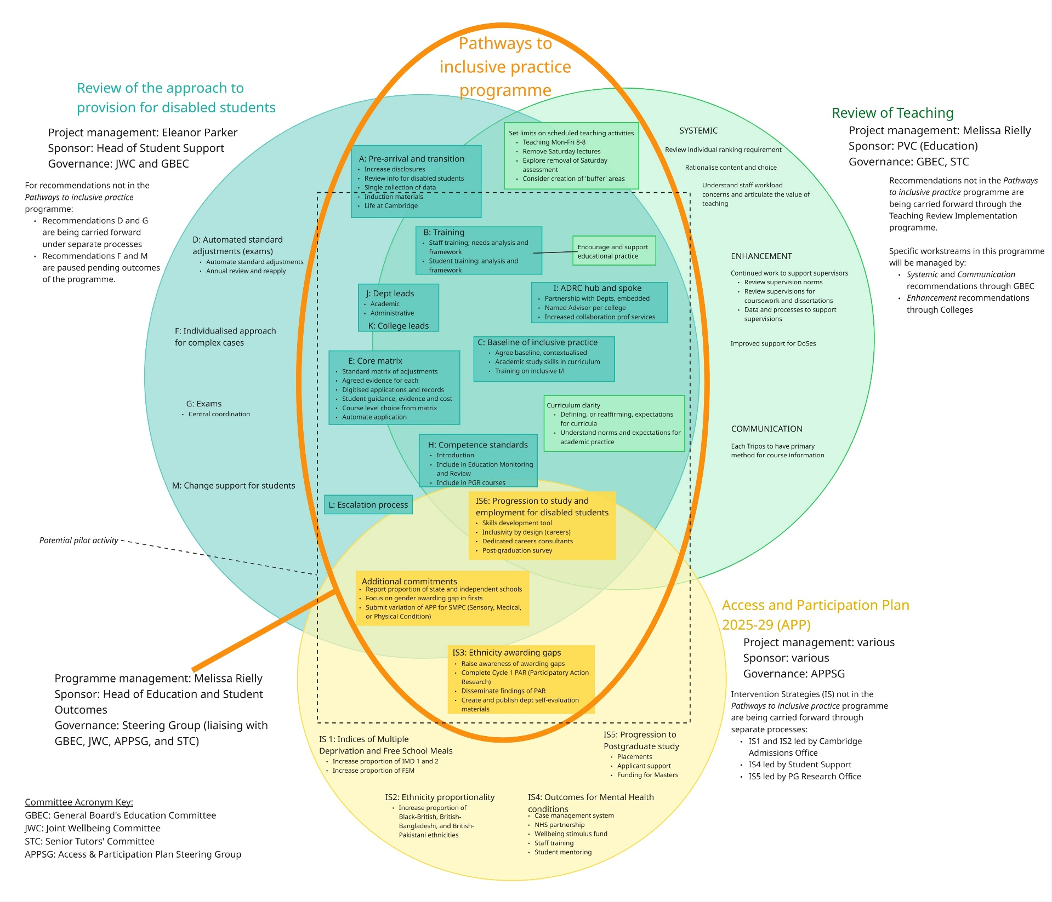
Diagram of sources
Notes:
The purpose of putting here is to show you the overlap, which drives our approach. Not expecting people to read it.

Slide 4
Two primary objectives
1. Creating the conditions for all students to make the most of their education, addressing barriers to this where they exist.
2. Ensuring that our data, processes, and systems actively support inclusive, high-quality education and align with legal and regulatory obligations.
Notes:
We have two main objectives - but these are very big, chunky, and complex items. In order to make them more achievable, we need to break them down into what this looks like more definitively.

Slide 5
To achieve this, we aim to:
Understand how best to design educational experiences that foster student success within our institutional and discipline specific models.
Set clear, consistent expectations for inclusive, effective curriculum design and delivery.
Empower and equip staff to create learning environments where all students are able to thrive.
Align data, processes, and systems to support inclusive educational practice and enable meaningful action.
Provide targeted support for staff and students to engage confidently with inclusive teaching and learning.

Slide 6

Eight areas of activity
Funded pilot projects
Standards and definitions
Disability Service Operating Model
Roles and responsibilities
Support and training
Data and Information (individuals)
Data and information (trends)
Scheduling
Notes:
These will (generally) run in parallel but are inter-related – for example the pilot projects will be the testing ground for our definition of inclusive practice and responsibilities.

Slide 7

Funded pilot projects
Department-led, up to 2 years; two phases
Range of scales and readiness; postgraduate and undergraduate
Test potential innovations, identify barriers and challenges, build case for change
By the end they will have created:
Contextualised baseline of inclusive practice
Core matrix of reasonable adjustments
Position on competence standards
Identified training and support needs, roles and responsibilities
Identified appropriate interventions for awarding gaps
Notes:
Two phases of pilots running for up to 2 years. Pilots are crucial; will allow us to test and build evidence base, understand what “works” in our educational and disciplinary models. Accelerators, but also driving and guiding change elsewhere.

Slide 8

Standards and definitions
Developing clear standards for curricula design and delivery – what does “inclusive practice” mean and what is expected?
Led by Cambridge’s Education Committee
Includes development of materials to frame and support pilots

Slide 9

Disability Service Operating Model
Developing the existing hub-and-spoke operating model
Scalable, effective
Builds trust and understanding
Ensuring most effective use of expertise

Slide 10

Roles and responsibilities
Identifying and defining roles and responsibilities for delivering, supporting, and ensuring inclusive educational practice
Clarity on who does what, and why
Clarity on how roles interact to support and deliver inclusive education

Slide 11

Support and training
Identifying what is needed and how it can effectively be delivered
Developing opportunities and resources
Creating networks and knowledge exchange
Agreeing a support model that is scalable and effective

Slide 12

Data and information
Individuals and trends
Data about students; records management and information sharing
Data about barriers; how and where they occur, and how they can be mitigated
Systems and process improvements

Slide 13

Scheduling
Approving, and implementing, limitations on scheduling of teaching sessions
Saturday lectures and assessment
Reviewing impact and effect (estate, students, staff)

Slide 14

Inclusive Education Hub
Collaborating across Education Services to bring together expertise, knowledge, and support
Coordinating business-as-usual, to provide a single point of access
Supporting operational decision-making and delivery of the programme

Slide 15




What can the Hub do?
Advise on inclusive teaching and learning strategies and curriculum design
Assess current practice and identify areas for improvement
Provide training on inclusive education (in partnership with pilot areas)
Support creation of inclusive blended learning environments

Slide 16
Thank you.
Any questions?
Dr John Harding, jah214@cam.ac.uk
March 2026

