Slide 1
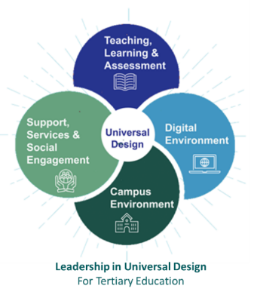
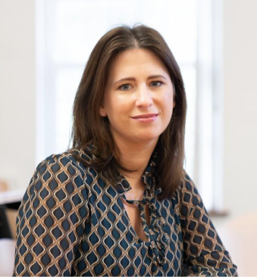


Universal Design (UD) / Universal design for Learning (udl):
What Senior Leaders Need to Know
UDL Conference | Dublin
Laura Hegarty & Mairead McCann
Atlantic Technological University (ATU)

Slide 2
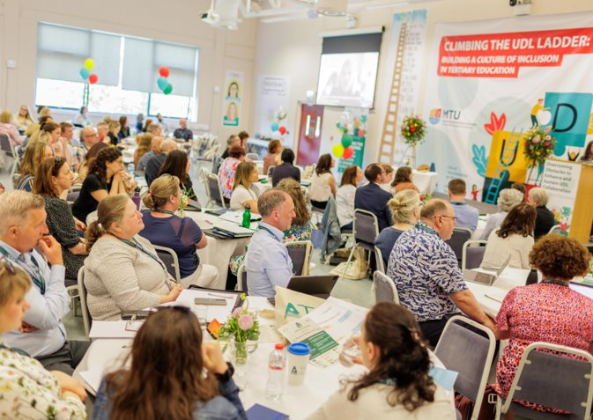
Topics
Introduction and Project Overview
Icebreaker Activity (5mins)
Strategic Alignment - Why UD/UDL Matters Now
Show the UD Course Portal
Exemplars
Brainstorm activity (20mins)
Key Takeaways
Notes:
Introduction and Project Overview (3 mins)
Icebreaker Activity (5mins)
Strategic Alignment - Why UD/UDL Matters Now (3 mins)
Show the UD Course Portal (7mins)
Exemplars (2 mins)
Brainstorm activity (20-25mins)
What is their key takeaways (2mins)

Slide 3
Introduction and Project Overview

Slide 4








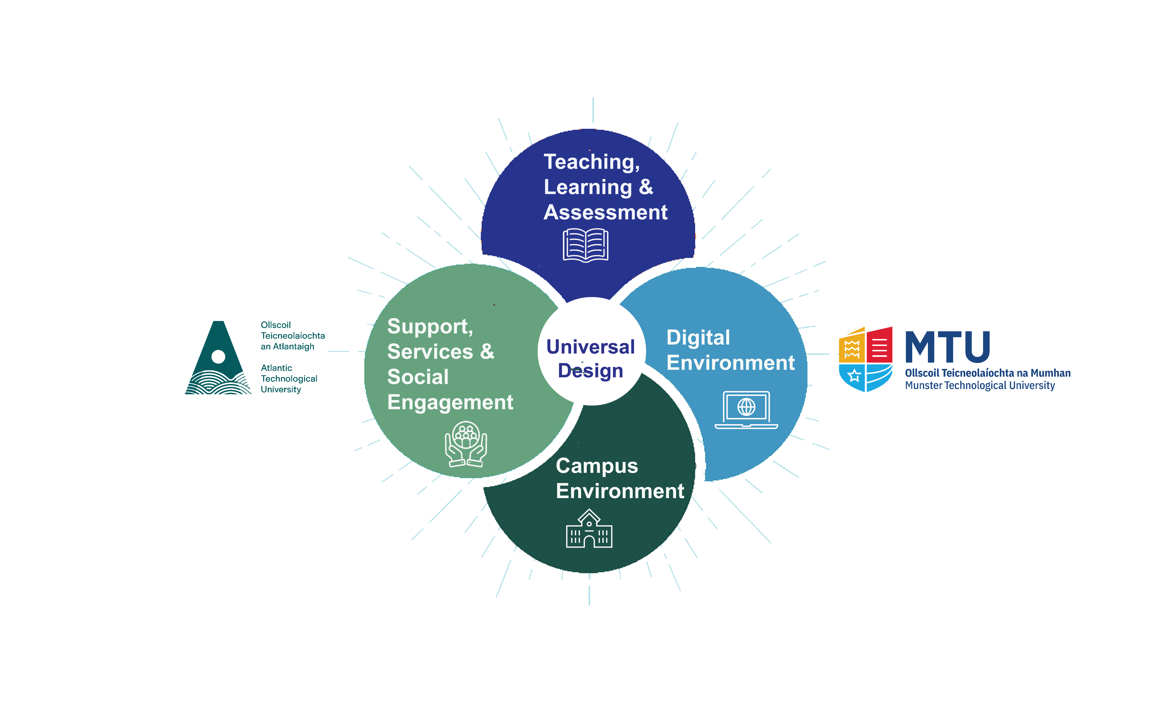











Leadership in Universal Design
For Tertiary Education
Laura Hegarty Mairead McCann
Atlantic Technological University (ATU)
Margaret Finch Aileen Kennedy
Munster Technological University (MTU)

Slide 5
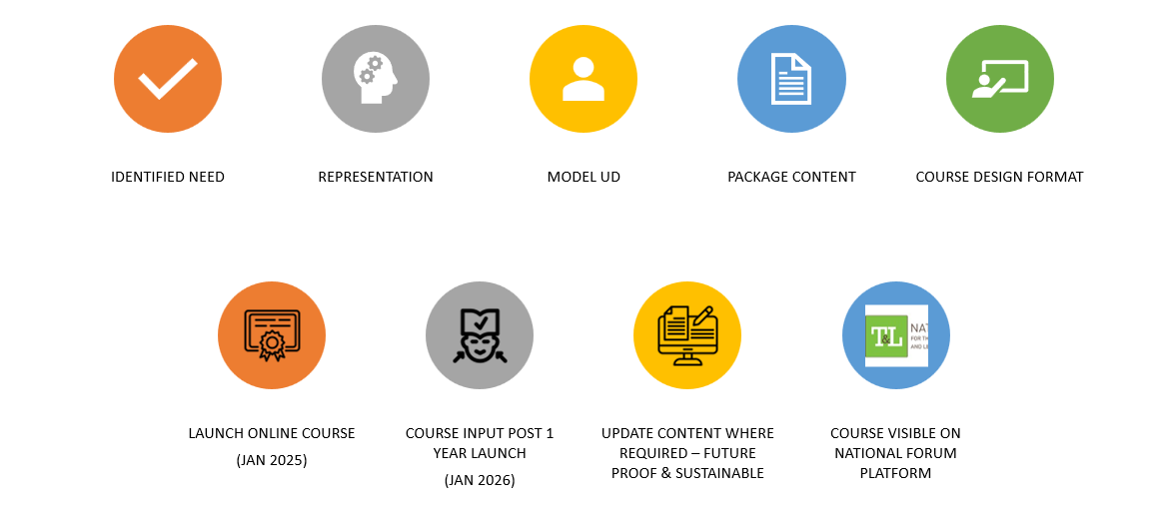
Project Background & Milestone

Slide 6
Icebreaker

Slide 7
Impact Strategy –How can you influence?
Question 1
  Where is your influence within your organisation?
Question 2
  If you can change one thing tomorrow, what would it be?
Notes:
Chat and Share within group – mingle and capture some ideas
(Use resources on table and pick up written comments – Print Likert scale)
Do people feel they have leadership remit​
Capacity to shape policy​
Deal with challenges​
Have I a role or influence

Slide 8
Strategic Alignment
Why UD/UDL Matters Now

Slide 9
Why This Matters for Senior Leaders
Strategic Excellence: Embed UD/UDL in governance, QA, and planning cycles to support institutional missions
Funding Opportunities: Many grants prioritise accessibility, widening participation, and innovation.​
Regulatory Alignment: Strengthens compliance with accessibility and disability legislation.​
Innovation: Promote student success through encouraging digital transformation and pedagogical innovation.
Staff Productivity: Well‑designed systems reduce administrative burdens and retrofitting.

Slide 10
Role and Responsibility of Leadership
Senior leaders can create a supportive environment where UD / UDL becomes a fundamental part of the institution's educational culture.
By committing to and investing in UD/UDL initiatives, they can help ensure that all staff and students have equitable access within our institutes.
Senior leaders in organisations can play a vital role in supporting Universal Design initiatives, which aim to create products, environments, and services that are accessible and usable by a wide range of individuals, regardless of their age, abilities, or disabilities.
Leadership drives cultural change
Notes:
Inclusion is a strategic priority in tertiary education
Policy, funding, and performance indicators increasingly reflect accessibility expectations
Small design shifts can create large institutional impact
Leadership drives cultural change
Leadership Levers for change
Strategic vision and messaging
Resource allocation and funding calls
Staff development and CPD
Recognition and reward structures

Slide 11
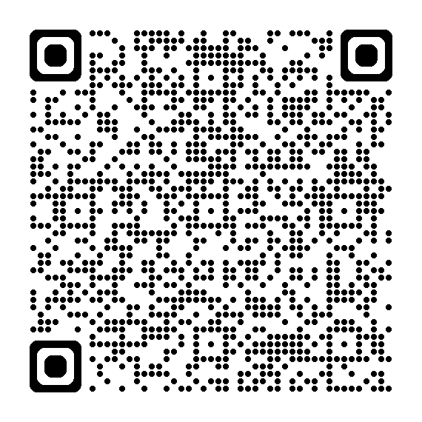
Demonstration of Leadership Course
Scan QR code to access course

Slide 12
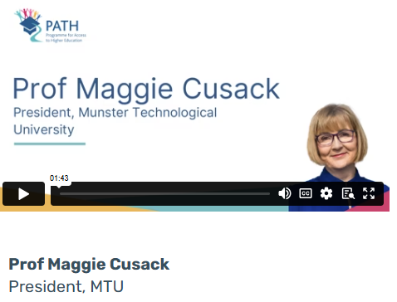

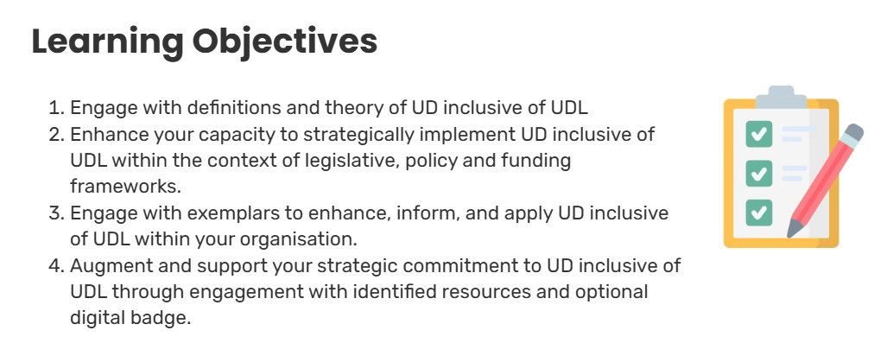
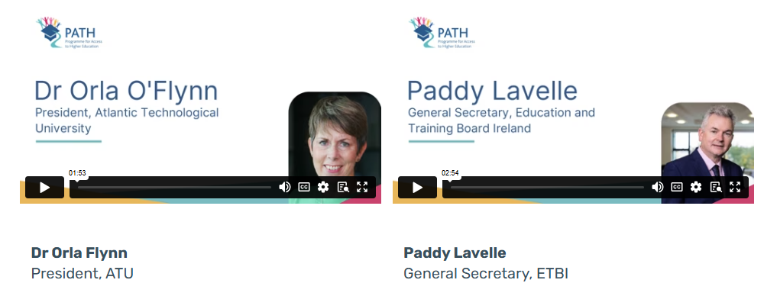
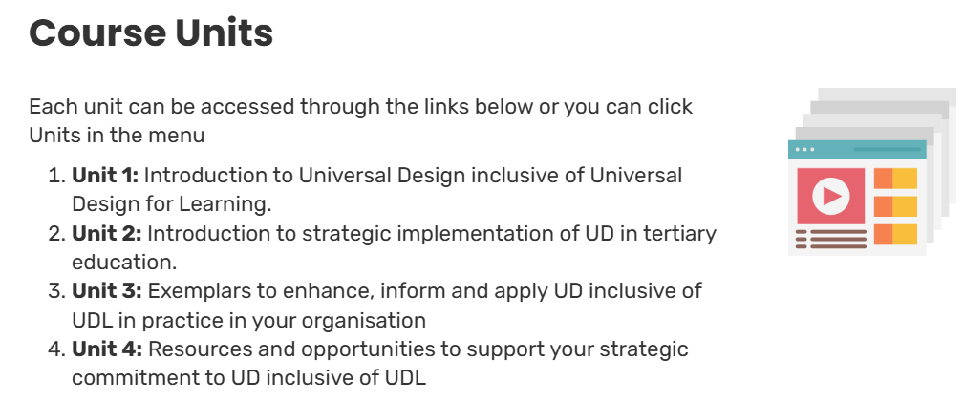
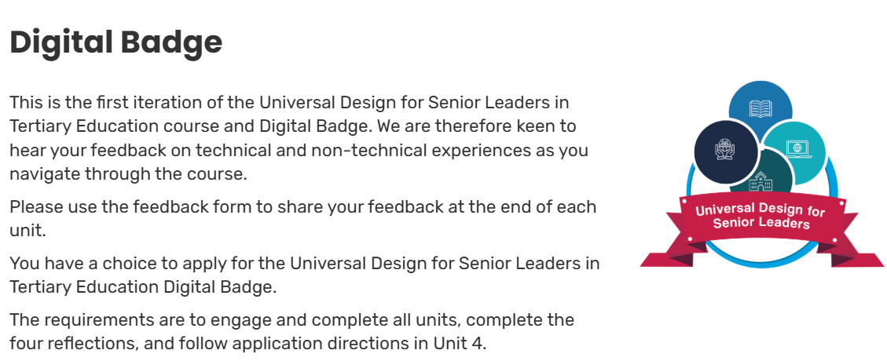
Course Outline

Slide 13
Exemplars

Slide 14
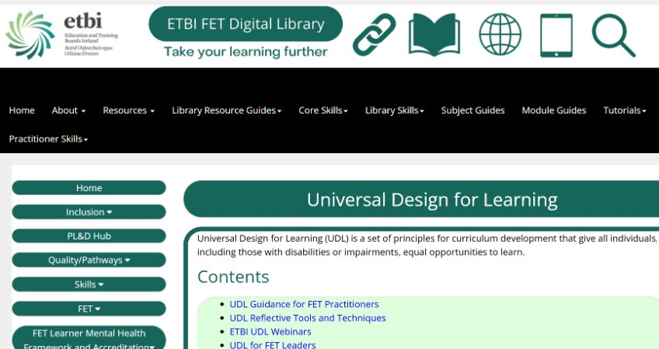
Real‑World Examples & Quick Wins​ - ETBI FET Digital Library

Slide 15
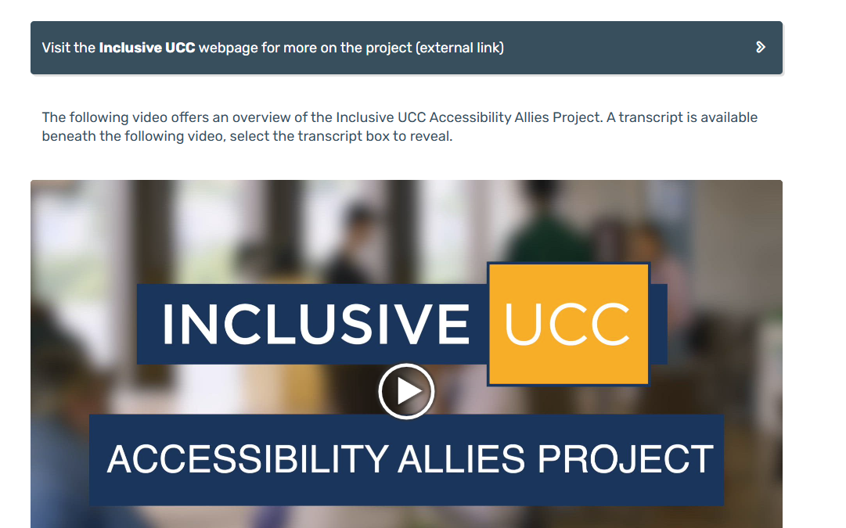
UCC – Accessibility Allies Project

Slide 16
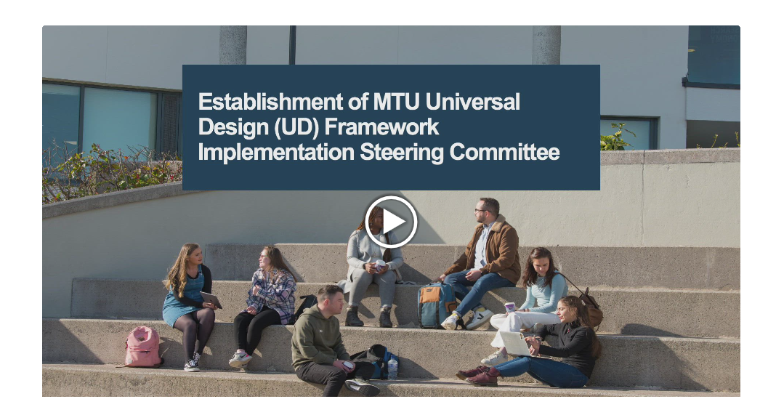
MTU – UD Framework Implementation Steering Committee

Slide 17
Brainstorm Activity

Slide 18
Group Brainstorm Activity
Purpose: Turn leadership challenges into UD/UDL opportunities.​
Instructions: In your group identify a current institutional challenge/barrier (e.g., clear vision, retention, staff workload, digital transformation, allocate resources)
Then brainstorm:​
  Use the worksheet provided to spark ideas and capture your thinking or use a voice note to share with us
  Agree on one actionable commitment by the end of the Activity to share ☺
Notes:
Prompt cards – trigger Q what would stop implementation
What UD/UDL shift could help?​
What would success look like?​
Who would need to be involved?​

Slide 19
Key Takeaways

Slide 20
Commitments & Key Takeaways​
Embed UD and UDL into leadership strategy and governance
  Small, strategic design decisions create significant impact
  Leaders set the tone for inclusive culture
  Immediate actionable insights for your institution
How will you show your commitment to UD/UDL leadership within your institution?

Slide 21
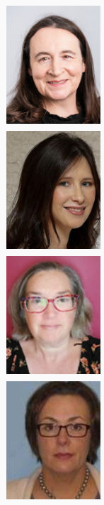
Team Contact Details
Mairead McCann ATU mairead.mccann@atu.ie
Laura Hegarty ATU laura.hegarty@atu.ie
Margaret Finch MTU margaret.finch@mtu.ie
Aileen Kennedy MTU aileen.kennedy@mtu.ie

Slide 22

Thank you!

