Slide 1
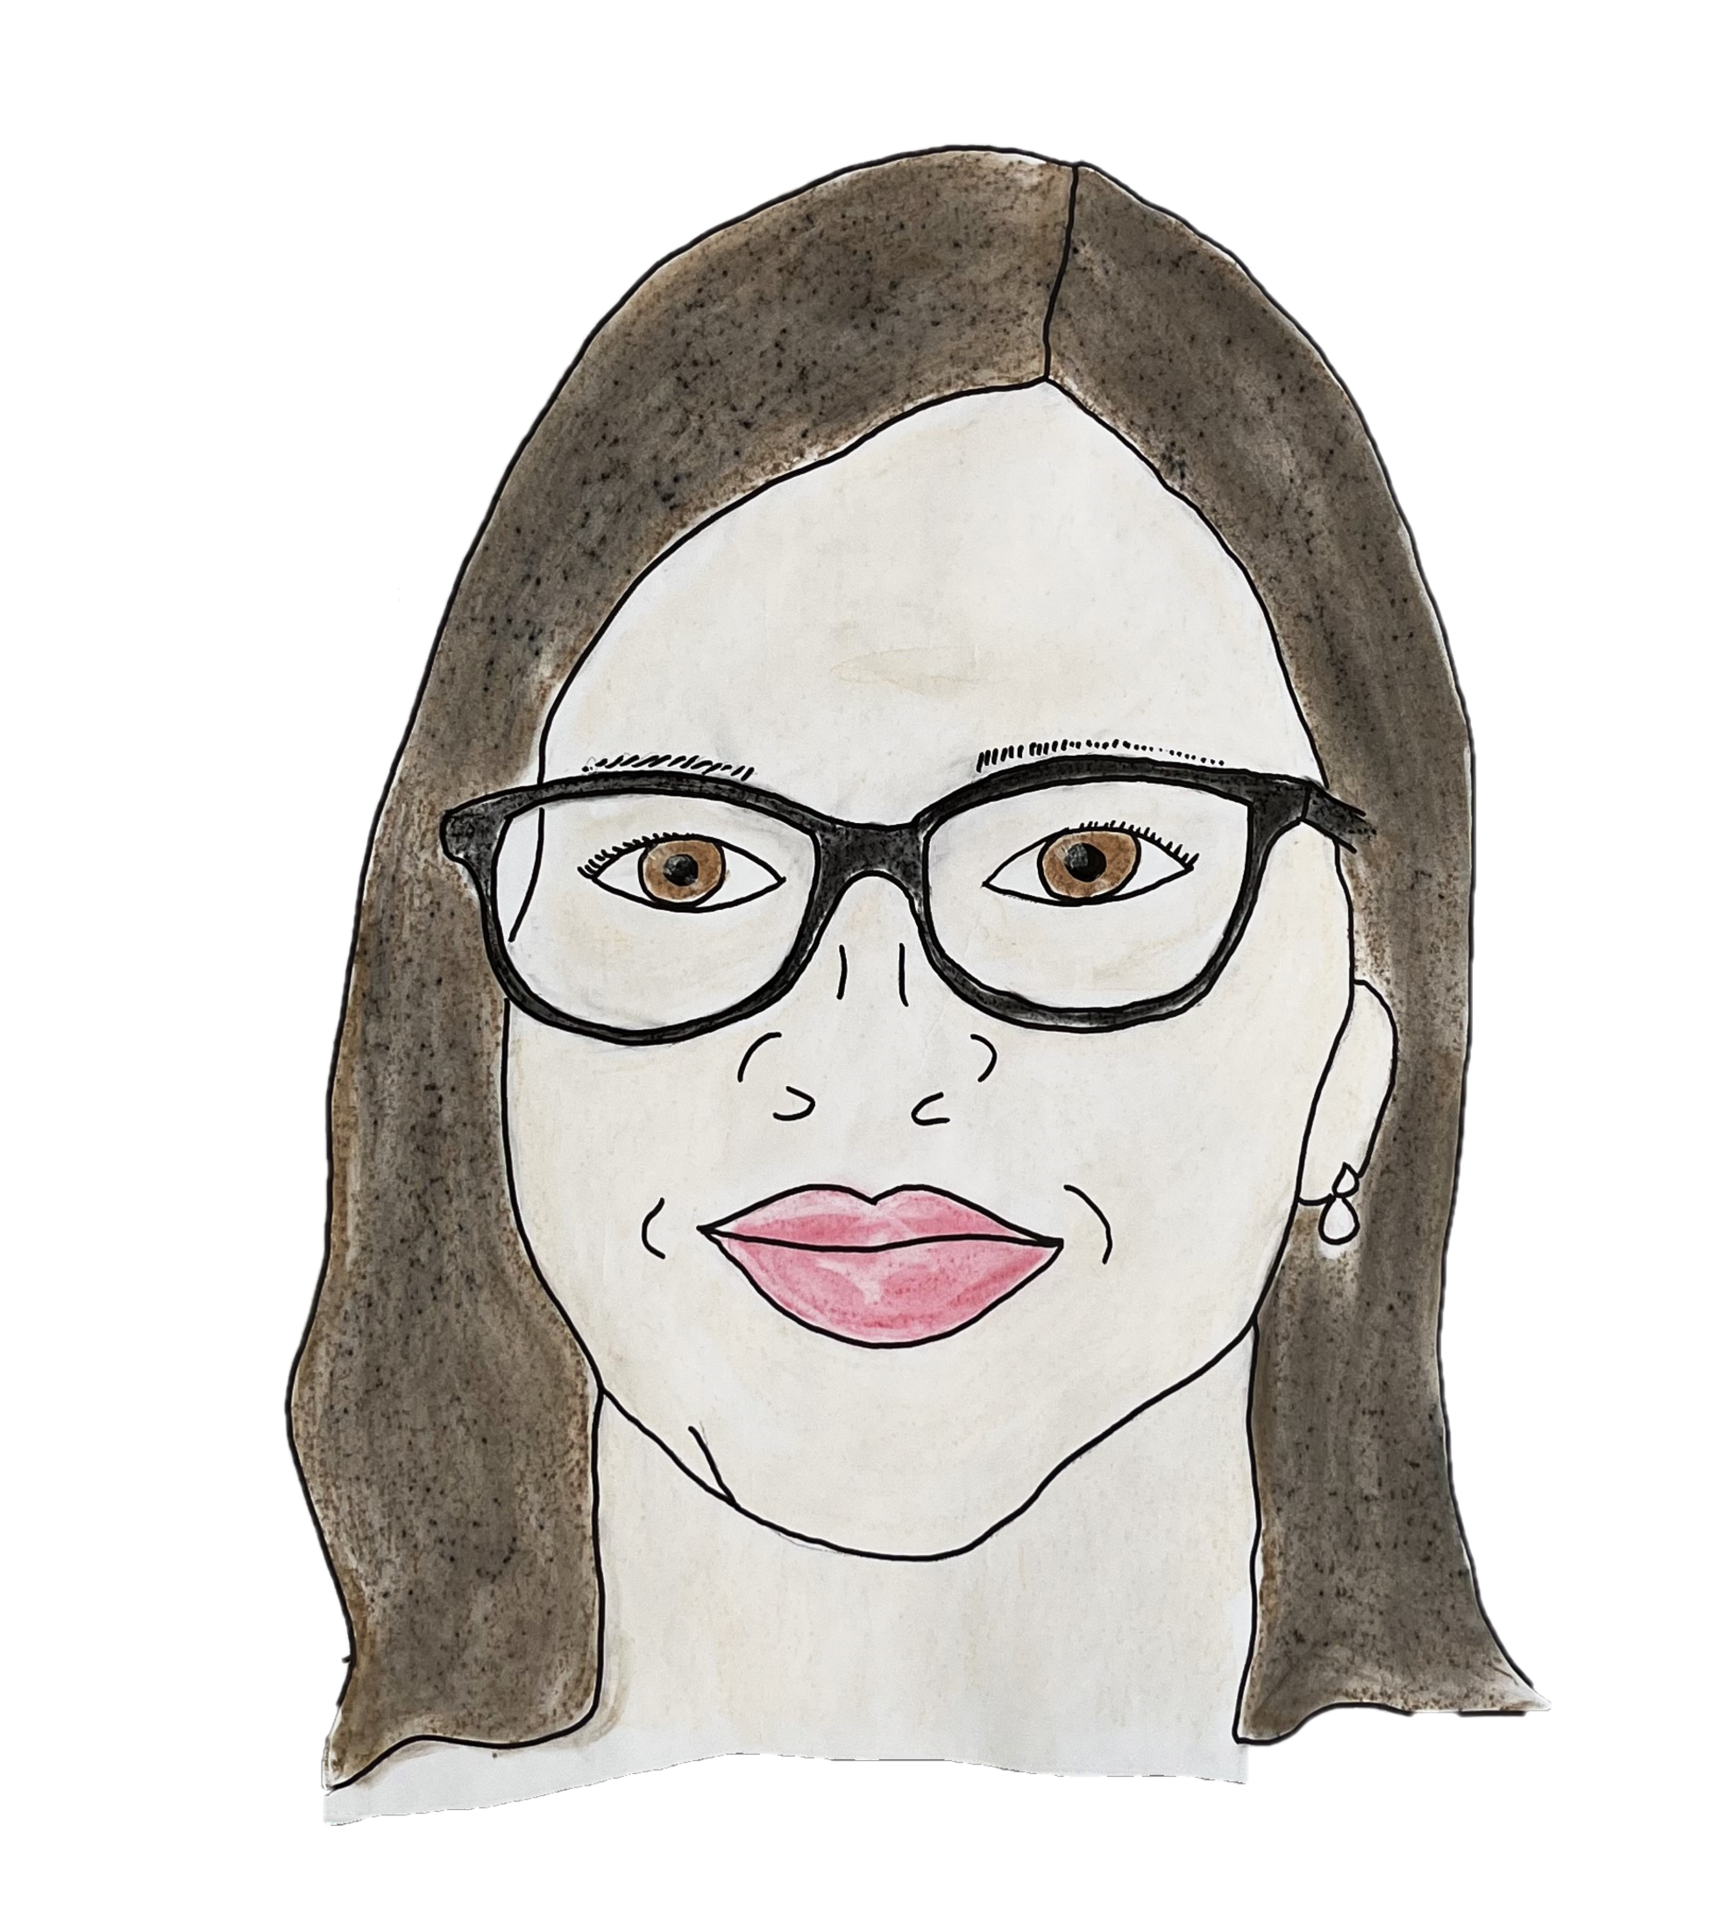

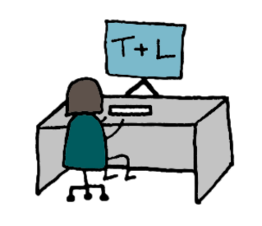

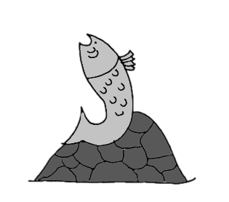

Visual Your Message: Harnessing the Power of Graphics in Communication
Visualise Your Message: Harnessing the Power of Graphics in Communication
UD Beyond the Classroom: My +1 Redesign
Patricia Henry
Atlantic Technological University
Teaching & Learning Support Centre
Notes:
Hello everyone, I’m Patricia Henry from the Teaching & Learning Centre in Atlantic Technological University Sligo. My role as Senior Support Officer involves supporting all things Teaching & Learning, from workshops to our annual UDL conference.
Because I work closely with colleagues on their UDL journey, I wanted to deepen my own understanding and apply UDL principles in my everyday work. As I am not in a student-facing role, I wanted to focus my redesign on a topic where I could still gather meaningful feedback. This led me to focus on the Moodle page for the Postgraduate Certificate in Universal Design for Learning, where I could apply UDL thinking in a practical, impactful way.

Slide 2
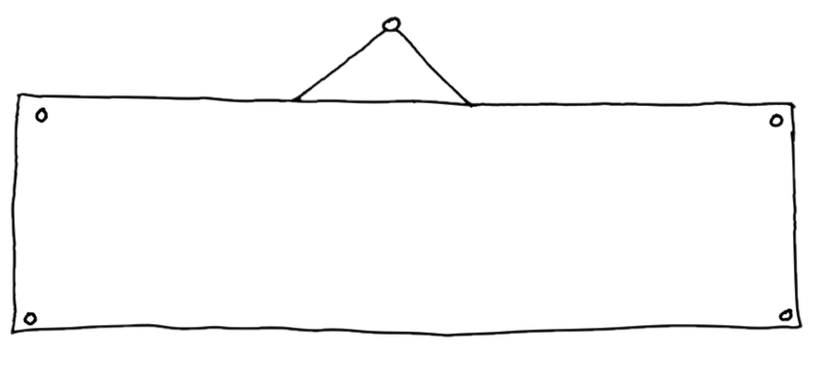


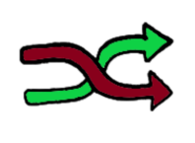

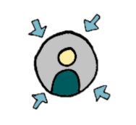
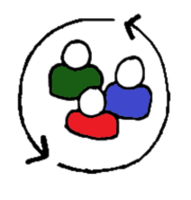
What I learned
Key UDL Principles That Guided My Thinking
Equitable
Universal Design is about creating a more inclusive and equitable society by considering the diversity of human abilities and needs when designing various processes and procedures.
Flexibility
User
Centered
Collaboration
Inclusivity
Notes:
My Understanding of Universal Design is about creating a more inclusive and equitable society by considering the diversity of human abilities and needs when designing various processes and procedures.
The following include Some of the Key findings from my own reflections:
Firstly, everything should be Equitable – All processes and procedures should be designed so that they are accessible to all individuals.
Flexibility – We should always strive to provide a range of options and adaptability to accommodate the diverse range of individuals.
Inclusivity – Universal Design emphasizes the importance of inclusivity and that the needs of all individuals should be considered to ensure all individuals can participate fully in society.
User-Centered – Universal Design places a strong emphasis on a user-centered approach, which means involving the end user in the design process, so a better understanding of their needs is captured.
And finally, Collaboration – To implement effective changes, often requires collaboration among various stakeholders to ensure that diverse perspectives are taken into account

Slide 3

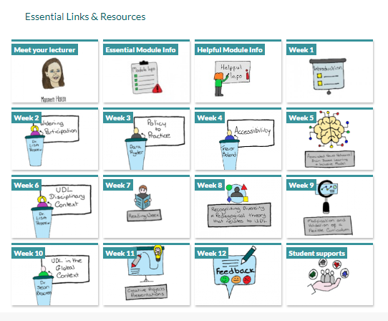
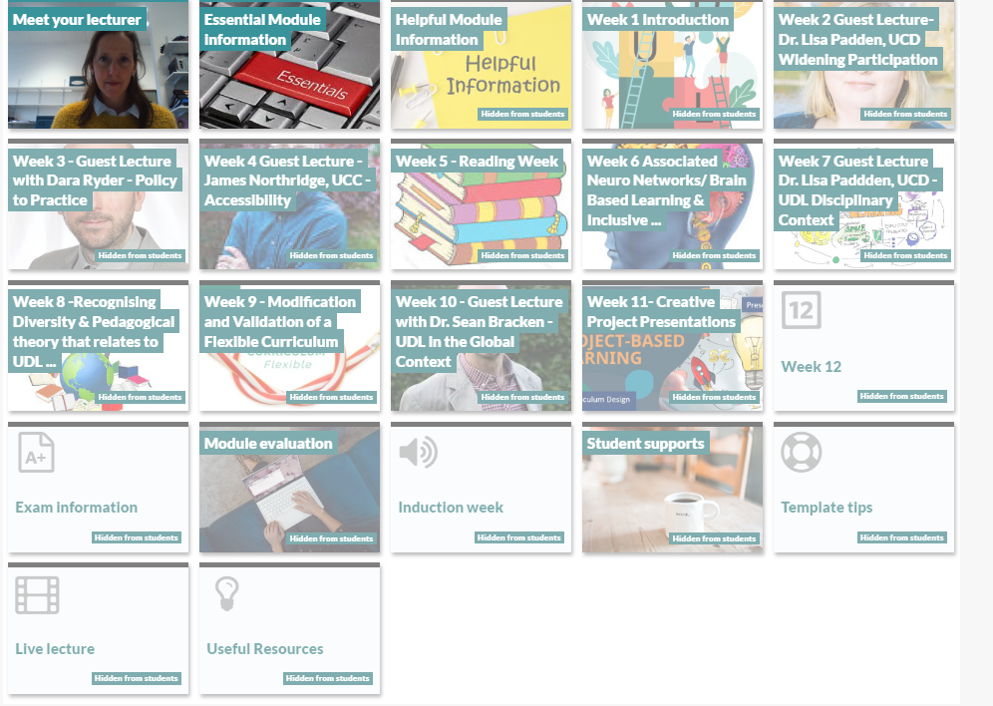
The Redesign Opportunity
The Redesign Opportunity
Moodle Tile Redesign – Before & After
Before
After
Notes:
With access to the Moodle Page for the P.G cert in UDL, my aim was to improve the visual clarity and user experience, while also demonstrating UDL by offering multiple means of representation.
As I have previously achieved a Digital Badge in Graphic Facilitation, I decided that my Plus 1 approach to the redesign would be to use my graphic facilitation skills and create new graphics for each tile. You can see here a Before and After image of what the Tiles on the Moodle page looks like.
While images can significantly enhance the communication of Universal Design principles, it’s crucial to ensure that the images themselves are designed with accessibility in mind. This includes providing alternative text for screen readers, using high contrast for visibility and considering the overall inclusivity of the visuals chosen.
My aim was to improve the visual clarity and user experience, while also demonstrating UDL by offering multiple means of representation.

Slide 4
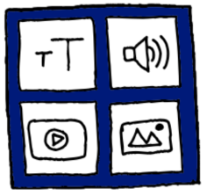


UDL Principle Focus
UDL Principle Focus
Multiple means of Representation / The What of Learning
Multiple means of Engagement
Multiple means of
Action & Expression
Multiple means of Representation
Notes:
The 3 principles of UDL are Multiple means of Engagement, Multiple Means of Representation and Multiple Means of Action & Expression and because of the Plus 1 approach that I undertook, the specific Universal Design for Learning principle that I focused specifically on was Multiple Means of Representation, which is about presenting information in different ways so it’s accessible to all. Not everyone processes text easily and some engage more quickly with visuals. By creating clear, inclusive graphics, I aimed to make the page more intuitive and more memorable for users

Slide 5

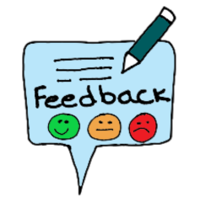

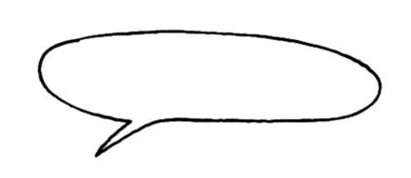


What Changed
What Changed
Visually recognizable graphics
Graphical Facilitation in Practice
Graphics are inclusive
“The images are clear, relevant & memorable”
Minimal text
Use of visual and verbal explanation
Notes:
What does Graphic Facilitation mean? It means, presenting information in various formats, using different media, and offering alternative methods for accessing and understanding content. Some key points to remember when creating graphics are
Graphics need to be visually recognisable
There should be a visual and verbal explanation
The use of high contrast colours are recommended
Minimal use of Text
And Graphics should be inclusive of all.
By doing so, it ensures that information is accessible to learners with diverse learning styles, preferences, and abilities.
The updated tiles use high-contrast, recognisable graphics with minimal text – just enough to support clarity.
Student/Learner Feedback:
Once all graphics were created an uploaded to the Moodle page, I created a short MS form to gather some feedback from the users of the page
The feedback was 100% positive to the changes. Some quotes as follows:
“A very good user experience. The graphics are designed in a very engaging way and add to the user experience of the page.”
“Nice clear easy to use layout.”
And the one I was most happy to read - “The images are clear, relevant and memorable” which encapsulates what I was trying to achieve.

Slide 6

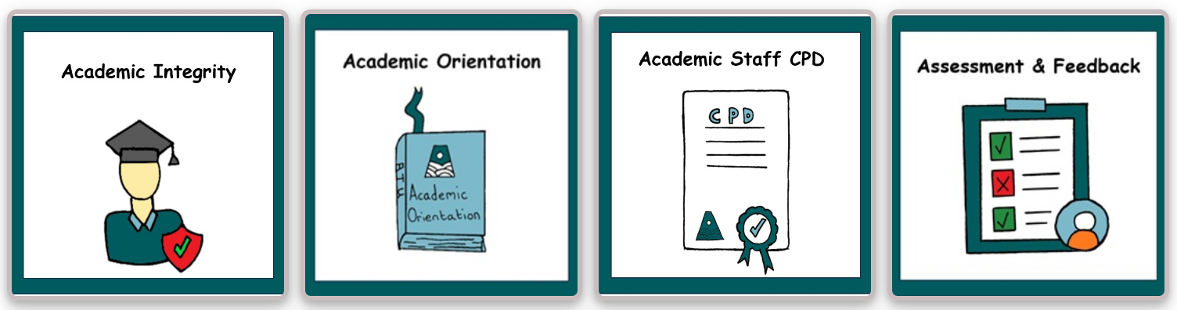
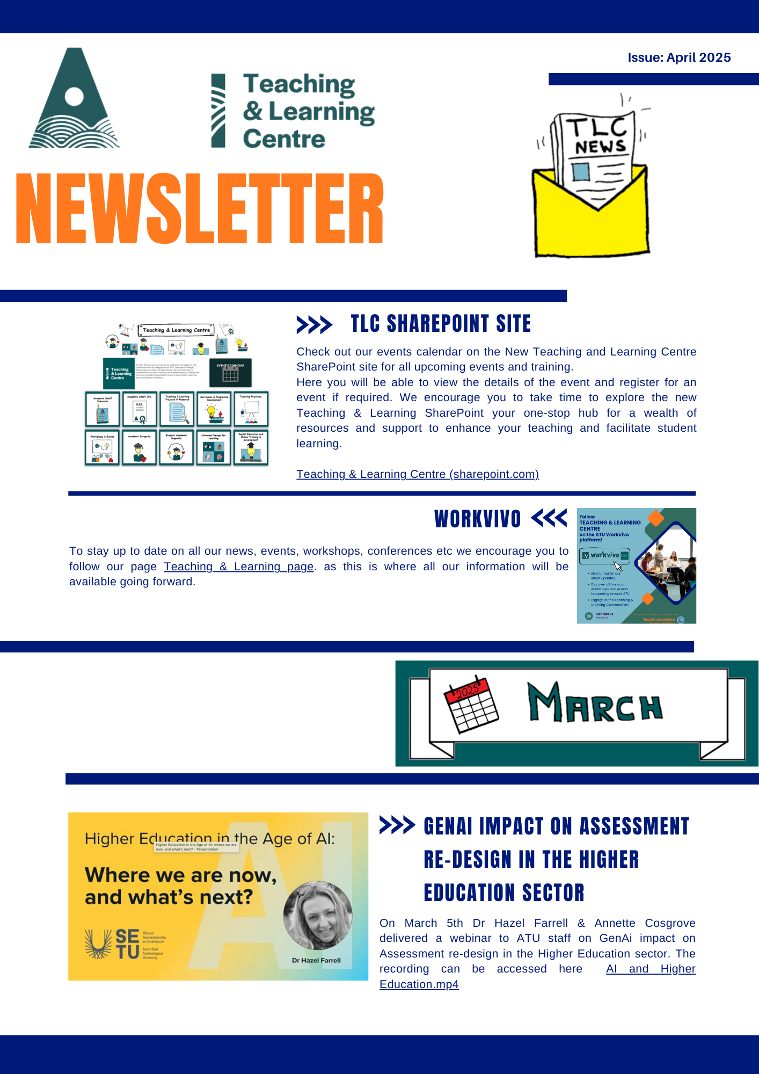
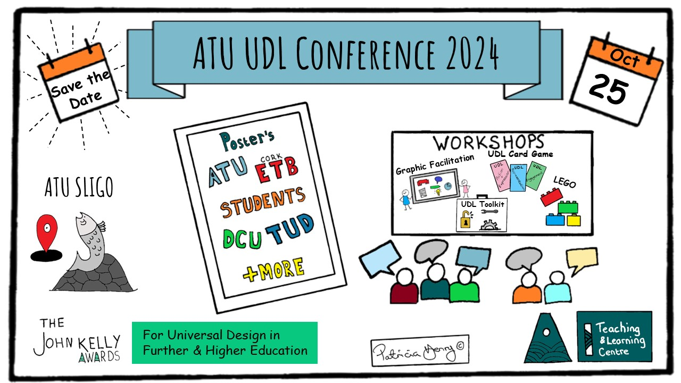
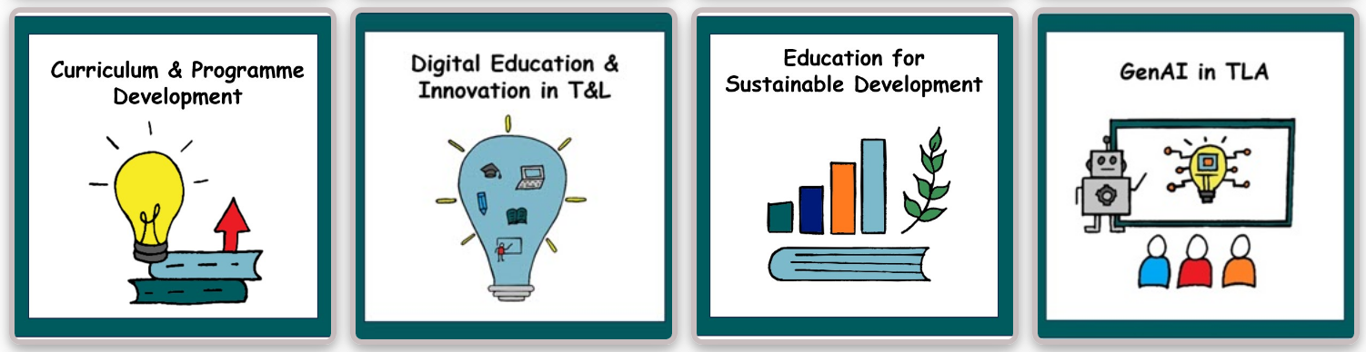
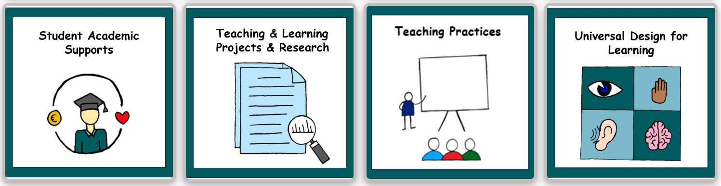
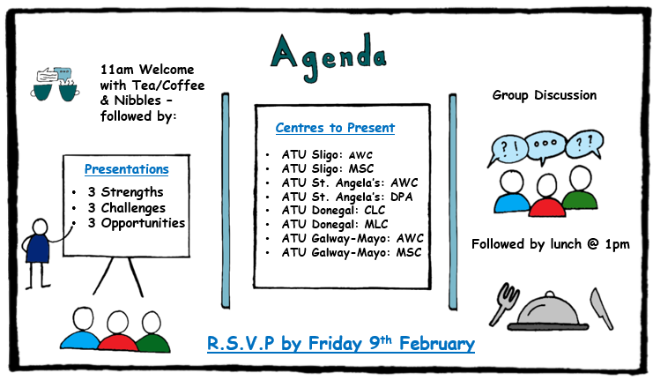
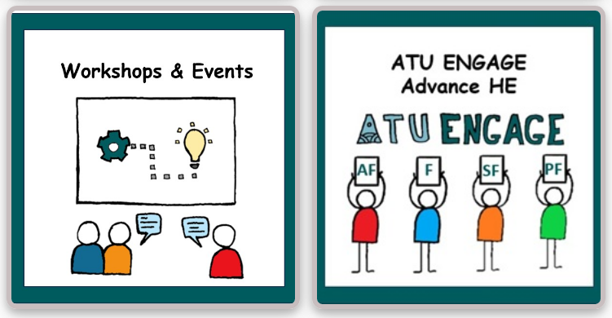
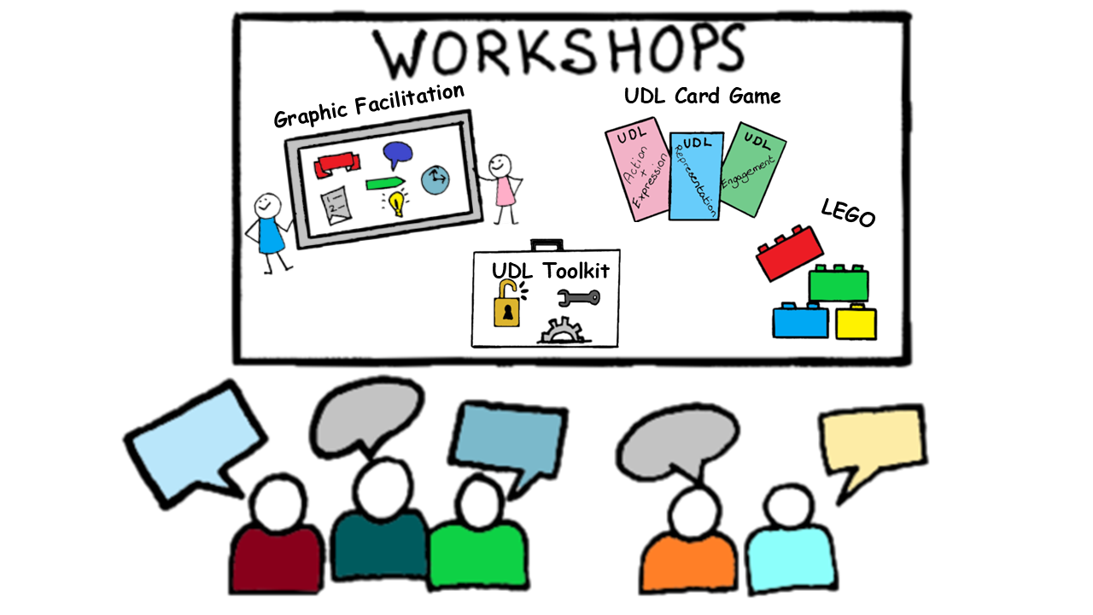

Future Plans…
Continuing the +1 Approach
Teaching & Learning Centre Sharepoint Landing Page
Monthly Teaching & Learning Newsletter
Communication / Information dissemination
Notes:
Having got very positive feedback from the changes implemented to the Moodle page, I decided I wanted to continue implementing the +1 approach.
One of the first areas I looked at was our information dissemination. The Teaching & Learning Centre communicates across multiple platforms: our SharePoint landing page, the monthly T&L newsletter, T&L Workvivo Page (ATUs Internal Staff communication platform) workshop announcements, agendas, save‑the‑date notices, and more. These are essential tools, but I realised that each one could benefit from a clearer, more consistent, and more visually engaging approach.
Using what I learned from Graphic Facilitation and the UD Beyond the Classroom Digital Badge, I began incorporating icons, colour coding, and simplified layouts. This makes our materials more accessible, easier to navigate, and easier to understand at a glance—especially for busy staff managing multiple commitments. This Plus 1 approach helps reduce cognitive load and supports a wider range of users. Given that our T&L SharePoint page is one of the most visited pages in ATU, it’s no surprise that I receive frequent queries about its design and usability. This really highlighted the importance of making it as clear and accessible as possible.
So to finish, completing this redesign has helped me embed UDL more intentionally into my daily practice.
Thank you!

Slide 7
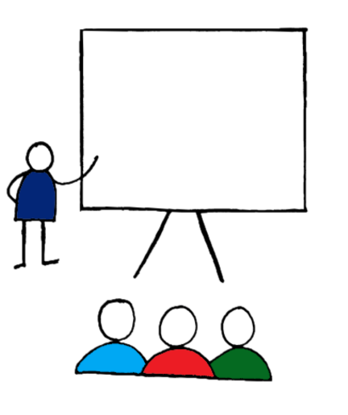

Contact me
Thank
You
Patricia.henry@atu.ie

