Slide 1

Digital Inclusion in Online Learning
Between the guidelines

Slide 2
Accessible
≠
Inclusive

Slide 3
What has led me to this?
Independent Research
UDL
Instructional Design
Digital Accessibility
User
Journey
CLT
UI
& UX
Graphic
Design

Slide 4



Who is Responsible?
Learning Technologist
Lecturer
Support
Staff

Slide 5
What the AHEAD Data Shows (2021–2024)
2021 - 2022
2023 - 2024
Total HE Students
261,902
7%
281,847
Students Registered
with DSS
18,097
24%
22,511

Slide 6

Growth Rate
Total Enrolment
Registrations with Disability Support Services

Slide 7

A Closer Look at the Figures
Mental Health
Ongoing Illness
Physical Disability
Sensory Disability
Speech/Language
Other/Multiple
66%
SLD
ADD/ADHD
ASD
34%

Slide 8
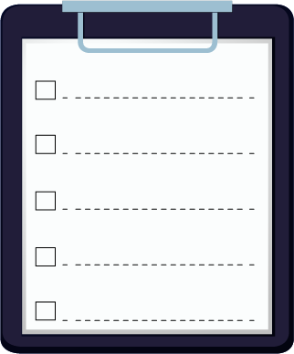

Current Frameworks and Guidelines
WCAG / EAA
UDL
CLT
UX
Research

Slide 9

The Inclusion Paradox
Confusion about guidelines and Frameworks
Lack of training or understanding
Ticking Boxes
Reactive Response

Slide 10
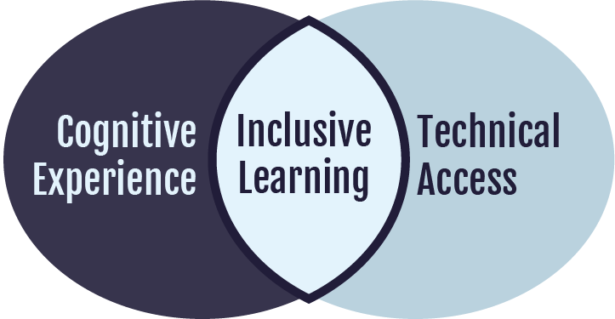
Cognitive-Technical Accessibility (CTA)
UDL
User Interface
Web accessibility guidelines
User Experience
Cognitive load theory
Research

Slide 11
Cognitive-Technical Accessibility Pillars
Cognitive Load Awareness
Consistency & Predictability
Sensory
Modulation
Flexible Engagement
Reducing strain on memory and attention
Reducing uncertainty and navigation load
Minimising sensory
stressors
Supporting autonomy and meaningful choice
Chunking, clarity, reducing distractions
Stable layouts, predictable progression
Balanced contrast, motion control
Accessibility controls, alternative
formats

Slide 12
Key References
AHEAD (2023). Participation Report 2021/22. AHEAD Educational Press. 1
AHEAD (2024). Participation Report 2022/23. AHEAD Educational Press. 2
AHEAD (2025). Participation Report 2023/24. AHEAD Educational Press. 3
W3C (2018, updated 2023). Web Content Accessibility Guidelines (WCAG) 2.1/2.2. World Wide Web Consortium.
Seale, J. (2014). E-learning and disability in higher education.
Meyer, A., Rose, D. H., & Gordon, D. (2014). Universal Design for Learning.
Sweller, J., Ayres, P., & Kalyuga, S. (2011). Cognitive Load Theory.
Power, C. et al. (2012). Guidelines are only half of the story.
Lazar, J., Goldstein, D., & Taylor, A. (2015). Ensuring digital accessibility.

Slide 13



Thank You
susan.april.horgan@mtu.ie
Susan Horgan - LinkedIn

