Slide 1



Co-Creating Employment Pathways
Facilitating Disabled Students in the National Learning Network
to transition to jobs and careers with Mr. Price Branded Bargains
Authors: Anne Marie McDonnell and Edel McSorley

Slide 2

National Learning Network
Education and Training Division of Rehab Group
55 Locations – Every County
Over 40+ Accredited Training Programmes
Supporting Progression of Further Education, Higher Education and Jobs
Approx 40% of the student body are autistic or neuro-divergent students
Small class sizes – 12 people
Comprehensive Student Support
Continuous Intake – ready when you are!

Slide 3

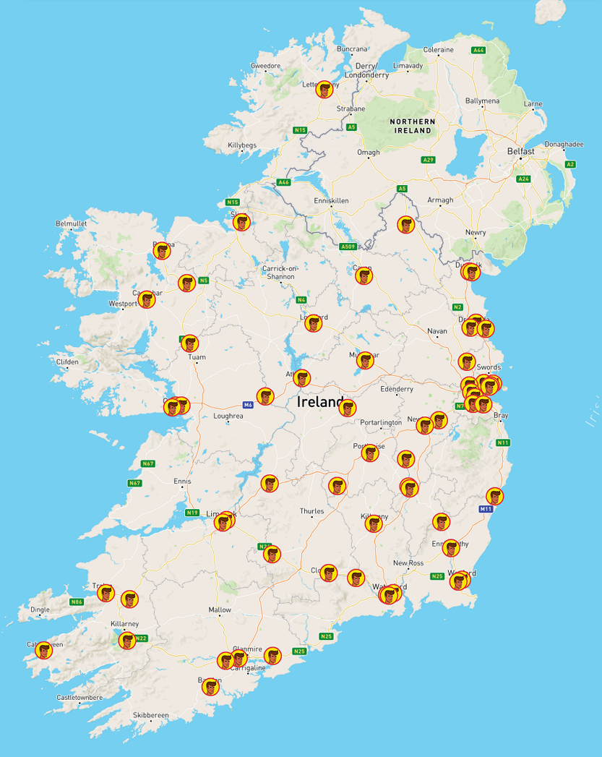
Mr. Price Branded Bargains
Leading Discount Retailer
70 Stores Nationwide
Committed to Inclusive Employment Practices
Authentic Partner
Over 300 Jobs and Careers in 5 Years by co-creating pathway to work with autistic students and disabled students

Slide 4
Critical Success Factors
Strengths Based Approach to Skills Development.
Neuro-Affirmative Recruitment Practices
Universal Design Approach
Community of Practice

Slide 5
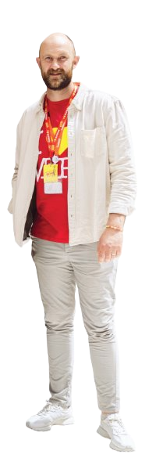
How can I help?
A Strengths Based Approach in Practice
What is the student interested in learning?
Can you share some strengths that we can build on during work experience?

Slide 6
Neuro-Divergent Affirmative Practices
Planning for Success with Work Experience
Which store?
Are there particular days or times that work best?
What do we need to consider in the environment?
    What might the student avoid?
    What might the student seek out?

Slide 7
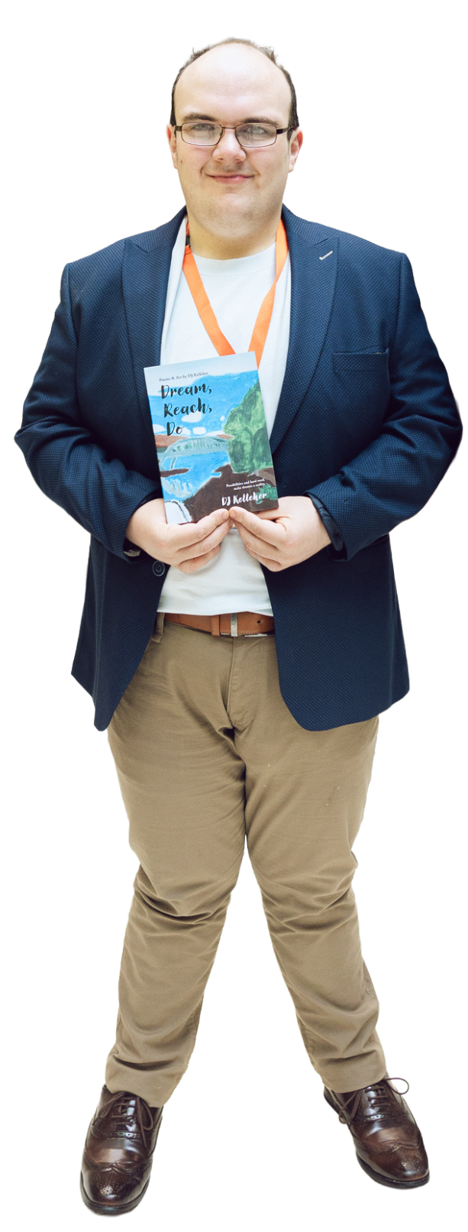
Neuro-Divergent Affirmative Practices
Co-Creating Inclusive Recruitment Practices
A Poem for a Position
D.J Kelleher
Trailblazer, Change Maker, Poet, Retail Assistant, Published Author, Son, Brother, Nephew, Friend, NLN Alumni

Slide 8

Universal Design Practices
Some ways job applications have happened
CV – only if that is your preference
Simple Application Form – Plain English
An email
Visual – Drawn or Created Digitally
Discussions reflecting on Work Experience
Is there something that we haven’t seen yet?
Just let us know

Slide 9
Solution Focused Planning and Innovation
Challenge:
Young Adults with Intellectual Disability interested in working with Mr. Price and needed some more exposure to the world of work; even before work experience.

Slide 10
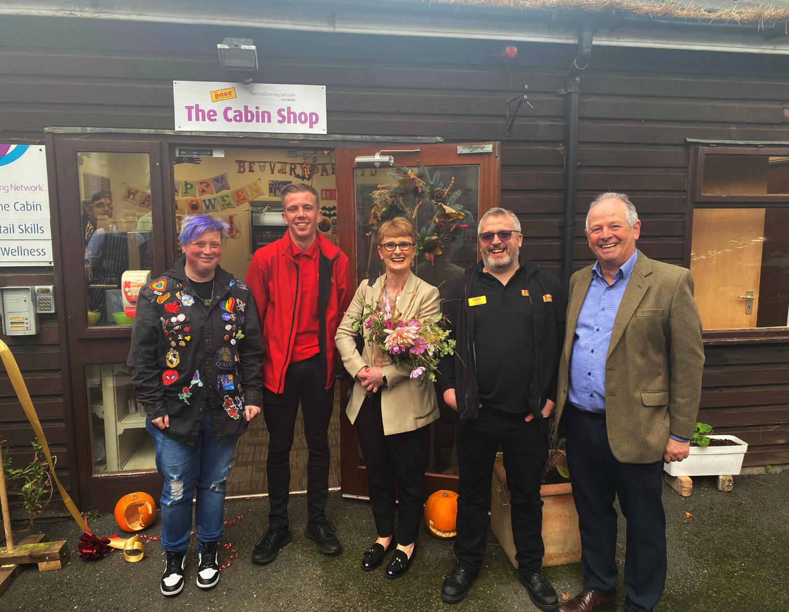
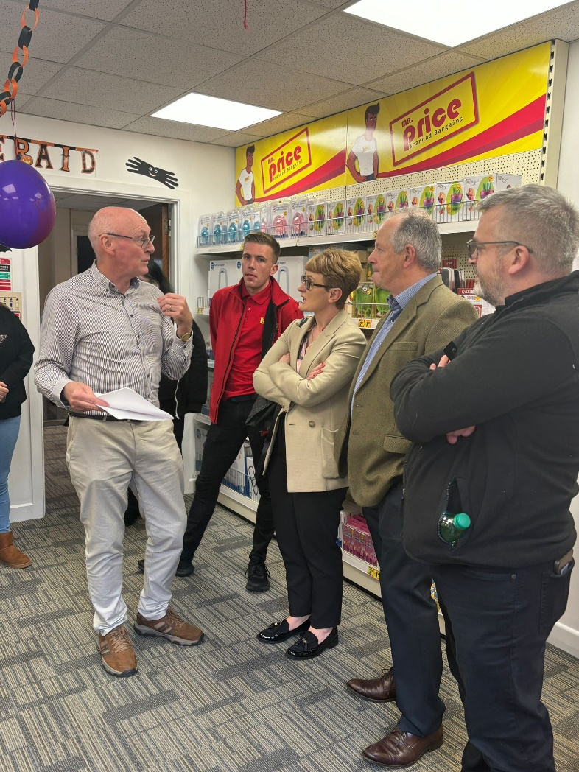
Solution Focused Planning and Innovation (2)

Slide 11
Co-Creating Employment Pathways
Authors:
Anne Marie McDonnell annemarie.mcdonnell@nln.ie
Edel McSorley ops@mrprice.ie

