Slide 1




Adult Dyslexia Assessment Pilot Project
Evaluation Report & Proof of Concept for National Scaling

Slide 2
Purpose of This Presentation
Present findings from the Adult Dyslexia Assessment Pilot (2025)
Highlight Universal Design principles embedded in the model
Share impact data and participant feedback
Outline recommendations for national rollout across ETBs

Slide 3
Strategic Context
Funded under Adult Literacy for Life (ALL) strategy
Collaboration: SOLAS, Cork ETB, Dyslexia Ireland
Addressed long waiting times and high assessment costs
Focused on equity of access within FET sector

Slide 4
System Barriers Identified
High cost of private adult dyslexia assessments
Long waiting lists for psychological services
Limited access for rural and marginalised learners
Delayed access to Higher Education and workplace supports

Slide 5
The Diagnosis Barrier in Further Education
A professional dyslexia diagnosis is often the 'missing piece of paper’ required to access HEI supports and workplace accommodations.
Cost
Time
Fear
The consequence: Progression is hindered

Slide 6
Universal Design Principles in Action
Accessible local FET centre locations
Streamlined and simplified assessment pathway
Reduced administrative burden on learners
Clear communication and structured follow-up
No IQ testing – focused, evidence-based literacy assessment

Slide 7

The Lean Assessment Model
1-hour total process (30 mins direct psychologist testing)
ETB staff manage pre- and post-assessment logistics
Focused subtests: word reading, passage reading, spelling
Formal recognised diagnostic report provided

Slide 8
Implementation Overview
Delivered across multiple Cork ETB FET centres
Urban and rural locations included
40 adults assessed during pilot year
Strong cross-team collaboration model

Slide 9
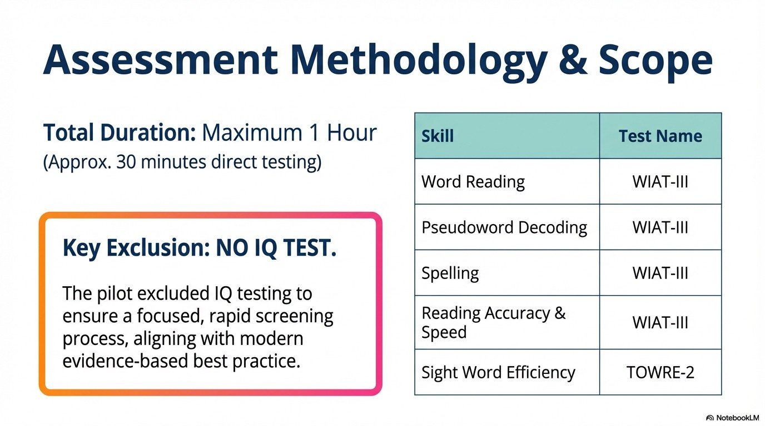
Assessment Methodology and Scope

Slide 10
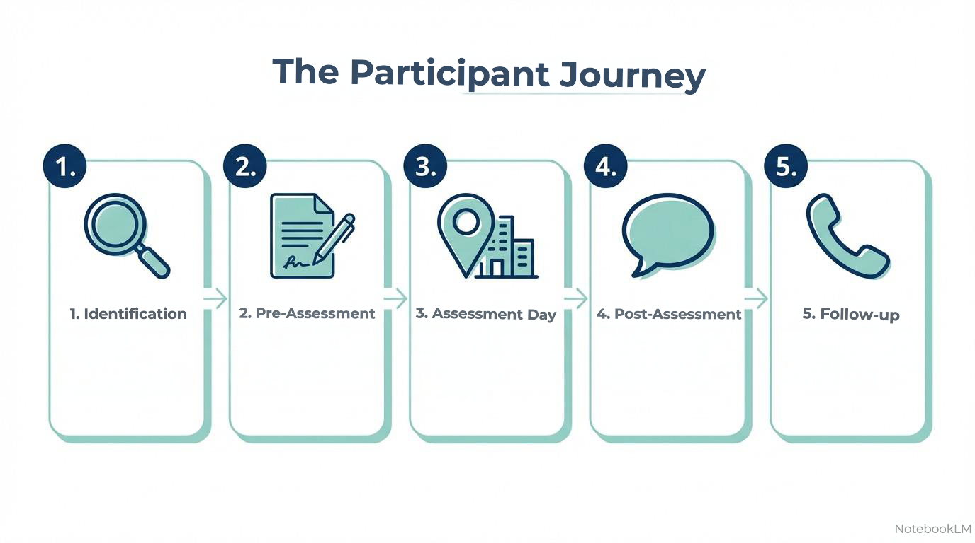
The Participant Journey

Slide 11
Equity & Social Inclusion Impact
Engaged learners previously unable to afford assessment
Improved access for rural learners
Successful engagement with members of the Travelling Community
Reduced anxiety through familiar learning environments

Slide 12
Participant Feedback Highlights
Overwhelmingly positive experience
Described as 'life-changing' by participants
Staff praised as supportive and professional
Local FET setting preferred over clinical environment

Slide 13
Areas for Improvement Identified
Provide more detailed pre-assessment information
Clarify expectations about timed elements of testing
Explore even more informal or flexible assessment spaces

Slide 14
System-Level Benefits
Reduced cost barriers
Reduced waiting times
Efficient use of psychologist time
Clear pathway to HEI supports and workplace accommodations
Scalable within existing ETB structures

Slide 15
Recommendations – National Scaling
Develop strategic framework for all 16 ETBs
Secure sustainable funding model
Consider assistant psychologist roles
Provide structured tutor training supports
Embed follow-up structured literacy and assistive technology guidance

Slide 16
Dissemination
Position FET as leader in adult dyslexia access reform
Contribute to national inclusive education policy

Slide 17
Discussion Questions
How can this model align with your ETB strategy?
What local barriers need addressing?
How can UDL principles be strengthened further?
What partnerships are required for sustainability?

Slide 18
Conclusion
Pilot demonstrates proof of concept
High learner impact with efficient resource use
Strong alignment with Universal Design and ALL strategy
Ready for structured national scaling

