Slide 1

Who Counts 2026: Democratising Data to Drive Institutional Transformation through Universal Design
New Edition coming soon!
Dr Bairbre Fleming & Dr Claire Mullen
UCD Access and Lifelong Learning
19th March 2026
Notes:
Lisa

Slide 2

Outline
Context
Who Counts
Data Democratisation
Universal Design

Slide 3


University College Dublin
Research Intensive
6 Colleges
38,000 + students
Over 25% of places reserved for Access pathways
40.3% of undergraduate students are in one or more access group

Slide 4

University for All
UCD’s whole-institution evidence-based approach to student inclusion
Systemic change initiative to weave inclusion into the fabric of the institution
Dispel myths of ‘traditional’ or average student – give access pathways visibility
Notes:
Encompasses strategy and policy, teaching, learning and assessment, student supports and services, the built environment as well as technological infrastructure.

Slide 5

University for All
In Action
Move from margins to mainstream
Access and inclusion is everyone’s business
Oversight provided by the UCD Widening Participation Committee
78.5% of students are aware of the University for All strategy
Notes:
Encompasses strategy and policy, teaching, learning and assessment, student supports and services, the built environment as well as technological infrastructure.

Slide 6

Who Counts? Measuring Inclusion in UCD: Evidence of a University for All
Admissions – quota & accepts
Participation
Progression, Retention & Completion
Graduate Outcomes
Studying abroad & Internships
Intersectionality – multi-access, ethnicity, commuting
Universal Design badges uptake
Notes:
This data is shared with University Leadership and Widening Participation Committee – used to prompt action.
Doesn’t come together without collaboration with our colleagues in Institutional Research, Careers & Registry

Slide 7

Who Counts?: Dual Purpose
UCD wide data, only some programme specific data
Informs policy makers and public about UCD’s current widening participation successes & challenges
Public facing report
Measuring Inclusion in UCD: Evidence of a University for All
UCD Programme specific data to democratise data
Provides impetus for staff to continue and improve widening participation efforts
UCD Staff only report

Slide 8
Admissions: Access Accepts 2018/19 – 2024/25
Quota: Reserved places for the six access pathways

Slide 9
Participation: 5 Access Groups 2015/16-2023/24
Almost 20% of students have disclosed a disability

Slide 10
UCD Undergraduates as a village of 100 people 2023/2024
19
4
QQI-FET Students
9
Part Time Students
Students with a disability
13
Low Income Students
6
Mature Students
10
Students in Multi-Access Groups

Slide 11
Intersectionality: Commuting & Access Groups

Slide 12




Universal Design Training Uptake in UCD
527
636
152
Introduction to Universal Design in UCD
UD Teaching and Learning
UD Beyond the Classroom
36
Facilitator Badges
Notes:
UCD has seen the highest institutional take up of T&L badge, not least because of the development of a Faculty Partnership Programme.

Slide 13
So What? Insights from Who Counts
Continued link between high points programmes and low numbers of access students.
Uneven use of access pathways
Increasingly intersectional access population – tailored support needed.
Significant resources still required for one-to-one adjustments.
High Universal Design take up but more to be done

Slide 14

Toolkit for Universal Design in Higher Education
Assist in creating an action plan
Recognise the work already achieved
Identify areas of priority
Offer practical steps to implement and embed inclusive practice
Facilitate dialogue between faculty, professional staff, technical staff etc. on the importance of Universal Design for inclusive educational practice.

Slide 15

How/why it’s worked
Democratisation/Delegation
Widening Participation Committee structure
Changing mindsets/perspectives
Systems change
Networks for active collaboration
Senior management buy-in
Notes:
Making it everyone’s business – giving colleagues the remit/responsibility and the platform.
Convincing/encouraging their colleagues about the value of UD, much more persuasive than anything we could say.
Embedding/weaving it into other projects for example POST, Academic Integrity and AI.
Opportunities to showcase their work – through case studies, symposia, recognition from senior management.
Google spaces/regular meetings to share ideas, solutions.

Slide 16






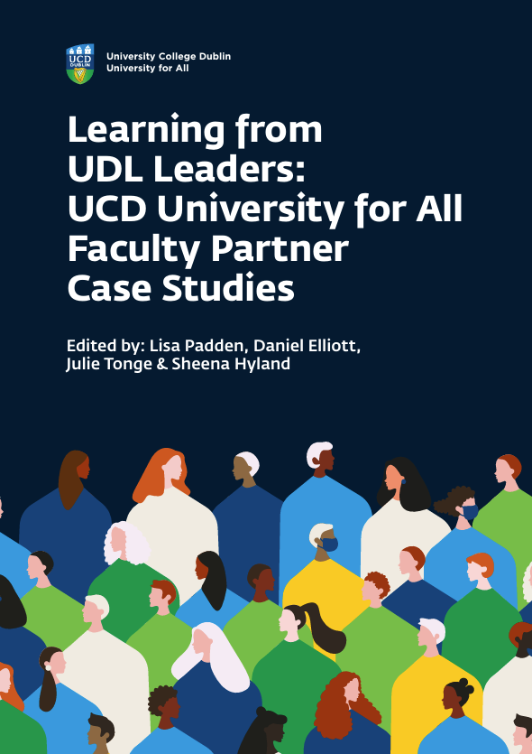
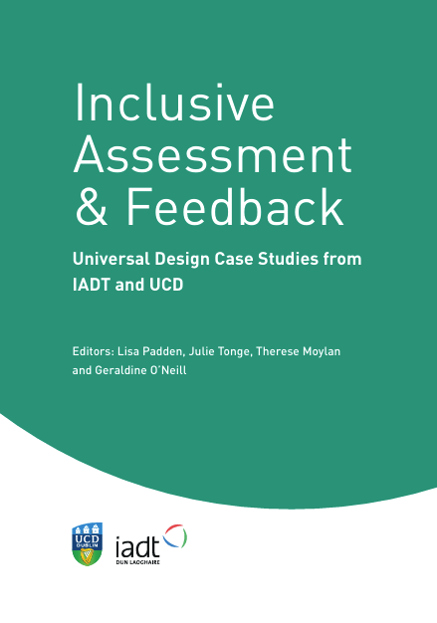
University for All Publications

Slide 17
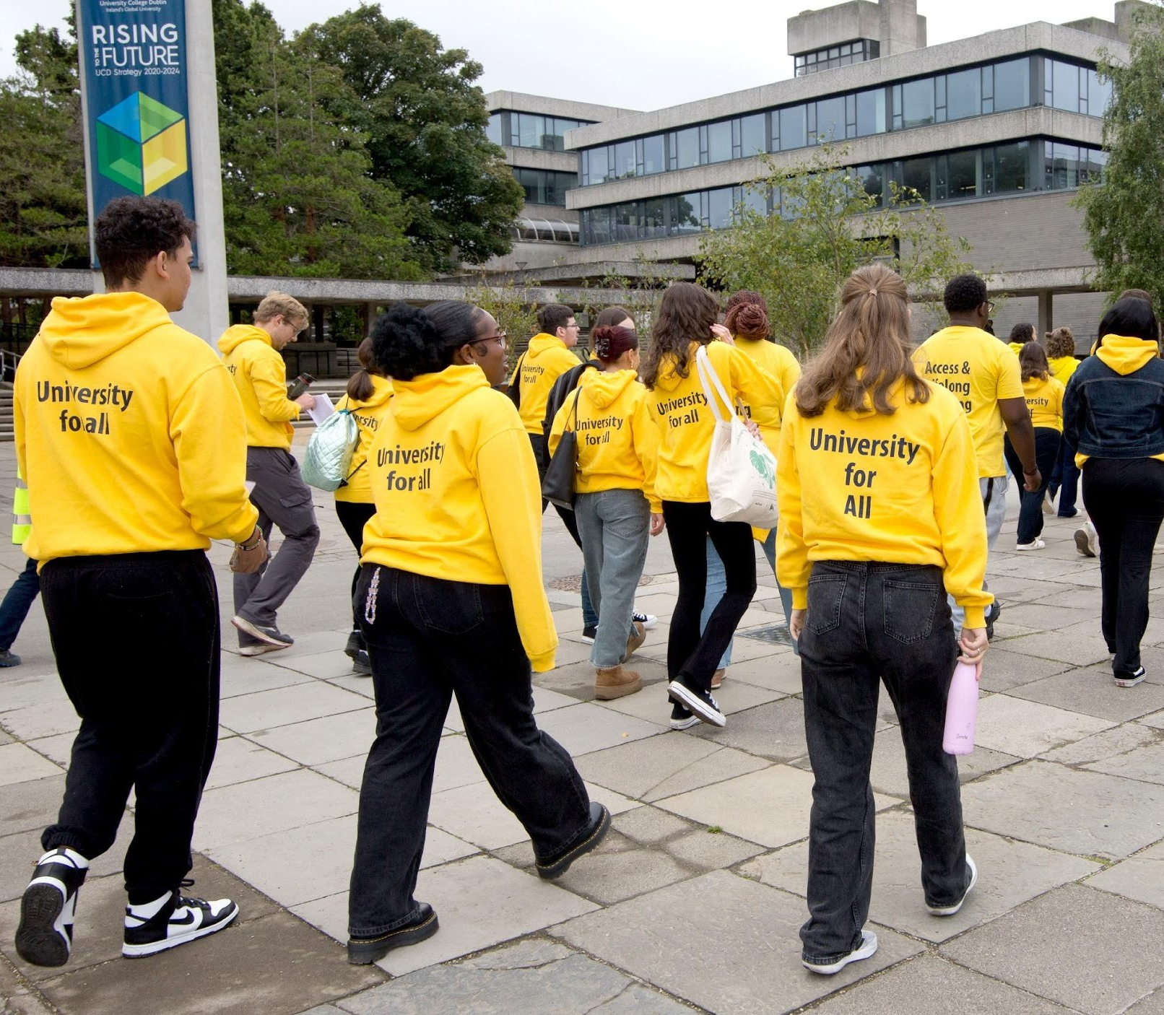
Thank you!
Questions?

