Slide 1



Evaluating Inclusivity in Higher Education: A UDL-Informed Programme Review at ATU
Mrs Eloise McGinty & Mr Patrick Brennan
ATU UDL Donegal Ambassadors
Faculty of Business
Department of Law
Public Service and Education, Department of Tourism and Sport

Slide 2
Evaluating Inclusivity in Higher Education: A UDL-Informed Programme Review at ATU
Rationale for implementing a UDL-informed review of existing ATU programmes
UDL-informed programme review process
Benefits of undertaking UDL-informed programme review
Recommendations
Background

Slide 3

ATU UDL Centre of Excellence Initiative: A Universally Designed Learning-Informed Programme Review
Address the diverse learning needs and preferences of all students through inclusive and flexible pedagogical approaches
1
Ensure full compliance with the principles and commitments outlined in the Altitude Charter
3
Align with the strategic priorities and educational vision articulated in the ATU Strategic Plan
2
Notes:
Places inclusion at the core of institutional values, with Universal Design for Learning serving as a mechanism to realise ATU’s commitments to inclusion, collaboration, innovation, respect, and trust.
Prioritises flexible, inclusive, and accessible learning environments under the Enabling Education pillar, emphasising innovative teaching methods that enhance student success and widen participation.
Supports systematic embedding of UDL across programmes through the ATU UDL Centre of Excellence, which provides workshops, training, digital badges, and postgraduate offerings to help staff integrate UDL principles into curriculum design.
Aims to create equitable learning experiences for diverse students, aligning with UDL’s focus on addressing learner variability through multiple means of engagement, representation, and expression.
Positions UDL as foundational to ATU’s ambition to be a globally connected and inclusive university, ensuring that teaching and learning practices remain future‑focused, accessible, and responsive to regional and international needs.

Slide 4
Rationale to conducting a UDL-Informed Review: to align with ATU Strategic Plan
Places inclusion at the core of institutional values Prioritises flexible, inclusive, and accessible learning environments under the Enabling Education pillar Supports systematic embedding of UDL across programmes Aims to create equitable learning experiences for diverse students Positions UDL as foundational to ATU’s ambition to be a globally connected and inclusive university
Notes:
Places inclusion at the core of institutional values, with Universal Design for Learning serving as a mechanism to realise ATU’s commitments to inclusion, collaboration, innovation, respect, and trust.
Prioritises flexible, inclusive, and accessible learning environments under the Enabling Education pillar, emphasising innovative teaching methods that enhance student success and widen participation.
Supports systematic embedding of UDL across programmes through the ATU UDL Centre of Excellence, which provides workshops, training, digital badges, and postgraduate offerings to help staff integrate UDL principles into curriculum design.
Aims to create equitable learning experiences for diverse students, aligning with UDL’s focus on addressing learner variability through multiple means of engagement, representation, and expression.
Positions UDL as foundational to ATU’s ambition to be a globally connected and inclusive university, ensuring that teaching and learning practices remain future‑focused, accessible, and responsive to regional and international needs.

Slide 5
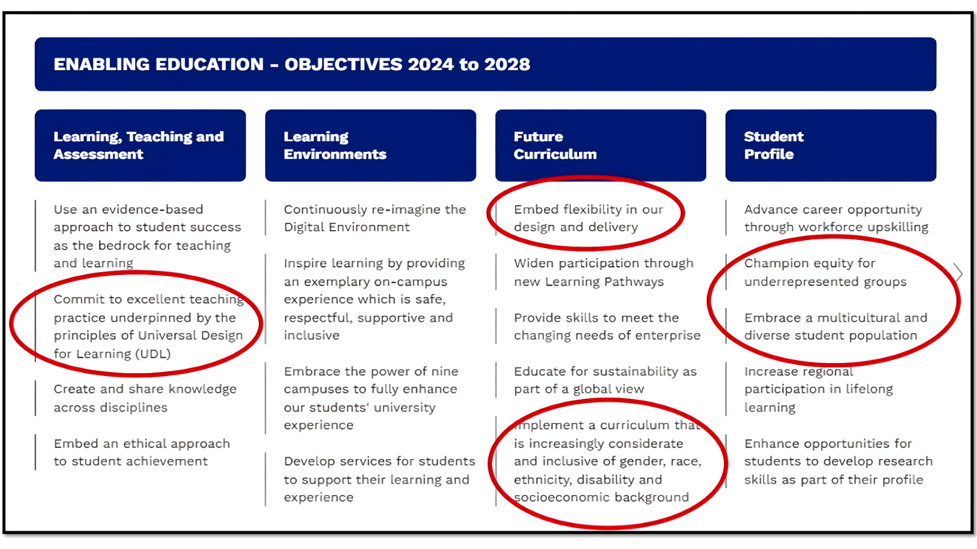
Enabling Education – Objectives 2024 to 2028 document
https://atu.turtl.co/story/atu-strategic-plan-2024-to-2028/page/6/3

Slide 6




Rationale to conducting a UDL-Informed Review : To align with the Altitude Charter
System-wide integration
Across teaching, assessment, supports and institutional policies
Inclusive design and student voice
Flexible assessment, accessible environments, cultural change and staff capacity building
Alignment with standards
National and international standards: a structured mechanism to review practices and promote commitment
Notes:
Provide a systemic roadmap that helps institutions embed UD and UDL across teaching, assessment, student supports, and policies.
Created in response to evidence that UD/UDL commitments were not consistently reflected in institutional practice, despite strong policy support
The ALTITUDE Charter Focus areas include: inclusive learning design, flexible assessment, accessible environments, student voice, institutional culture change, and staff capacity building.
Aligned with major national and international frameworks, such as: UNCRPD Article 24, UN Sustainable Development Goals 4 & 10, National Access Plan (Objective 1.3: embedding UD to support student success), Irish equality and disability legislation (EPSEN, Equal Status Acts, Disability Act 2005) Provides institutions with a structured way to identify barriers, review practices, and plan improvements to support all learners. Functions as a commitment mechanism: institutions that adopt it pledge to integrate UD/UDL into all systems, services, and teaching practice

Slide 7




Key aims of conducting a UDL-informed programme review
Systematic evaluation
Curriculum design and delivery to ensure accessibility, flexibility, and effectiveness
Multiple means (UDL)
Assessing the extent to which modules provide multiple means
Minimise barriers
Accommodating learner variability, and fostering expert, independent learning
Inclusivity and diversity
Disabilities, neurodiversity, and varied cultural backgrounds
Notes:
Entails a comprehensive and systematic evaluation of curriculum design and delivery to ensure that learning experiences are accessible, adaptable, and pedagogically effective for an increasingly diverse learner population.
Provide a systemic roadmap that helps institutions embed UD and UDL across teaching, assessment, student supports, and policies.
Created in response to evidence that UD/UDL commitments were not consistently reflected in institutional practice, despite strong policy support
The ALTITUDE Charter Focus areas include: inclusive learning design, flexible assessment, accessible environments, student voice, institutional culture change, and staff capacity building.
Aligned with major national and international frameworks, such as: UNCRPD Article 24, UN Sustainable Development Goals 4 & 10, National Access Plan (Objective 1.3: embedding UD to support student success), Irish equality and disability legislation (EPSEN, Equal Status Acts, Disability Act 2005) Provides institutions with a structured way to identify barriers, review practices, and plan improvements to support all learners. Functions as a commitment mechanism: institutions that adopt it pledge to integrate UD/UDL into all systems, services, and teaching practice

Slide 8

ATU UDL-informed programme review: process
Initial meeting with programme chair
Programme chair provides the necessary information
Meeting with the team
Team assess their module through UDL lens
Report from the auditing team
Notes:
The process begins with a concise 20-minute presentation delivered to all academic staff teaching on the programme, introducing key UDL principles and their relevance to curriculum design and delivery.
Following this, drop-in clinics are made available to support lecturers in evaluating their modules using a one-page UDL modular toolkit checklist.
Completion of the checklist is expected to take approximately 15–20 minutes per module and will prompt staff to reflect on multiple means of engagement, representation, and action and expression within their teaching practices. Lecturers then upload their completed checklists to a secure programme audit Teams’ folder accessible only to programme staff. These submissions inform a systematic ATU UDL-informed programme review aimed at identifying barriers, accommodating learner variability, and fostering expert, independent learning across all modules.

Slide 9


ATU UDL-informed programme review: tools
Inclusive Module Audit Forms
Questions on teaching materials and classroom practices
Programme Documents
Module descriptors
Programme recommendation
Summary Form
How to use the toolkit
Excel Tool
Spreadsheet summarising the responses of the respondents
Communication channel: Teams folder

Slide 10
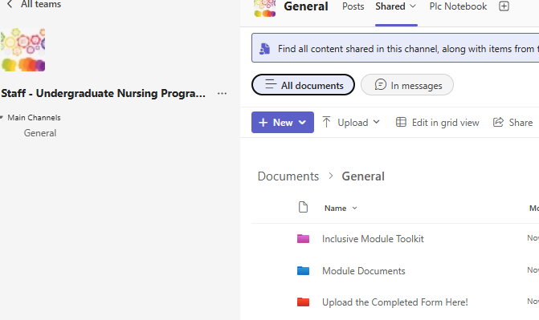
Screenshot of collaboration within Microsoft

Slide 11
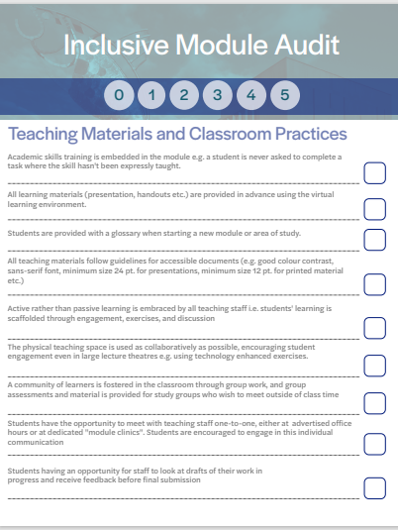
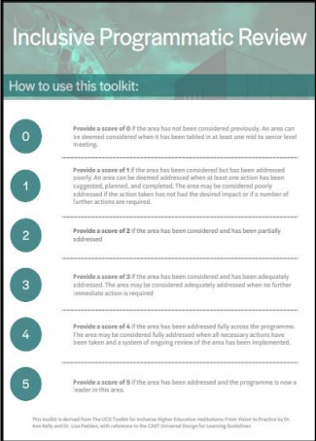
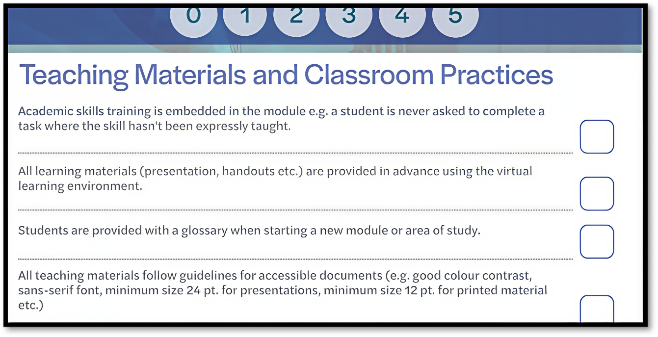
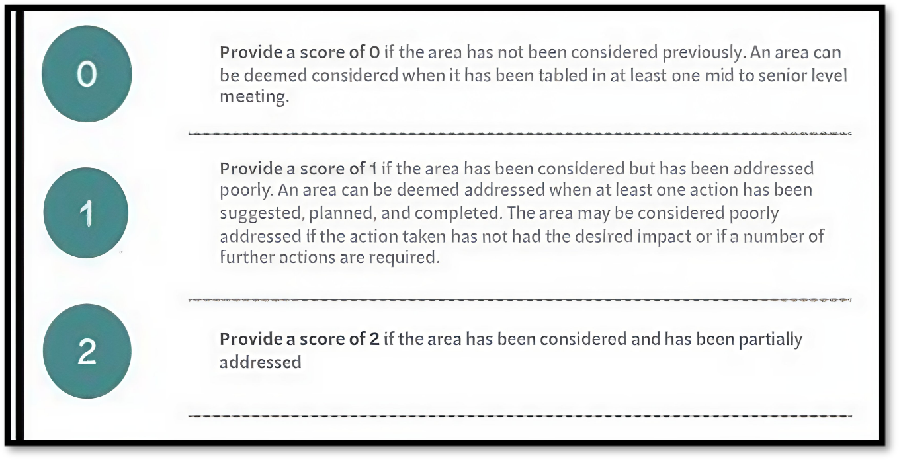
Inclusive Module Toolkit

Slide 12
Excel audit document
Inclusive Module Audit : Teaching materials and classroom practices
 | 1 | 2 | 3 | 4 | 5 | 6 | 7 | 8 | 9 | 10 | 11 | 12 | 13 | 14 | 15 | 16 | 17 | 18 | 19 | 20 | 21 | 0
Academic skills training is embedded in the module. Eg: a student is never asked to complete a task where the skill hasn't been expressly taught. | 5 | 4 | 5 | 4 | 5 | 5 | 5 | 5 | 5 | 5 | 5 | 5 | 5 | 4 | 4 | 4 | 5 | 5 | 5 | 5 | 5 | 4.76
All learning materials (presentation, handouts etc.) are provided in advance using the virtual learning environment. | 5 | 5 | 4 | 5 | 5 | 1 | 5 | 5 | 2 | 2 | 5 | 3 | 3 | 5 | 4 | 5 | 5 | 5 | 5 | 5 | 4 | 4.19
Students are provided with a glossary when starting a new module or area of study. | 4 | 3 | 0 | 0 | 4 | 0 | 4 | 5 | 0 | 4 | 4 | 0 | 0 | 3 | 5 | 1 | 4 | 5 | 4 | 2 | 5 | 2.71
All teaching materials follow guidelines for accessible documents (e.g. good colour contrast, sans-serif font, minimum size 24 pt. for presentations, minimum size 12 pt. for printed material etc.) | 5 | 5 | 4 | 2 | 5 | 3 | 4 | 5 | 5 | 3 | 5 | 4 | 4 | 5 | 5 | 5 | 5 | 5 | 5 | 4 | 5 | 4.43
Active rather than passive learning is embraced by all teaching staff i.e. students' learning is scaffolded through engagement, exercises, and discussion | 5 | 5 | 5 | 5 | 5 | 4 | 5 | 4 | 5 | 5 | 5 | 5 | 5 | 5 | 4 | 5 | 5 | 5 | 5 | 5 | 5 | 4.86
The physical teaching space is used as collaboratively as possible, encouraging student engagement even in large lecture theatres e.g. using technology enhanced exercises. | 4 | 4 | 4 | 4 | 5 | 4 | 4 | 4 | 5 | 5 | 4 | 4 | 4 | 4 | 3 | 4 | 4 | 5 | 4 | 5 | 5 | 4.24
A community of learners is fostered in the classroom through group work, and group assessments and material is provided for study groups who wish to meet outside of class time | 3 | 3 | 0 | 0 | 5 | 5 | 5 | 3 | 5 | 5 | 5 | 3 | 3 | 3 | 3 | 4 | 3 | 5 | 5 | 5 | 5 | 3.71
Students have the opportunity to meet with teaching staff one-to-one, either at advertised office hours or at dedicated "module clinics". Students are encouraged to engage in this individual communication | 4 | 5 | 5 | 0 | 4 | 3 | 4 | 5 | 5 | 4 | 4 | 5 | 5 | 5 | 3 | 3 | 4 | 5 | 4 | 5 | 5 | 4.14
Students having an opportunity for staff to look at drafts of their work in progress and receive feedback before final submission | 5 | 5 | 0 | 0 | 4 | 2 | 2 | 4 | 3 | 2 | 5 | 0 | 0 | 5 | 3 | 0 | 5 | 5 | 5 | 3 | 5 | 3.00

Slide 13
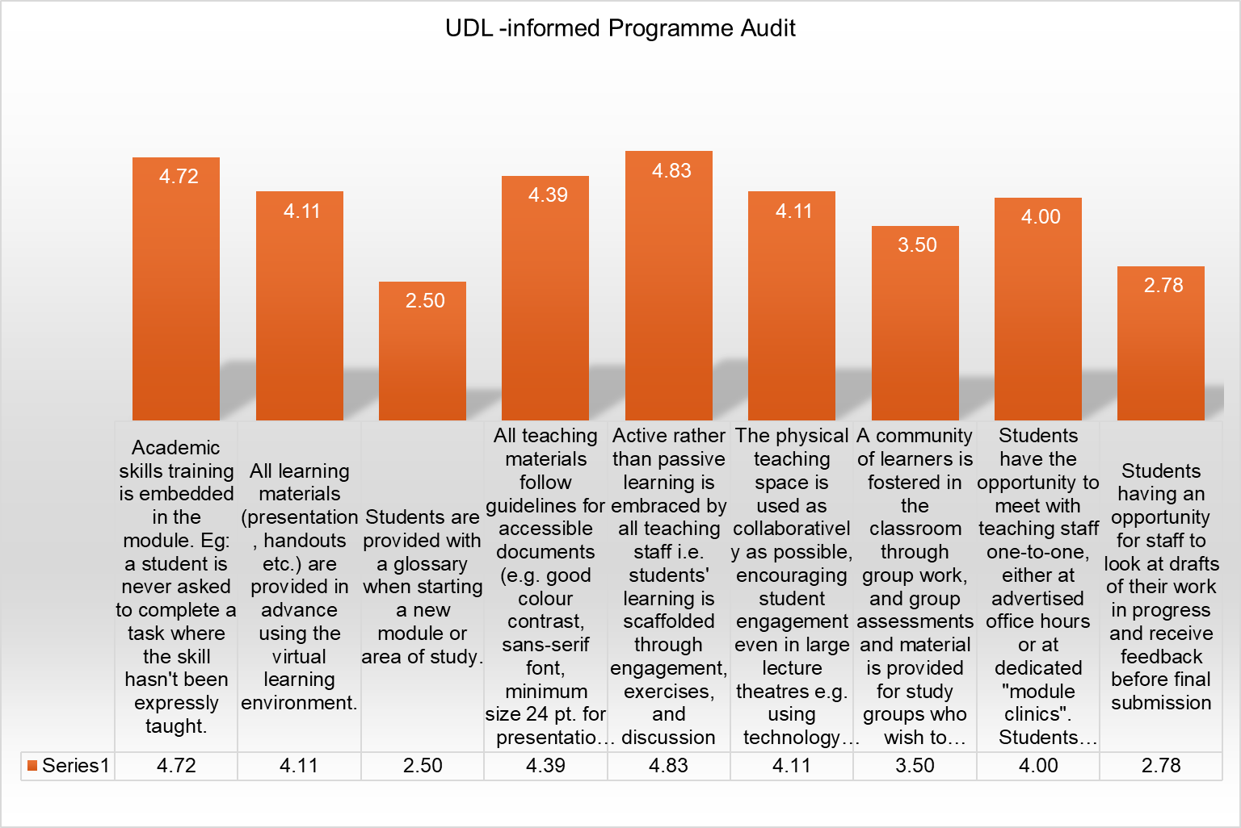
UDL-informed Programme Audit

Slide 14
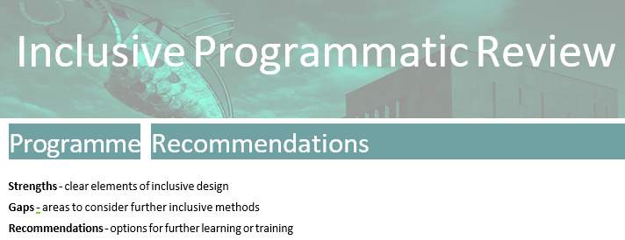
Inclusive Programmatic Review

Slide 15
Inclusive Programmatic Review: Strengths identified
Overall, we can see there is a good effort at active learning with activities that are engaging and encouraging discussion
Material is provided in advance on Virtual learning environment Moodle/Blackboard which is good practice
Material generally follows the guidelines of accessibility varied formats
There is a clear awareness of learning process ensuring learning is scaffolded
Learners have the opportunity to discuss one to one with the lecturer if needed

Slide 16
Inclusive Programmatic Review: Gaps identified
A glossary enhances accessibility of module content and represents good pedagogical practice
When lecturers are assigned new modules, time constraints in preparing and delivering content may limit the immediate integration of UDL best practices
Group work is a key principle of UDL, promoting peer learning, skill development, and a sense of community that enhances inclusivity and productivity
Feedback and feed forward is essential for learners to assess what they need to work on and gauge their progress. Consider feedback in different media/formats: On-line, audio feedback, verbal class feedback

Slide 17
Inclusive Programmatic Review Recommendations
Know Students’ Strengths and Barriers
Offer students choice in how they demonstrate learning (e.g., written, oral, visual, multimedia formats), removing unnecessary barriers and supporting autonomy.
Use of Digital Materials: Provide accessible digital content that allows for text-to-speech, adjustable font sizes, embedded definitions, and translation tools
Share content in varied formats (e.g., plain language summaries, detailed readings, videos, podcasts) to enhance accessibility and comprehension.

Slide 18

Inclusive Programmatic Review Recommendations
Digital Badge
Think-Pair-Share
Quick Write
Complete
Activates prior knowledge, supports structured peer dialogue, promotes cognitive processing and inclusive participation.
Supports engagement, immediate feedback, and inclusive participation.
Turn and Talk
Polling
Academically productive talk: share and refine ideas, listen actively, deepen reasoning- engage constructively with peers
Brief, timed written responses supports articulating understanding, clarify thinking, and engaging critically with content

Slide 19
Thank you very much for your time. Any questions?

