Slide 1

UDL-Informed Digital Approaches to Learning, Teaching, and Assessment in Undergraduate Nursing and Midwifery Education
Jennifer Byrne and Kerry McGlynn

Slide 2
Our Digital Recording Team
Kerry McGlynn. RGN, H.Dip Nursing, MSc in Leadership, PNE in Nursing Education, RNT
Jennifer Byrne. RGN, RCN, BSc., PGDip in Perioperative Nursing, PGCert in Practice Education.
Dr Kevin Johnson. B.Eng, M.Eng, PhD., Senior AV Technician, School of Nursing & Midwifery.

Slide 3
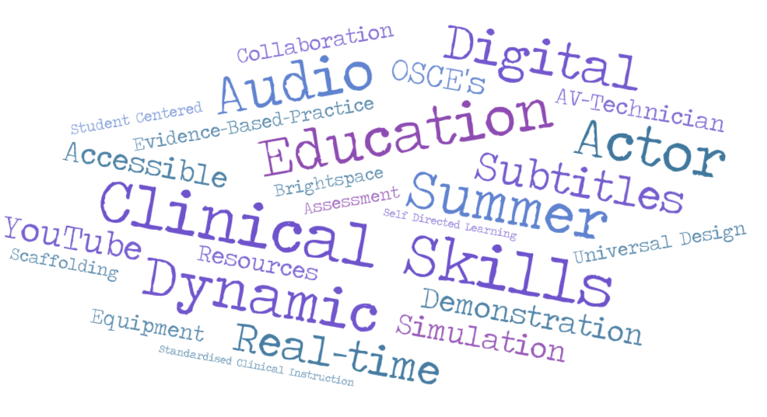
Word cloud

Slide 4
Pillars in Practice: Digital
Development of a suite of pre-recorded clinical skills for undergraduate nurses and midwives
Widely accessible user-friendly platforms- YouTube/Virtual Learning Environment
Universal Design enabling transformative learning for all
Embracing human diversity and promoting positive learning environments
Embedding Universal design at the strategic level with UL

Slide 5

Why Develop pre-recorded clinical skills films to support student’s learning?
Student Inclusion
Digital learning supports blended learning and self-paced revision
Authentic and Innovative
Standardised clinical instruction
Scaffolding student learning through repeated exposure to clinical skills
Evidence-based best practice
Clinical Placement limitations?
Time and resource constraints
Notes:
Diverse population with differing learning needs- embraced
Accessibility and Inclusion which tr
Universal Design -key!
Easily navigated and accessed
to support teaching and learning
Equality, Diversity and Inclusion

Slide 6

A Driver for Change
Dialogue with Peers
Module Team
Past students – anecdotal
Professional Development

Slide 7
Pre-recorded Clinical Skills development
How were they created?
  Collaboration between academic staff and clinical experts.
  Filmed in simulation labs for authenticity.
  Actors- Self Funded
  Summer Term- no negative impact on teaching.

Slide 8
Pre-recorded Clinical Skills – Features and Accessibility
Step-by-Step demonstrations
High-quality visuals
Voice over audios
Subtitles
Integration with Brightspace and YouTube platforms
Available 24/7.
Compatible with mobile devices

Slide 9
Impact on Learning & Assessment
Benefits for students
  Inclusive educational experience for all
  Flexible asynchronous teaching modality
  Reinforce traditional teaching modalities
  Uniformity of teaching
  Supports preparation for OSCEs and clinical placements
  Encourages autonomous learning

Slide 10
Impact on Learning & Assessment (2)
Benefits for faculty
  Leading out through modelling and visibly supporting universal design
  Innovative evidence-based practice
  Uniformity of teaching through shared universal design practice
  Flexible asynchronous teaching modality
  Supports preparation for OSCEs and clinical placements

Slide 11
Impact to Date
Ventrogluteal IM Injection technique
Since November 7th 2025 Views – 18,401, Likes 26
Dorso gluteal IM Injection Technique
Since October 24th 2025 Views - 16,204, Likes 22
Deltoid IM Injection Technique
Since October 24th 2025 Views - 3605, Likes 12
Subcutaneous Injection Technique Since September 19th 2025 Views - 9,909, Likes 22
Vastus Lateralis IM Injection Technique Since October 24th 2025 Views - 17,845, Likes 19
Logrolling a person with known or suspected Spinal Cord Injury (SCI)
Since September 15th 2025 Views – 2,185, Likes 15

Slide 12
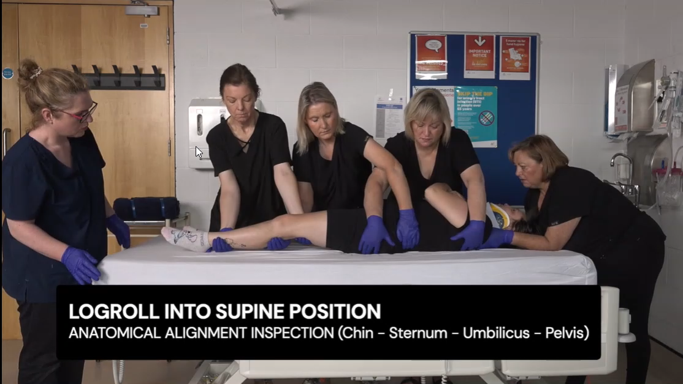
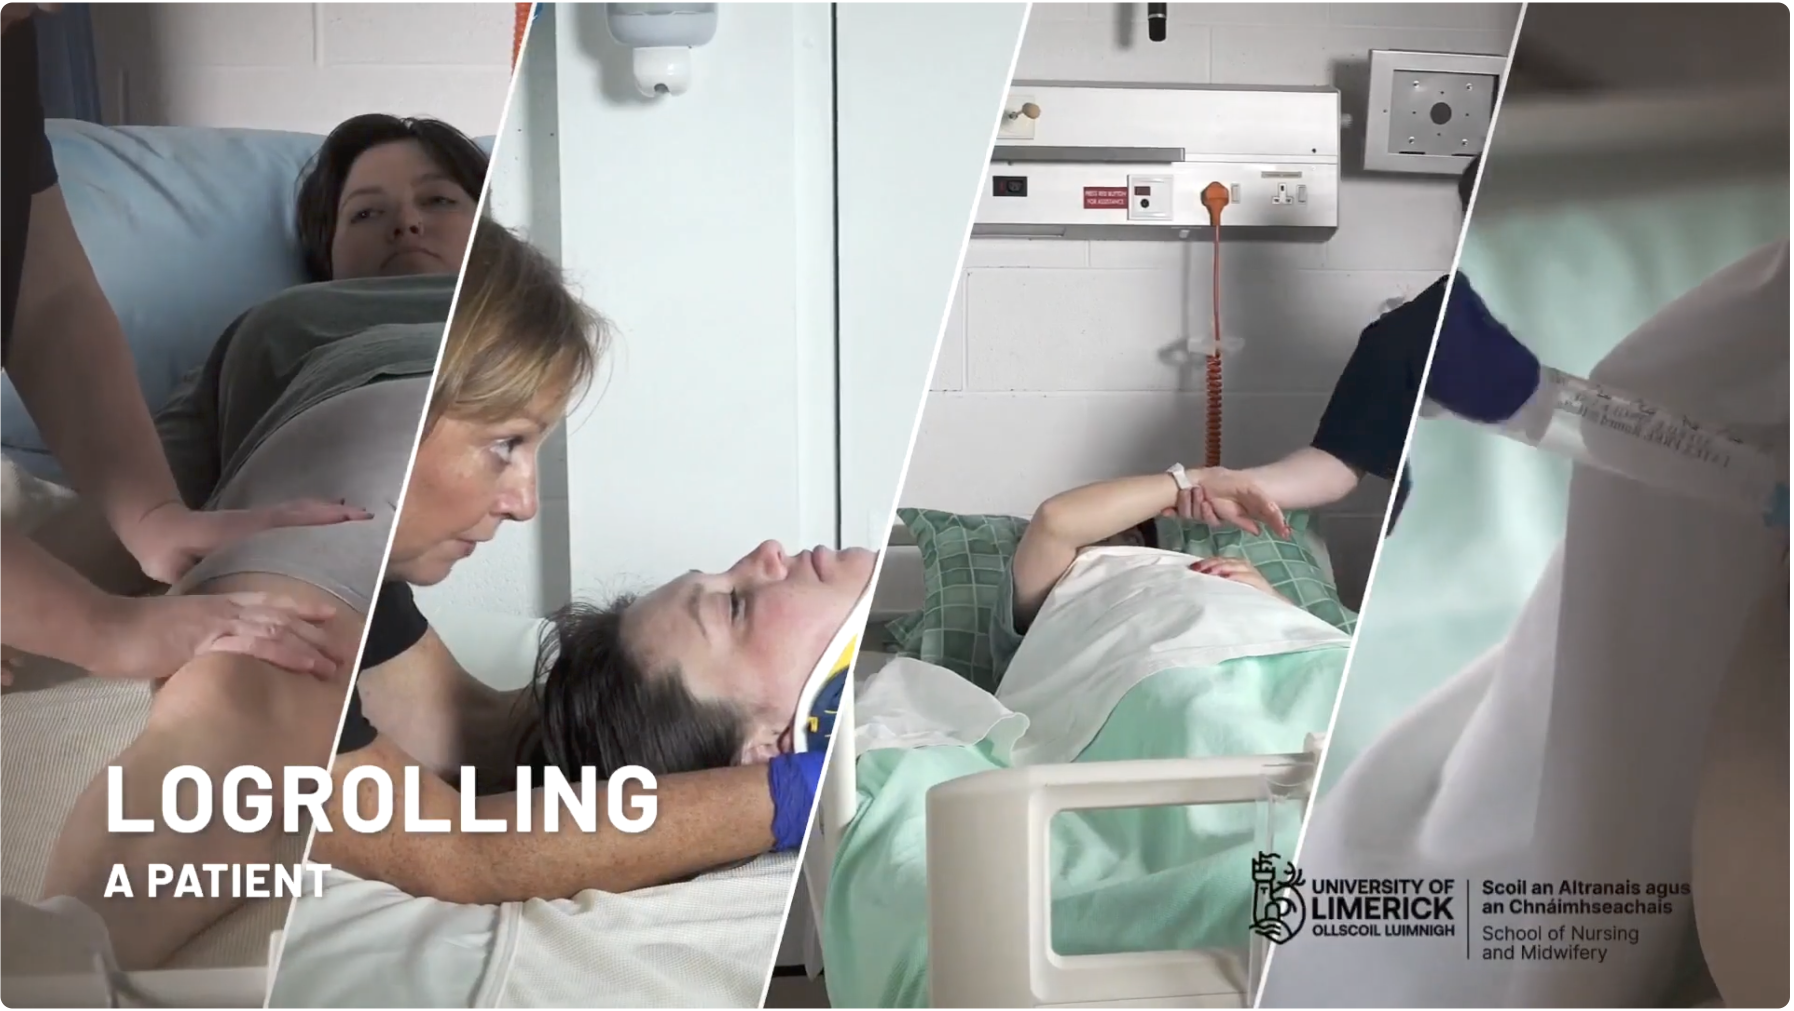
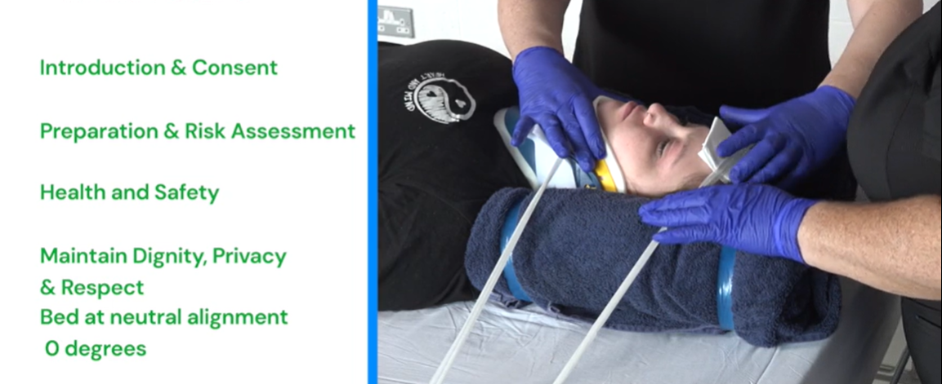
Spinal Logrolling Video

Slide 13
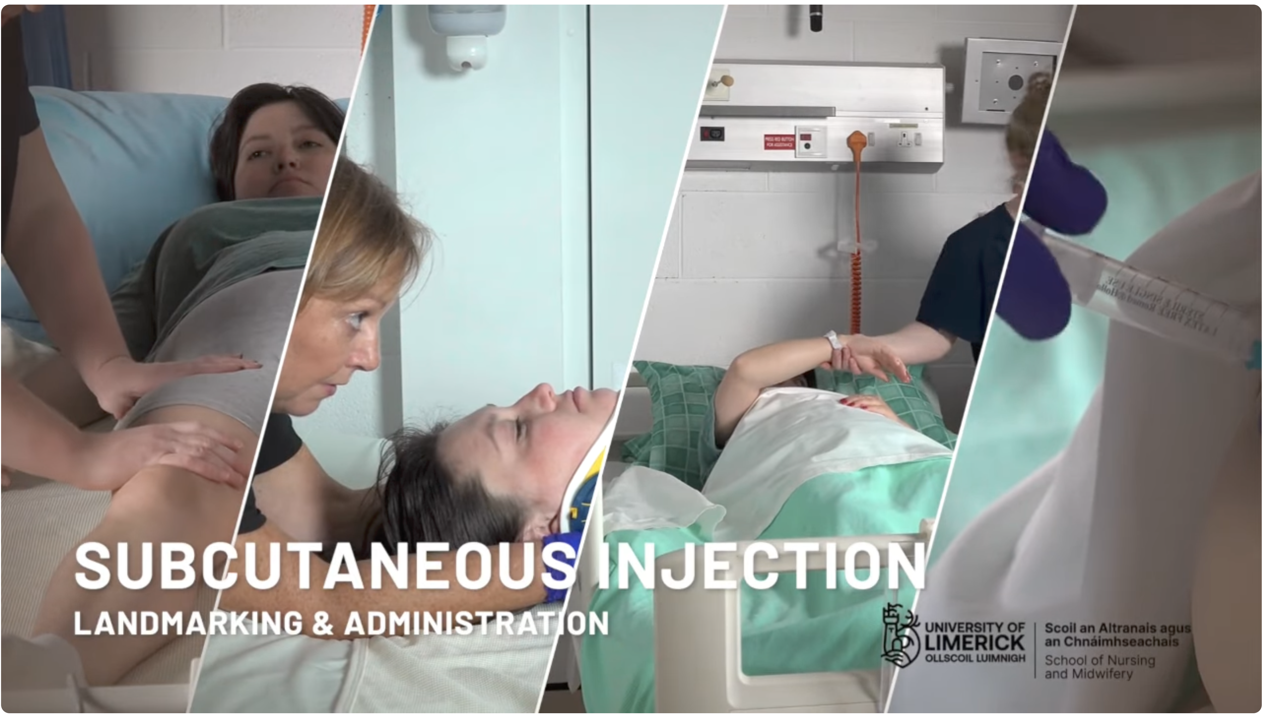
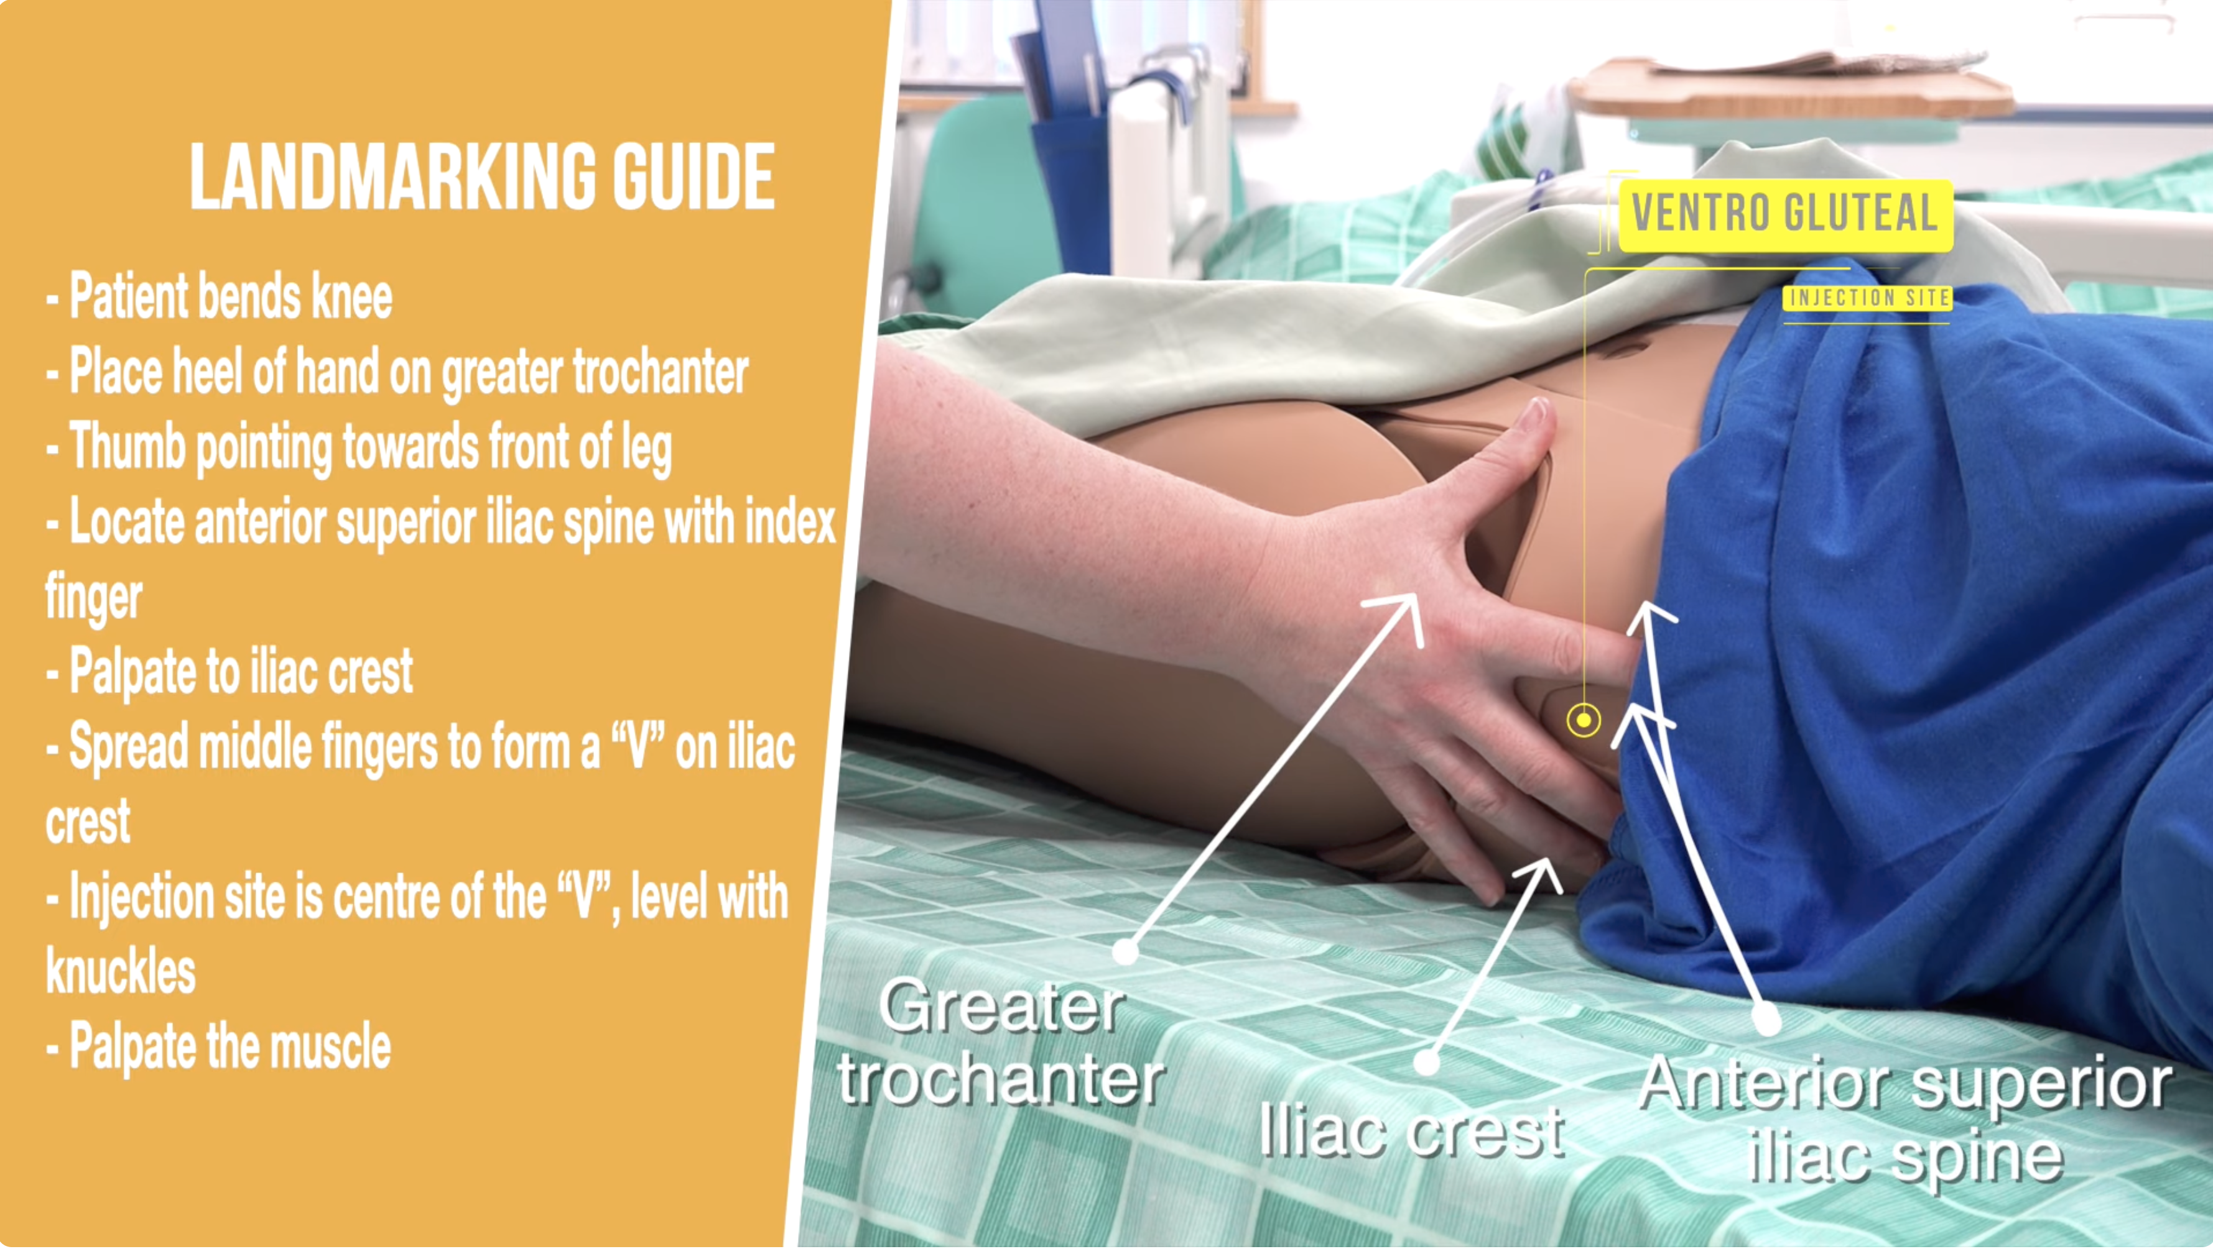
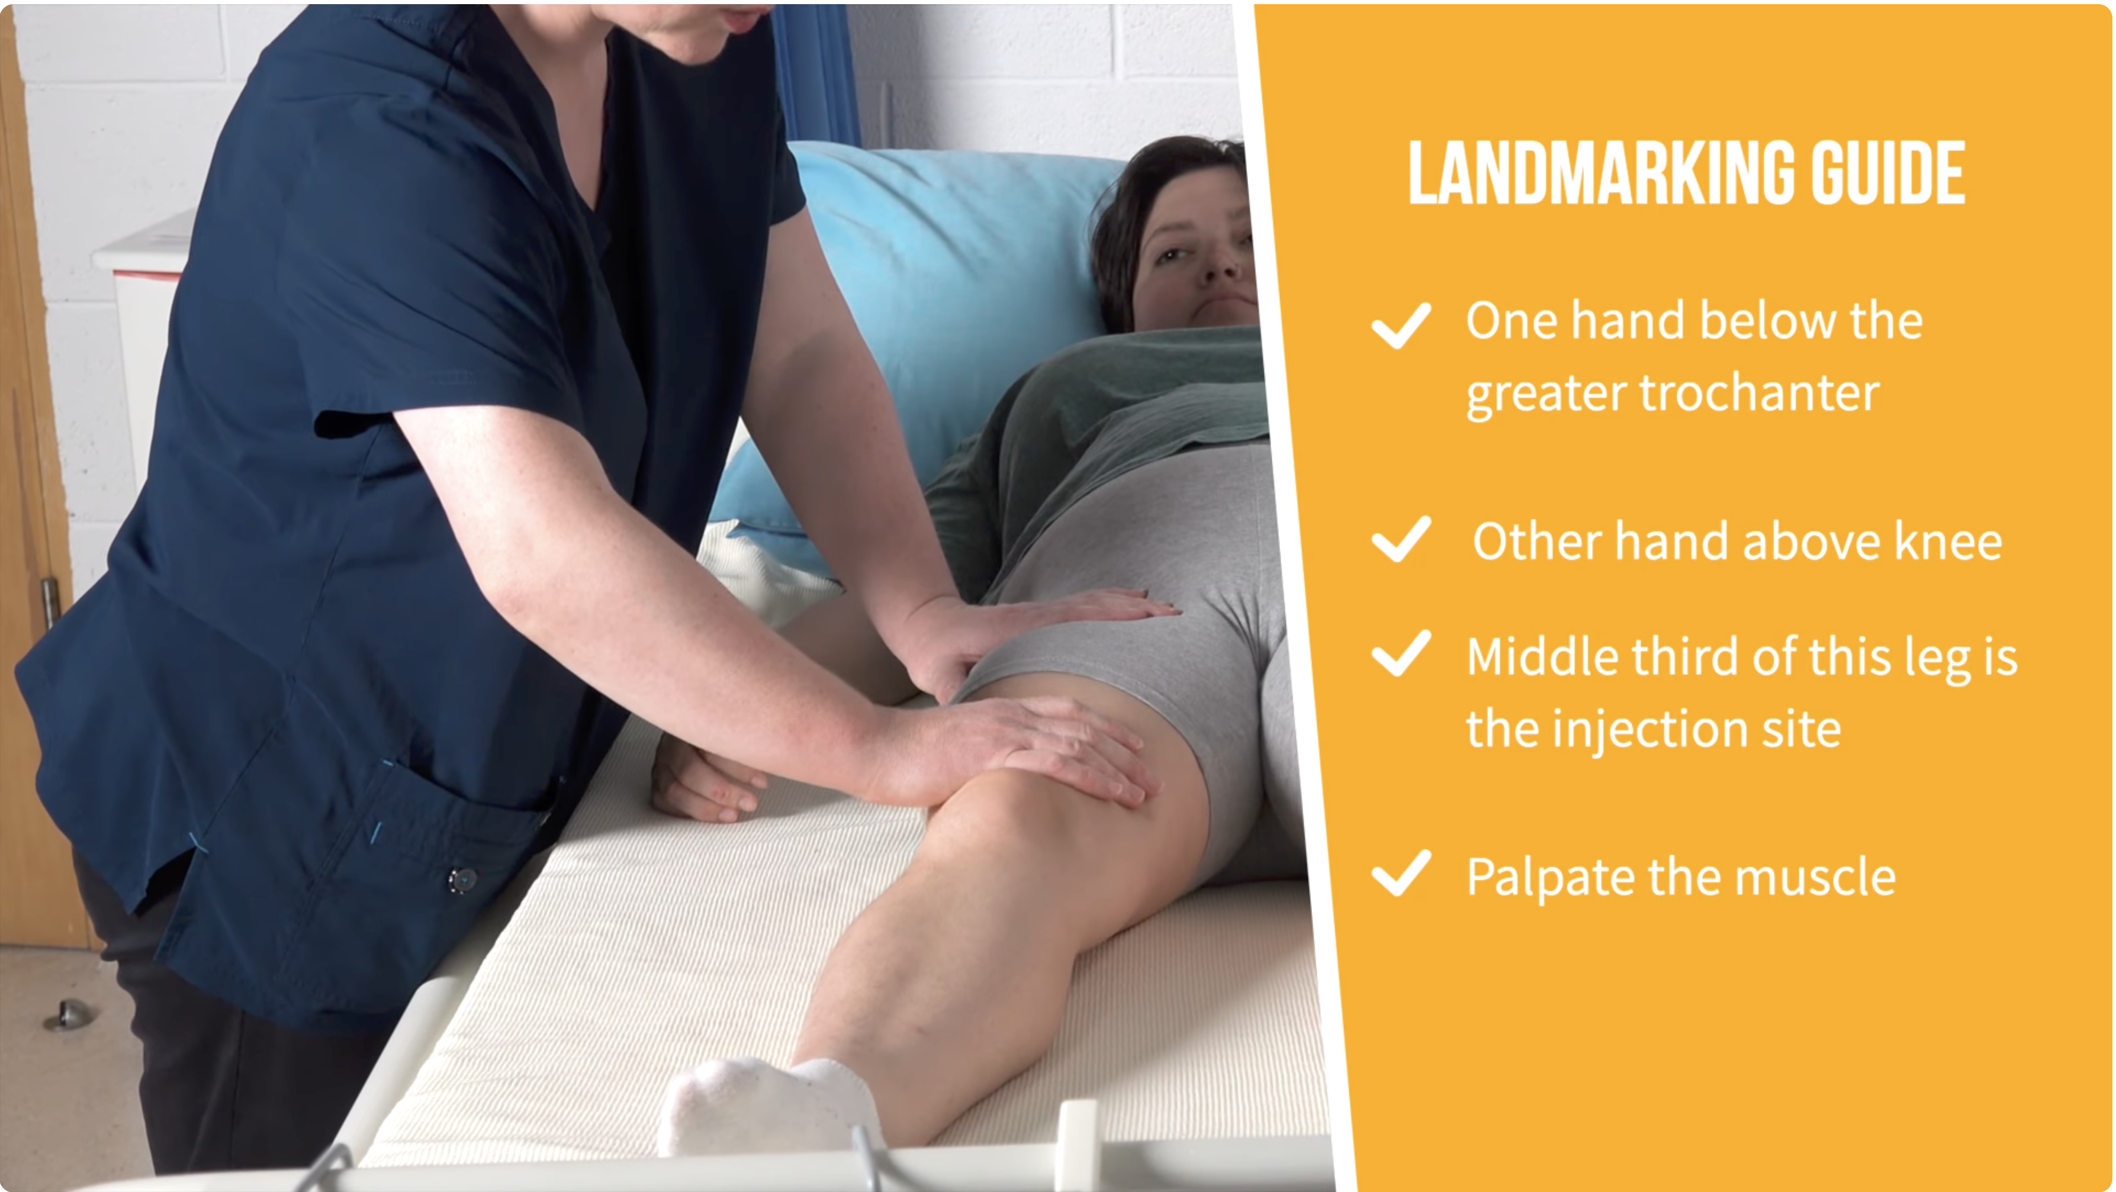
Injection Technique Videos

Slide 14
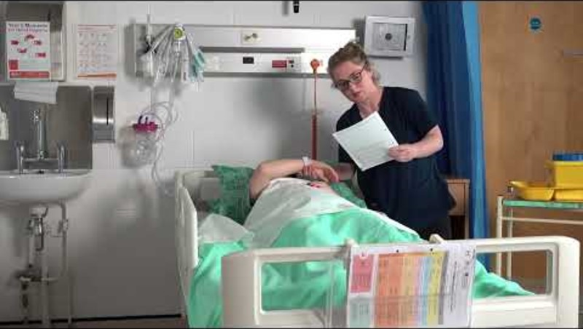
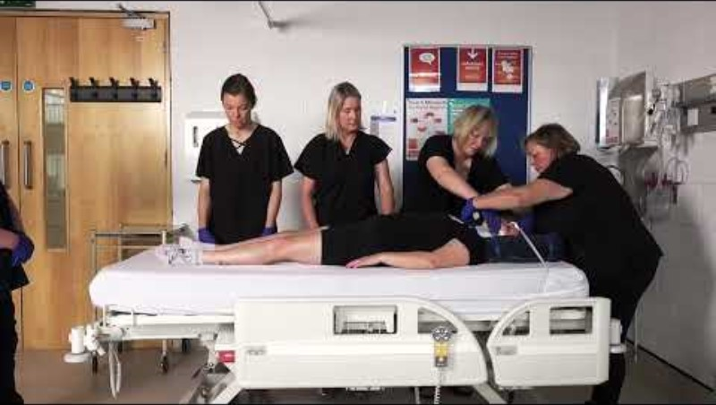
Clips of our Videos

Slide 15
School of Nursing & Midwifery: Social Media
YouTube Subscribers to School of Nursing & Midwifery, UL channel
Then: June 2025 – 79
Now: February 2026 - 243

Slide 16
Challenges & Lessons Learned
Technical challenges
Professional challenges
Alignment with Evidence-Based Best Practice
Real-time updates and student feedback

Slide 17
Future Plans...
Expand video repository to cover more skills
Incorporate interactive elements (e.g., VR, AR)
VLOG
Research impact on student learning and clinical performance.

Slide 18
Contact Information
Jennifer Byrne: University Teacher, School of Nursing & Midwifery
jennifer.byrne@ul.ie
Kerry McGlynn: University Teacher, School of Nursing & Midwifery
kerry.mcglynn@ul.ie
Dr Kevin Johnson, AV Technician, School of Nursing & Midwifery
kevin.johnson@ul.ie
Notes:
If you have any questions-

Slide 19
Thank you!
Jennifer & Kerry
ul.ie

