Slide 1

Empowering Educators: Tools and Strategies for UDL Success Trish O’Connell, Laura Hegarty, Katie O’Dwyer

Slide 2
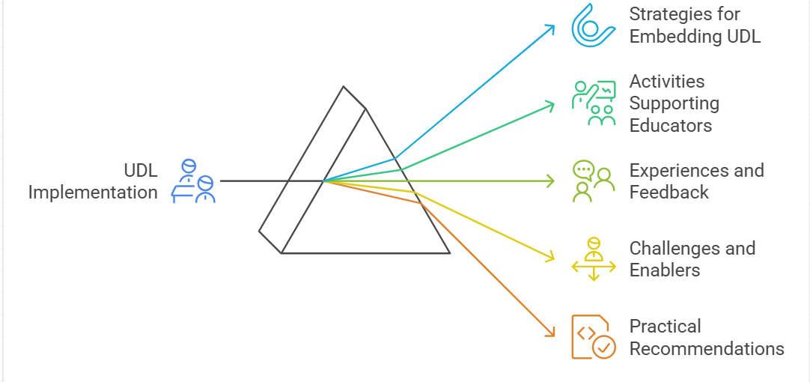
Agenda

Slide 3
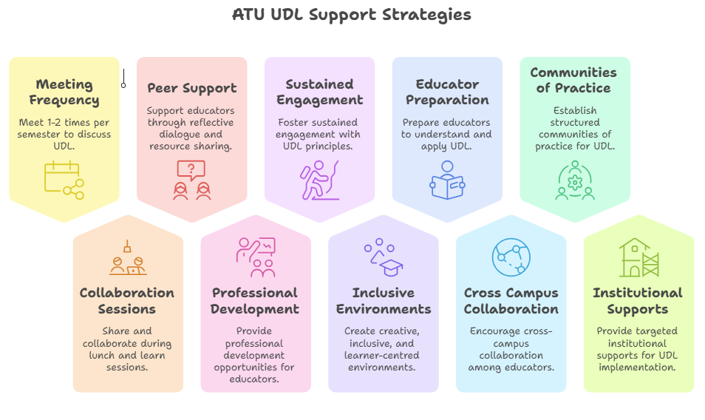
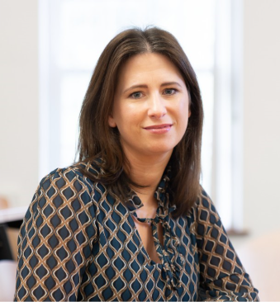
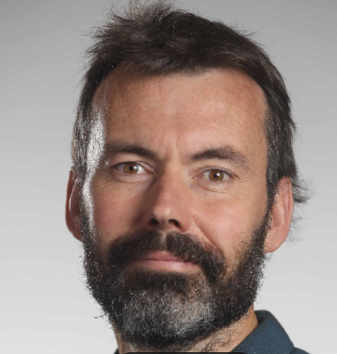
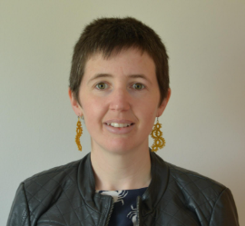
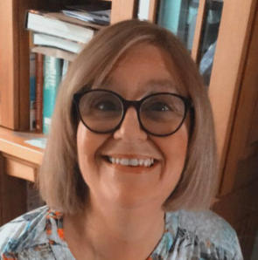


Origin story…. Where it all started
2023 Team
Laura Hegarty
Katie ODwyer
Cormac Flynn
2025 Team
Trish OConnell
101 members & growing

Slide 4
Past activities
Facilitation of UDL badge nationally and within ATU
DigitalEd conference
Programmatic review
Certificate in Teaching & Learning guest lectures
John Kelly Awards
Altitude Charter launch

Slide 5
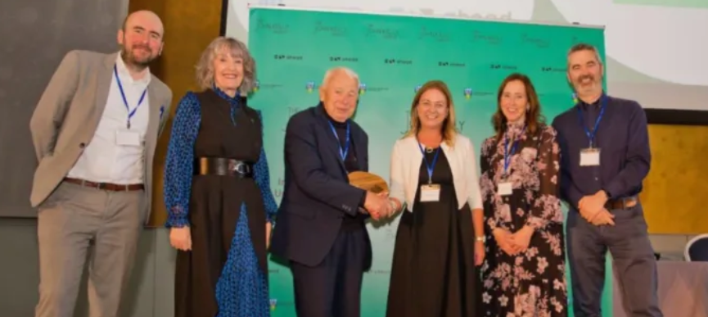
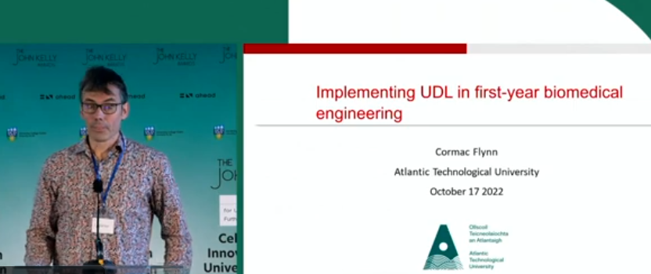
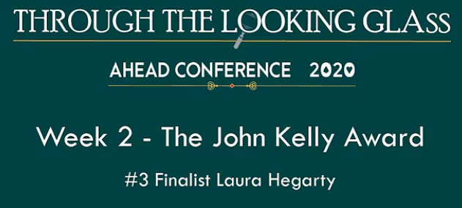

John Kelly Awards…

Slide 6
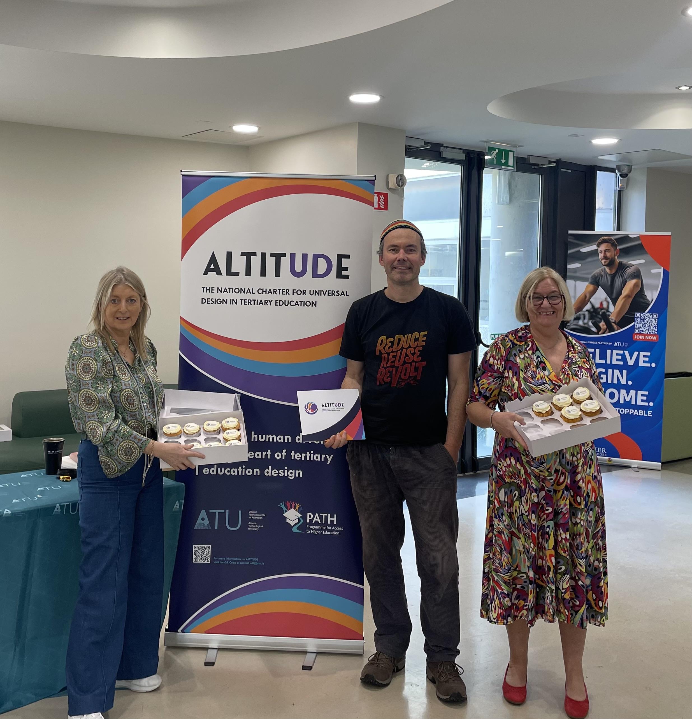
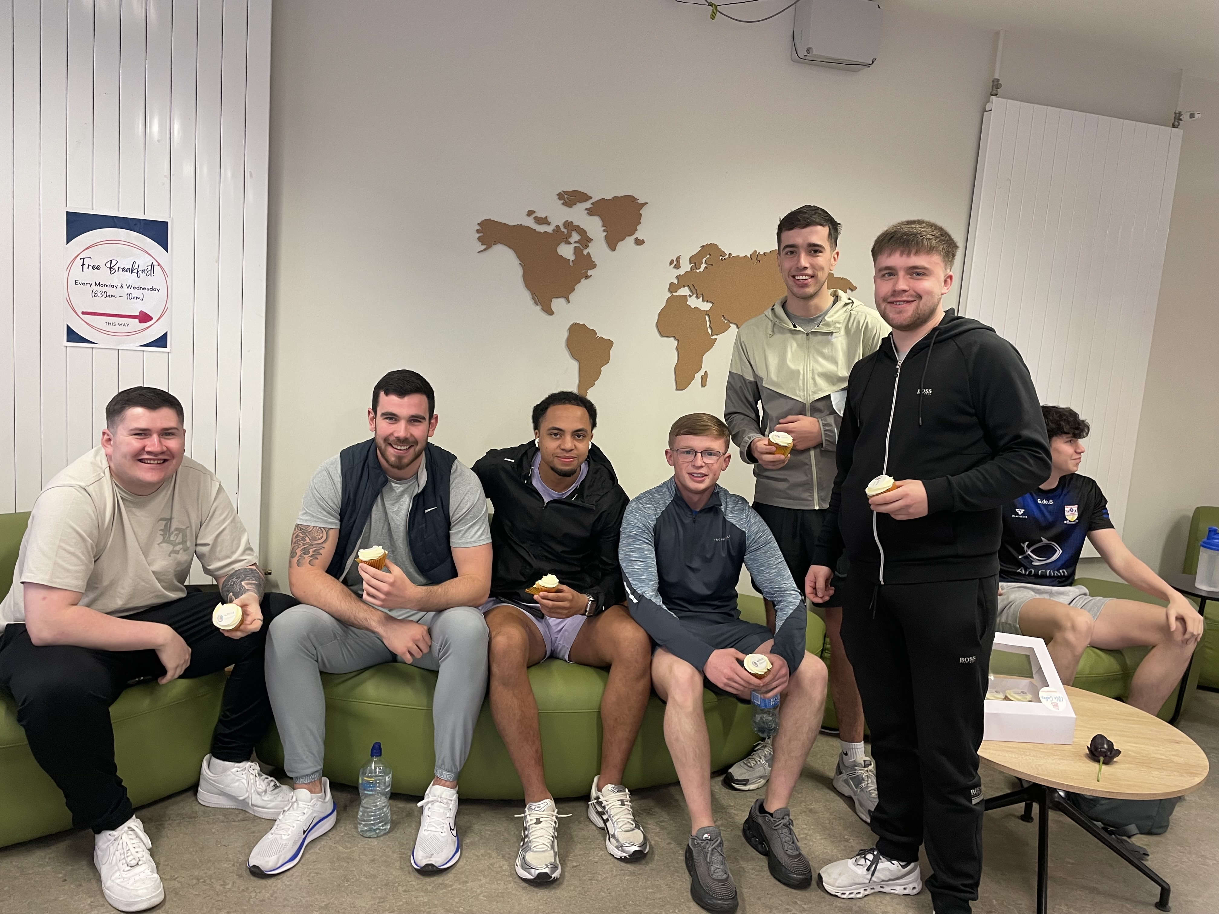
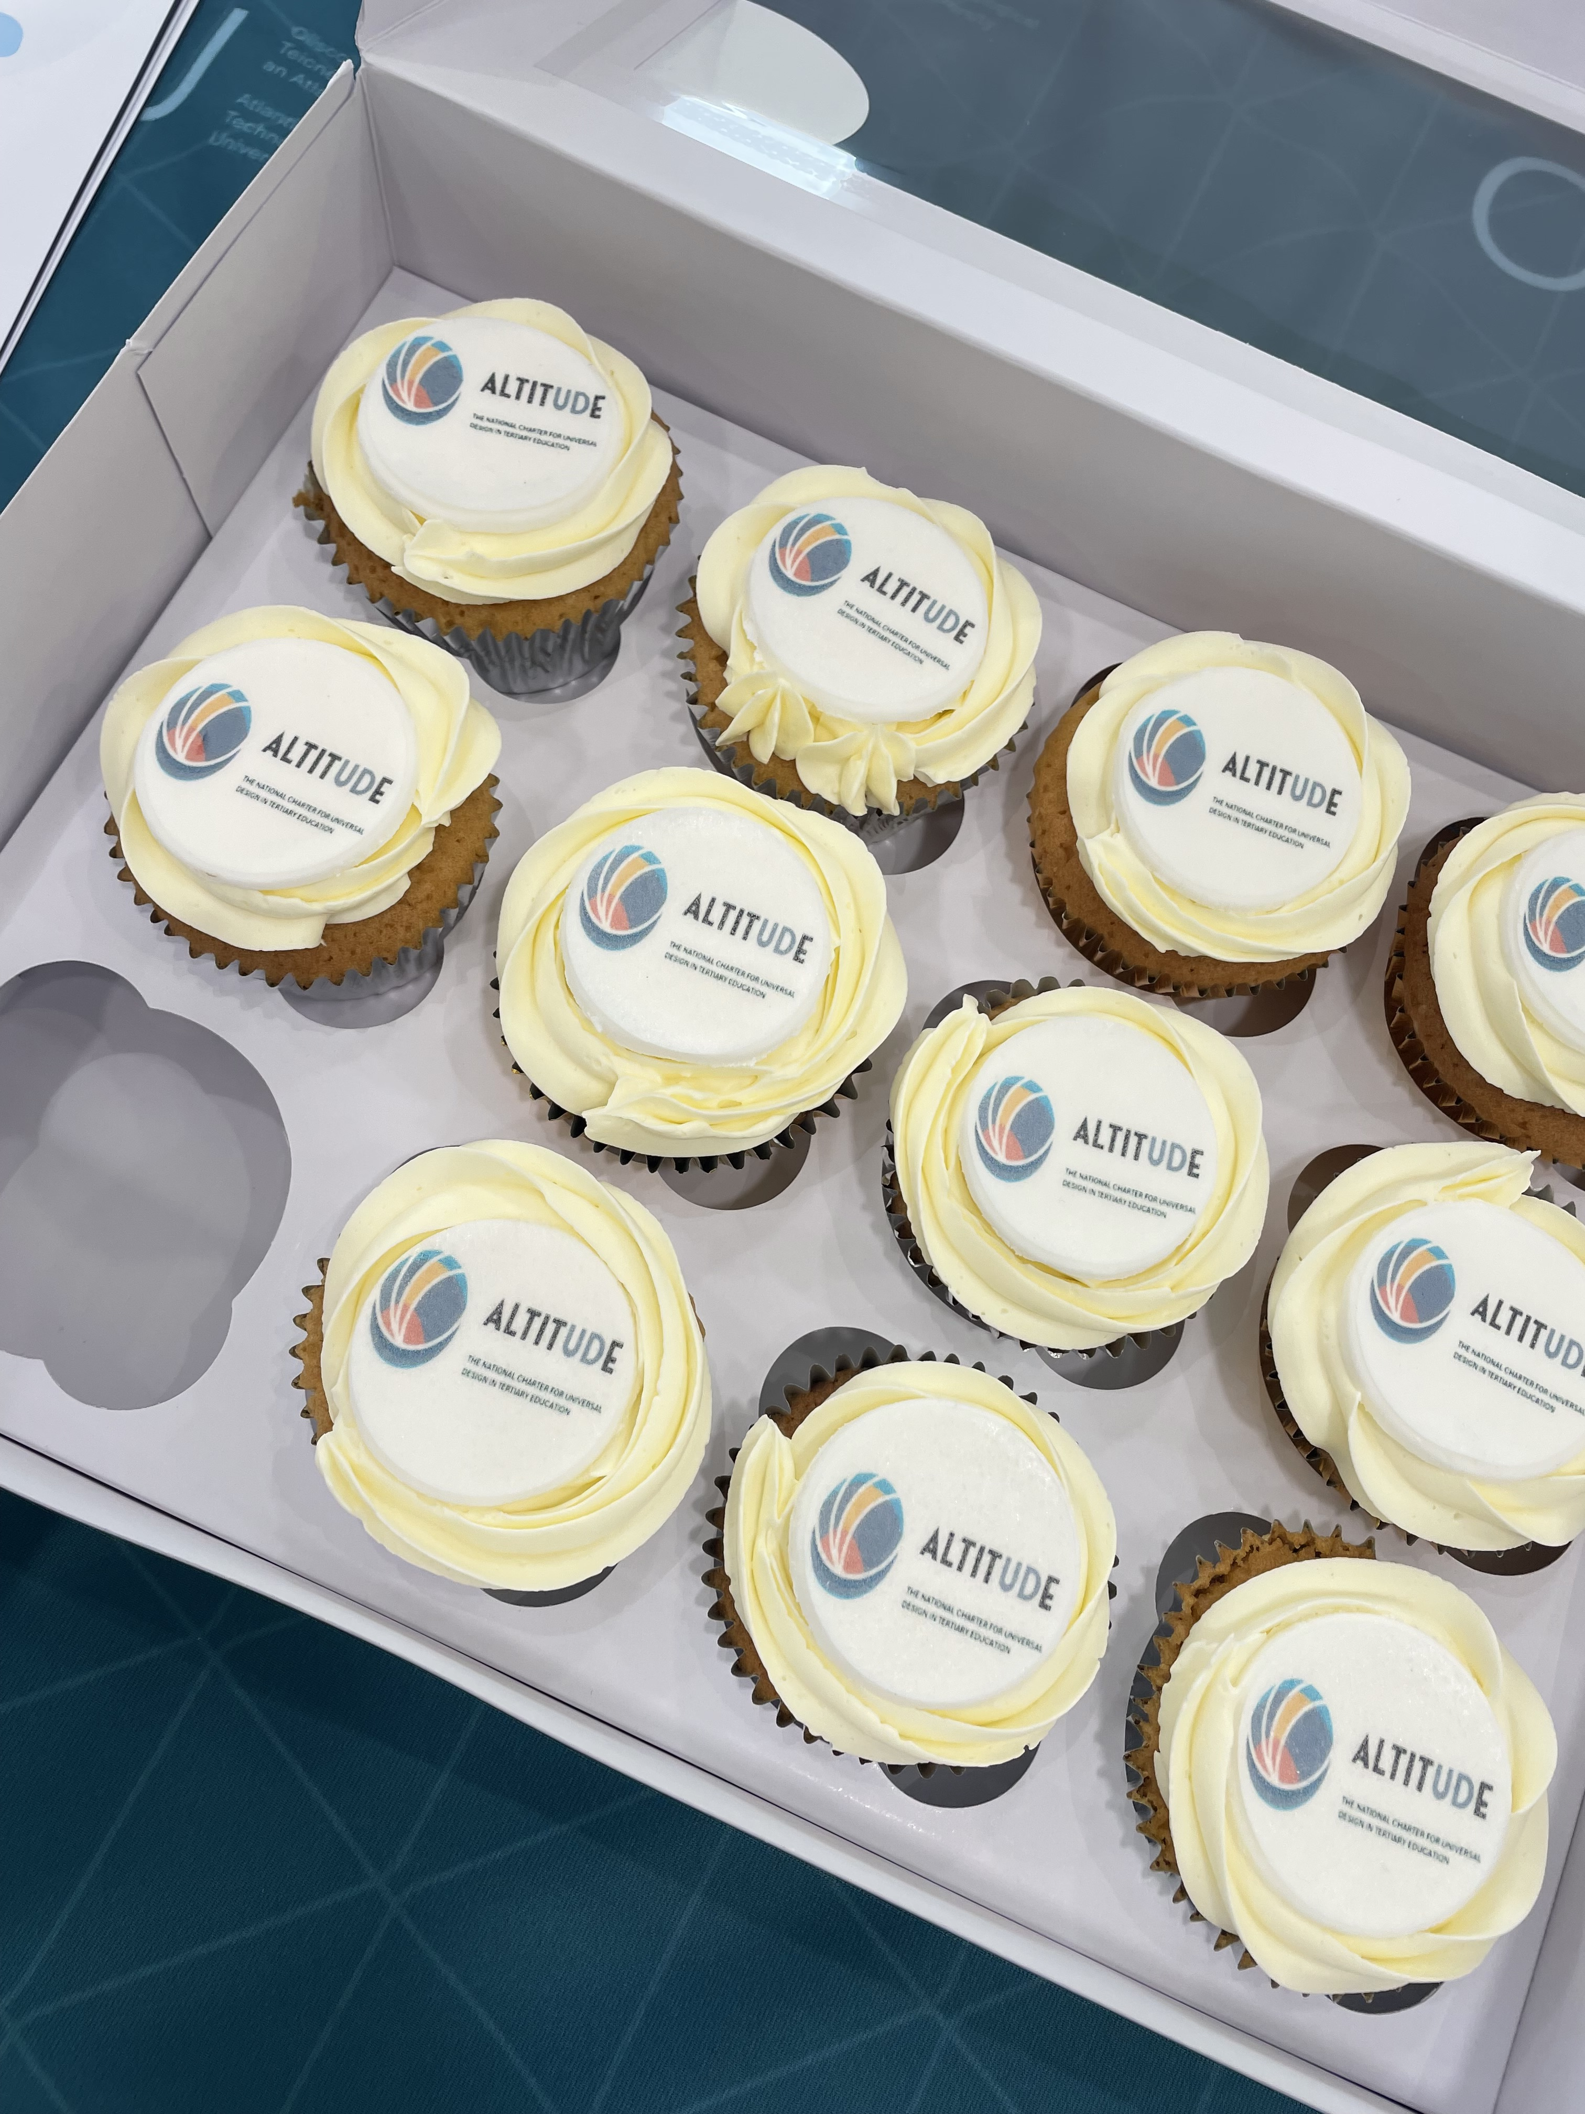
Altitude Charter Launch

Slide 7
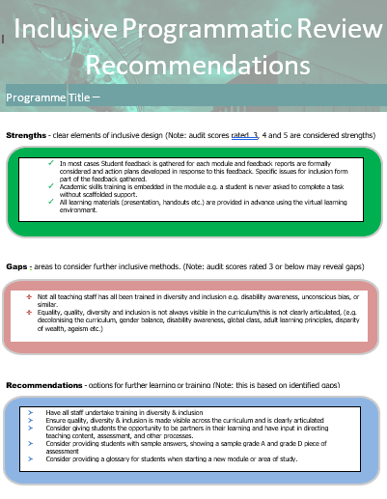


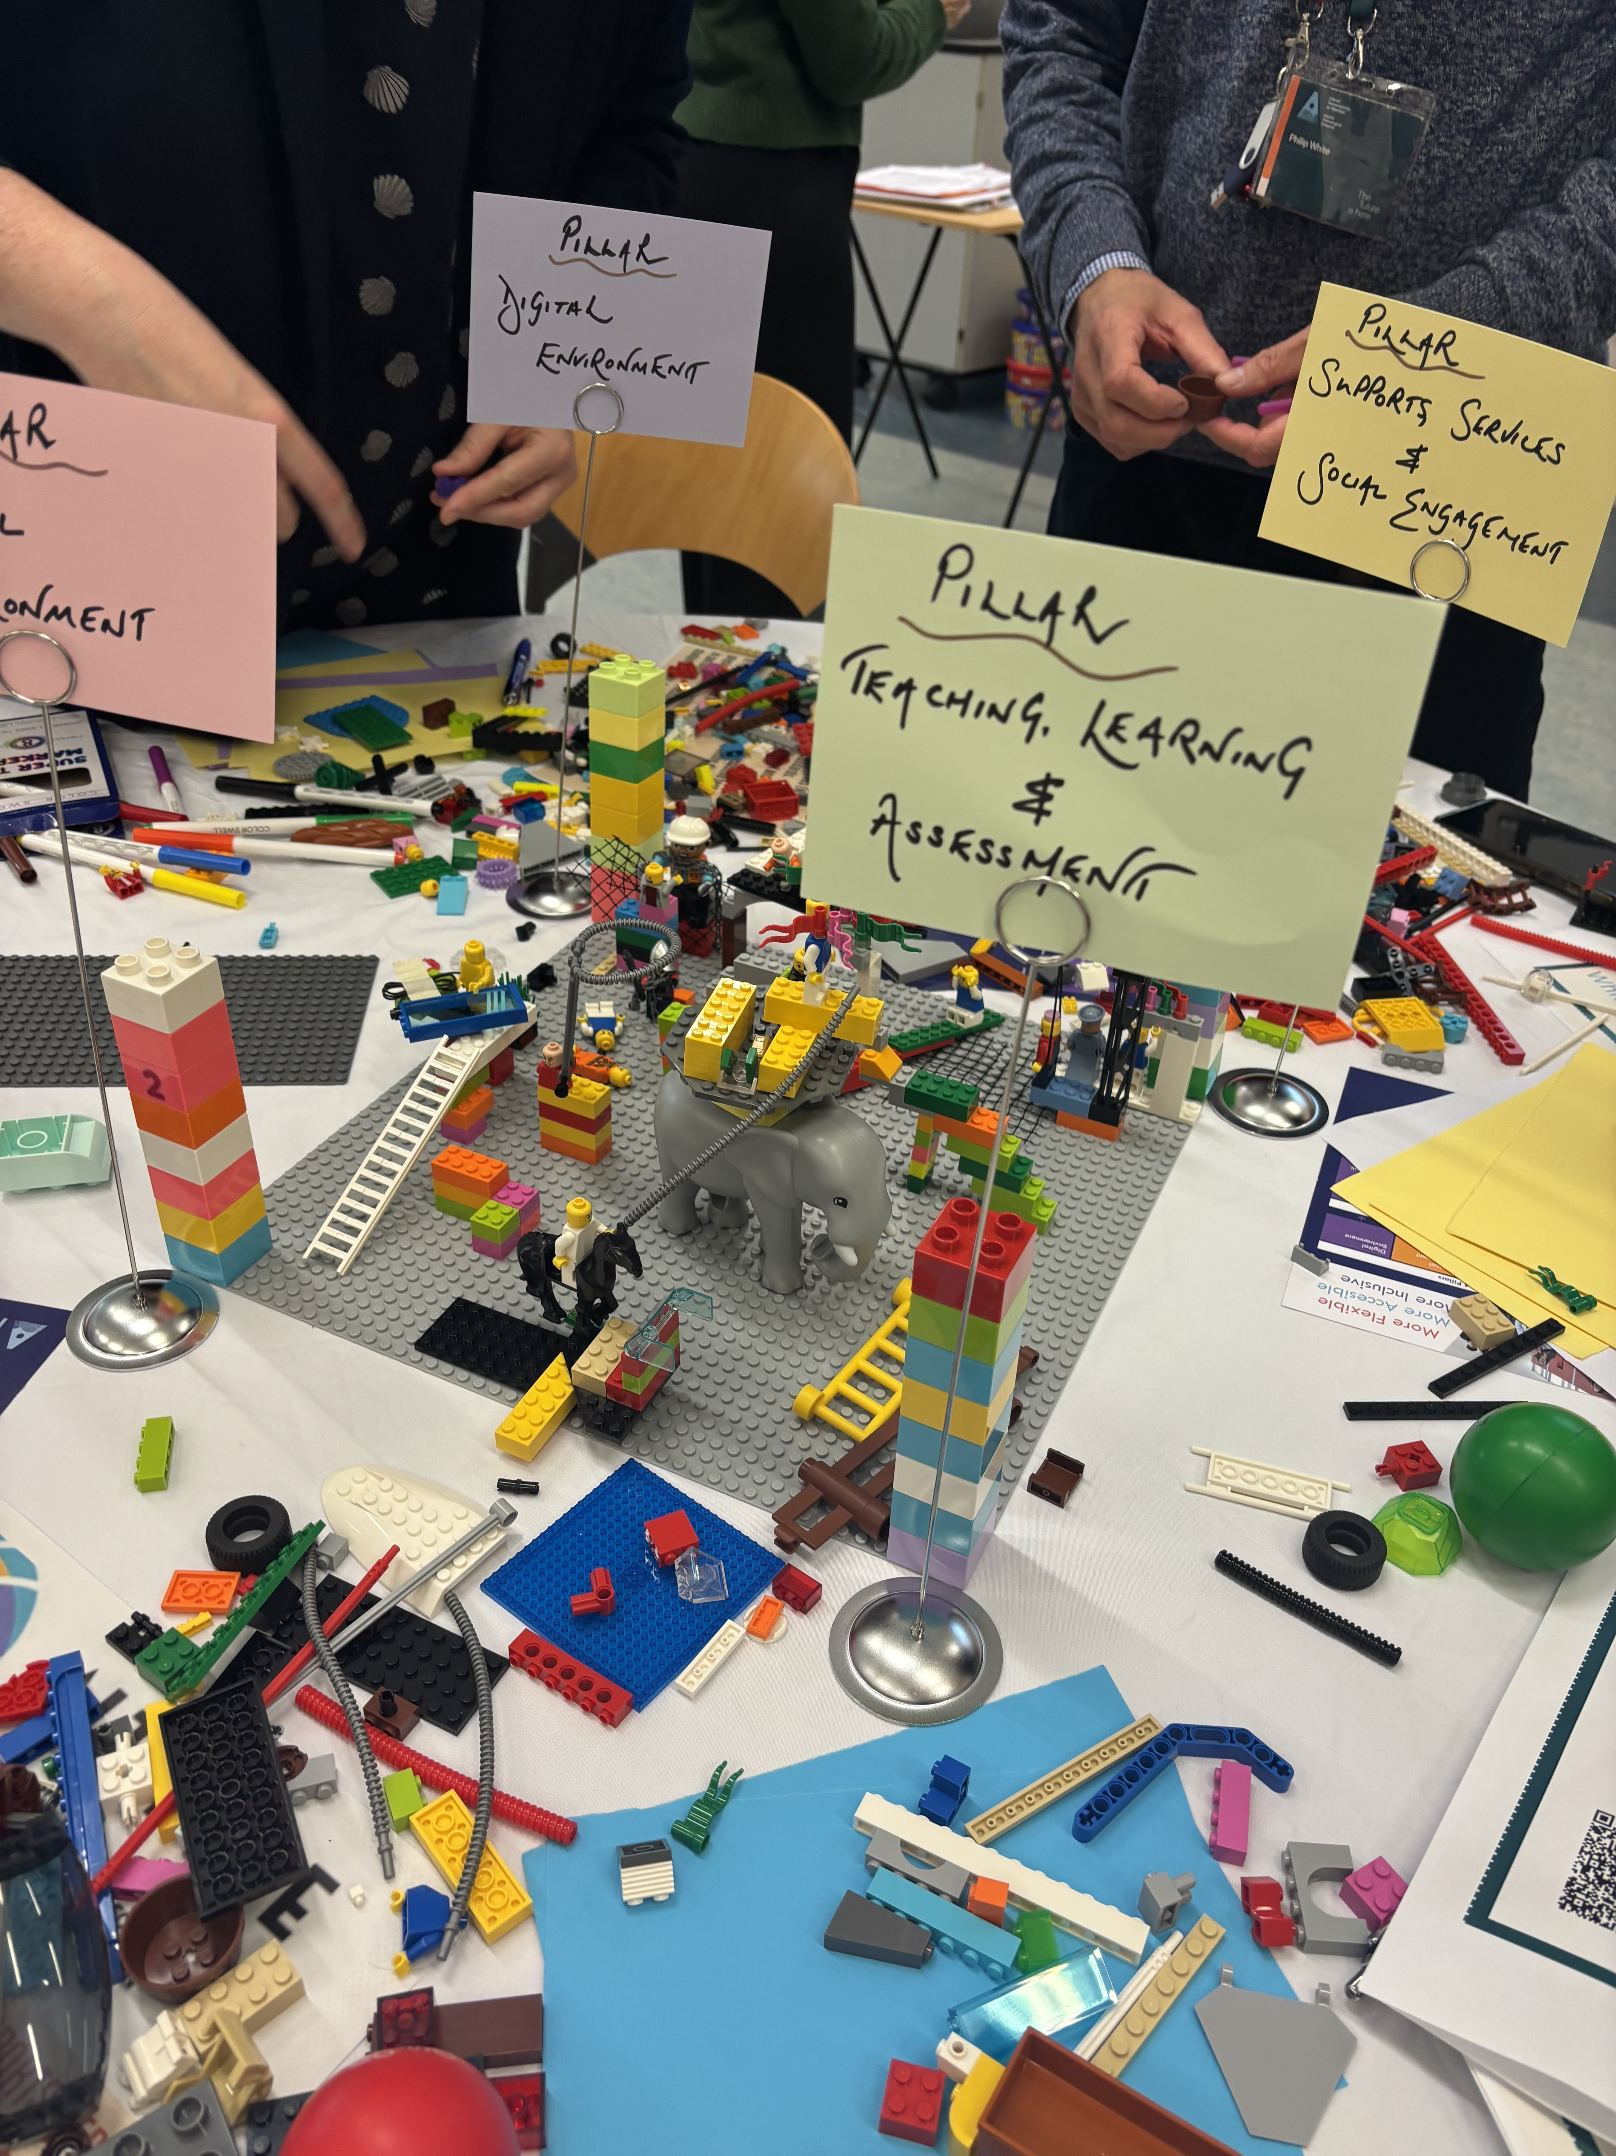

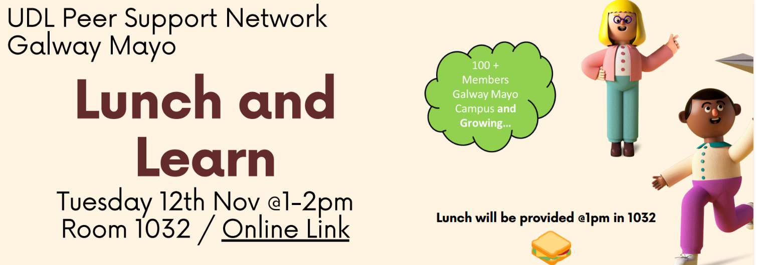
Ongoing Activities...

Slide 8
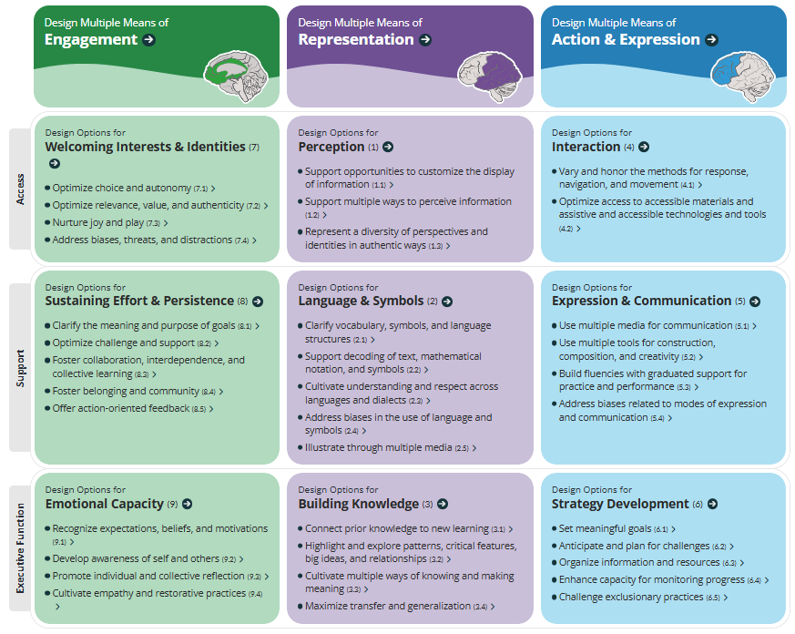
Lunch and Learn – Sample Exercise
Request for peer sharing activities
Divide into >3 teams
Assign one cell of the CAST guidelines to each team
Summarise activities carried out by each team within the options outlined
Group discussion

Slide 9
Inclusive Module Audits
30 questions covering:
(1) module details,
(2) general UDL principles,
(3) assessment, and
(4) teaching materials & classroom practices.

Slide 10

Other ATU wide activities

Slide 11

Feedback
Celebrating Good Practice
Idea Generation & Collaboration
Learning & Knowledge Sharing
Practical Implementation Support
Community & Dialogue
Visibility & Advocacy
Notes:
🌟 Celebrating Good Practice
Share all the great work happening across the team related to UDL.
Create a central space or hub to view and access examples of good practice.
Include a regular showcase of projects, ideas, or successes to inspire others.
Celebrate and highlight individual contributions (e.g., Colin’s interactive activities).
💡 Idea Generation and Collaboration
Provide short showcases or “spotlights” on what colleagues are doing to generate conversation.
Encourage collaboration through sharing exercises, ideas, and approaches.
Include dedicated time or space for group discussions about what works and what doesn’t.
Share “get to know you” or icebreaker activities that others have found effective.
🧠 Learning and Knowledge Sharing
Share personal experiences of applying UDL principles and lessons learned.
Include case studies or mini presentations at each session to highlight real examples.
Offer practical, actionable examples of UDL strategies that staff can implement in their own modules.
Discuss challenges such as giving too many choices—how this impacts learner engagement and outcomes.
🧩 Practical Implementation Support
Provide shared resources and templates as starting points for colleagues to adapt.
Include one or two interactive exercises per session to model UDL practices in action.
Offer session “hints” or “tips” so everyone leaves having learned something new.
Encourage reflection on how ideas can be integrated into individual teaching contexts.
🔄 Ongoing Communication and Community
Build a culture of sharing best practices and peer learning across disciplines.
Include regular updates on UDL-related events or new initiatives.
Foster open discussion forums for exchanging successes and lessons learned.
Advocate for UDL across the university by showcasing its value and impact.
Community & Dialogue
Space to discuss implementation challenges
Reflection on impact of choice (e.g., can there be too much?)
Peer learning conversations
Visibility & Advocacy
Highlight good work across the university
Promote UDL institutionally
Events updates

Slide 12


Challenges
Enablers
Time to learn about UDL
Capacity to implement UDL
Support to gather feedback on implementations
Identifying measures of success
Institutional silos
UDL badge and modules
Institutional support and policy alignment – CPD course for senior leaders
Add questions to module feedback forms and studentsurvey.ie
Ongoing CPD
Notes:
Challenges - Acknowledge common challenges such as workload, varying levels of familiarity with UDL, and structural silos.
Time and workload pressures
Variability in UDL understanding
Institutional silos
Translating theory into practice
Enablers - Highlight enabling factors including leadership support, policy alignment, and accessible institutional resources.
Leadership support
Clear institutional policy alignment
Accessible resources and toolkits
Ongoing professional development

Slide 13
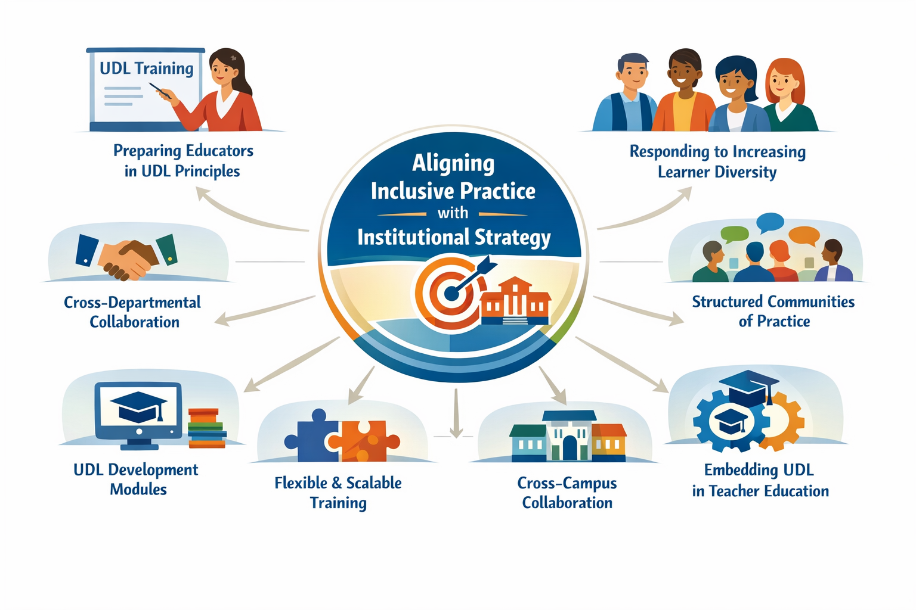
Practical Recommendations

Slide 14






Key takeaway
Staff time allocation recognition / awards
Increased confidence applying UDL
Commitment of ATU’s UDL Centre of Excellence
Collaboration fosters shared culture of inclusion
Scalable training material / resources of inclusion
Lunch

Slide 15

Go raibh míle maith agaibh
Empowering Educators: Tools and Strategies for UDL Success Trish O’Connell, Laura Hegarty, Katie O’Dwyer

