Slide 1
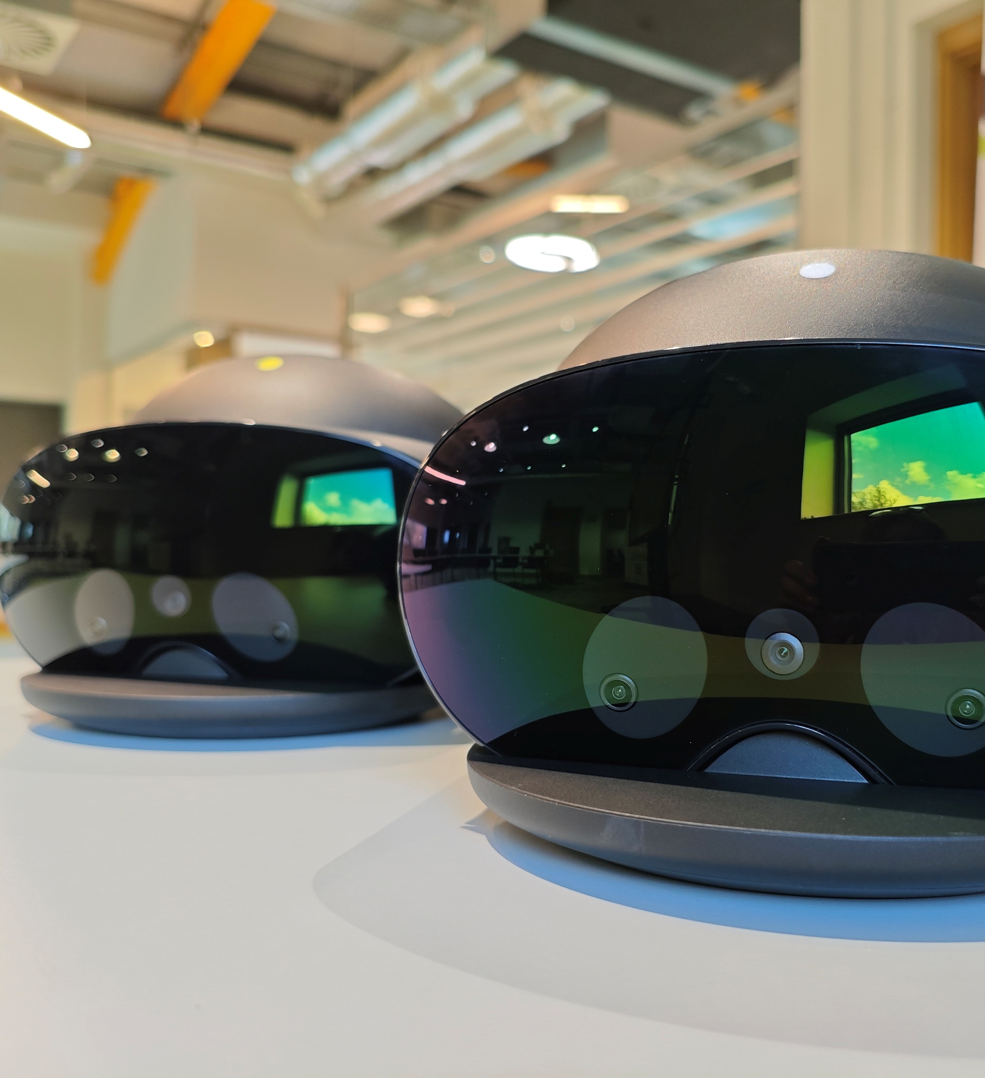
Immersive Technology in Teaching Practice
Pilot Project in MSLETB
ALTITUDE Summit 20th March 2026

Slide 2
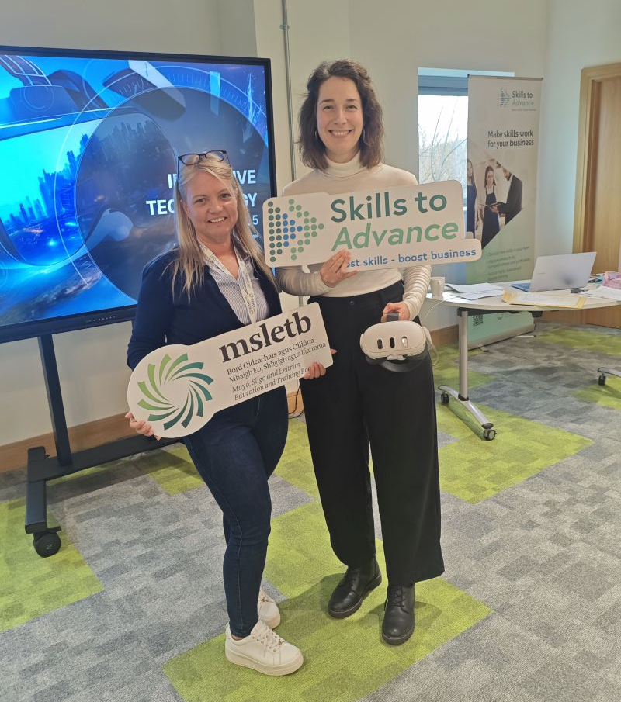
Who we are
Iris Kerssebeeck – MSLETB XRHub & Immersive Technology programme manager
Sarah Peinelt - Technology Integration Coordinator

Slide 3

About the project
Exploring how VR can create inclusive, engaging learning environments
Collaboration with teachers across diverse subject areas
Focus on safe, effective integration of immersive tools in the classroom

Slide 4
Issues Identified
Teachers had little or no experience with VR
No knowledge or understanding of setup, hygiene, procedures for safety, and classroom management
Need for training & support in how to bring VR into the classroom
No resources available in MSLETB to support teachers with VR
No existing Code of Practice for VR use
Notes:
Experience during onboarding – noticed lack of training and support
Inspiration for project
Support and train instructors – how to bring VR into classroom
Engagement → How do we get learners interested and feeling safe and motivated?
Representation → How do we explain things in different ways so everyone can understand?
Action & Expression → How can learners show learning in different ways (not just one format)?
Slide links: https://msletb.sharepoint.com/:p:/r/teams/AltitudeUDL2026/_layouts/15/Doc2.aspx?action=edit&sourcedoc=%7B0d3ebadd-da04-406e-8555-68d6fb2595b2%7D&wdOrigin=TEAMS-MAGLEV.teamsSdk_ns.rwc&wdExp=TEAMS-TREATMENT&wdhostclicktime=1770820200487&web=1

Slide 5
What we hoped to achieve
Understand how VR impacts student engagement and learning
Provide multiple ways for students to engage, learn, and express
Provide scaffolded support (technical support, training pathways)
Develop a clear, safe, repeatable process for VR use in classrooms
Build teachers’ confidence through hands-on experience & structured guidance
Notes:
Build teachers’ confidence through hands-on experience and structured guidance

Slide 6
What did we do
Introductory immersive sessions with educational technologist support
Piloted VR activities across a range of subject areas
Observed real‑time teacher and student interactions
Built surveys to gather structured feedback
Observed & identified challenges, barriers, opportunities, and training needs
Notes:
Multiple Means of Engagement
Onboarding – teachers and instructors prior to VR experience
Identified need for training
Delivered QQI L 5 Imm Tech – Teach the instructor – Train the trainer in Immersive Tech – blended format – online theory F2F for practical
Pilot group from Sligo College
Name topics – diversity of areas
Feedback forms – learners & instructors

Slide 7
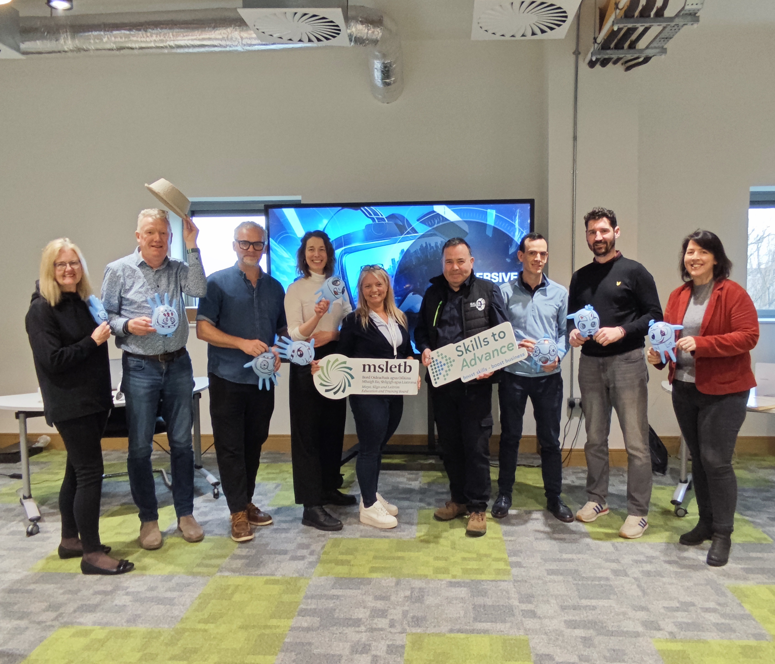
How did we do it
Delivered VR Train-the-train in Immersive Technology
Delivered guided VR onboarding across a range of subject areas
Support provided for initial classroom sessions
Collected surveys from students and teachers gather structured feedback
Notes:
Observed & identified challenges, barriers, opportunities, and training needs

Slide 8
What was the result
6 teachers upskilled with a Immersive Technology QQI Level 5
6 VR champions in the college to provide peer support
Develop resources on Moodle to support teachers during student onboarding
Ongoing VR Train-the-Trainer in the XRHub

Slide 9
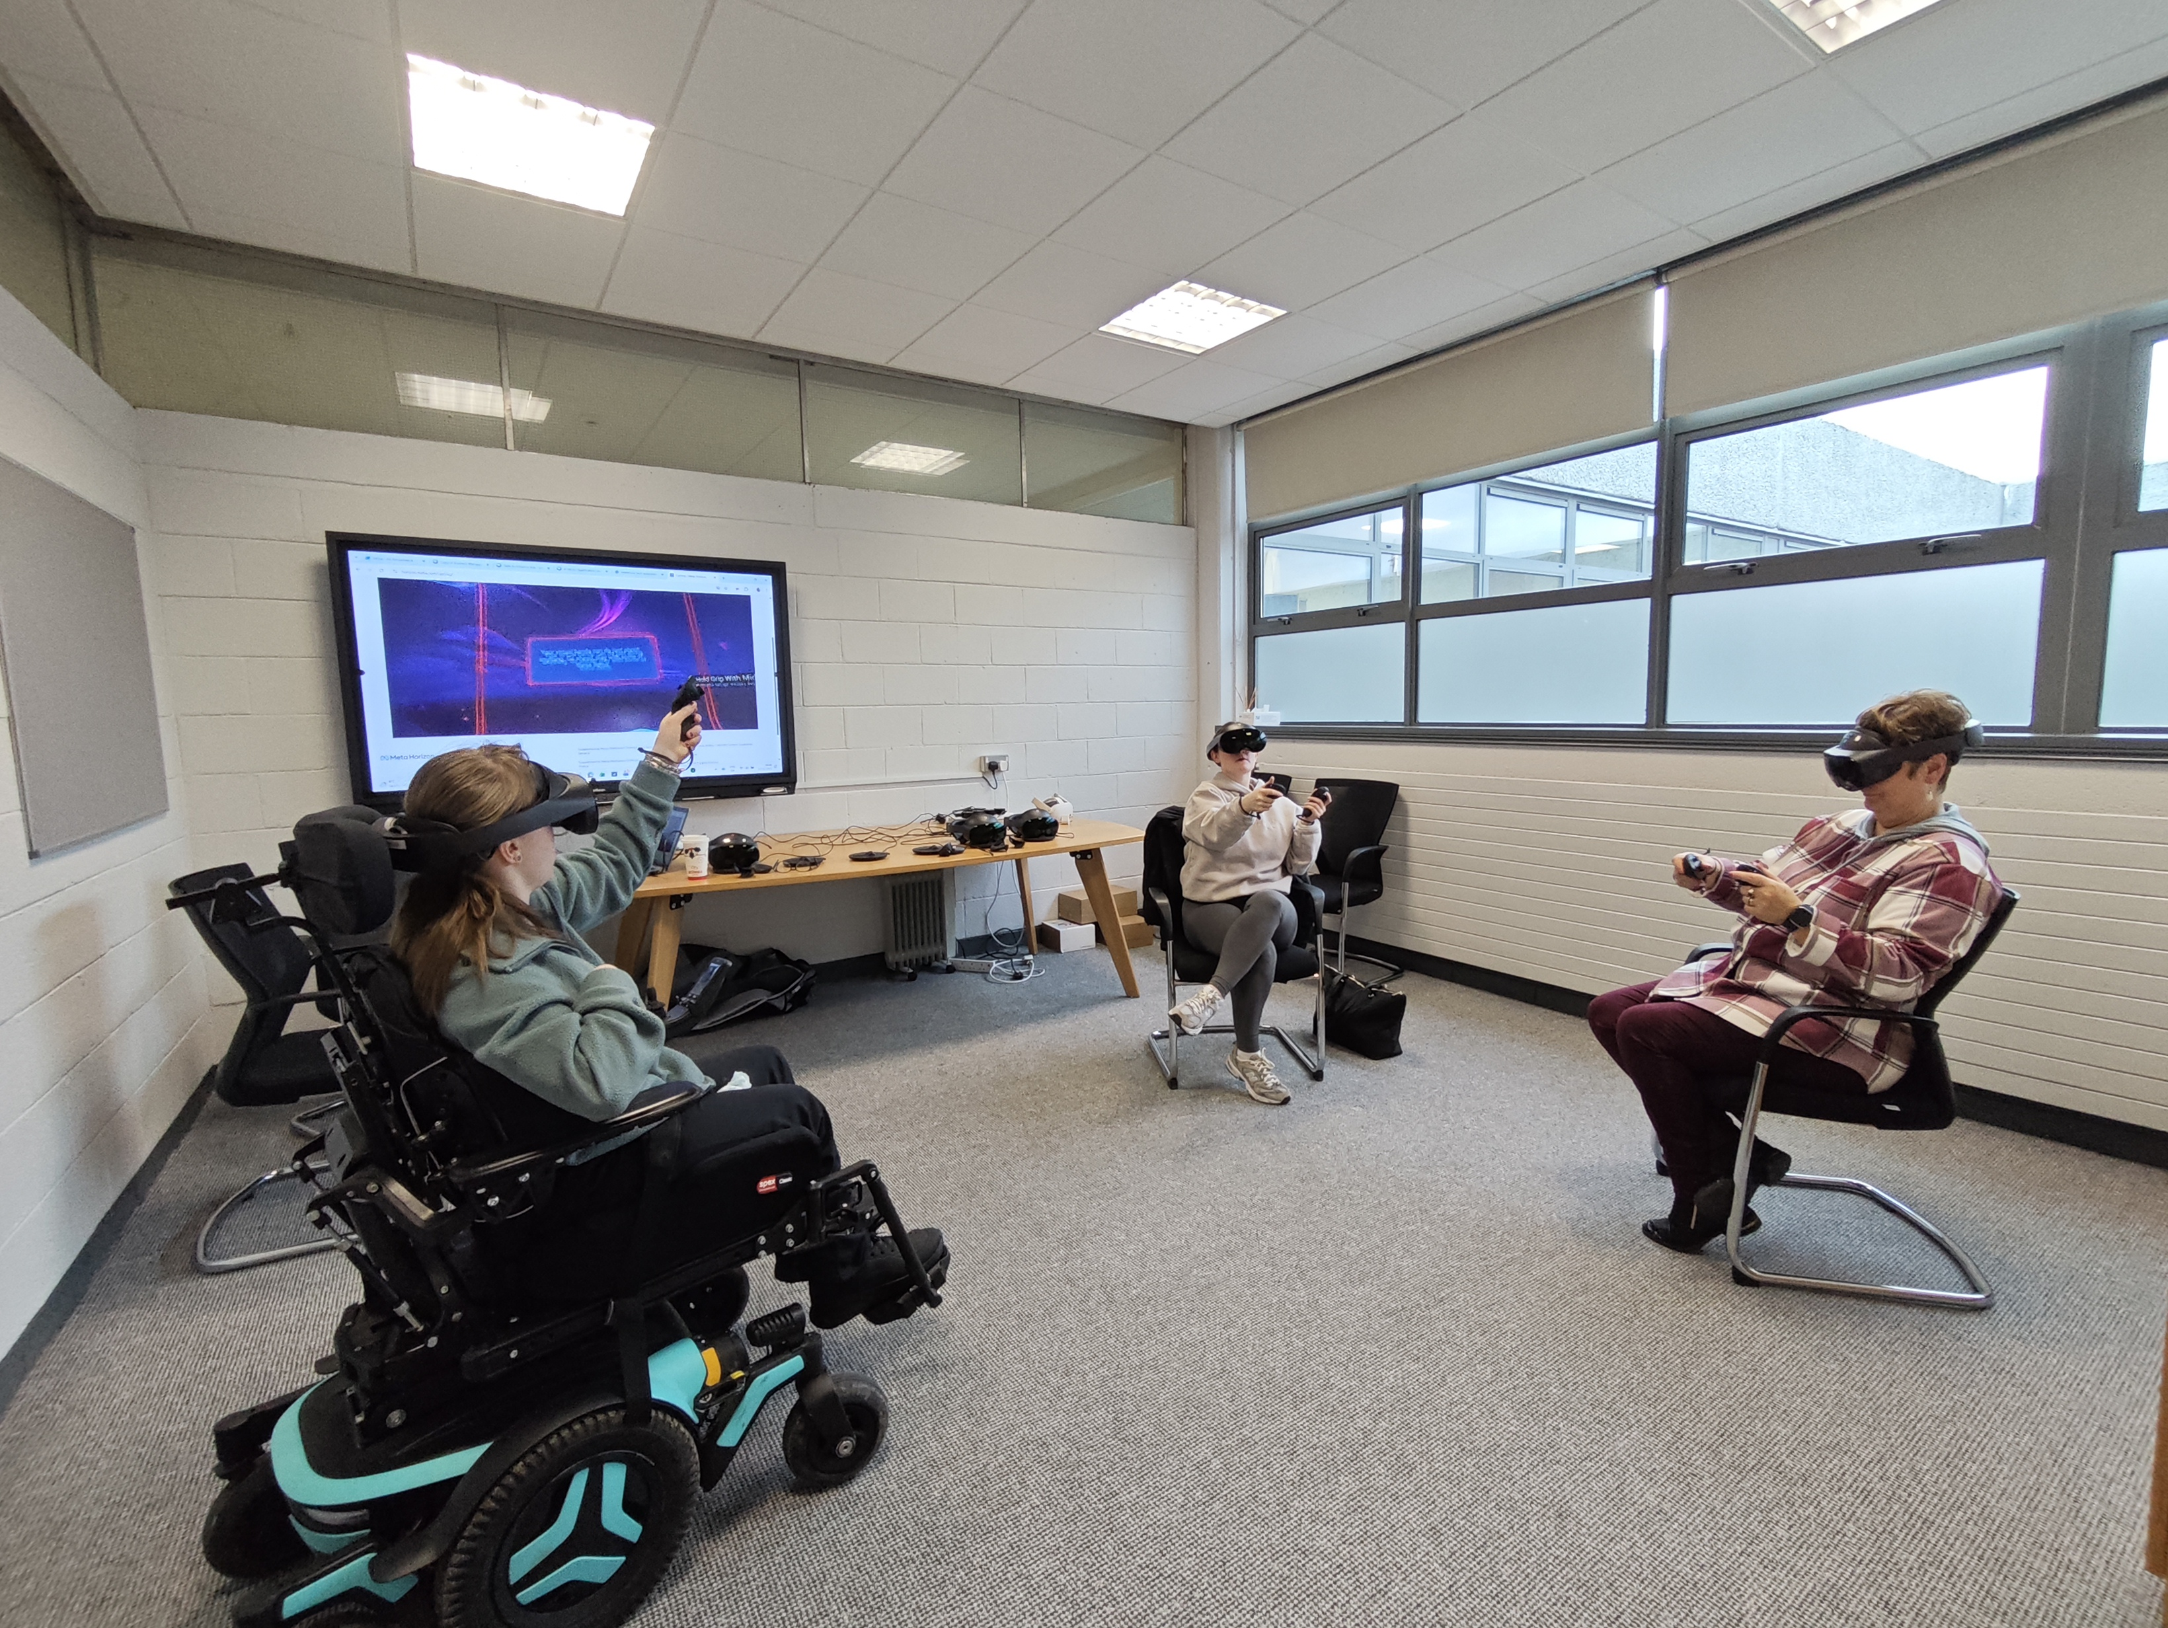
Results from Instructors' Survey
Teachers see strong potential for VR in the classroom
Challenges during onboarding sessions, e.g. keeping all students engaged and on task
Impact on learning is too early to determine, but teachers report strong student enthusiasm
Notes:
Skills, confidence and competencies to bring VR into subjects
Skills and competencies to develop vr sessions
Confidence to deliver session
Feedback – cycle review - progression

Slide 10
Results from Students' Survey
100% | 85% | 90% | 1/3 | What to Improve
Would like to use VR again in classes | Reporting VR helped them understand the topic better | Felt comfortable using the headset and found the instructions clear | Of students reported mild discomfort, mostly eye strain or motion sickness | Longer onboarding time manage room noise better

Slide 11


Thank you
Sarah Peinelt
Technology Integration Coordinator
Email: SarahPeinelt@msletb.ie
Iris Kerssebeeck
XRHub Manager &
Immersive Technology Programme Manager
Email: IrisKerssebeeck@msletb.ie

