Slide 1











UNITE:
University Network for Inclusive and digiTal Education
Alexa MacDermot, Team member
Eglė Karpavičiūtė, Team member

Slide 2
UCD Team
Assoc Prof. Ernesto Vasquez del Aguila, PrincipaI Investigator
Dr. Theresa Schilling, Project Manager
PhD cand. Alexa MacDermot, Team member
PhD cand. Eglė Karpavičiūtė, Team member

Slide 3
ABOUT UNITE

Slide 4
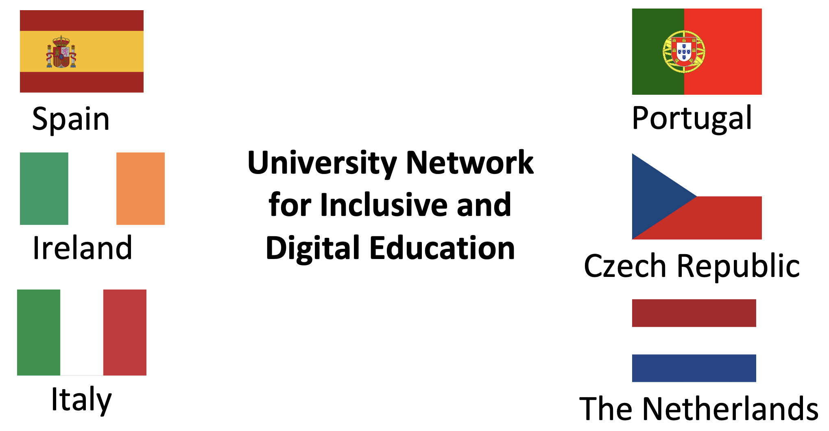
What is UNITE?
Notes:
UNITE: University Network for Inclusive and Digital Education is an Erasmus+ Consortium composed of seven European universities and organisations in Czech Republic, Ireland, Italy, the Netherlands, Portugal, and Spain
The primary goal of UNITE is to promote inclusion, drive digital transformation, and improve teaching quality in higher education by creating innovative programs, digital tools, and strategies
By utilising the consortium’s diverse expertise, it aims to establish best practices that universities can implement to reduce inequalities and encourage both innovation and inclusion

Slide 5
Lines of Action: Four Work packages
I-TEACH
AWARE
DONE
GUIDANCE
Notes:
I-TEACH creates innovative digital tools based on podcasts and mixed reality
AWARE improves awareness of diversity and inclusion through training courses for University students and lecturers
DONE facilitates the use of AI for students from all backgrounds by creating digital tools to support students’ learning
GUIDANCE produces and shares good practices for a high-performing digital and inclusive education ecosystem

Slide 6

UCD’s ROLE
Notes:
Ernesto

Slide 7
UCD Role
Consultation
Analysis
Development
Inclusive and transformative pedagogy and teaching innovation, participating in all work packages
UCD leads WP3 – AWARE (AWareness trAining for lectuRers and studEnts)
Notes:
Consultation – Analysis – Development
The UCD team advises on topics of inclusive and transformative pedagogy and teaching innovation, participating in all work packages
UCD leads WP3 – AWARE (AWareness trAining for lectuRers and studEnts):
Mapping and analysis of existing inclusion and diversity training
Development of faculty training programmes
Development of student training programmes

Slide 8
AWARE: Inclusion Training for Higher Education
Two training programmes:
1. University tutor/faculty training
2. University student training
Notes:
Two training programmes:
University tutor/faculty training: enhanced awareness on topics related to inclusion and innovation in teaching processes, learning and soft skills.
University student training: enhanced inclusion awareness: gender, sexualities, racial and cultural differences, disability and neurodiversity.

Slide 9
AWARE OUTCOMES

Slide 10
AWARE Training Strategies
Aim: empower tutors & students as ambassadors for inclusion
Builds conceptual and practical strategies for:
Decolonial pedagogy
Intersectional analysis
Inclusive teaching - axes of oppression and identity: race, gender, sexuality, neurodiversity, disability, etc.
Notes:
Builds conceptual and practical strategies for:
Decolonial pedagogy
Intersectional analysis
Inclusive teaching that recognises and explores axes of oppression and identity, including race, gender, sexuality, neurodiversity, disability, etc.
Uses multimodal materials (articles, art, podcasts, media)
Aim: empower tutors & students as ambassadors for inclusion

Slide 11
Decolonial & Intersectional Approach
Inclusive education is an active praxis
Recognises colonial legacies
Critically examines learning contexts through an intersectional lens
Approaches teaching as co-learning
Remain critical of institutional approaches (tokenism, hidden curriculums, and that address “diversity” without real strategies of inclusion)
Notes:
Inclusive education is an active praxis which involves a genuine commitment to cultivating transformative academic communities within and beyond the classroom
We aim to critically examine and challenge structural inequalities that prevent true inclusion within higher education (inclusive training for tutors/students)
Recognises colonial legacies; Decentres Western and hegemonic epistemologies
Critically examines learning contexts through an intersectional lens
Approaches teaching as co-learning; Supports solidarity through action-oriented pedagogy
Remain critical of institutional approaches that rely on tokenism, that don’t challenge hidden curriculums, and that address “diversity” without real strategies of inclusion

Slide 12
TRAINING FOR TUTORS

Slide 13
Tutor Training Programme Development
Embedding Inclusion through Decoloniality and Intersectionality (UCD)
Assessing institutional inclusion (Endurance)
Approaching diverse learning requirements, UDL, and neurodiversity (Europass)
Equity, gender, and cultural barriers (Europass Teacher Academy)
Artificial intelligence in HE (Teach 4 All - University of Tuscia)
Notes:
University College Dublin leads this programme
The university tutor training programme is currently in the last stages of development, to commence in January 2026
AWARE Partners: University of Lisbon, Portugal; University of Cordoba, Spain; University of Tuscia, Italy; Charles University, Czech Republic; University College Dublin, Ireland.
Training content:
Equity, gender, and cultural barriers (Europass Teacher Academy)
Embedding Inclusion through Decoloniality and Intersectionality (UCD)
Approaching diverse learning requirements, UDL, and neurodiversity (Europass)
Assessing institutional inclusion (Endurance)
Artificial intelligence in HE (Teach 4 All - University of Tuscia)

Slide 14
TRAINING FOR STUDENTS

Slide 15

Training Programme Development
Training sessions commencing May 2026:
Decoloniality & Intersectionality
Race, Racism and Stereotypes
AI & Virtual Reality
Disability and Accessibility
Inclusive Design for Sustainable Environments
Hackathon-style format
Notes:
The student training programme will commence in May 2026.
Interactive training sessions focused on critical and emerging topics, including:
Gender & Sexuality
AI & Machine Learning
Disability and Accessibility
Culture & Race
The programme will adopt a hackathon-style format, encouraging hands-on learning, problem-solving, and collaboration across disciplines. Participants will not only gain knowledge but also develop actionable solutions in a dynamic, team-based environment.

Slide 16
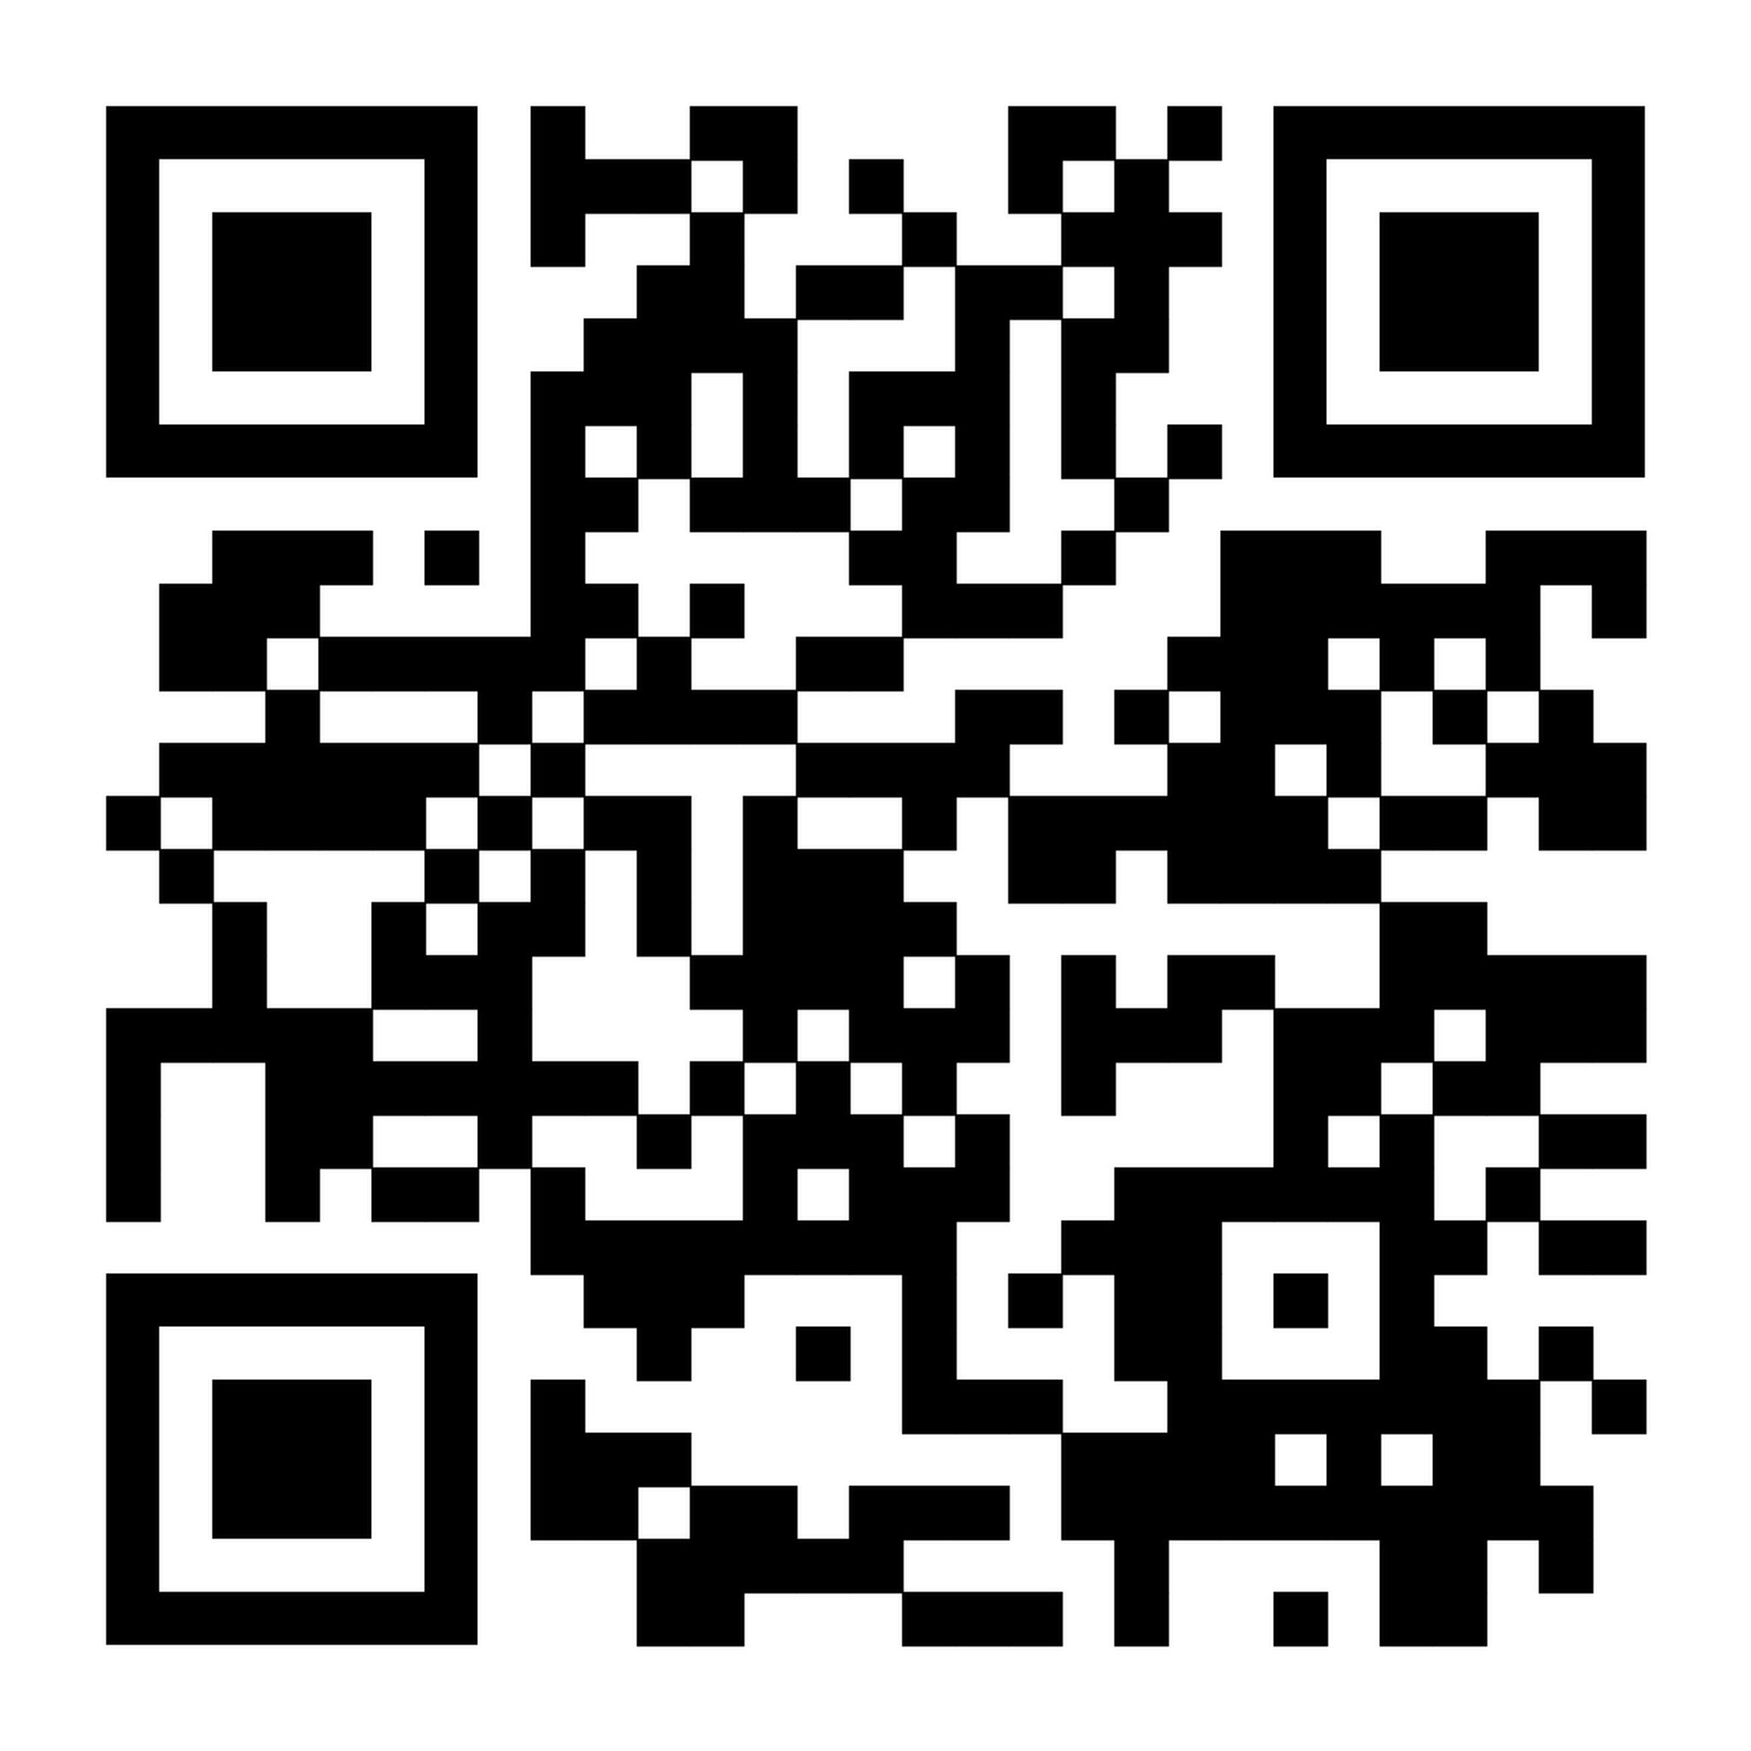
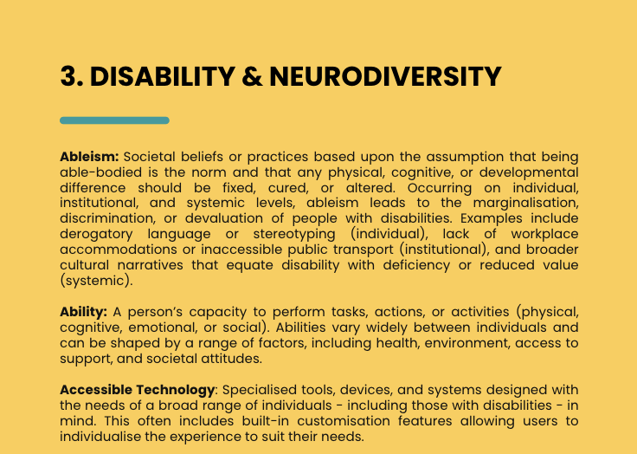
ALL IN TOOLKIT: A UNITE Teaching & Learning Guide to Implementing Inclusive Language
All In Toolkit link

Slide 17
Thank You
Alexa MacDermot, Team member
Eglė Karpavičiūtė, Team member

