Slide 1


A-Z of Getting College Ready
Caoimhe Cronin
Student Engagement Officer

Slide 2
What we will cover:
Assistive Technology
Services available in Institutions
Funding/ Financials
Goals, organisation, and balancing your time
Important things to consider when choosing where to study

Slide 3
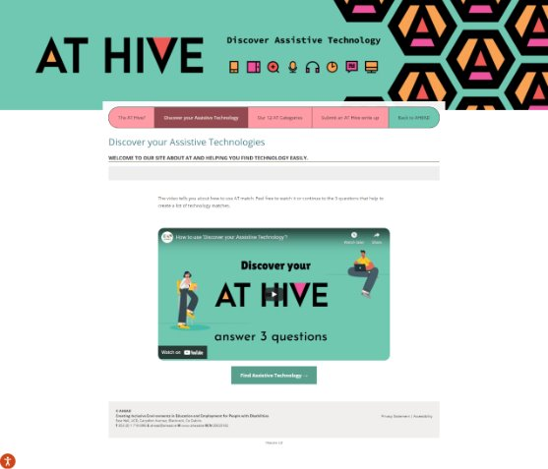
Assistive Technology
AT is equipment, devices and systems that people with disabilities can use to more equally access information and engage in activities, online and off.
Low Tech | Mid Tech | High Tech
Pencil Grip Eyeglasses Walking Stick | Spellcheck in Word Mouse Calculator Remote Control | Screen readers Voice recognition software Website accessibility overlays or plugins

Slide 4
Choosing where to study
Attend college open days/online events
Visit the campus to get a feel for what it is like
Getting to college – transport /accommodation
Vantastic

Slide 5
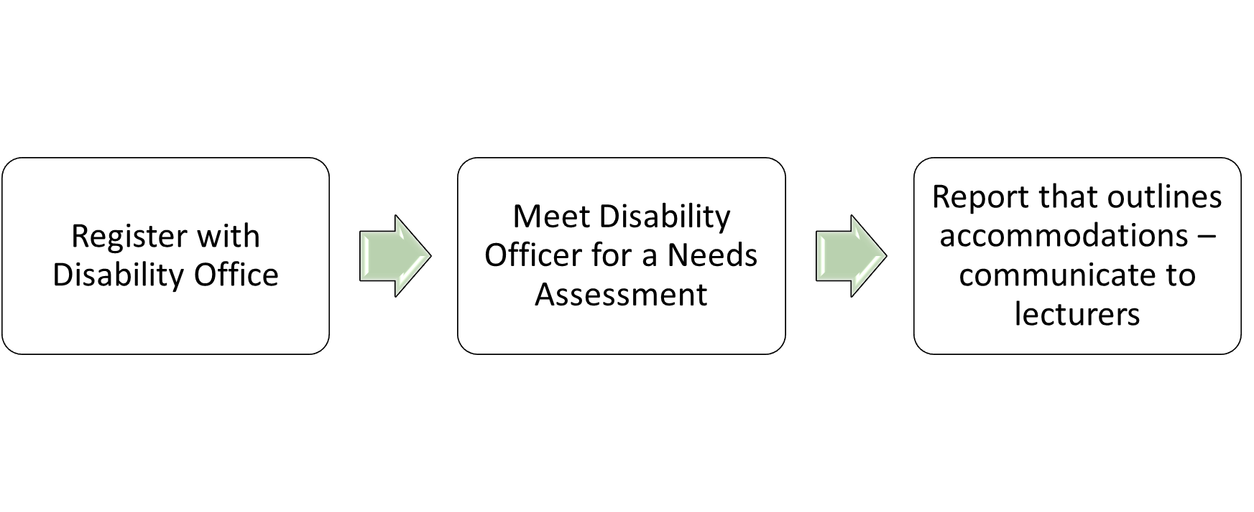
Disability Support Services

Slide 6
Extracurricular Activities
Getting involved in Clubs or Societies is a great way to make friends, learn new skills and find a new hobby.
Gain great experience!
Create your own if you have an idea that isn't already available.

Slide 7
Financial Aid
Fund for Students with Disabilities pays for disability related supports needed in college/online learning – administered through the disability support service
Disability support funding is also available in further education colleges – contact disability support service
College Scholarships (for SWD) for example 1916 Bursary
SUSI Student Grant (college fees/maintenance grant).
Back to Education Allowance
Student Assistance Fund.
For more information about funding at third level check out the following website: www.studentfinance.ie

Slide 8
Goal Setting
Meet with the Institutions Guidance/ Career Officer to help you set goals and stay on track.
Ensure your goals are reasonable, and not too far out of reach!
Stay motivated by setting smaller goals, building up towards your end goal.

Slide 9
Health and Wellbeing
Usually, Institutions have a discounted rate to visit the Doctor.
Often, free counselling services are available on campus.
The Student Union are trained to support students with most issues they may face while studying.
The Institutions website will always have a 'Student' webpage where you can access different types of support.

Slide 10
Know Your Campus
During Orientation, the Institution will usually give a guided tour of the Campus.
Make sure to take note of where student services, support offices, and the SU are located on campus, it will make things much easier when you need to access them.
Quiet rooms, accessible bathrooms, and student-centred spaces are important to note for yourself and others!

Slide 11
Library Resources
Take the Library Tour!!
Explore the Academic Skills Support Programmes: programmes designed to help you make the most of your learning.
Meet the team: the library staff can help you navigate the library and find the resources you need.
Borrow Books and Other Resources: Academic journals, DVDs, newspapers, magazines, and other archives can be great resources for papers and projects.
Plan in Advance: if you are using the university library for specific resources, check in advance that the resources you need are available (usually via the website).
Reserve a Table or Computer: check if you need to reserve a table or computer ahead of time.
Choose a Study Space: choose a study space that best suits your study needs.
Ask for Help

Slide 12
Needs Assessment
A Needs Assessment appointment is a meeting between a student and a member of the DSS.
The assessment is not a test of your academic ability but an evaluation of the support you need to adapt to higher education and university life.
A Reasonable Accommodation is any action that helps to lessen a disadvantage due to a disability or medical condition.
Make sure to meet with the DSS to ensure you have all the Reasonable Accommodations you need to get the most out of your studies!

Slide 13
Orientation
Often Institutions will have a specific Accessible Orientation.
Contact the Institution and organise one for yourself if there isn't one.
Great way to introduce yourself, and get to know staff.

Slide 14
Planning and Time Management
Consult your diary/calendar
Keep a tidy study place
Use to-do lists to break down tasks
Make a study plan and keep it realistic
Prioritise good note taking, and refer back
Develop a system for organising class material and reading

Slide 15
Research Skills
Research skills refer to the ability to search for, locate, extract, organise, evaluate and use or present information that is relevant to a particular topic.
Academic research is a specific type of research: a process of detailed and methodical investigation into some area of study. It involves intensive search, investigation, and critical analysis, usually in response to a specific research question or hypothesis. (It also usually involves a lot of reading.)
Institutions often have "Study Skill's" workshops at the beginning of term.
Notes:
Don’t be afraid to ask questions. Whether it’s academic, social, or administrative, there are resources and people available to help.

Slide 16
Work- Life Balance
If you are working while studying, make sure to give yourself time to decompress.
Managing this can get overwhelming, don't over extend yourself.
If possible, book time off during busy periods (Exam season, Reading weeks)
Notes:
Don’t be afraid to ask questions. Whether it’s academic, social, or administrative, there are resources and people available to help.

Slide 17

(e)Xtra Support
AHEAD/ USI Students with Disabilities Advisory Group:
A diverse group of students working to promote accessible and inclusive learning environments. The group help to organise and develop the annual Power of Disability event in February.
GetAHEAD Programme:
Upskill through training events, information and resources including;
Work Placement
Interview Preparation
Writing Your CV
Job Seeking
Legal Entitlements
Grants Available
Disclosure
Notes:
Don’t be afraid to ask questions. Whether it’s academic, social, or administrative, there are resources and people available to help.

Slide 18
Your Rights (Student Union)
A Student Union is an organisation dedicated to ensuring fairness, opportunities and a voice for the whole student community within the institution.
Students become members once they register as a student.
Every year, students vote to elect a new team of Full Time and Part Time Officers.
As a democratic, member-led organisation, students choose their class reps, who, as
well as dealing with issues at a local level as they arise, steer SU policy at Union
Council, which is the highest decision-making body within the SU.
Notes:
Don’t be afraid to ask questions. Whether it’s academic, social, or administrative, there are resources and people available to help.

Slide 19
Zzzzz- Sleep!
Make sure you get enough sleep!! This is so important!
You cannot perform to the best of your ability without being well rested.
Avoid burnout- make sure you give yourself downtime to decompress and recuperate.
Notes:
Don’t be afraid to ask questions. Whether it’s academic, social, or administrative, there are resources and people available to help.

Slide 20

Thank you! Any Questions?
You can email me: caoimhe.cronin@ahead.ie
Notes:
Or come to a drop in and talk to me private

