Slide 1



Keynote AHEAD 2020: A Utopian vision of what HE Disability service provision might look like in a genuinely inclusive future
AHEAD Conference 2020, Dublin
Frederic Fovet, School of Education and Technology, RRU

Slide 2

Interactive interlude
We will use a quick Zoom poll in order to get you individually engaging in the overarching theme.
Poll:
Do you feel, looking ahead to perhaps just two years ahead down the line, the format of accessibility services delivery will be able to withstand current challenges? Will we make it through to 2022 without a massive rethink?

Slide 3
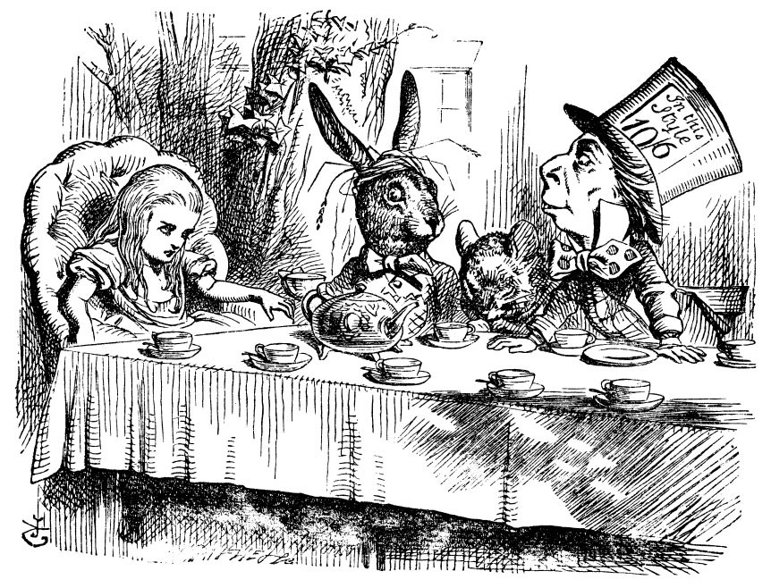
I am inviting you on the strangest of journeys

Slide 4
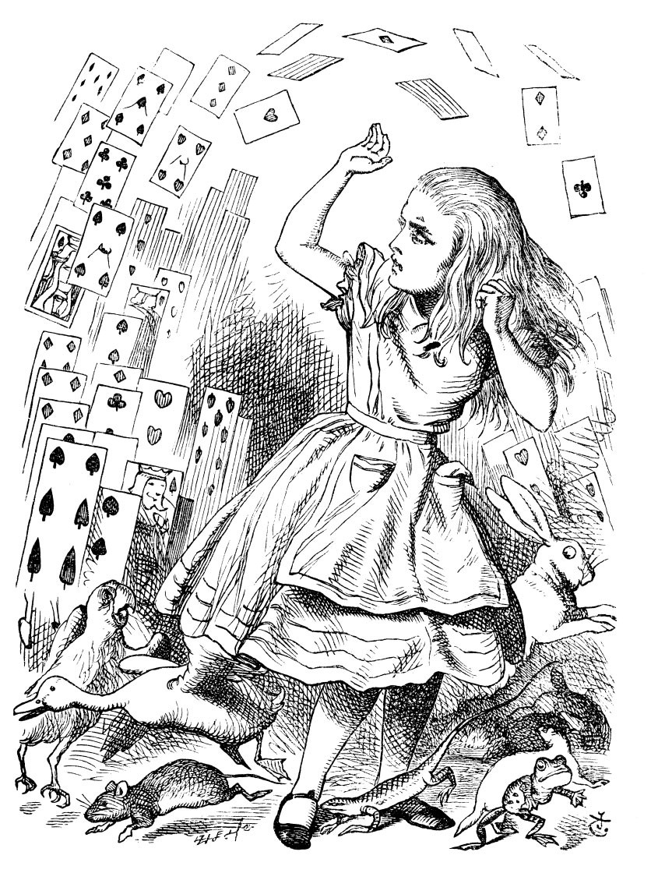
Key issue discussed in this workshop
Higher Education is changing rapidly. Our goals when it comes to Inclusion in post-secondary are evolving quickly too. It is in this context that Universal Design for Learning (UDL) is becoming increasingly appealing.
It will be difficult to move forward towards this new reality, however, without first fully acknowledging the complex tension which is appearing between the traditional format of accessibility services and the goals we are seeking to achieve.
All illustrations by John Tenniel (1865)

Slide 5
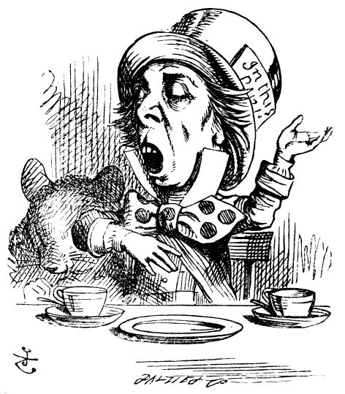
Your travel partner on this dystopian journey
Currently Associate Professor in Education at Royal Roads University in BC, Canada
Previously Director of the Office for Students with Disabilities at McGill for 4 years
Continue to act as consultant to colleges and universities on matters of accessibility and Universal Design for Learning
Heavily involved in UDL promotion in HE in Canada
Have been Academic Lead on an MEd for 3 years at UPEI and am now Program Head on an MA in Educational Leadership and Management.
Identify seamlessly with the perspective of accessibility services, but also able to step back and take some distance to examine objectively how existing practices create uneasiness.
You Mad Hatter on this journey!

Slide 6
Format of Keynote
When discussing the transfer of the Keynote to an online format, Dara and I thought the most engaging way to structure the talk would be a discussion format. Dara has graciously accepted to be my partner in this dialogue.
Will encourage Dara to stop me when participants have questions. Please use the chat function in Zoom.
We have inserted interactive activities to encourage participants to take on an active role in the discussion.
A reflection on UDL within the conference delivery format has led me to create a website to support the talk, and offer participants multiple pathways to the content. The site can be found at: www.keynoteAHEAD2020.com
I also wish to stretch the opportunity we have for dialogue well beyond the hour we are given here. You can continue the discussion via email (frederic.fovet@royalroads.ca) or through social media such as Twitter (@ffovet or #AHEAD2020). Please join these discussions and build the momentum around these important themes.

Slide 7
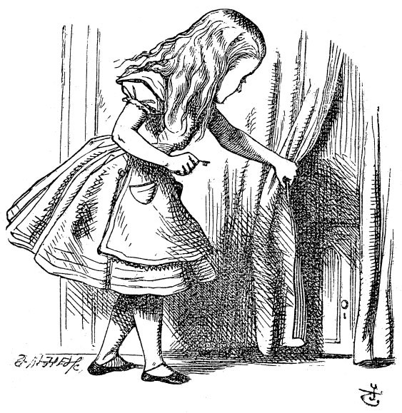
First part of the journey: Down the rabbit hole
Let’s begin our journey down the rabbit hole. Accompany me on an exploration of a dystopian future world where nothing has changed and trends have become accentuated…

Slide 8

Interactive interlude 1
Interactive activity – Using Menti, we are going to get you to explore and share some of the areas of tension you are currently experiencing within Disability support services. Where are the seams cracking? Please keep entering your thoughts in Menti through this section and we will go through some of the comments together at the end of the section.

Slide 9
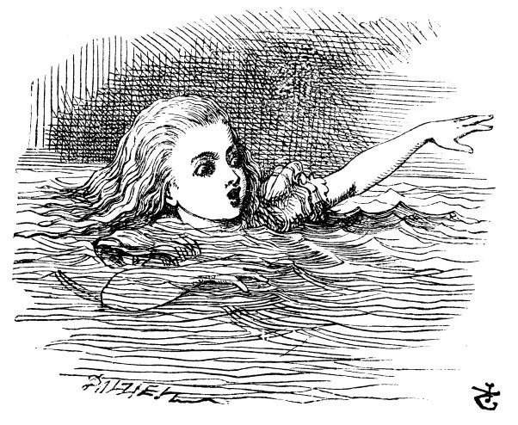
Down the rabbit hole
As we descend down the rabbit hole, we are going to consider five points of tension:
- Growing demographics
- Explosion of diagnostic labels
- Need for financially sustainable solutions
- Inherent clash between current practices and social model goals
- Increasingly loud expectations of the student body

Slide 10
Explosion in demographics
Emerging trends
Impact on Accessibility services
Unprecedented explosion in service request (up to 150% in one year on certain North American campuses)
Emergence of a significant body of ‘floaters’, students who require services but do not register
Percentage of service users who do not identify as having a Disability and refuse to approach these services
Intake appointments impossible to maintain in their current format
Long bottleneck and waitlists
High percentage of learners cannot access their services
Increasing provision of template services that are not specifically aligned with learners’ needs.
Increased number of complaints and appeals – including litigation and settlements
Disconnect and frustration from faculty

Slide 11
Explosion of diagnostic labels
Emerging trends
Impact on Accessibility services
Services set up for ‘traditional’ disabilities (hearing, visual and mobility impairments) are forced well beyond their expertise and applying a targeted, remedial, diagnostic approach to diagnoses they have little understanding of.
This leads to processes that are contradictory and purport to put a campus on notice of a diagnosis whilst not providing specialized expertise. Letter of accommodations to instructors has become entirely meaningless.
Phenomenon of disempowerment and emergence of a ‘culture of referral’ on campuses that seem to purport that to be a specialist on access one needs to have diagnostic expertise.
The diagnostic document is no longer a tool it becomes a barrier between the service provider and the learner and often precludes genuine dialogue on barriers created by the learning environment.
Many learners in fact do not actually require traditional accommodations, but are still being forced to acquire diagnostic documentation.

Slide 12
Need for financially sustainable solutions
Accommodations were designed and conceived at a time when students with Disabilities represented a very small percentage of the campus population.
In those days it was possible to create inclusive provisions in this way; it remained uncomplicated, relatively cheap, manageable and relatively efficient.
This is no longer the case: the existing format of services is extremely costly and has become unsustainable.
The issue is not the cost itself, but rather the fact that these expenses keep increasing, that they snowball and escalate out of control – without ever having any tangible structural impact on practices or pedagogy.
A cost of this magnitude can only be justified if it succeeds in fundamentally altering structure and creates a more sustainable campus.

Slide 13
Inherent clash between current practices and social model goals
Intake format
Flavour of appointments and power dynamics
Issues with the notion of ‘help’ – breeds co-dependency on services than actual autonomy
Over-reliance on documentation
Creation of additional barriers, not removal of challenges
Particularly thorny issue of exam accommodation and onerous registration processes
Issues with outreach with implies an inherent adhesion to medical model
Funding model of accessibility services is ambivalent and prioritizes ‘bodies through the door’
Breeds a ‘working myself out of a job’ ambivalence in relation to UDL
Little time and resources dedicated to faculty support

Slide 14
Increasingly loud expectations of the student body
There is starting to be a clash of culture between a generation of students who ahev very specific expectations with regards to inclusion and a system that has so far not shied away from setting them apart and labelling them.
Where does that eloquent anger come from? We are now supporting a generation of students that has benefitted from inclusion in schools. They have a very clear understanding of social capital and why it is so important within education.
They wish to be treated as all other students and often reject being channelled towards a parallel system that purports to treat them differently.
Anecdote from my own practice in relation to final exams in Undrgraduate courses.
Mediatized case in Ontario that has set a precedent for Ontario universities:
This student voice highlights daily the fundamental clash that exist between some of our Disability services practices and the social model of disability/ genuine inclusion

Slide 15
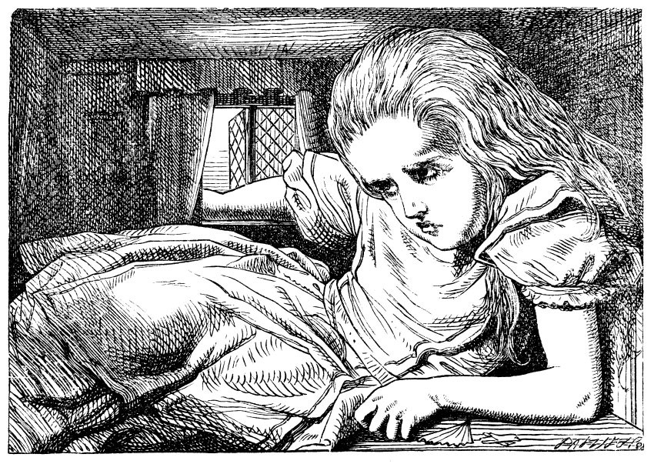
Our journey down the rabbit hole…
Unsustainable practices
Routines at odds with the very spirit of Inclusion
Exhaustion of staff dealing with an unsustainable future
Lack of support from faculty and other units who are aware of these contradictions and deterred from actively collaborating

Slide 16
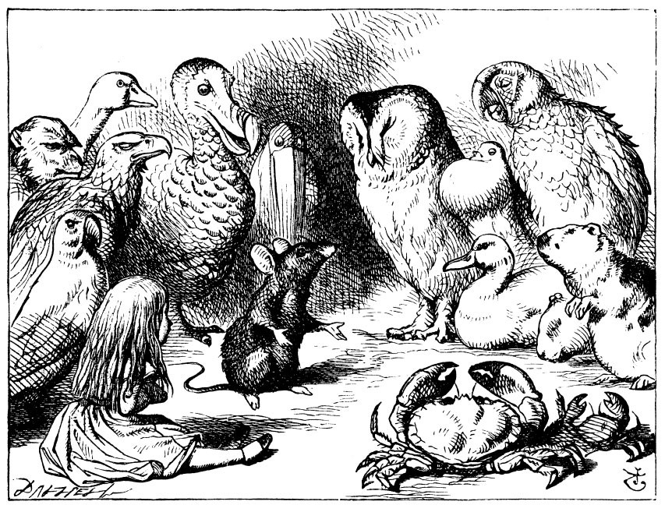
Part two of the journey: Through the looking glass
I now invite you on a very different journey, a journey to a world that could be, a future that is sustainable and addresses our concern – through the looking glass…

Slide 17
Interactive interlude 2
Interactive activity – Using Menti, Dara and I are going to ask you to create a word puzzle by posting words you feel have strong suggestive connotations in relation to the changes you feel are needed urgently in order to avoid the ‘madness’ we have just journeyed through… What would be your ‘one word’ recommendations to the sector for immediate change in the way we see and construct the Inclusion of diverse learners.

Slide 18
Part two of the journey: Through the looking glass.
Suggestions for a sustainable future:
shifting services towards faculty support
reframing the image of Accessibility services
rationalizing exam services
removing barriers from student interface
redefining sustainable development of Accessibility service

Slide 19
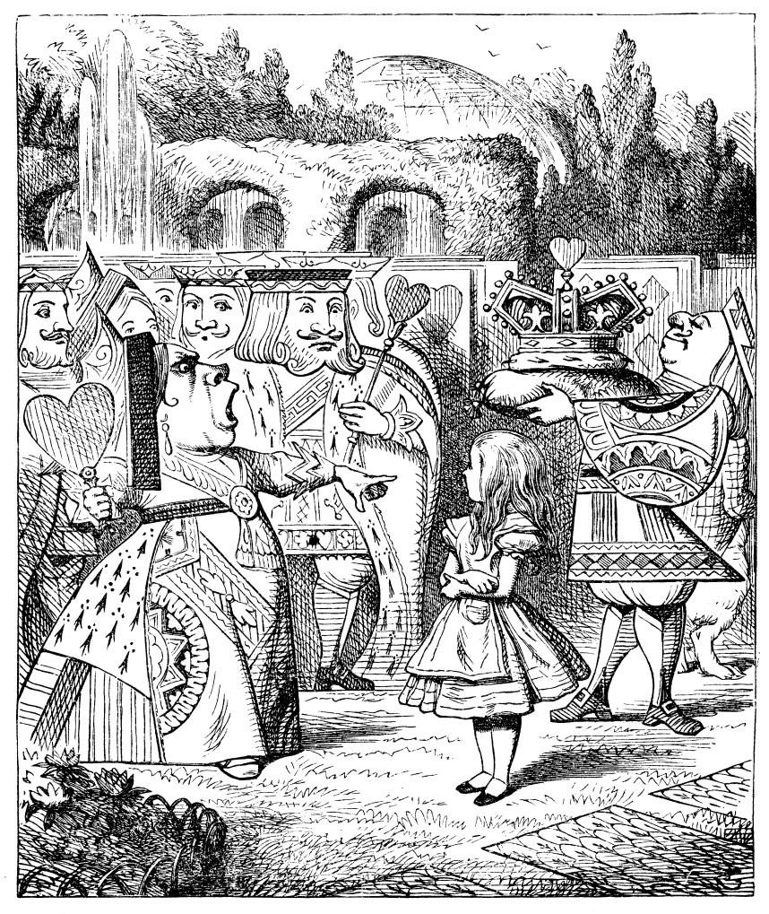
Part three of the journey: Sustainable leadership and management of change
As our journey through the looking glass comes to a close, I invite you to reflect on the leadership and management repercussion of this reflection.
What is required, on the part of unit leaders and senior management, to guide Accessibility services staff ‘through the looking glass’?
What are the pragmatic steps that must be taken, in terms of management of change, to reach these sustainable goals?

Slide 20

Interactive Interlude.
Interactive activity – During this section we will ask you to write down questions and use the Zoom Meeting chatbox to post them. Frederic and Dara will tackle as many of these as possible as the section comes to a close.

Slide 21
Part three of the journey: Sustainable leadership and management of change.
Acknowledge and challenge our ambivalence with regards to UDL
Engage in meaningful cross-campus alliances for the development and implementation of UDL
Avoid using obsolete funding model as an excuse for stagnation
Engage in an authentic reflection on hiring practices
Support staff as they begin using UDL as a lens on their practice
Collaborate with other student services and embracing Intersectionality
Boldly embrace a new wider role for Accessibility services on campus

Slide 22
Interactive Interlude...
Interactive activity – Recap on questions posted in the Zoom Meeting Q&A chatbox.

Slide 23
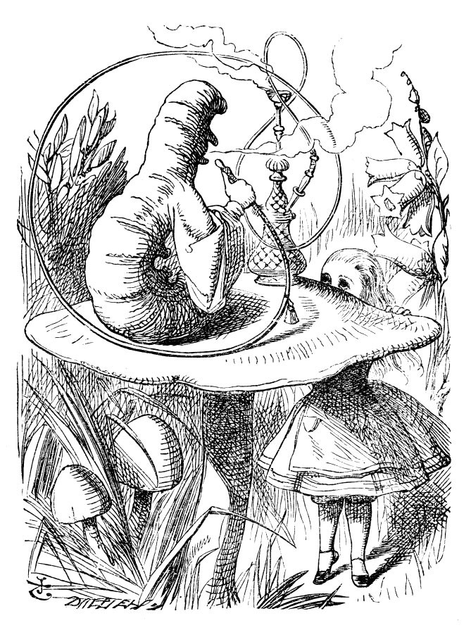
Let’s continue this journey together – Extend the conversation!
Let’s break this Keynote out of the traditional constraints of conference delivery.
AHEAD and Dara have helped us do this in part already by allowing it to take shape online.
Let’s apply UDL fully to it and turn it into an ongoing conversation!
I’ll be online for the evening (my afternoon) and we can chat using email (frederic.fovet@royalroads.ca) or Twitter (@Ffovet or #AHEAD2020)

Slide 24
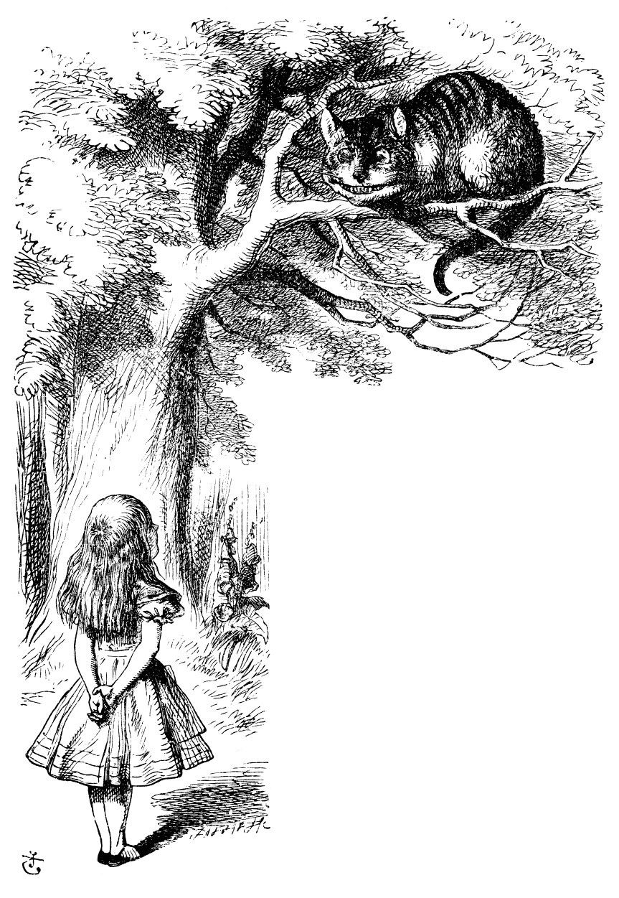
References
Bailey, M. (2017) Race and Disability in the Academy. The Sociological Review.
Beck, T., Diaz del Castillo, P., Fovet, F., Mole, H., & Noga, B. (2014) Applying Universal Design to disability service provision: outcome analysis of a UD audit. Journal of Post-secondary Education and Disability, 27(2), 209-222
Fichten, C., Heiman, T., Havel, A., Jorgensen, M., & Budd, J. (2016) Sustainability of Disability-Related Services in Canada and Israel: Will the Real Universal Design Please Stand Up? Exceptionality Education International, 26(1), 19–35
Fovet, F., & Giles, J. (2015) ‘What`s in a name?’ Assessing dynamic tension between Critical Theory ambitions and Neoliberal pragmatism in Higher Education Disability service provision. International Studies in Widening Participation, 2 (2), 4-11
Fovet, F. (2017) Access, Universal Design and Sustainability of Teaching Practices: a Powerful Synchronicity of Concepts at a Crucial Conjuncture for Higher Education. Indonesian Journal of Disability Studies (IJDS), 4(2), 118-129
Fovet, F. (2020) Examining the (lack of) impact the #disabilitytoowhite movement has had on Higher Ed Disability Service Provision. Paper presented at the Hawaii International Conference on Education, Honolulu, January
Fovet, F. (in print) Developing an Ecological Approach to Strategic UDL Implementation in Higher Education. Journal of Education and Teaching
Houghton, M. & Fovet, F. (2012) Reframing Disability, reshaping the provision of services. Communiqué, 13 (1), 16-19
Stienstra, D., Nyerere, L. (2016). Race, ethnicity and disability: Charting complex and intersectional terrains. In Grech, S., Soldatic, K. (Eds.), Disability in the global South (pp. 255–268). Cham, Switzerland: Springer.

Slide 25


Contact details
Frederic Fovet (PhD.)
Associate Professor, School of Education and Technology, Royal Roads University
Frederic.fovet@royalroads.ca
@Ffovet
www.implementudl.com

