Slide 1


Enhancing Accessibility in Education
Power of Disability

Slide 2
What does accessibility even mean?
“able to be reached or easily obtained”

Slide 3


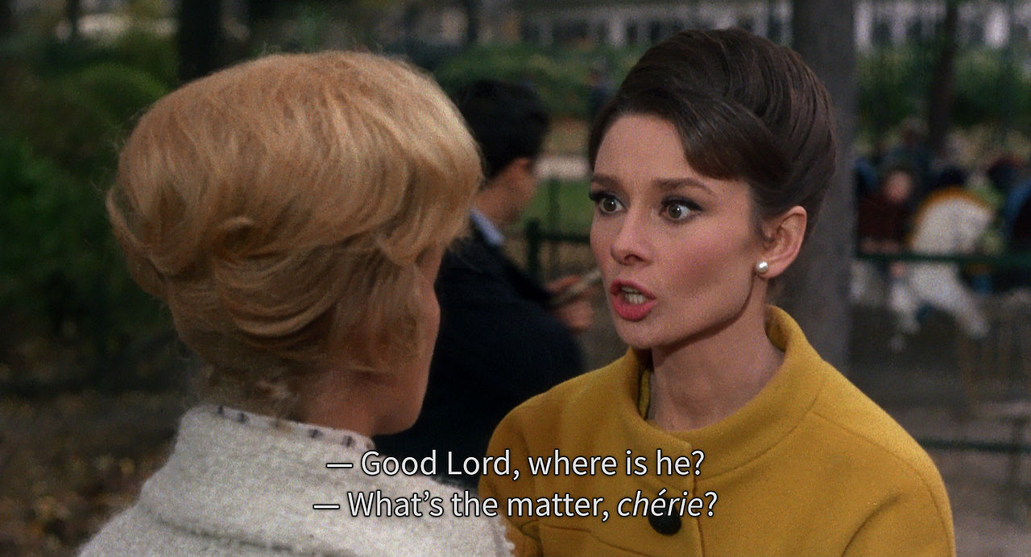
Accessibility can mean a lot of different things

Slide 4

Accessibility and Assistive Technology

Slide 5


Accessibility and You
Trevor Boland
Assistive Technology Officer
Dublin City University
(Dog fantanatic, Song: California Soul, Game:Zelda)

Slide 6

Curiosity …
Curiosity about yourself
  What type of learner are you?
  What Technology skills you have/ need?
  What are your strengths and challenges?
Curiosity about your College / University
  What services do they have?
  How do you access them?
  Do you engage with them?

Slide 7

Curiosity… about your Disability Service
Talk to your Disability Service:
Email / meet up - ask the Team
Disability Officer / Occupational Therapist
Assistive Technology - types?
Other services - Library…
Student Union

Slide 8

DCU Compass
www.dcu.ie/students/inclusive-technology

Slide 9

Curiosity… and Assistive Tech
Why even think about Assistive Tech:
Note-taking - OneNote / Google Docs
Read Aloud - Immersive Reader / iPhone
Writing - Write with your Voice
Organisation - Bookmark on Browser
Procrastination - What makes you work?

Slide 10

Curiosity… Tech Skills
What are your Core Tech skills:
Files / Folders / Browser
Accessibility in your Device - explore
Explore Technology - be critical
Use YouTube to get skills

Slide 11

Curiosity… and transform files
Reading can be a big challenge:
Volume of reading
New terminology
Densely written
Reading and commuting
Reading and walking
Bookshare and File transforming - document to Mp3

Slide 12

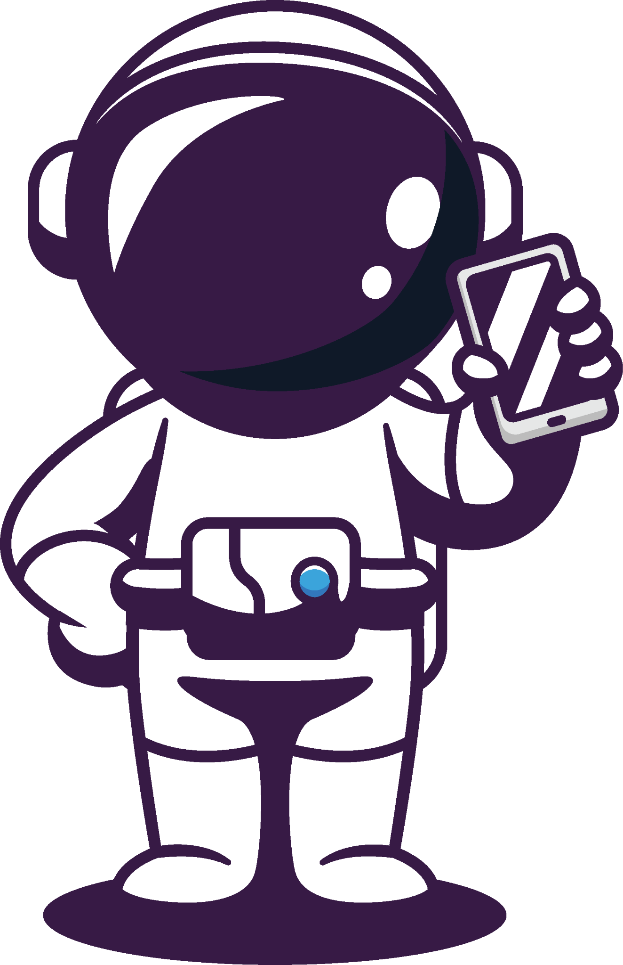
Curiosity… Digital Accessibility
Headings and Structure
Ornamental or Description
URLs and Links
Sans Serif and Readability
Evaluate Accessibility

Slide 13

Curiosity…Find your Tribe

Slide 14
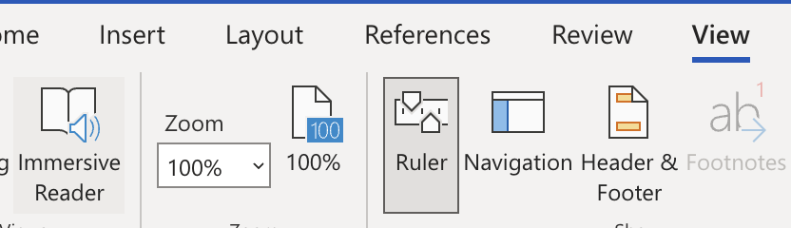
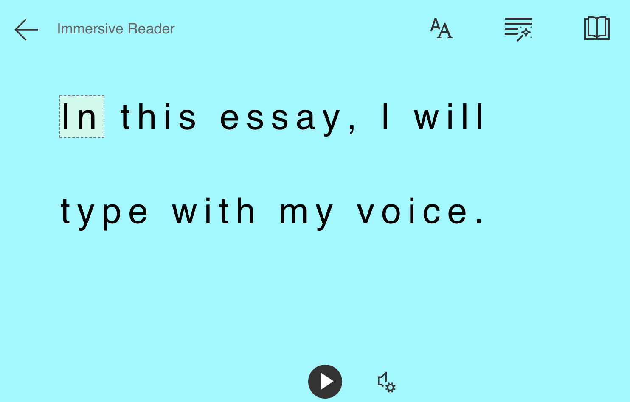
Microsoft Tools
Immersive Reader in Word
Go to Office.com
Log into your DCU account
Open a Word Document
Go to ‘View’
Open ‘Immersive Reader’ (IM)
IM reads out your document
Press the play button
Proof listening / memorisation

Slide 15
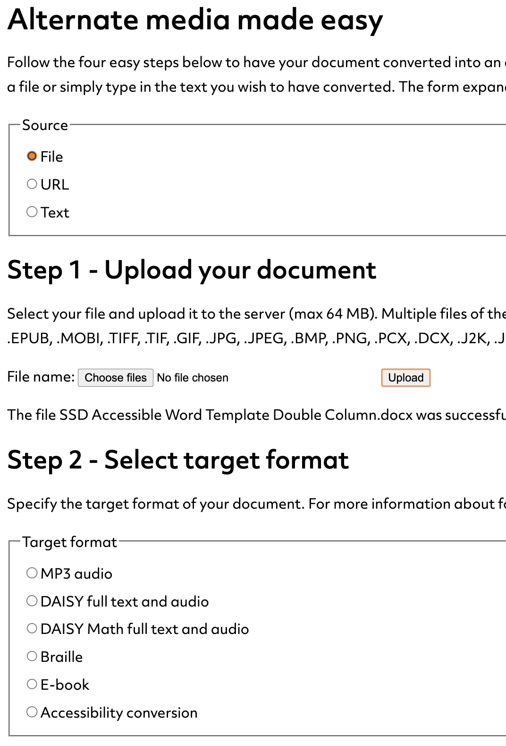
Sensus Access
Document to audio file
Sensus Access on DCU site
Search for Senus Access in DCU site
Select link to ‘Webform’
This opens the form you see here:
Select ‘File’ option
Then ‘Choose File’
Then ‘upload’ it
Then ‘MP3 audio’
Then add your email - shortly you get a mail shortly with a link to the file.

