Slide 1

ALTITUDE
Where It's At, Early Impact and Celebration of New Adopters
Notes:
MH – Representing ALTITUDE - brief intro

Slide 2


In This Session
We will:
Take stock of where we are at ALTITUDE adoptions
Celebrate newly adopting institutions
Get a sample early impact and consider what’s next for ALTITUDE
Notes:
MH
Strong legislative responsibility for access and inclusion present, and with the European Accessibility Act coming down the tracks, that responsibility will grow.
Sectoral commitment ‘Inclusion is Everyone’s Business’ approach – collective responsibility. UD is an evidence-based approach to make that idea a reality.
However, Irish research shows – more dialog required at the strategic level, lack of collaborative effort between different areas of institutions evident.
Charter seeks to address this, supporting institutions to operationalise a UD approach, improving the student experience and increasing compliance with existing and impending Irish and EU law.

Slide 3

Reminder: Mission of the ALTITUDE Project
“To support HEIs and ETBs to make sustainable progress towards systemically embedding a universal design approach, which places human diversity at the heart of tertiary education design and fosters student success for all.”
Notes:
MH

Slide 4
Reminder of the ALTITUDE Timeline
Oct 2022
Development Process Commenced – Project Group Formed
Mar 2025
Adoption Period Commenced – First National Adoption Day
Mar 2024
Charter Launched Kick-starting National Conversation
Mar 2026
Inaugural ALTITUDE Summit

Slide 5
Adoption Yr 1 – 23 Institutions on Board!
7/19
HEA Funded HEIs
10/16
Education and Training Boards
4
Private/ Other Institutions
2
National Agencies/ Bodies

Slide 6




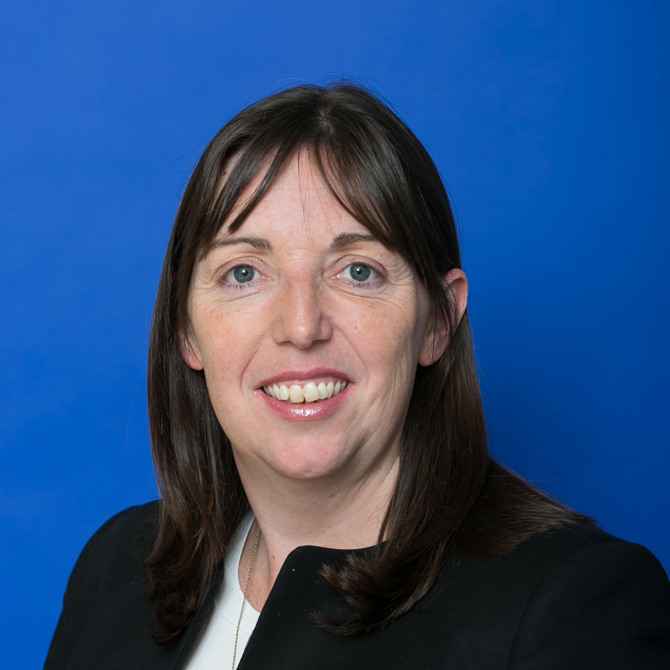
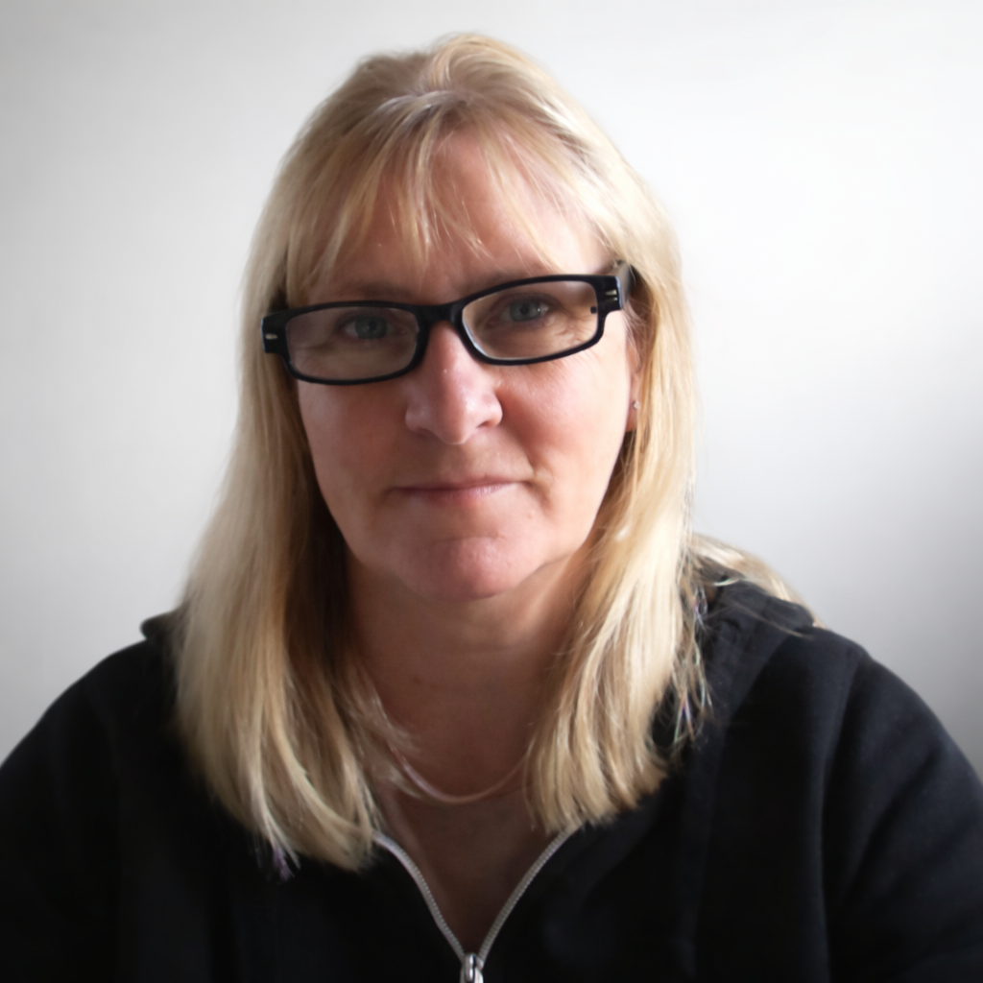
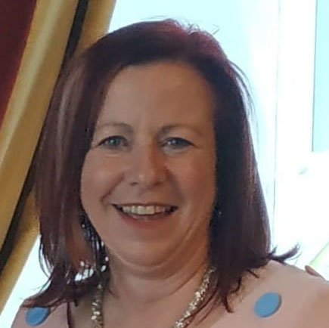
Welcoming New ALTITUDE Adopters
Dr Anne-Marie Butler
Karen Higgins
Martha Bolger
Summit

Slide 7

Teagasc Adoption
Dr Anne-Marie Butler

Slide 8
City College Group Adoption
Karen Higgins

Slide 9
KCETB Adoption
Martha Bolger

Slide 10

Examples of ALTITUDE’s Early Impact

Slide 11

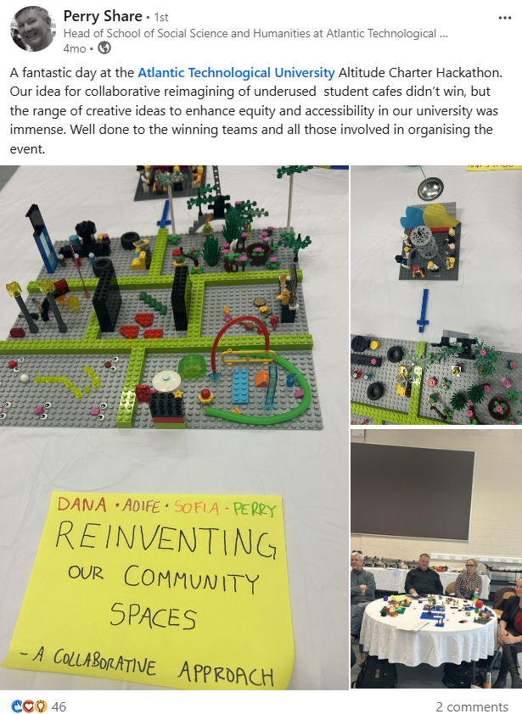

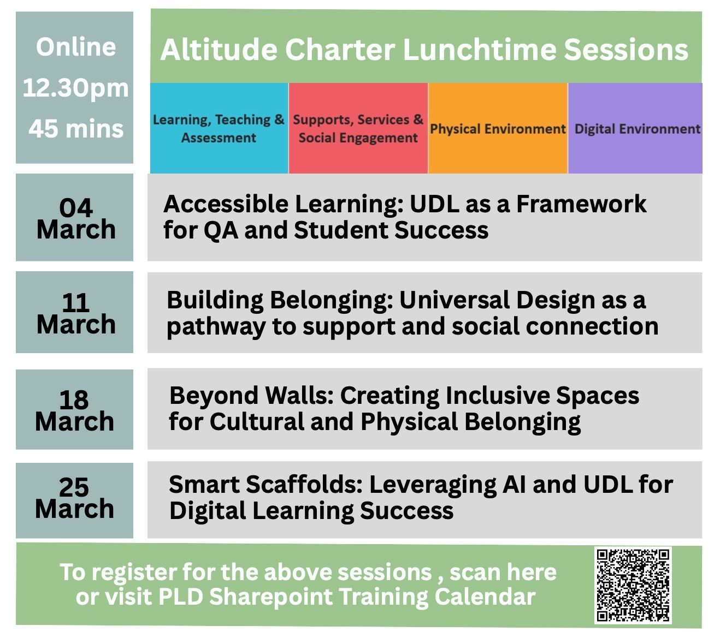
Socialising the Charter and Prof Development

Slide 12


Pillar-based Example:
Physical Environment
New 10-Year Campus Development Plan: Universal Design and underlying ALTITUDE physical/digital pillar actions added as Design Standards in plan
Embedding in Governance: ‘Lack of Universal Design Embedded in Project’ added as standing risk item in template risk register used for all new capital projects.
With thanks to Cormac Cloonan, Head of Capital Development in TUS for permission to share

Slide 13

Next: The National ALTITUDE Community
AHEAD, with guidance from the ALTITUDE Activation Group, are designing a National Community of Practice.
Interested? Come to the online Town Hall event, 11:30-13:00, May 6th, 2026 - online via Zoom and have conversations which will help us to shape this community.
Register using the QR code or contact altitude@ahead.ie with queries.

