Slide 1
Assistive Technology in Action
Danielle Duignan, Digital Media & eLearning Officer, AHEAD
Better Options 2025

Slide 2
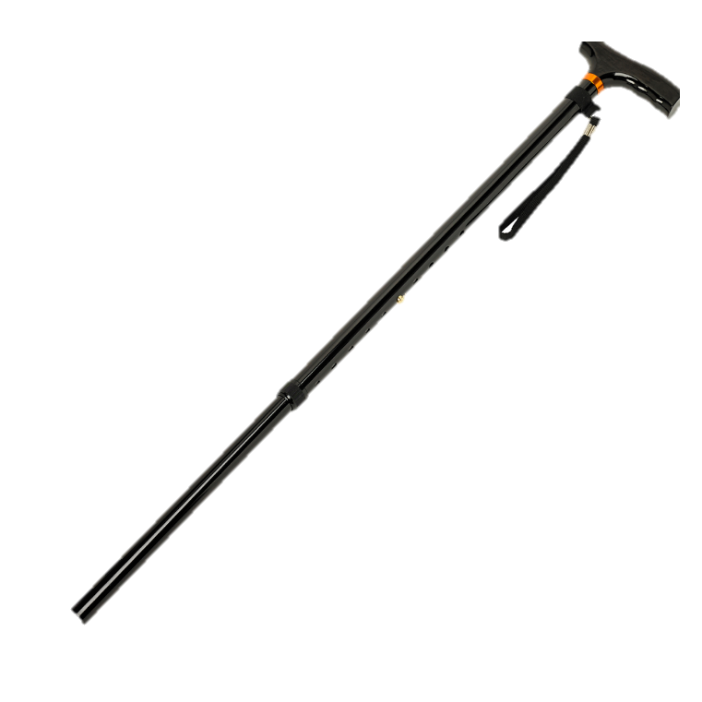

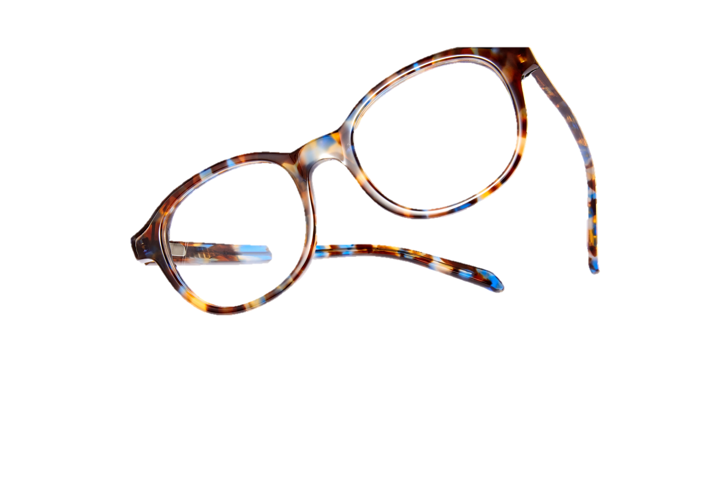
What is Assistive Technology?
“…umbrella term for assistive products…(which) help maintain or improve an individual’s functioning related cognition, communication, hearing, mobility, self-care, and vision…”

Slide 3
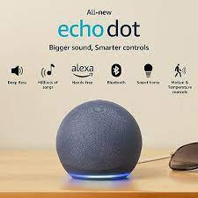
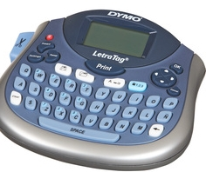
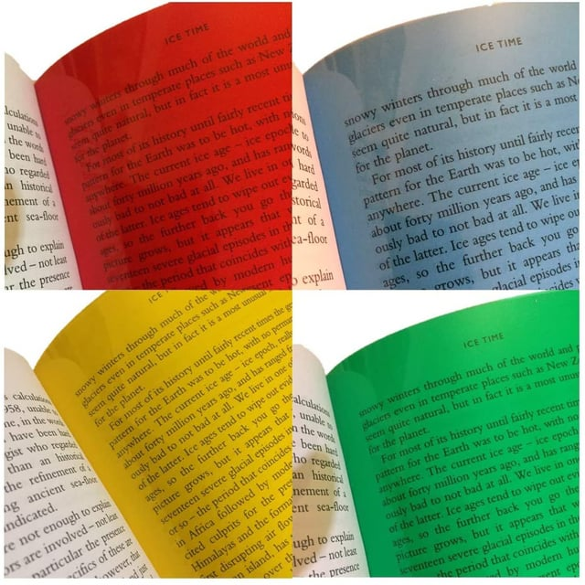
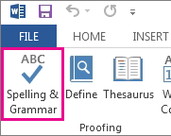


The Tech in Assistive Technology
Low-Tech or No-Tech
High-Tech

Slide 4





Where is Assistive Technology (AT)?
Smart phones
Apps – App Stores
Inbuilt >> Settings >> Accessibility
Desktop / Laptop
Software
Websites
Google / Office 365
Browsers>>Chrome/ Edge
Inbuilt >> Dictation / Magnify
Tablet / iPad
Apps – App Stores
Inbuilt >> Settings >> Accessibility
Devices
Dictaphone
Livescribe pens
Magnification
Braille devices

Slide 5





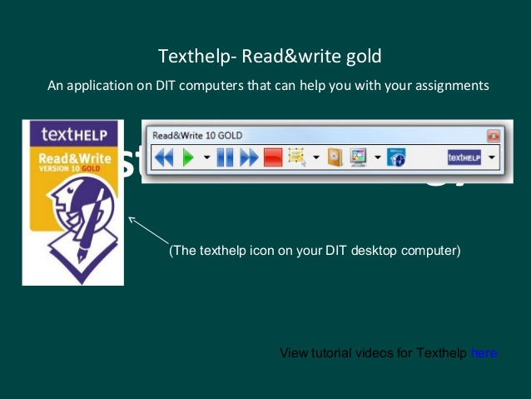

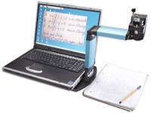



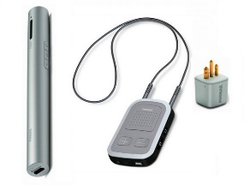
Register with your Disability Service
Val
Dyslexia
Aideen
Hand Impairment
Rogerio
Visual Impairment
Eric
Hearing Impairment
Maria
Blind
Texthelp Read & Write Gold
Dragon
Optiverso

Slide 6
The SETT Framework for AT.
‘The SETT (Student, Environments, Tasks and Tools) model of assessment (Zabala 2005).
The SETT framework is a four-part model that promotes collaborative decision-making in all phases of assistive technology service design and delivery, from consideration through implementation and evaluation of effectiveness.
Student: The learning needs / abilities / barriers?
Environment: Materials /equipment are currently available/needed in the environment?
Tasks: What are the critical elements of the tasks required to participate and learn?
Tools: High/Low tech to address needs.
Read about a project using this framework in UL in the AHEAD Journal
Source: SETT Framework, joyzabala.com

Slide 7

AT Barriers /Stigma / Abandonment.
When the environment is unsupportive, negative perceptions and experiences can be such that the potential usefulness of AT is uncoupled from their perceived value.
AT is frequently abandoned or not used, the reasons are often multifactorial and can include difficulties in incorporating assistive technologies in identity and self-image.
Livescribe Pens for recording audio – making a disability visible.
Further Reading: ‘Assistive technology and people: a position paper’

Slide 8
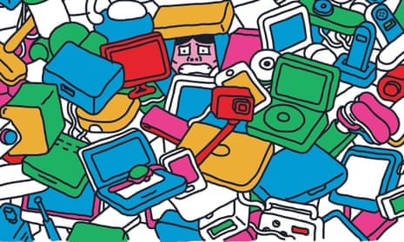
So…what now?
Illustration: Oscar Bolton Green

Slide 9

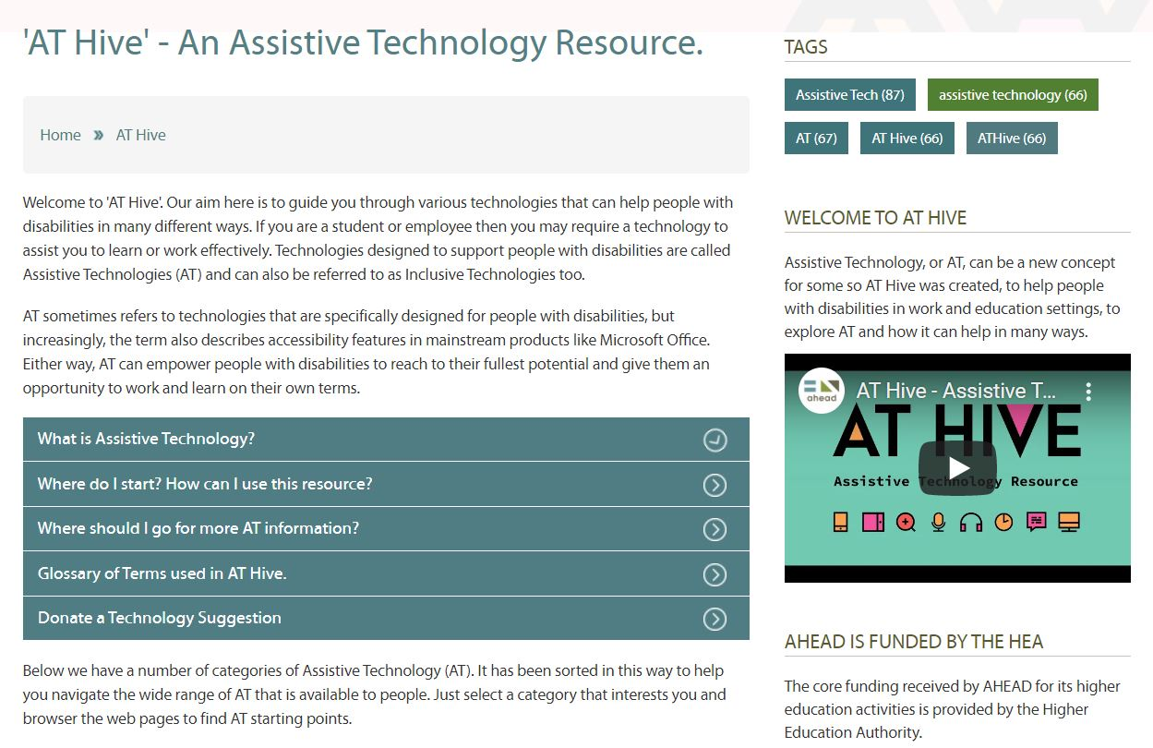
AT Hive – Raise awareness
AT Hive is an Assistive Technology Resource, in the AHEAD website, that aims to raise awareness and where to find AT and how to use it.
To date a collection of 50 technologies (websites, apps, browser plugins…) about reading, writing, organisation, communication and more.
#ATHive
Go to www.ahead.ie/ATHive

Slide 10
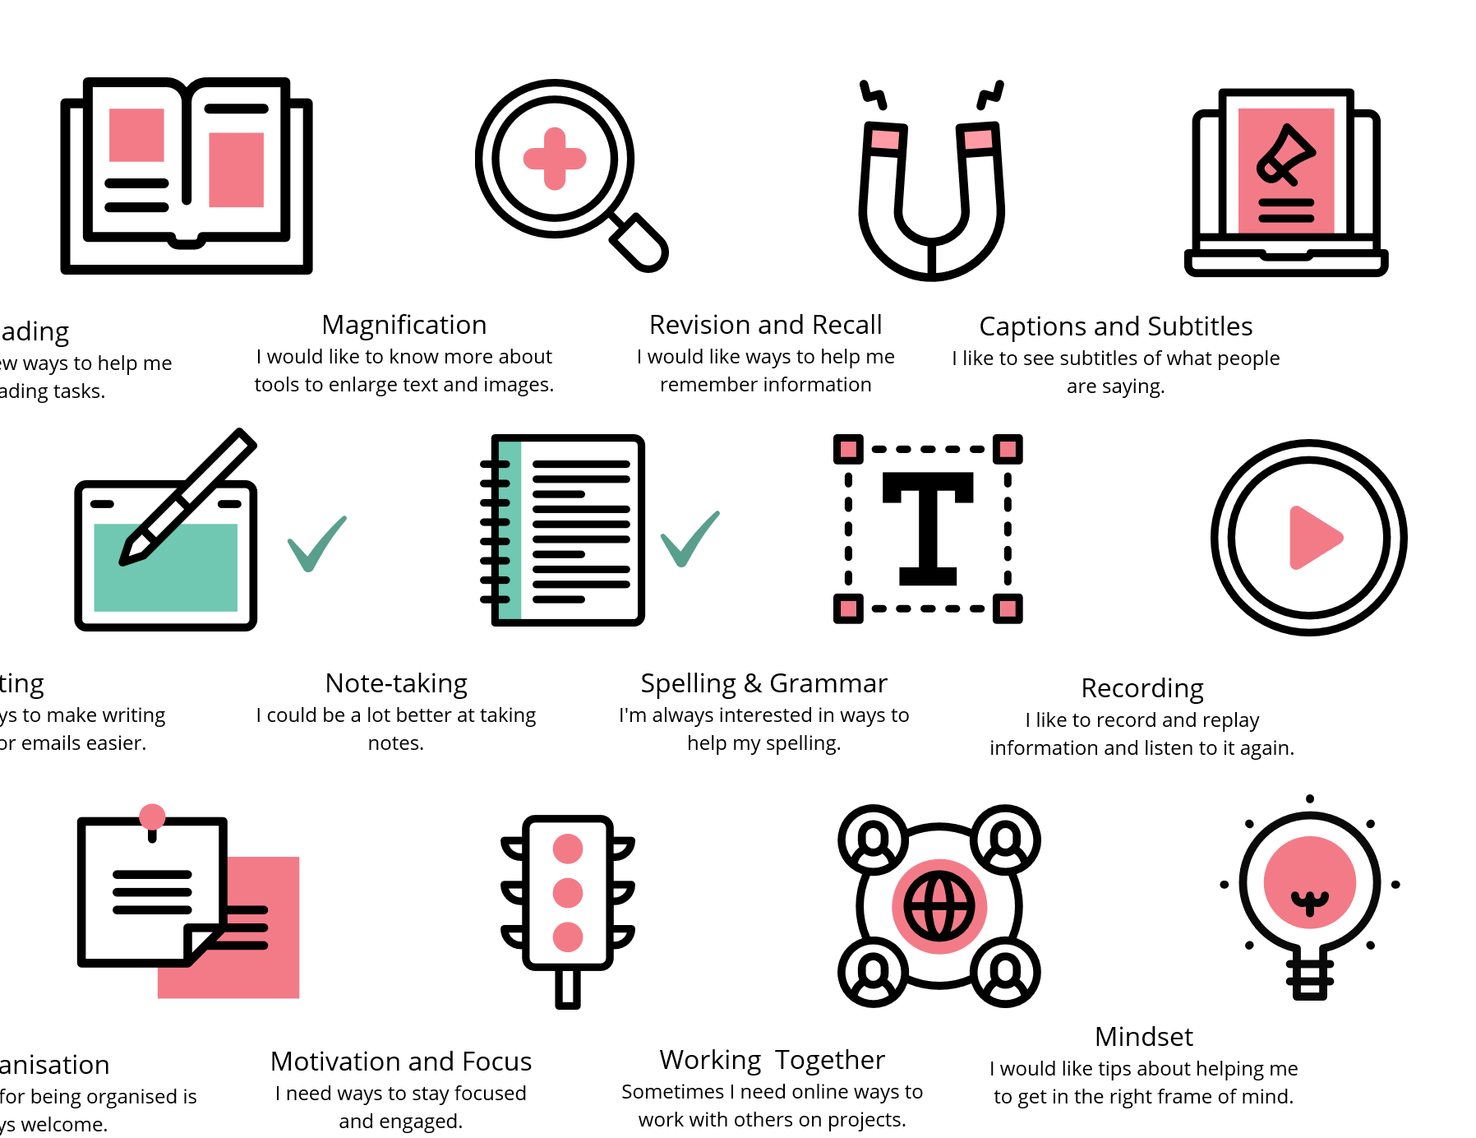

Interests you would like to explore?
Q1 of 3
www.ahead.ie/Discover-your-AT

Slide 11
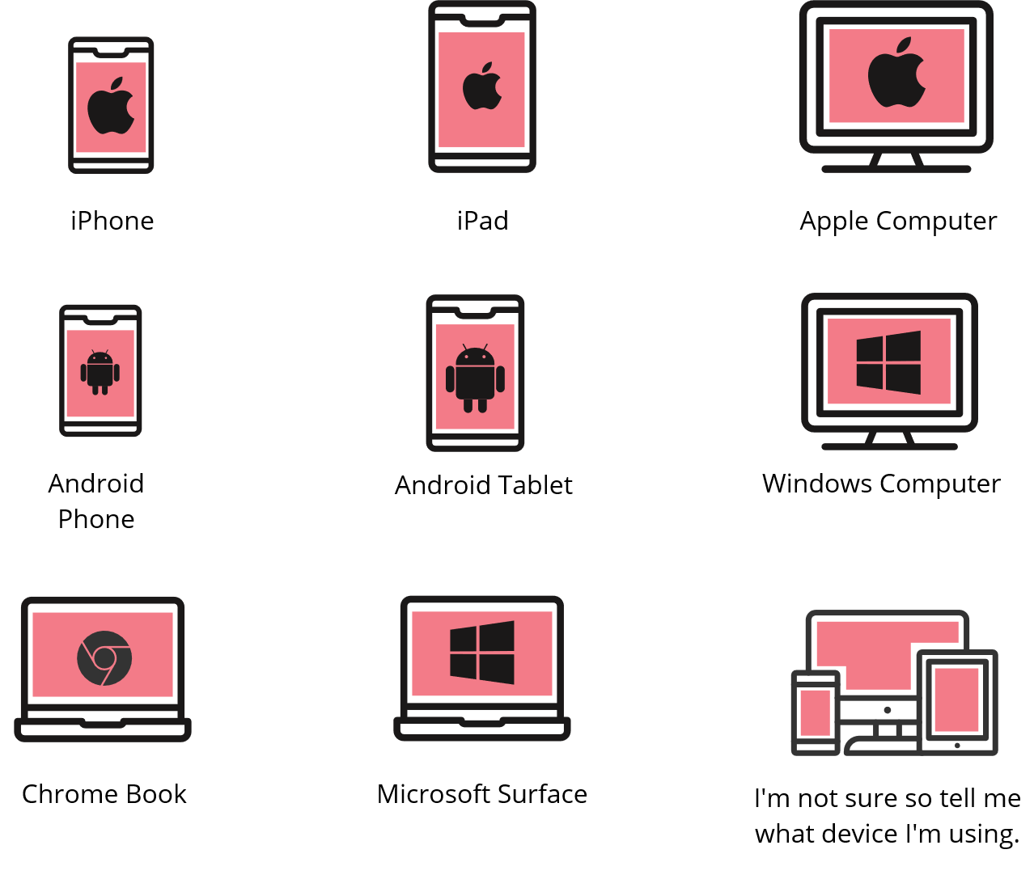
What do you use?
Q2 of 3
www.ahead.ie/Discover-your-AT

Slide 12



Choose your Digital Eco-system
Q3 of 3
www.ahead.ie/Discover-your-AT

Slide 13
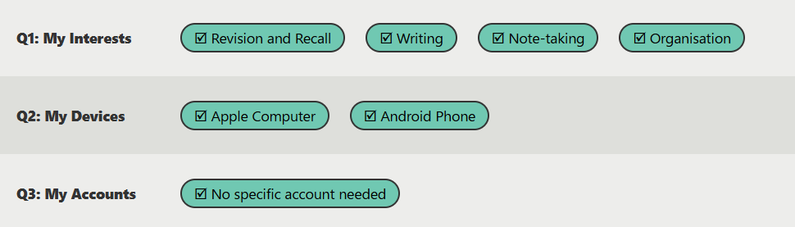


The AT Results Page – A Starting Point

Slide 14
AT Demonstrations
Accessibility Features on Laptop
  Dark mode
  Automatic captions
Glean – audio notetaking
Immersive Reader

