Slide 1

AT is for Everyone
Danielle O’Rourke, Digital Media & eLearning Officer, AHEAD
Notes:
This will take approx. 40 minutes. In this talk, we want students to learn how can assistive technology help with assignments and college work, which will include a practical demonstration of how to use assistive technologies to support students skills.

Slide 2

Overview
What is Assistive Technology (AT)?
How can it help me?
Demonstrations & Questions
~40 minutes

Slide 3
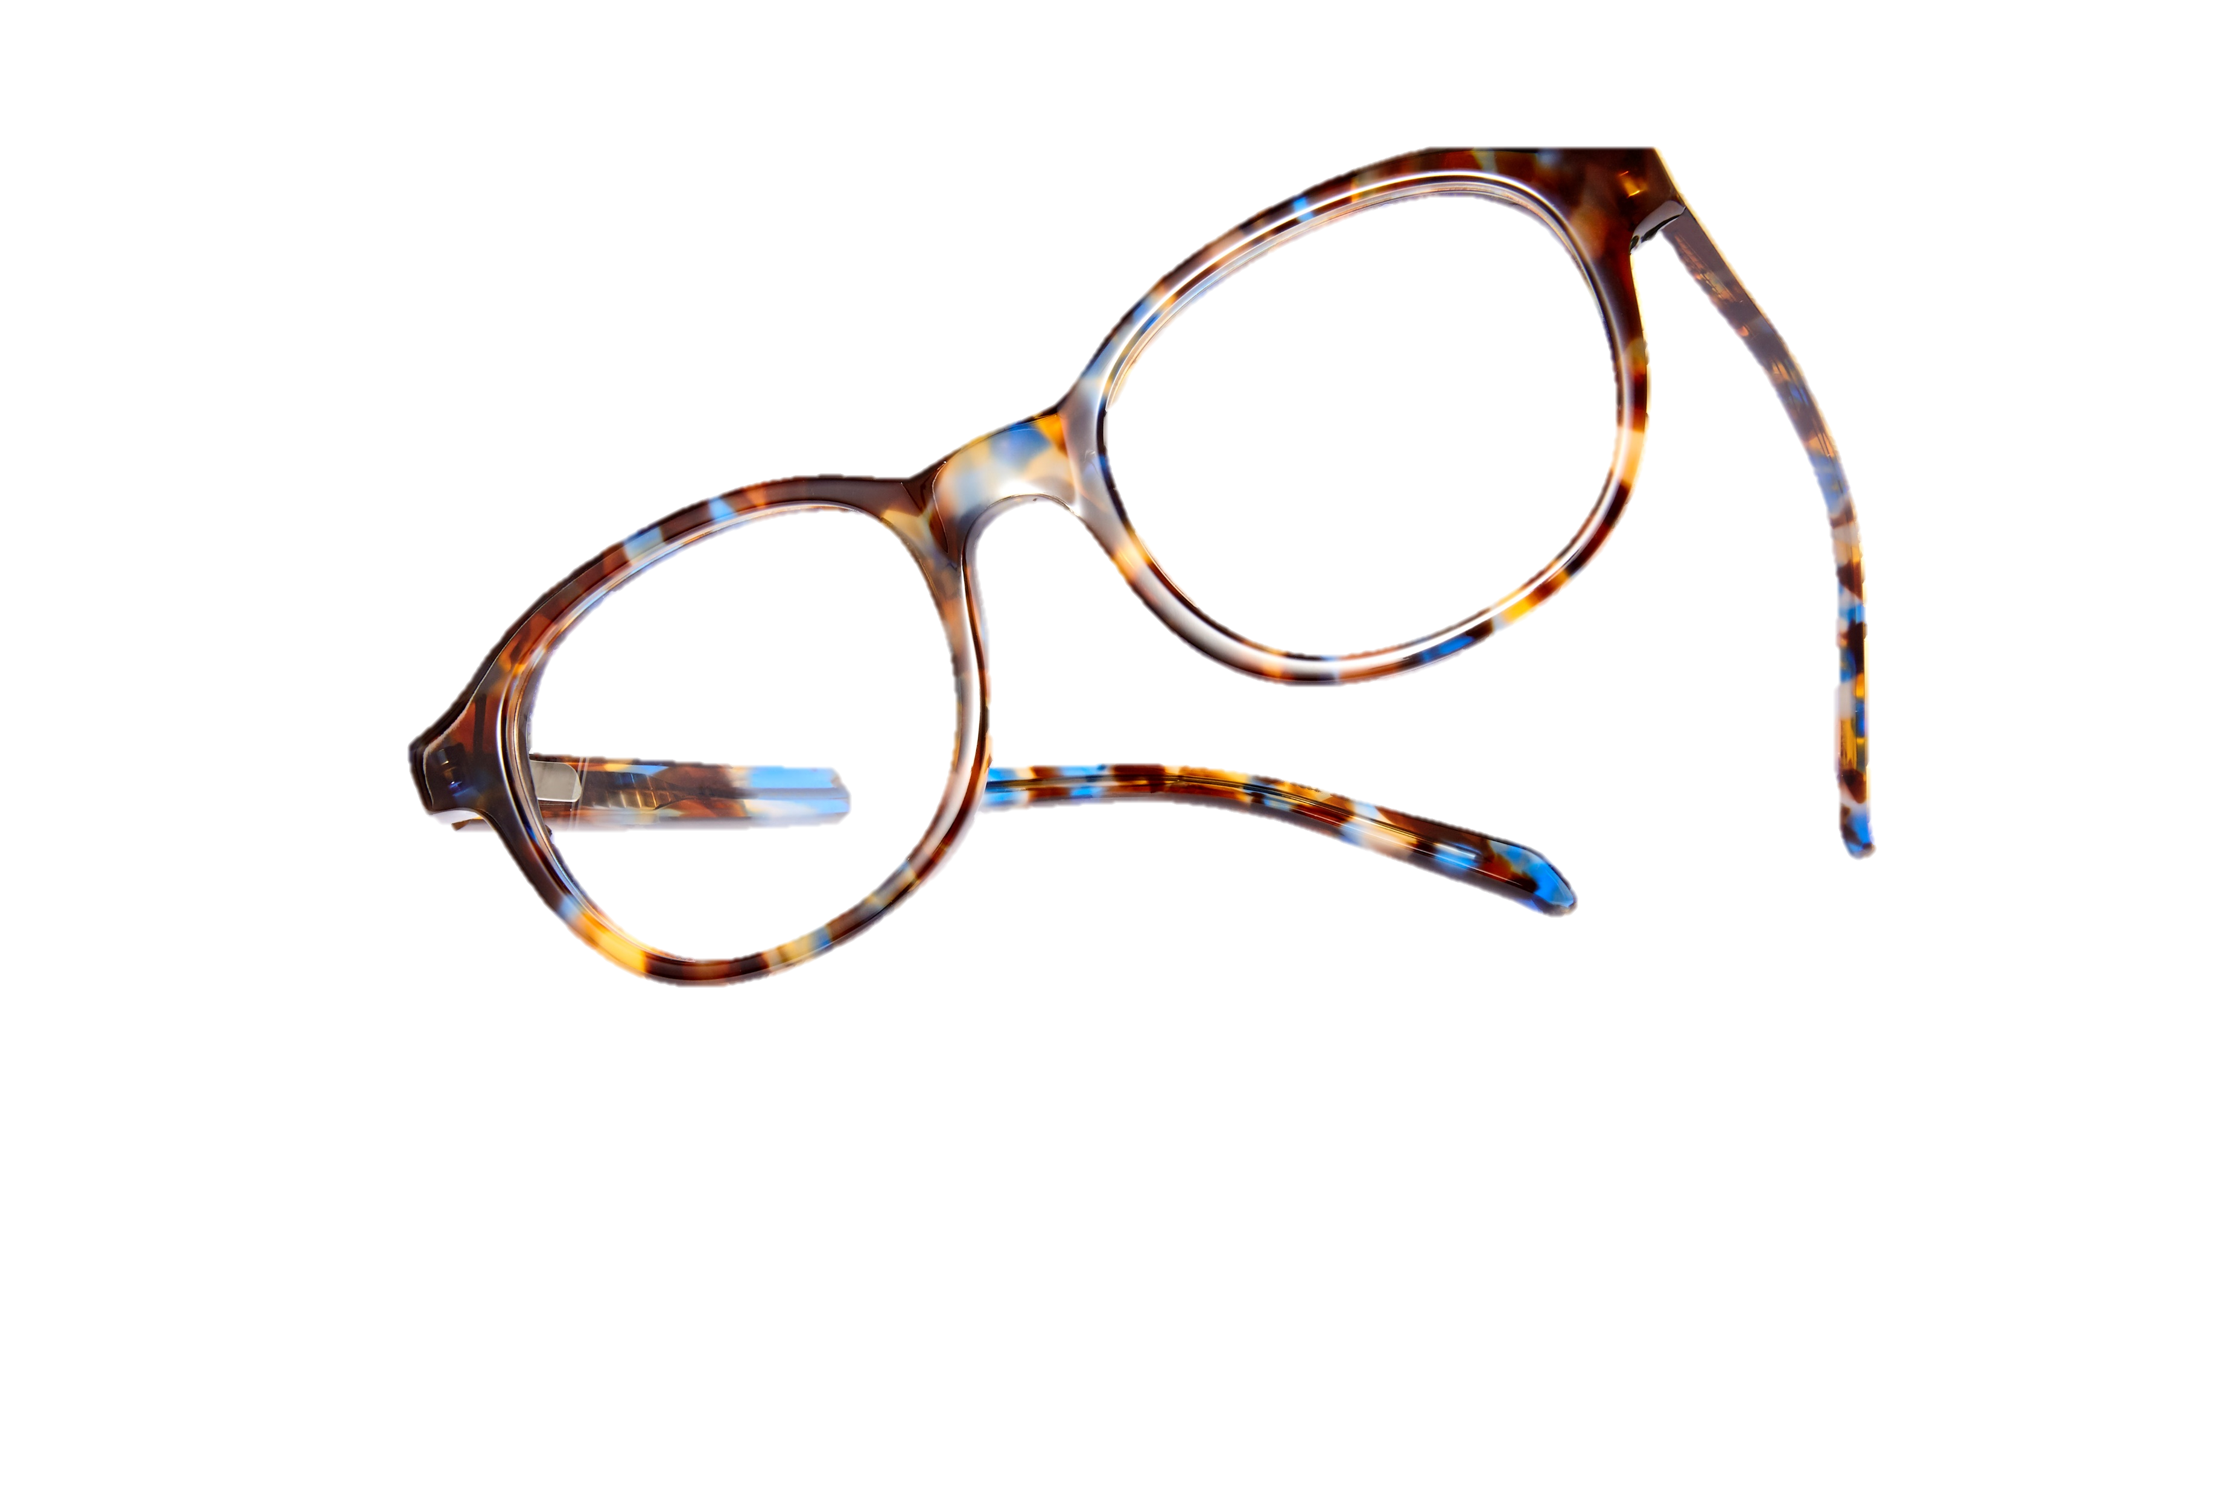
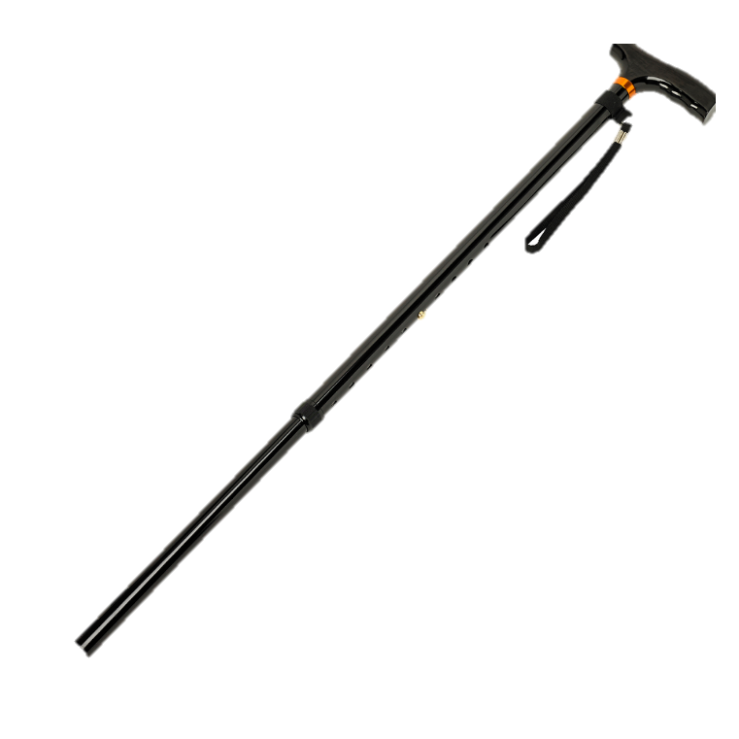


What is Assistive Technology?
“…umbrella term for assistive products…(which) help maintain or improve an individual’s functioning related cognition, communication, hearing, mobility, self-care, and vision…”
Notes:
Low Tech – Mid Tech – High Tech

Slide 4


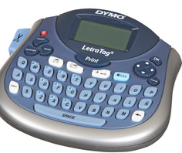
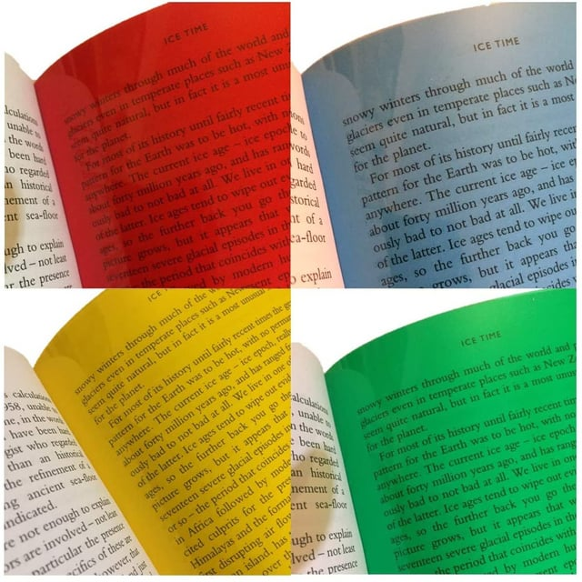
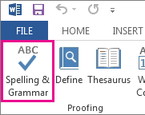


The Tech in Assistive Technology
Low-Tech or No-Tech
High-Tech
Notes:
Low Tech – Mid Tech – High Tech

Slide 5




Where is Assistive Technology (AT)?
Purpose-built
Desktop / Laptop
Smart phones
Tablet / iPad

Slide 6


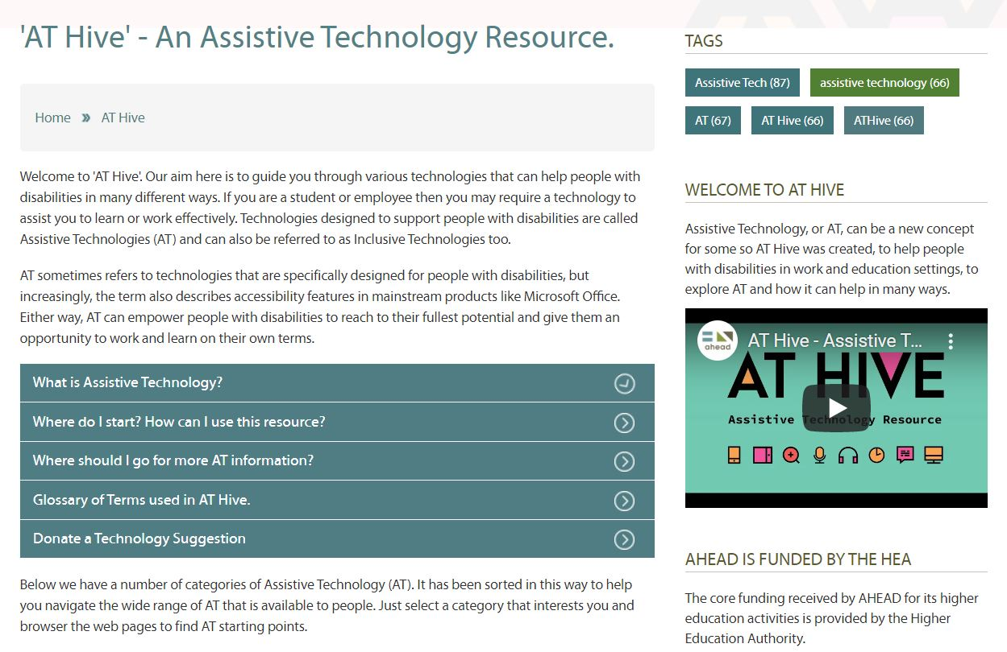
AT Hive – Discover your AT
Answer 3 questions to find out what AT could help you
Collection of ~50 technologies (websites, apps, browser plugins…) about reading, writing, organisation, communication and more.
Discover your AT – ahead.ie

Slide 7


AT Demonstrations
Notes:
https://www.ahead.ie/Microsoft-Dictate
https://www.ahead.ie/Glean

