Slide 1

Further Education and Training
Navigating Courses and Supports

Slide 2
What is FET and why should I choose to study there?
Further Education and Training is 3rd level education.
No points required- based on interview and/or portfolio.
Smaller class sizes.
Good supports
Bridge between school and Higher Education.
More focus on Practical skills.

Slide 3
Why Cntd.
I am not ready for University!
I don't have the points!
I need some support for my...
The lectures are too big
I have no idea what I want to do after college!

Slide 4
What would I like to do?
What am I interested in?
What am I good at?
What do I see myself doing 5 years from now?

Slide 5
Faculties
Arts, Humanities and Creative Media
Business, Administration and Law
Education, Manufacturing and Construction
Health and Welfare
Computing, Digital and Data
Natural Sciences
Tourism, Hospitality and Services
Social Sciences, Journalism and Information

Slide 6

CDFET locations

Slide 7
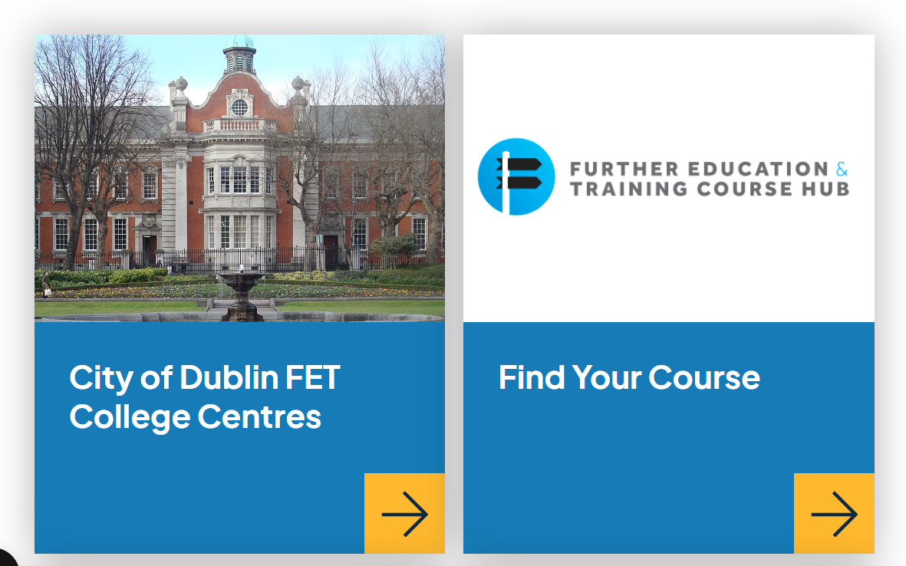
Website screenshots

Slide 8
How to apply
Website:
www.cityofdublinetb.ie

Slide 9
Learner Supports
Tick the box for support on the application form of the course you are applying to.
1
You will be contacted for a Needs Assessment.
2
The results will be shared with the course team.
3
Option to go to support when needed. Different colleges have slightly different approaches.
4

Slide 10

Any Questions??!!

