Slide 1

Building Capacity
AT & UDL in FET
Angela McElhinney & Treasa McGinley
Donegal ETB

Slide 2
Presentation Overview
Donegal ETB UDL Journey & Professional Learning Network (PLN)
Representation Strategies
Action & Expression Strategies
Engagement Strategies
Questions

Slide 3

Mentimeter Slide Here – How familiar are you with UDL?

Slide 4
Donegal ETBs UDL Journey
Now 66 UDL Digital
Badge Holders &
10 UDL Badge
Facilitators
Began 2019 with 3
staff completing
AHEAD UDL Badge
PLN Vision:
"to support members
implementing UDL
in their work & to
help practitioners
gain a deeper
understanding of UDL"
UDL Professional
Learning Network
(PLN) set up in
February 2022

Slide 5
Donegal ETB Professional Learning Network (PLN)
Fosters Peer-to-Peer Learning
Builds Relationships
Collaboration
New Opportunities & Connections
Share Information & Resources
Informal support for UDL implementation
Motivating other staff get involved in UDL & Complete the UDL Badge
Empower staff
Notes:
Fosters Peer-to-Peer Learning
Builds Relationships
Collaboration
New Opportunities & Connections
Share Information & Resources
Informal support for UDL implementation

Slide 6
Quotes from our PLN Members
“Lunch bytes is interesting, relevant and helps to keep me up to date with how colleagues
are using innovative ways to deliver material.” Sarah in Student Support
“It's important that all students get an opportunity to learn (using whichever method best suits
them) and teachers need to adapt their teaching approach to allow for this to happen. I find the
Lunch Byte sessions very useful to get ideas of new technologies and techniques to add to my
lesson planning so I can implement UDL in my classroom.” Pauline in BTEI
“I would say by implementing UDL in the classroom, my student was able to be part of the class,
join in discussions and progress through his work.” Priya in Youthreach

Slide 7
UDL Principles
Engagement – The Why of Learning
Representation – The What of Learning
Action & Expression – The How of Learning
Notes:
Engagement – The Why of Learning
Representation – The What of Learning
Action & Expression – The How of Learning

Slide 8
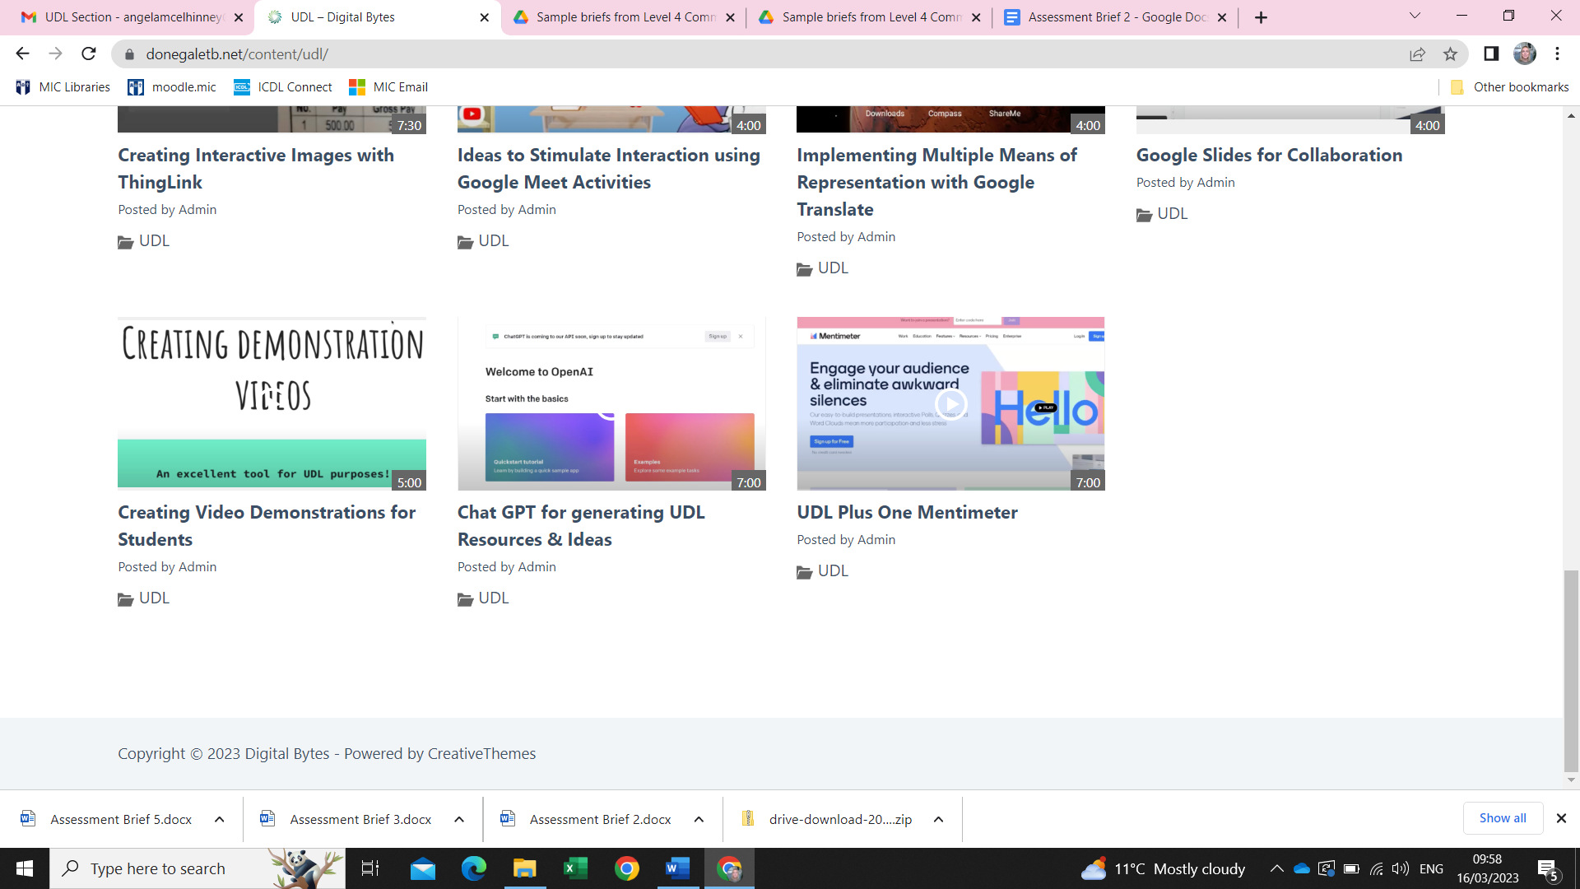
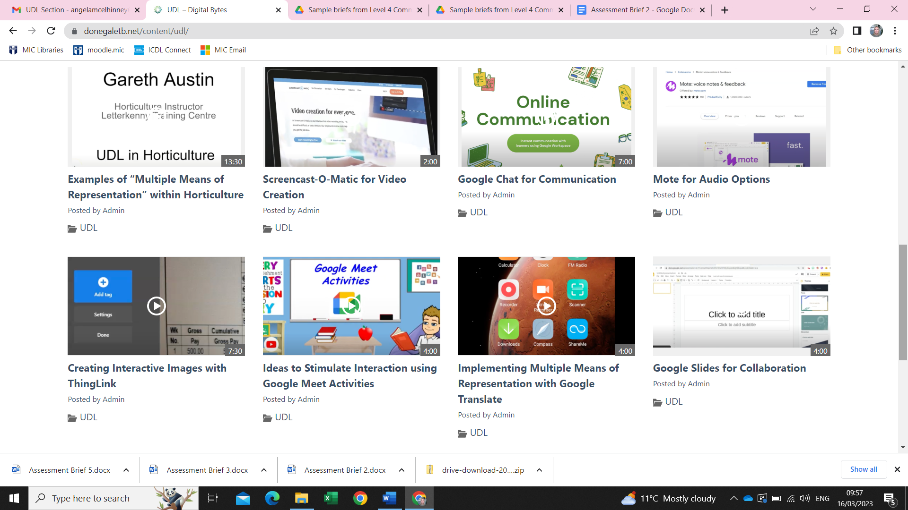
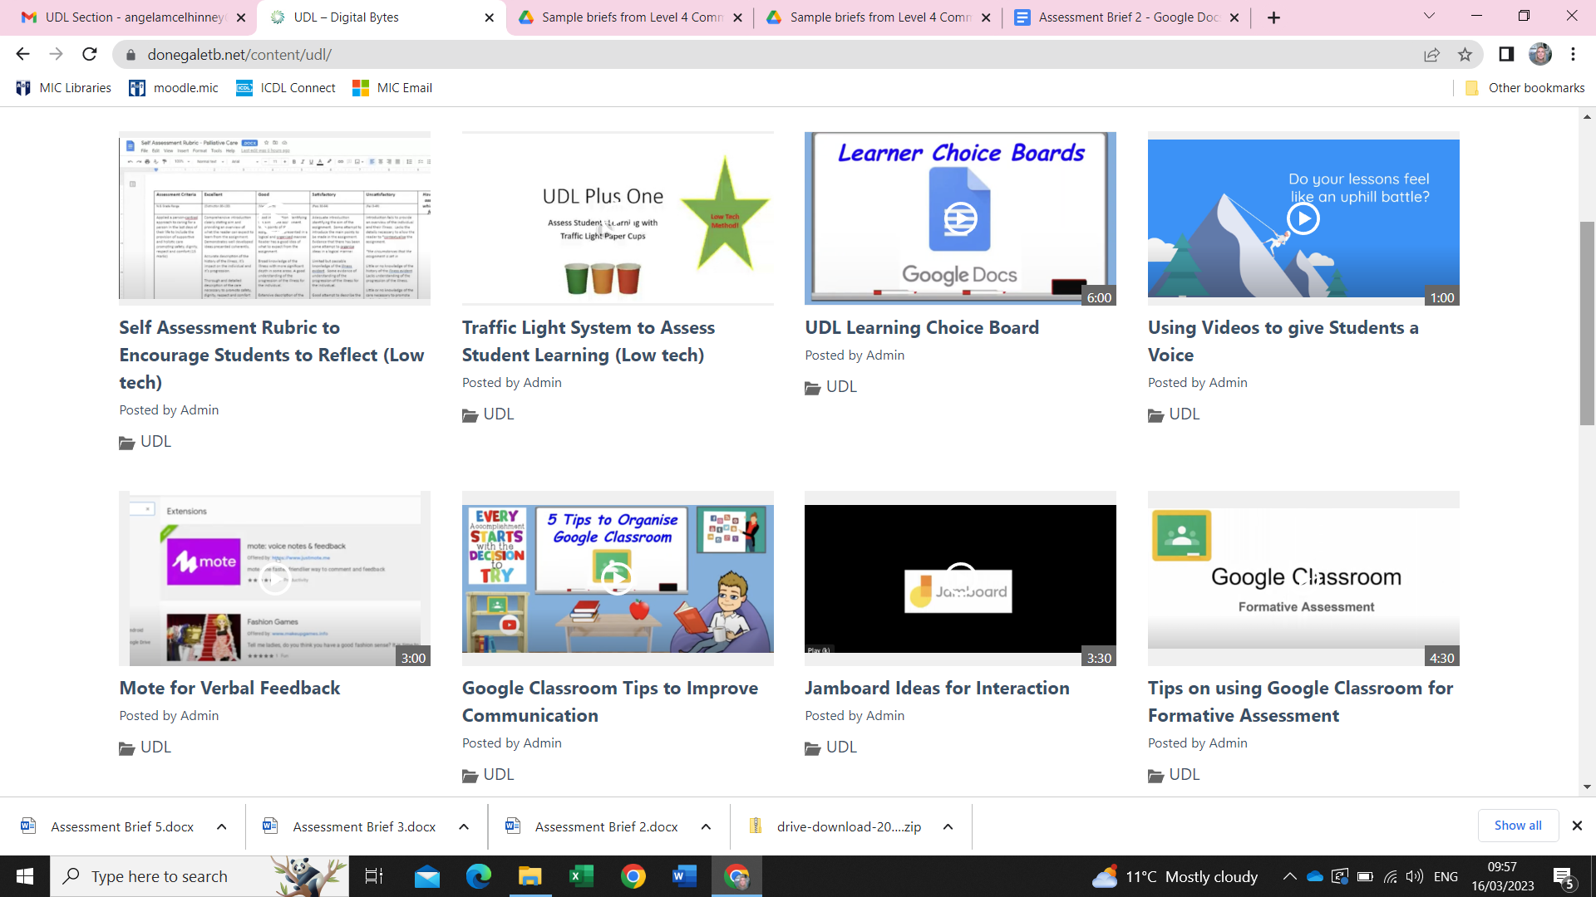

Engagement Strategies
‘Why’
Purposeful & Motivated
Recruiting Interest
Sustaining Effort & Persistence
Self Regulation

Slide 9
Mentimeter Slide Here – Pick an emoji that describes your mood today?

Slide 10
Representation Strategies
‘What’
Resourceful & Knowledgeable
Perception
Language and symbols
Comprehension

Slide 11
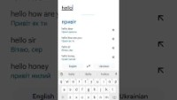
Video of Google Translate by Tom Bonnar

Slide 12
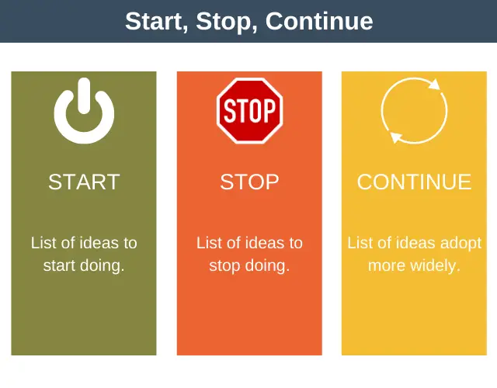
Action & Expression Strategies
Stop Keep Start
‘How’
Strategic & Goal Orientated
Physical actions
Communication and expression
Executive functions

Slide 13

Digital Hub

Slide 14

Video about Digital Hubs in Donegal ETB

Slide 15
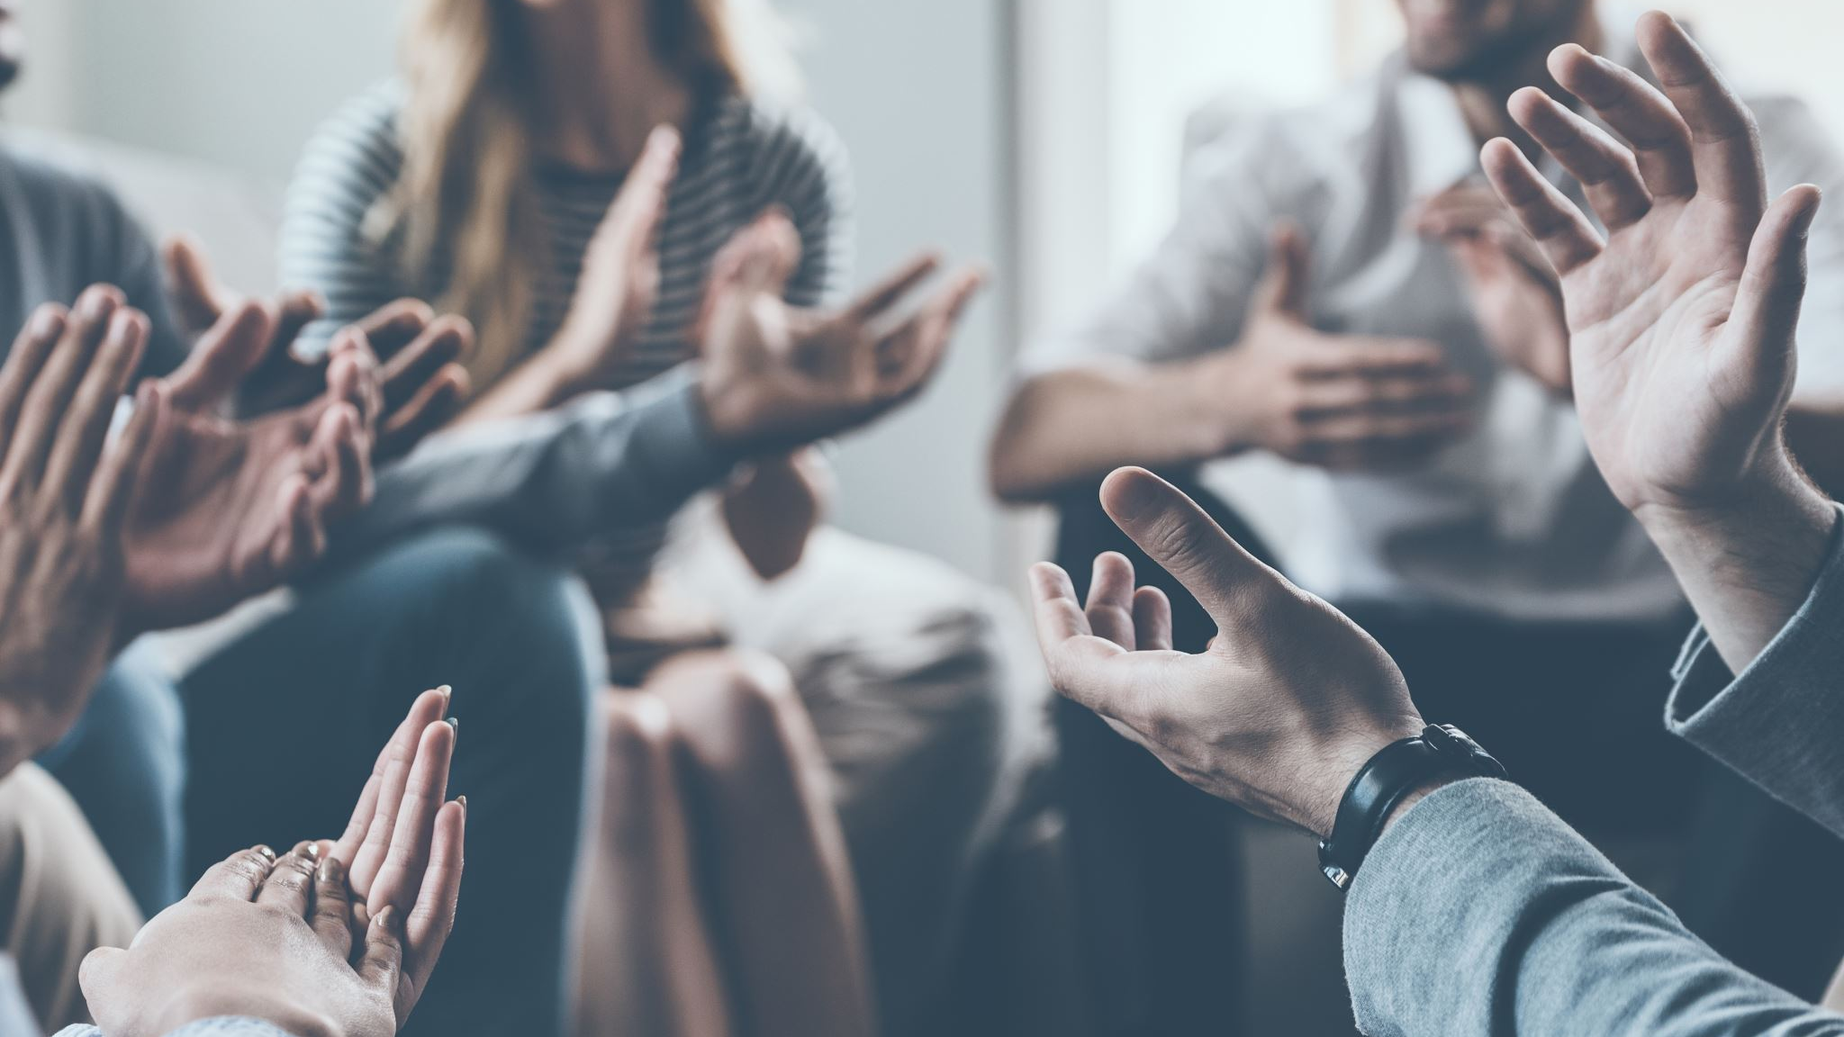
Thank you for listening!

Slide 16

Any Questions?

Slide 17
Useful Links
Donegal ETB PLN LunchBytes Videos
CAST UDL Principles
AHEAD UDL Resources
ETBI UDL Resources
Donegal ETB Digital Bytes

