Slide 1


Approaching CV’s and Interviews with Confidence
Approaching CV’s and Interviews with Confidence
Anna Flanagan
HR Department, Bord Bia

Slide 2

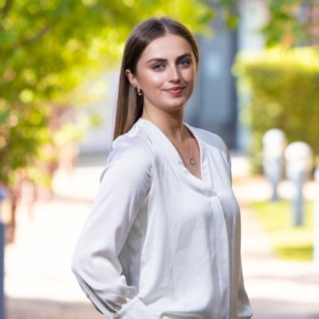
A bit about me!
My educational roadmap
My interests
Ursuline College Secondary School Sligo
Human Resources
Learning & Development
Bachelor of Commerce, University of Galway
Talent Development
Inclusive Workplace Culture
Bord Bia International Graduate Programme & MSc Global Business Practice
Wellbeing & Lifestyle

Slide 3

Let’s start from the beginning - what is a CV?
A CV, or curriculum vitae, is a document that provides a comprehensive summary of your educational and professional background.
When writing a CV as a graduate , it’s important to focus on your academic achievements, relevant coursework, extracurricular activities, and any relevant work experience or volunteer experience you may have.

Slide 4

Now let’s section that out!
Academic achievements
Relevant coursework
  Academic involvement
  Academic courses
  Academic awards
  Core modules
  Applied learnings
Extracurricular activities
Relevant work experience
  Team involvement
  Leadership roles
  Hobbies & interests
  Employment history - internships, previous relevant jobs
  Volunteering

Slide 5
Key sections of a CV
Personal Information / Contact details
Personal statement
Education
Qualifications
Work experience
Skills / Hobbies
Referees

Slide 6
  Personal Information/Contact details
1
2
3
4
Name
Phone number
Email
LinkedIn

Slide 7

  Personal Statement
Tailored to the specific job
Concise, 3-4 lines
Skills & experience that make you a strong fit

Slide 8
Examples of personal statements!
Motivated finance graduate with strong skills in financial reporting, data analysis, and Excel. Highly organised and detail-oriented, with experience supporting financial operations and working to tight deadlines.
Seeking to apply my analytical and administrative skills in a finance administration role and continue developing professionally.
Ambitious graduate with an enthusiastic interest in HR, bringing experience in communication, HR operations, and supporting people-focused processes.
Skilled in collaboration, data management, and maintaining accuracy and confidentiality in fast-paced environments.
Eager to contribute to employee experience and HR operations while developing professionally within a dynamic organisation.

Slide 9
  Education
University, College, Further Education
  Awarded Grade
  Relevant modules
  Relevant projects
Secondary school
  Junior + Leaving Certificate - mention grades if you wish
  LCA
  School achievements

Slide 10

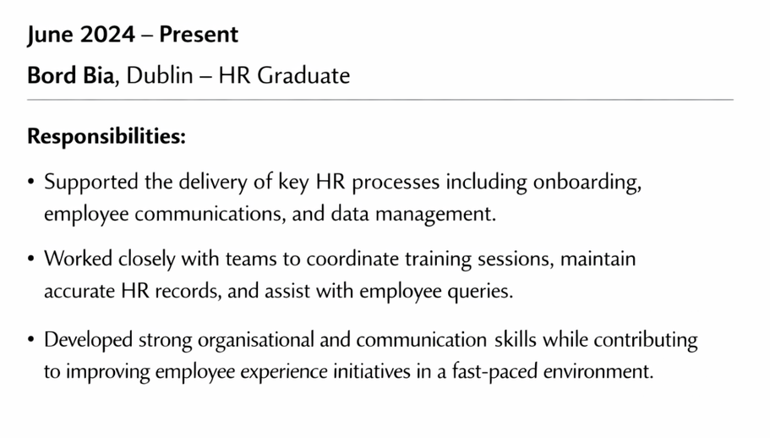
  Work Experience
Always in chronological order
  Dates
  Name
  Job title
  Responsibilities - include a brief paragraph describing the work you did and its importance

Slide 11
  Skills & Hobbies
Skills & Achievements
Hobbies
Consider relevant skills for the role - list them.
Show your personality through interests & hobbies - list them.
  Teamwork skills
  Communication skills
  Resilience skills
  Organisational skills
  IT skills - Microsoft Excel, Powerpoint
  Swimming
  Reading
  Baking
  Yoga
  Hiking

Slide 12

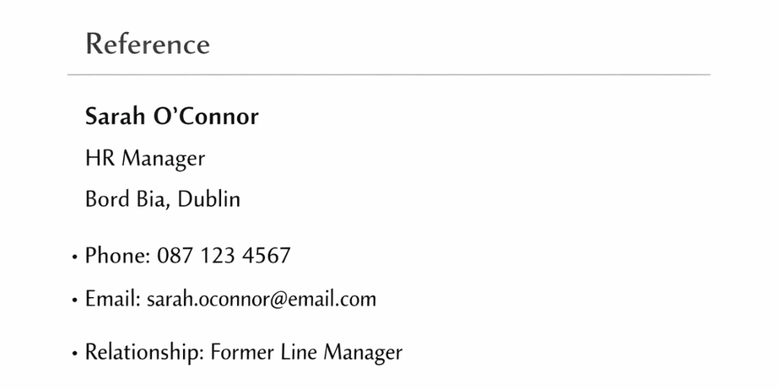
References
References/referees are people who will put in a good word for you. They will typically be a previous manager or supervisor, a lecturer or tutor, who will be able to describe your skills, work performance, and character.
Prior permission necessary

Slide 13
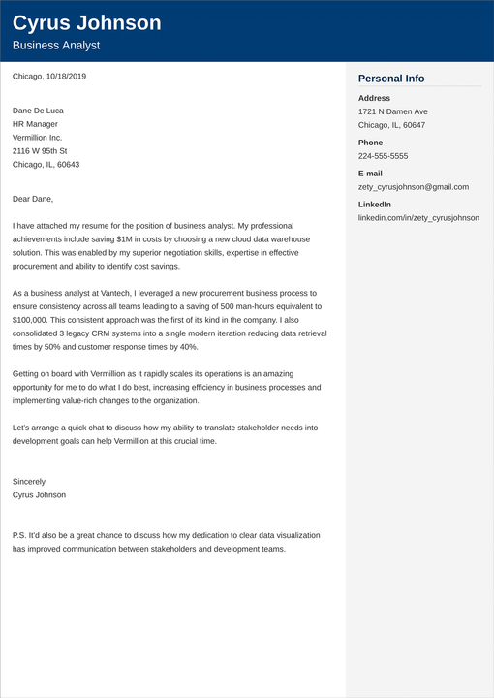
Cover Letters
A cover letter is a personalised, one‑page document that highlights your motivation, relevant skills, and the value you can bring to the role.
  Show genuine interest
  Connect your experience to the job description
  Highlight your strengths that make you a good match
  Show authenticity

Slide 14
Any Questions so far?

Slide 15


Going to Interview Stage

Slide 16
Preparation
Employers seek clarity, graduates often underestimate how compelling a simple, well-told story can be.
Anchor to impact
Practice out loud
Structure

Slide 17
Master the common questions
Tell me about yourself?
Keep it tight, relevant & confident
Why this role?
Show alignment between your goals and their needs
Strengths & Weaknesses?
Be honest, specific & growth-oriented
STAR method for behavioural questions

Slide 18
Ask Smart Questions
Ask about team priorities, success metrics & upcoming challenges
Strong questions show curiosity, genuine interest & long-term thinking
Avoid questions that you could obtain from the website

Slide 19
Research the company
  Know the company’s values & mission; connect them to your motivations
  Identify how you could contribute to any challenges currently being faced by the company
  Prepare an observation or insight to prove your research

Slide 20

Managing Nerves
  Slow breathing to rest your nervous system
  Arrive early enough to settle, not to wait anxiously
  Sufficient preparation will reduce anxieties
  Reframe the interview as a conversation, not an exam

Slide 21
Conclude & follow up professionally
  Thank the interviewers for the opportunity and reinforce your energy
  Send a short thank you note within 24 hours

Slide 22
Any Questions

Slide 23
Thank you for listening!

