Slide 1

The National Disabled Postgraduate Advisory Committee (NDPAC): Unifying The National Disabled Postgraduate Voice
Workshop, Ahead Conference
22.03.2022
Dr Vivian Rath, NDPAC Chair @RathVivan
Dr Teresa Shiels UL/ NDPAC @teresashiels01
Amy Hassett UCD/ NDPAC
Dr Patricia Mccarthy TCD/ NDPAC
Catherine Gallagher DCU/ NDPAC
Aoife Price NUIG/ NDPAC
Dr David Loughrey TCD/ NDPAC

Slide 2
Disabled Students In Higher Education
Increase in the number of disabled students in HE
7.1% - Undergrad (Ahead)
Very successful – DARE Scheme
Many barriers to full engagement still exist
2.8% - Postgrad – (AHEAD)
Low transition rates
Lack of knowledge & awareness within institutions
Challenges accessing and lack of information around funding, (how many disabled students are receiving support from funding bodies?)

Slide 3
Establishment Of The NPAC
Disabled Peer groups provide support and disability awareness initiatives
Contribute to a sense of belonging and support positive mental health
Disabled students not being included at the decision making table (Rath,2021)
NDPAC established to hear the voice of a group who were not at the decision making table
Postgrads & Early Career Researchers from colleges across Ireland, and growing
Group organised and comprised of disabled people

Slide 4
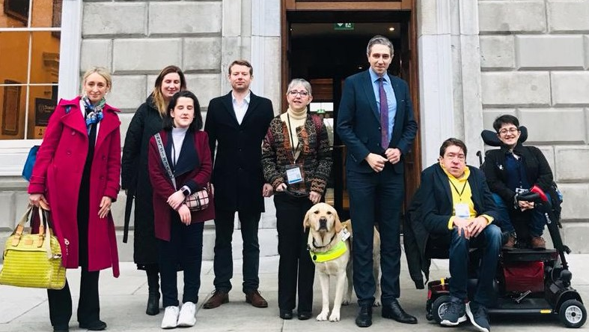
NDPAC members meeting Minister Harris

Slide 5
Presentation To Minister Harris
2021 And 2022

Slide 6
Other Achievements
KPI on Postgraduate Study in the National Access Plan
HEA/NDPAC Disabled Postgraduate Conference
Ahead Conference Workshop

Slide 7
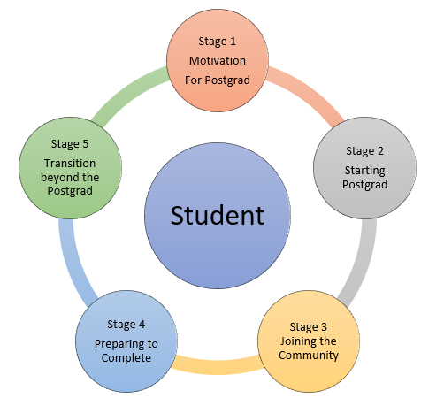
Need To Consider Wider Postgrad Engagement
  5 Stages to Journey from beginning to end
  Barriers exist at all stages
  Supports exist but not connected
  Ensure Postgrad pathway is visible & a viable option for disabled students
  Need to take a holistic approach

Slide 8
Five Thematic Approach
Theme 1
National Access Plan & Transitioning to Postgraduate
Theme 2
National Cross Campus Postgrad Study Awareness Campaign
Theme 3
Funding
Theme 4
Flexible Learning Approaches
Theme 5
Transitioning from Post-Postgraduate

Slide 9
Lived Experience
Dr Teresa Shiels
National Disabled Postgraduate Advisory Committee

Slide 10
Negotiating access to higher education was a complex process involving personal and systemic barriers for me as a PhD Student with Traumatic Brain Injury
Barriers | Supports
Physical barriers | Importance of educators/supervisors listening to the voices of neurodiverse students in planning, design and implementation of programmes of study in HE
Noisy environments | Flexibility in the doctoral process and access to disability support services
Ableist pedagogical Assumptions (normative expectations) | Communication and Collaboration with educators/supervisors/others
Annual doctoral progressions | Importance of supports to ensure resilience and self-advocacy such as being part of a peer-group
*Disclosure was both a barrier and support for me
Notes:
*Disclosure was both a barrier and support for me

Slide 11
Panel Discussion
Chair – Dr Patricia McCarthy TCD/NDPAC
Amy Hassett UCD/ NDPAC
Catherine Gallagher DCU/ NDPAC
Dr David Loughrey TCD/ NDPAC

Slide 12

Questions & Contact
Dr Vivian Rath
rathv@tcd.ie
Teresa Shiels
Teresa.Shiels@ul.ie

Slide 13
Resources
Social Engagement Experiences of Disabled Students in Higher Education https://irelandseducationyearbook.ie/irelands-education-yearbook-2020/higher-education/social-engagement-experiences-of-disabled-students-in-higher-education/
Rath, Vivian, The Social Engagement Experiences of Disabled Students in Higher Education in Ireland., Trinity College Dublin. School of Education, 2021
Note on Engagement with Persons with Disabilities and DPOs https://nda.ie/publications/note-on-engagement-with-persons-with-disabilities-and-dpos

