Slide 1


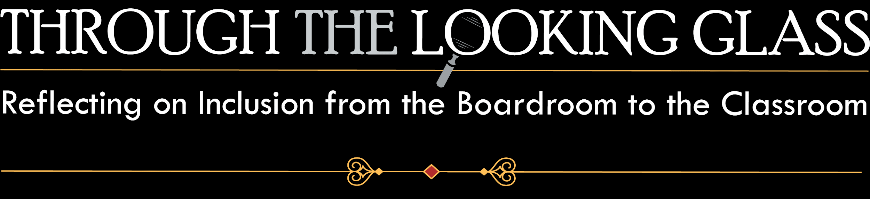


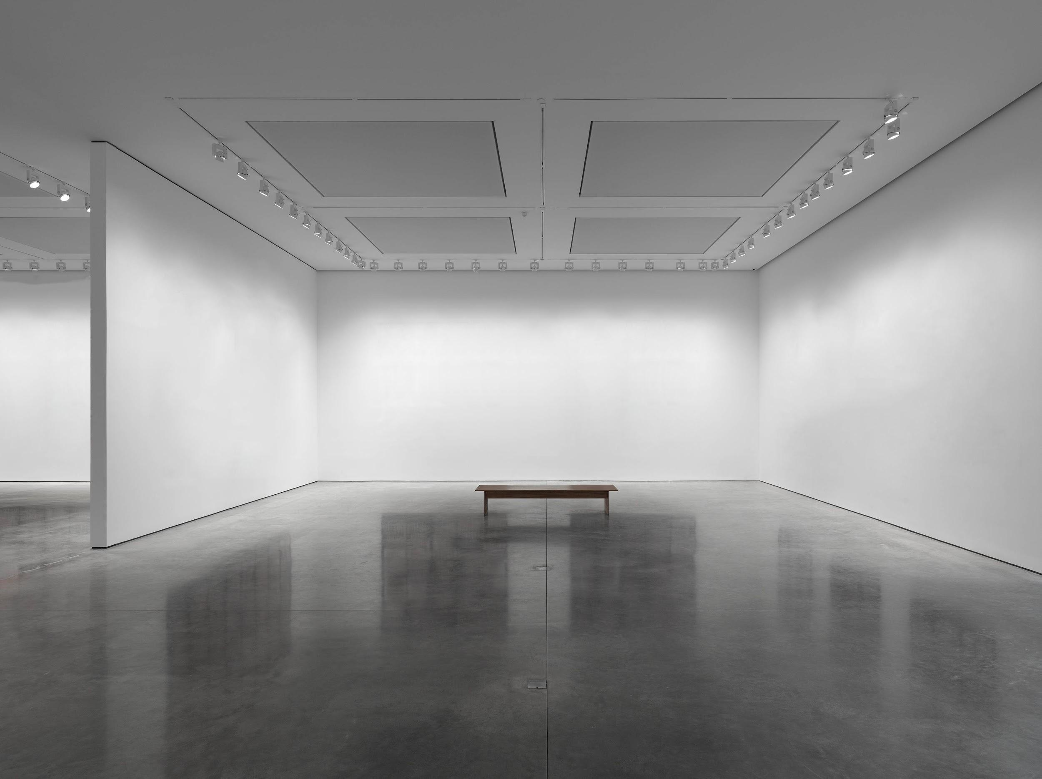
Welcome
AHEAD Student Exhibition 2020

Slide 2

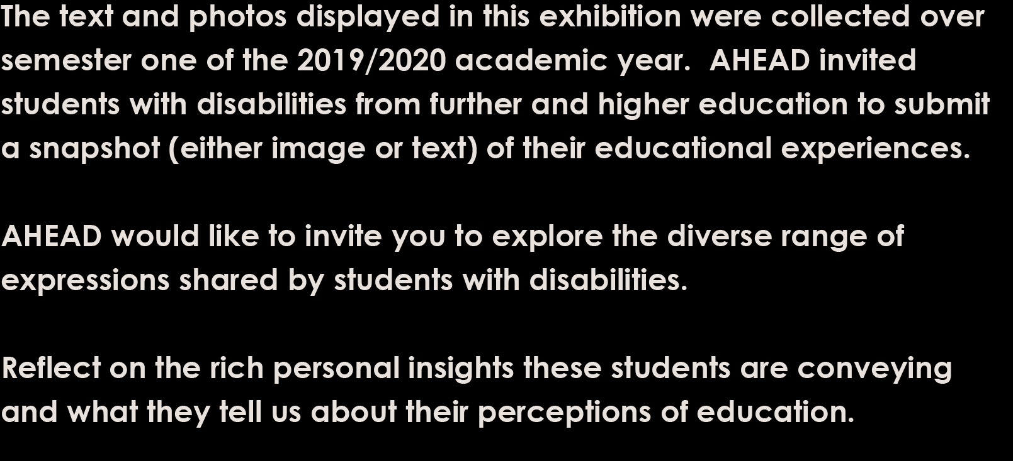
Introduction

Slide 3

Opening image

Slide 4
Welcome to our 3 rooms
Room 1 - What your disability means to you?
Room 2 - What College life means to you?
Room 3 - Name a change that you would like to see in the future in College?

Slide 5

Welcome to Room 1
What your disability means to you?

Slide 6
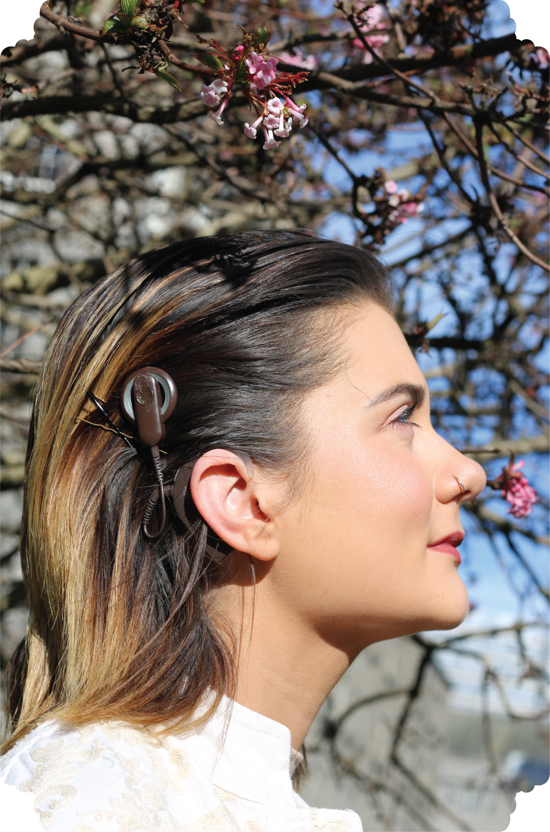
Room 1 – Slide 1
‘My disability makes me who I am’
‘My disability does not define me and it never will’
‘It gives me the desire to take every chance I get so that I can be the same as people without a disability.’

Slide 7
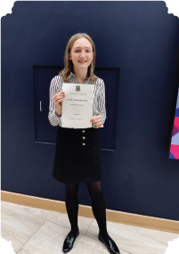
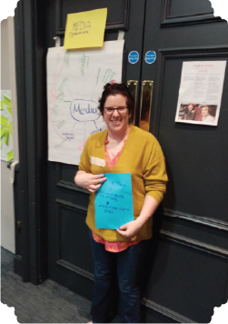
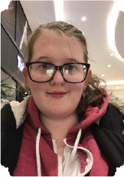
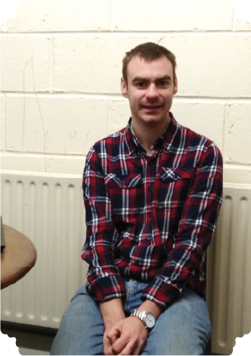
Room 1 – Slide 2
‘My disability is part of who I am, it can be destructive and beautiful at the same time, it's my superpower and weakness.’
‘My disability doesn't mean a lot to me…I don't let it stop me from doing anything, if anything it's taught me to be more driven and consistent because I really have to work hard at everything I do.’
‘Can be very draining but it also means that it is not a part of me and I am who I am with or without it.’

Slide 8
Welcome to Room 2
What College life means to you?

Slide 9
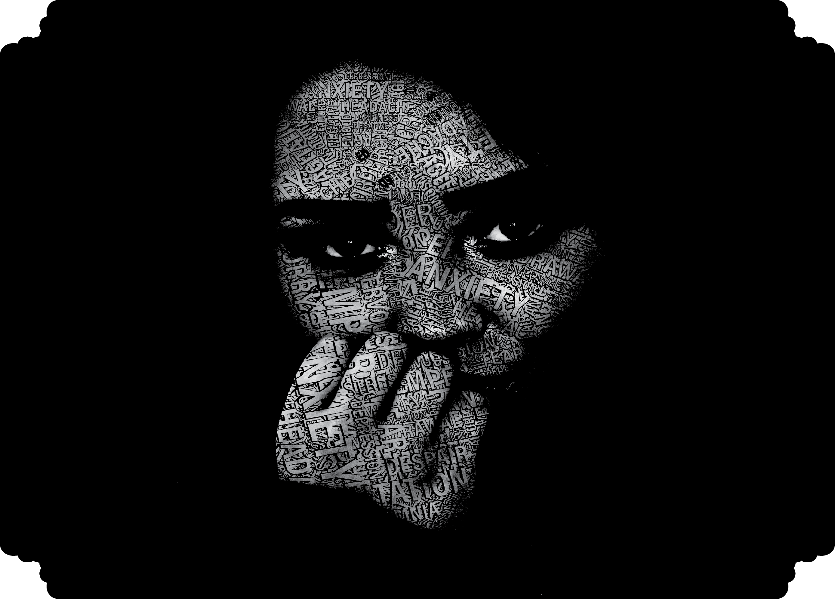
Room 2 – Slide 1
‘College life can be very overwhelming for someone suffering with mental health problems, it can be tough, aggressive, lots of pressure, competition, social anxiety, need to perform. It can become very…toxic but it can also be wonderful...’

Slide 10

Room 2 – Slide 2
‘College has given me a passion to talk about my disability and fight for people who don’t have a voice with my disability…
It has also given me the skills and confidence to speak to media outlets about my disability and college life.’
‘College life means a sense of purpose for me’
‘It's everything, it's a challenge but well worth it’
‘College has provided the space and structures to live independently, find my community, and develop as an individual.’

Slide 11
Welcome to Room 3
Name a change that you would like to see in the future in college?

Slide 12
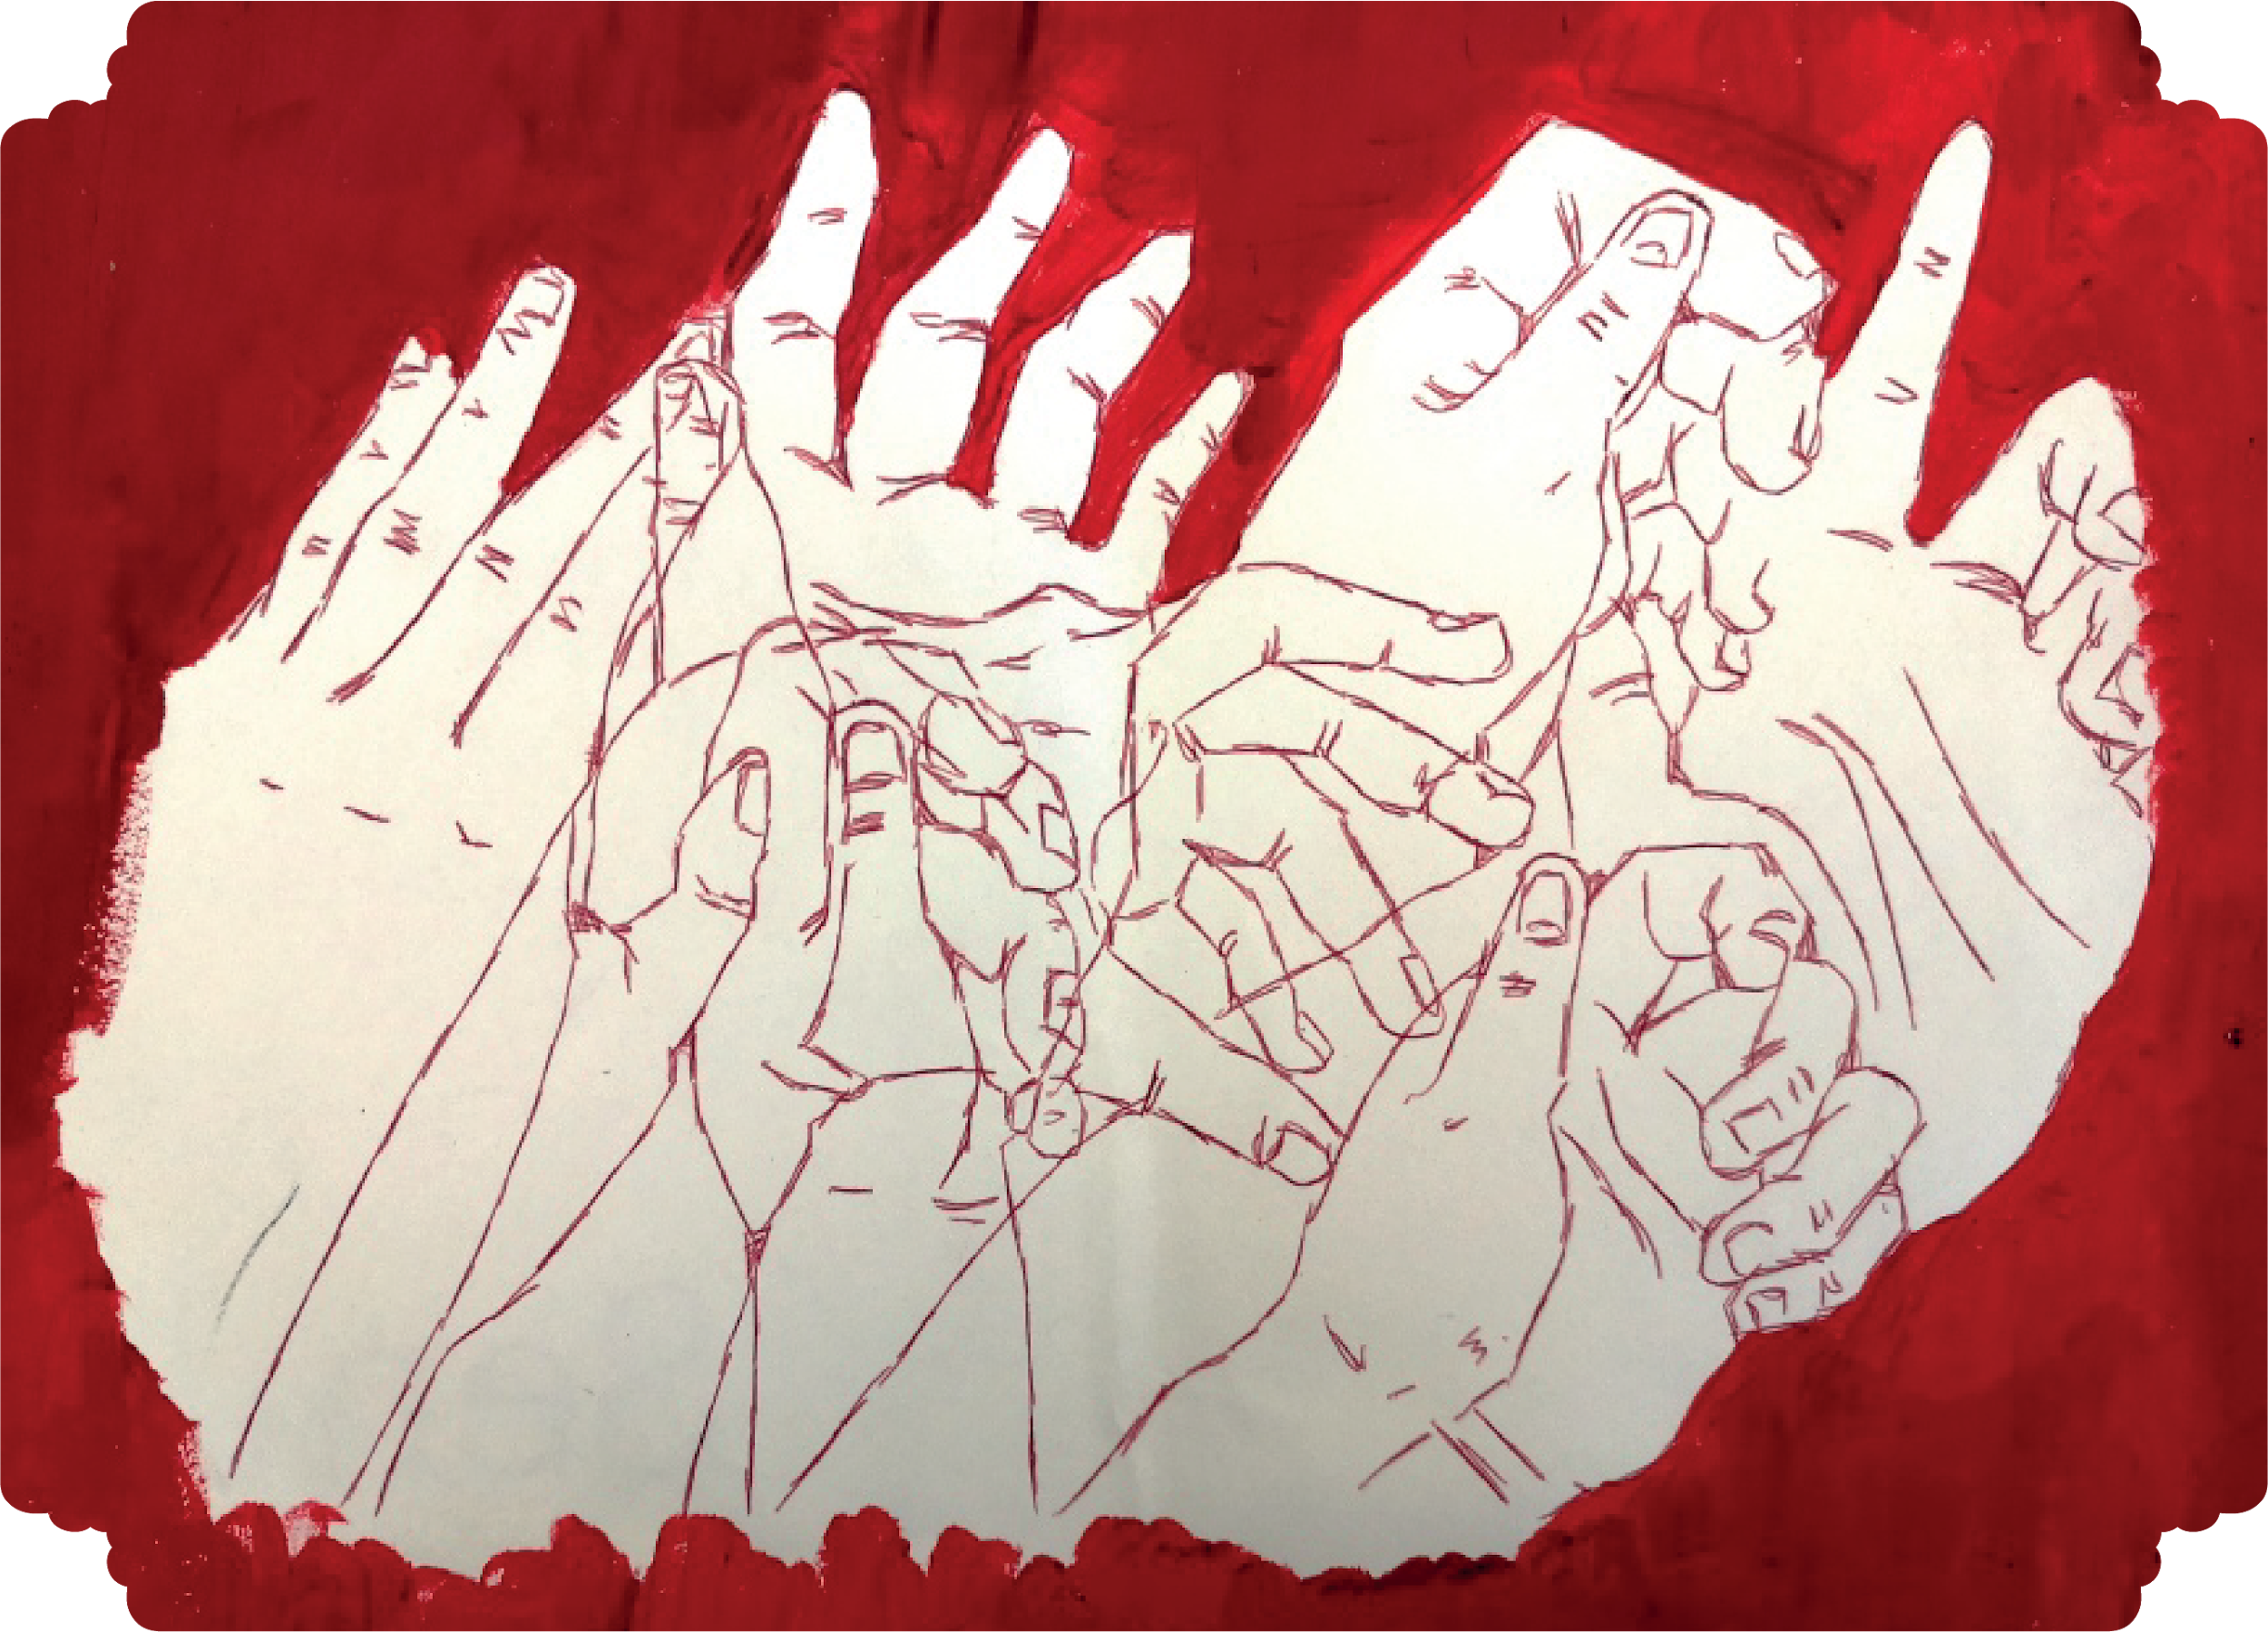
Room 3 – Slide 1
‘I would like there to be more awareness of disabilities especially invisible disabilities. If people were more educated on areas we struggle with we would not have to consistently push ourselves to be like everyone else. We are the same, but different.’

Slide 13
Room 3 – Slide 2
‘In all colleges, acknowledgement of hard of hearing… Ask can everyone hear. Use a microphone if possible. If discussing with lecture audience, ask people to stand up, face the crowd and speak up.’
‘..More accessibility around books and documents so that a person with a visual disability is able to interact more in class so that they don’t feel left out. ‘
‘A little more help for those who suffer with dyslexia’

Slide 14
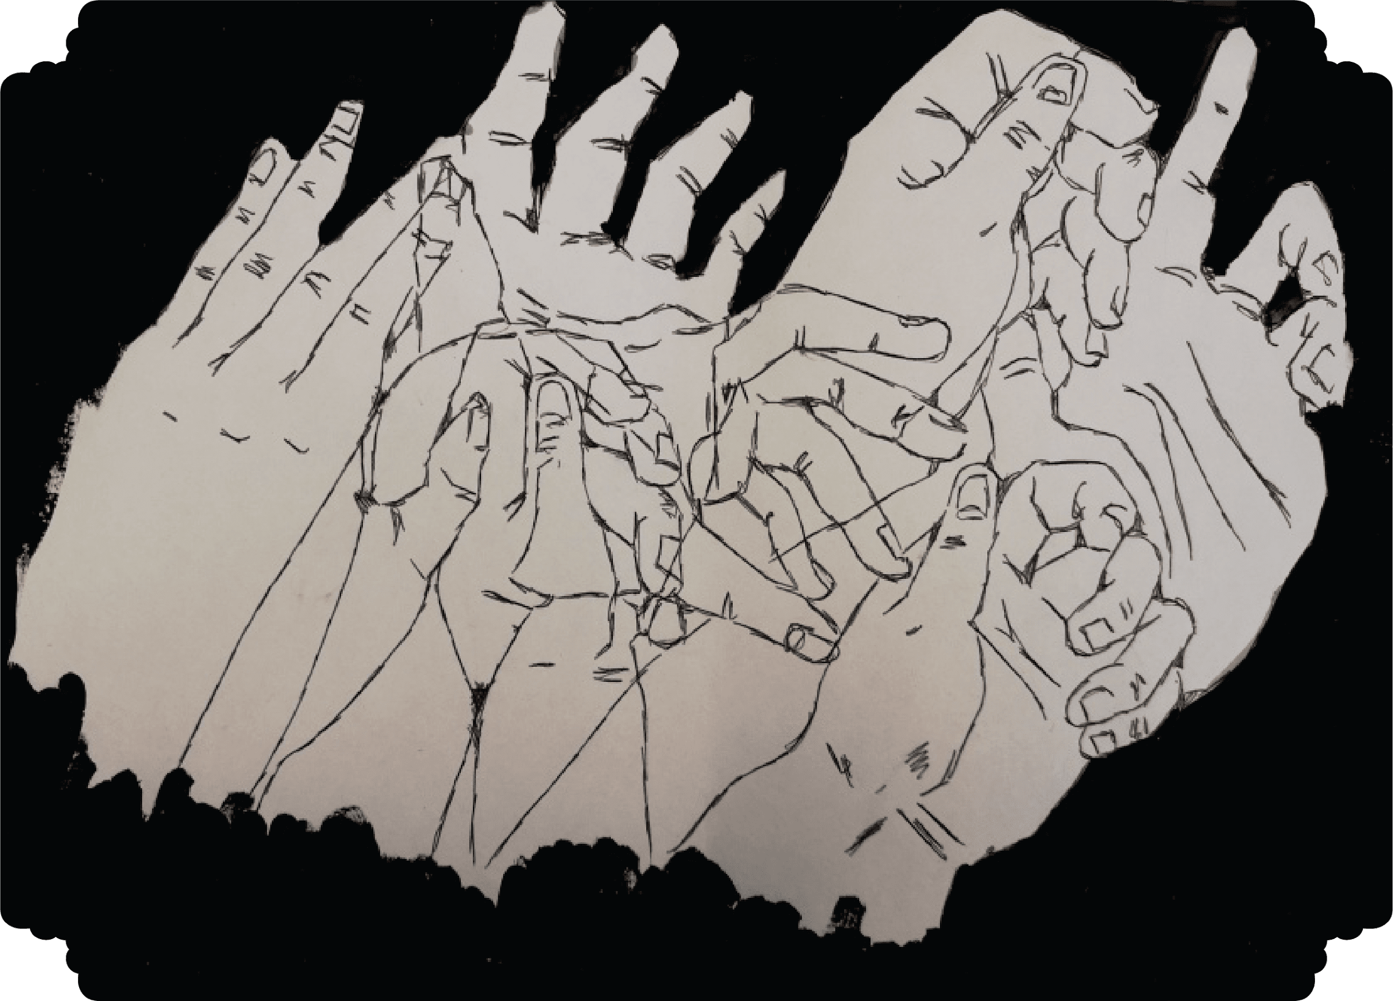
Room 3 – Slide 3
‘I want to experience University that is designed from the ground up with people of all abilities and backgrounds in mind’
‘Continue with the advances in technology and support. Maybe stop referring to it as disability support.’
‘There should be a better attitude towards positive mental health’

Slide 15
Through the Looking Glass
Text and image snapshots by students with disabilities
Twitter : #AHEAD2020

Slide 16
Thank you

