Slide 1

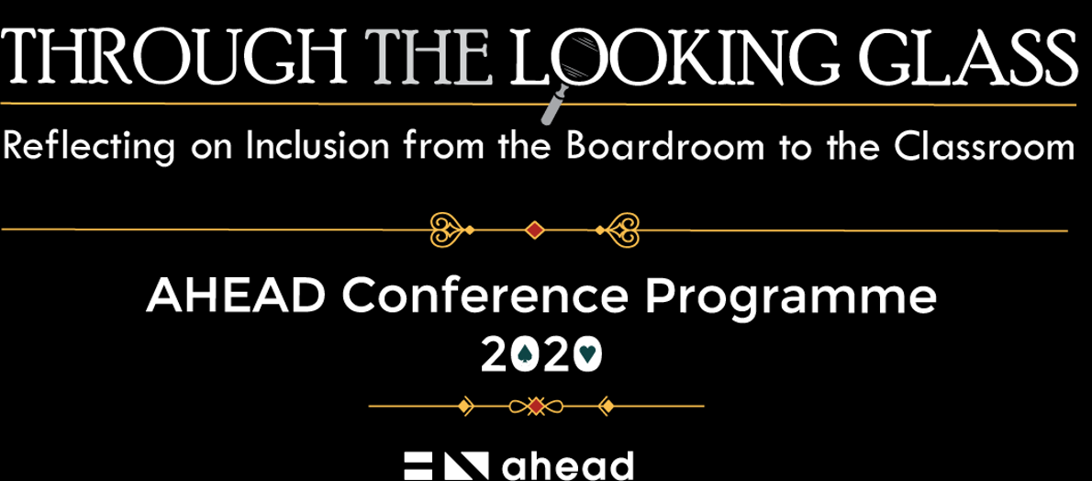
#AHEAD2020 – 10 Weeks of Webinars

Slide 2

Come together
exploring the potential of learning networks
to promote inclusion
Etienne Wenger-Trayner
AHEAD Ireland, March 27, 2020

Slide 3
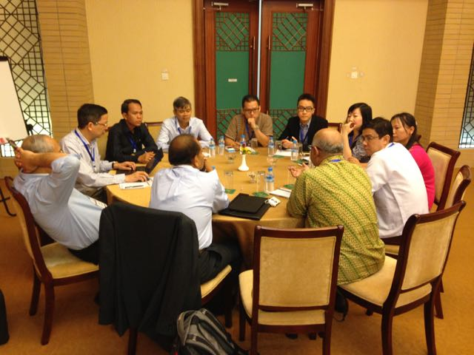

Discussing guidelines

Slide 4
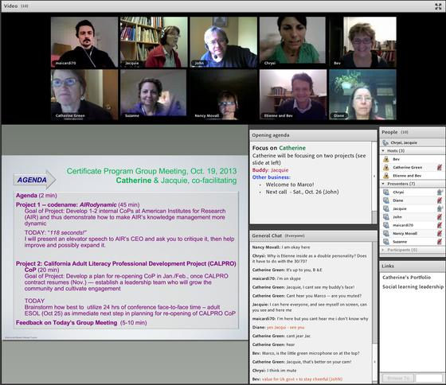
A case clinic
Working together online

Slide 5
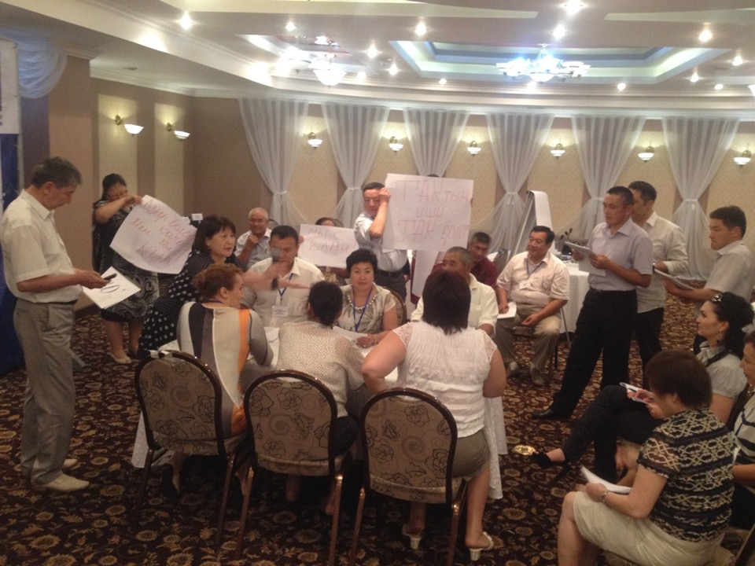
Debating a key issue

Slide 6
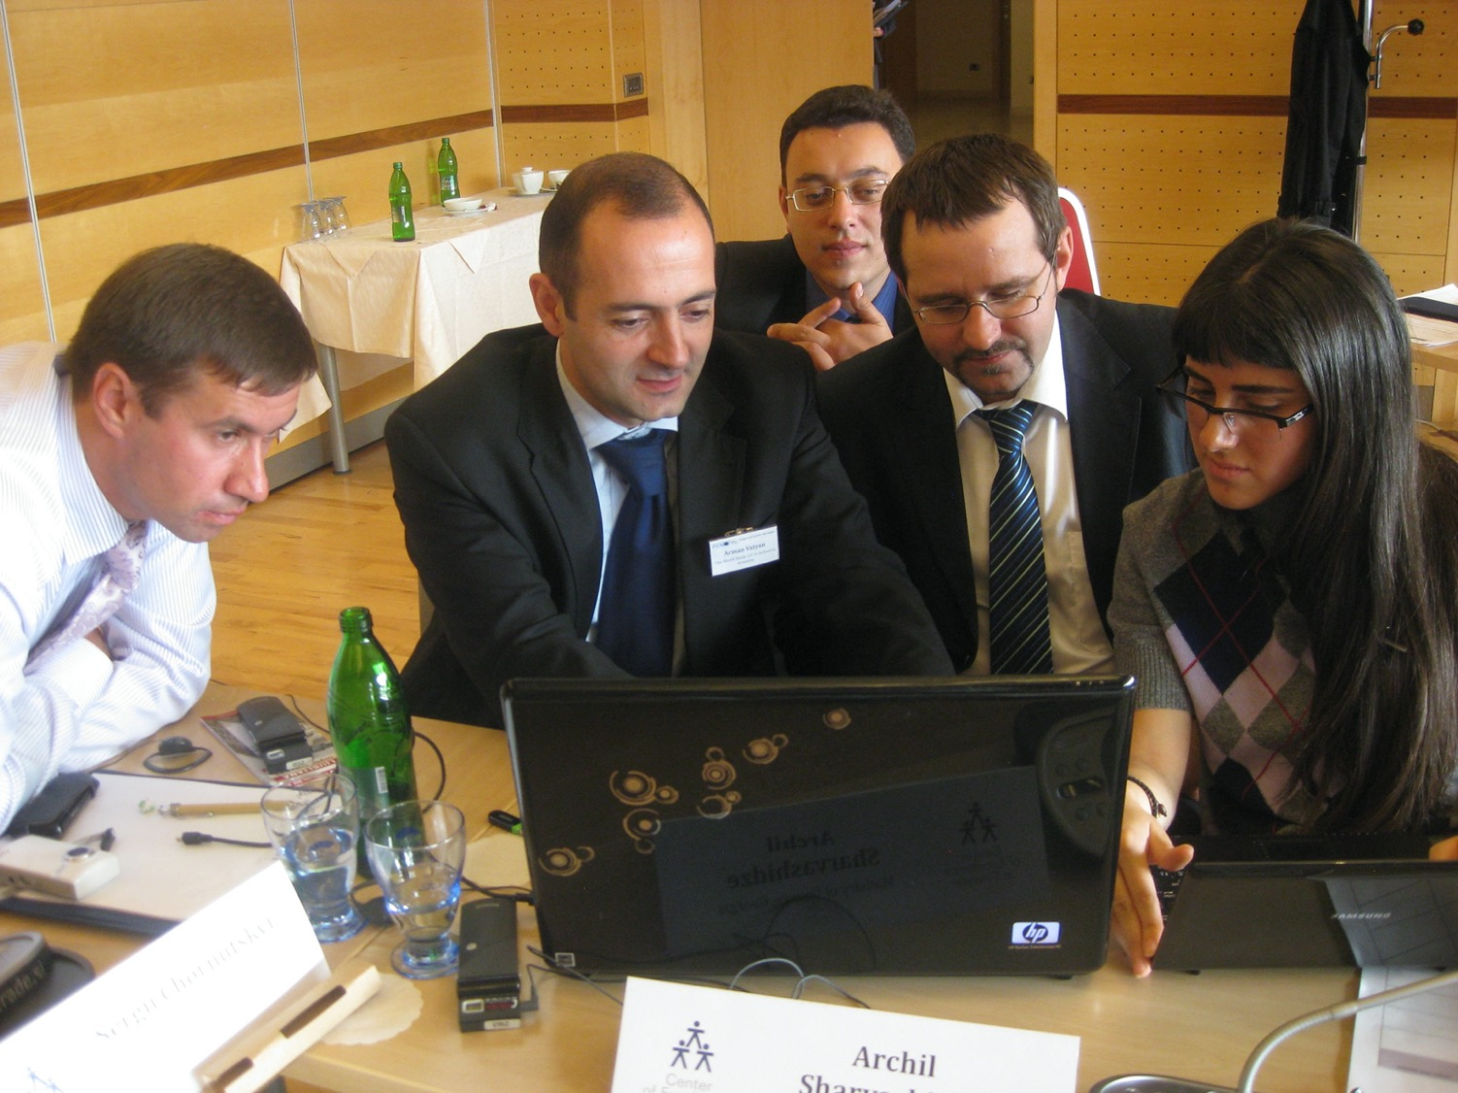




Preparing a document

Slide 7
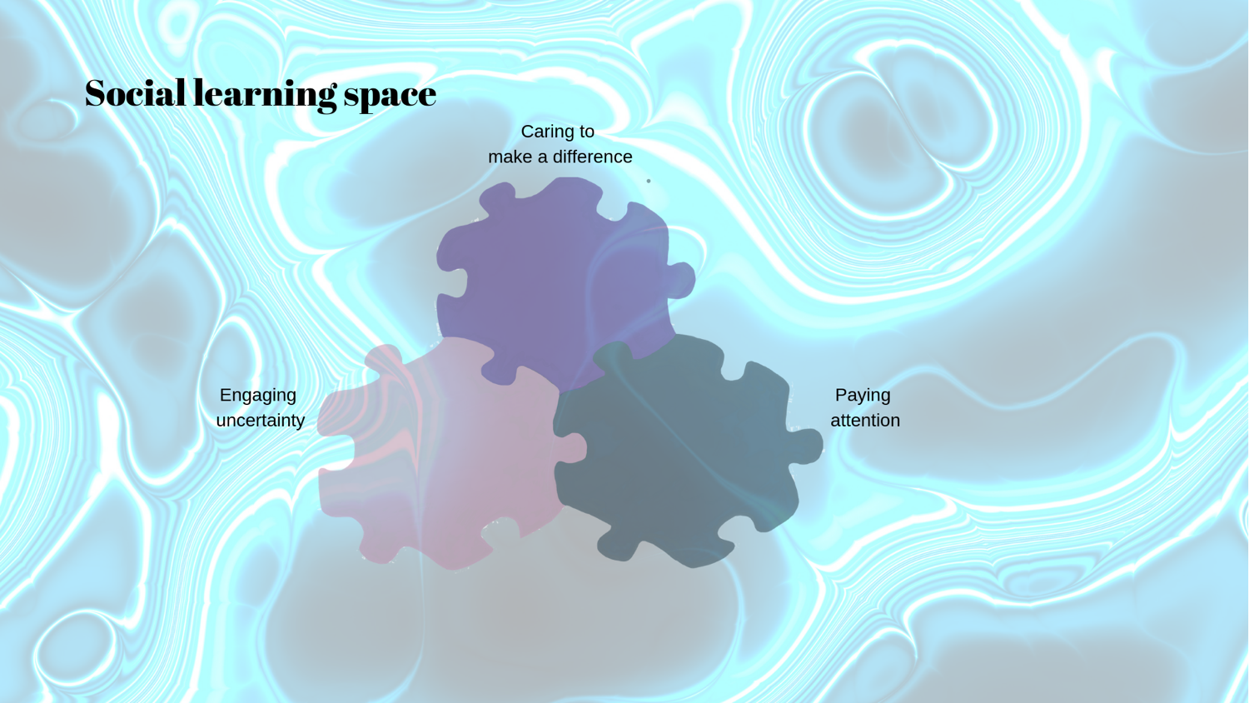
Creating social learning spaces

Slide 8
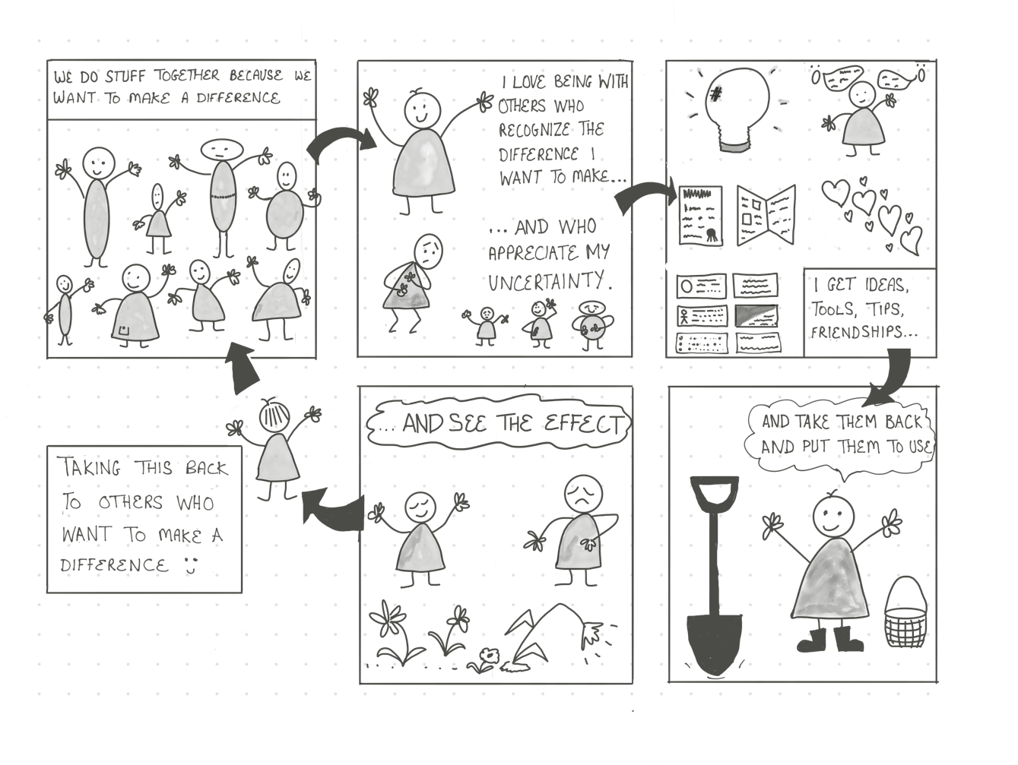
How does social learning work?
Developing practice in a learning network
Notes:
Intentional space: may include being aware images and particularly cis- and hetero-normative photos/pictures/health poster displays, magazine choices, safe-place stickers in the window, having space for confidential check-in with receptionists. At my clinic, all of our artwork is nature based and the majority of our health literature/pamphlets are without people based images.
Inclusive people: Front line staff as well as clinical! Diverse folks that have LGBTq cultural competency skills, comfortable with asking questions, offering pronouns as well as asking for them, people who can use culturally appropriate language and who can adapt with how quickly it changes.
Paperwork: Get rid of the boxes! Ask about preferred names, gender, partner(s)/marital status, pronouns. Have an EHR that can mirror the paperwork (again, this is the IDEAL clinic).

Slide 9
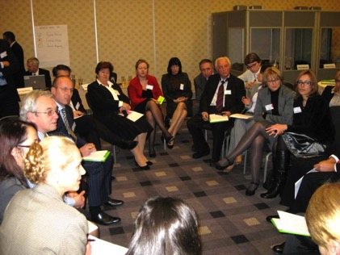
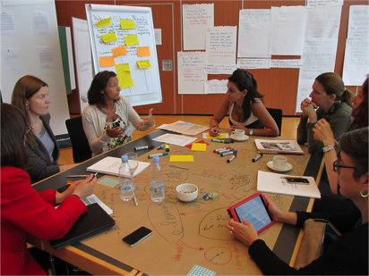
Practitioners need each other to …
… help each other solve problems
… hear each other’s stories across contexts
… reflect on their practice and improve it
… build shared understanding
… keep up with change
… cooperate on innovation
… find a voice and gain strategic influence
Notes:
Additional notes: ________________________________________________________________________________________________________________________________________________________________________________________________________________________________________________________________________________________________________________________________________________________________

Slide 10

A Question…
While you are taking part, some reflections….
What are the barriers and enablers to starting/sustaining inclusive learning networks in your college (max 3 each –word/phrase)?
Using your phone, go to menti.com and enter the code 810088

Slide 11
Enablers and barriers - community
    High value for time
    Relevance to practice
    Shine a light
    Personal touch
    Leading-edge access
    Trust and respect
    Responsiveness/follow-up
    Finding a voice
    Internal leadership
    Ownership
    Dominant voices
    Groupthink
    Lack of continuity
    Death by presentation
    De-energizing tasks
    Personal attacks
    Complicated access
    to participation
Notes:
This slide lists factors associated with community cultivation:
critical factors for a successful community of practice are listed on the left under the green light
risks associated with a mistaken focus are listed on the right under the red light.
Success factors
Passion for domain: This is the key factor. Unless members feel a strong connection to the domain, because of their personal interest or because it is central to their job, it is not going to work.
Internal leadership: The dedication, skills, and legitimacy of people who take internal leadership in nurturing the community is perhaps the most important factor in determining the quality and longevity of the community. When starting a new community, finding members who are ready and willing to take on a leadership role in nurturing the community is the most important step.

Slide 12
Enablers and barriers - organization
    Engaged sponsorship
    Strategic partnership
    Self-governance
    Valued time
    Recognition of contributions
    and initiative
    Shifting support
    Culture of mistrust
    High competition
    Fighting fires
    Micro-management
Notes:
This slide lists factors associated with community cultivation:
critical factors for a successful community of practice are listed on the left under the green light
risks associated with a mistaken focus are listed on the right under the red light.
Success factors
Passion for domain: This is the key factor. Unless members feel a strong connection to the domain, because of their personal interest or because it is central to their job, it is not going to work.
Internal leadership: The dedication, skills, and legitimacy of people who take internal leadership in nurturing the community is perhaps the most important factor in determining the quality and longevity of the community. When starting a new community, finding members who are ready and willing to take on a leadership role in nurturing the community is the most important step.

Slide 13
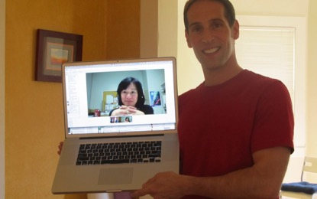
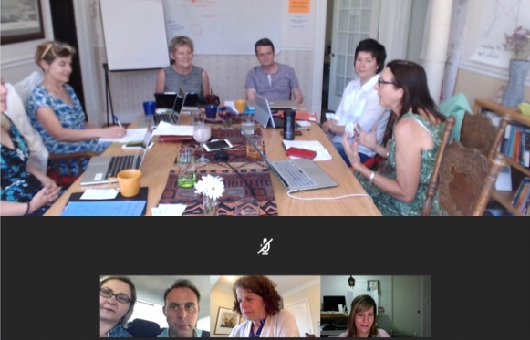
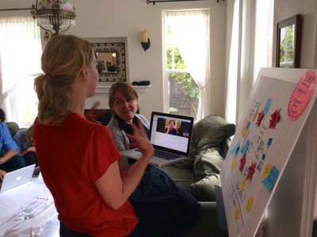
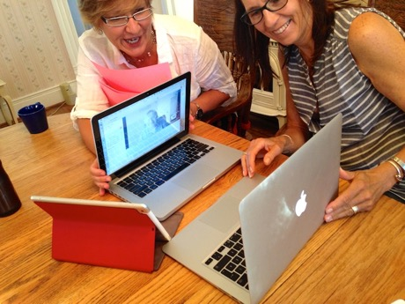
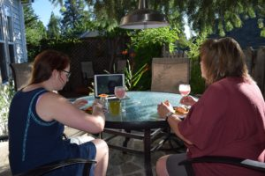
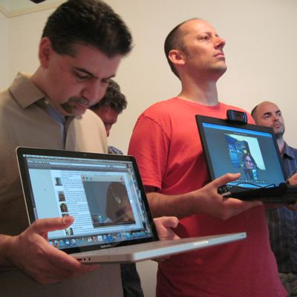
A new enabler: blending online and face-to-face

Slide 14
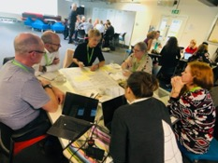
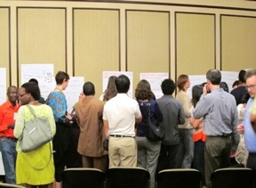
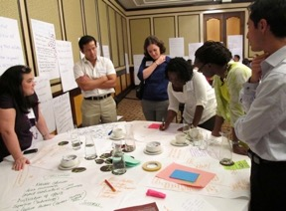
How to get going
1. Prepare value proposition
Refine value proposition
2. Talk, talk, talk
Build a community
Who are we?
Develop internal leadership
3. Launch
What difference do we want to make?
What can we do?

Slide 15
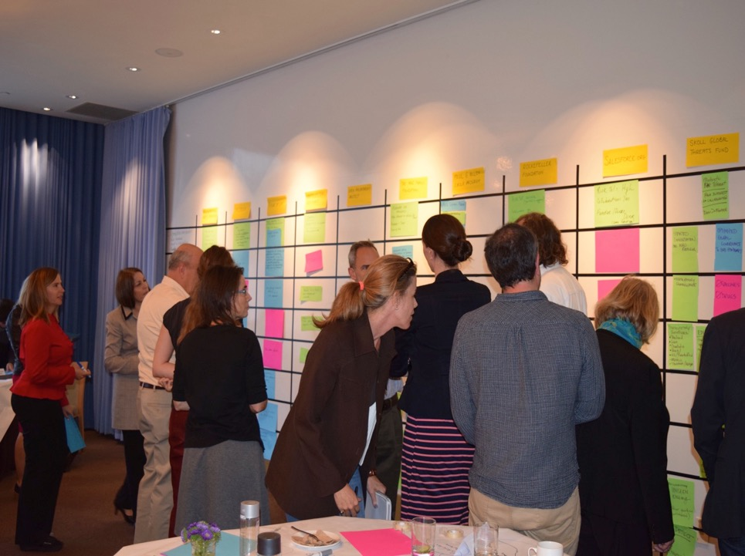
Creating a shared picture of the community

Slide 16
Thanks!
Etienne and Beverly Wenger-Trayner
email: be@wenger-trayner.com
website: http://wenger-trayner.com
Social learning lab
workshops face-to-face and online:
http://wenger-trayner.com/events/

Slide 17
Next Up for #AHEAD2020
Next Friday (April 3rd): 14:30 – ‘Final of John Kelly Award for Universal Design for Learning’
Register for all sessions free at ahead.ie/conference2020

