Slide 1
Tertiary Education as Accessible Workplaces
Connor Duignan,
Technical Software Developer
Innopharma Education

Slide 2
About Me: A Comprehensive Guide
Autistic

Slide 3
Tertiary Education and Student Accommodations
We provide many supports and accommodations for students with disabilities. Such supports can help all students:
Remote Learning
Screen Readers
Academic Supports
Alternate Exam Rooms
A human-centred approach to learning supports!

Slide 4
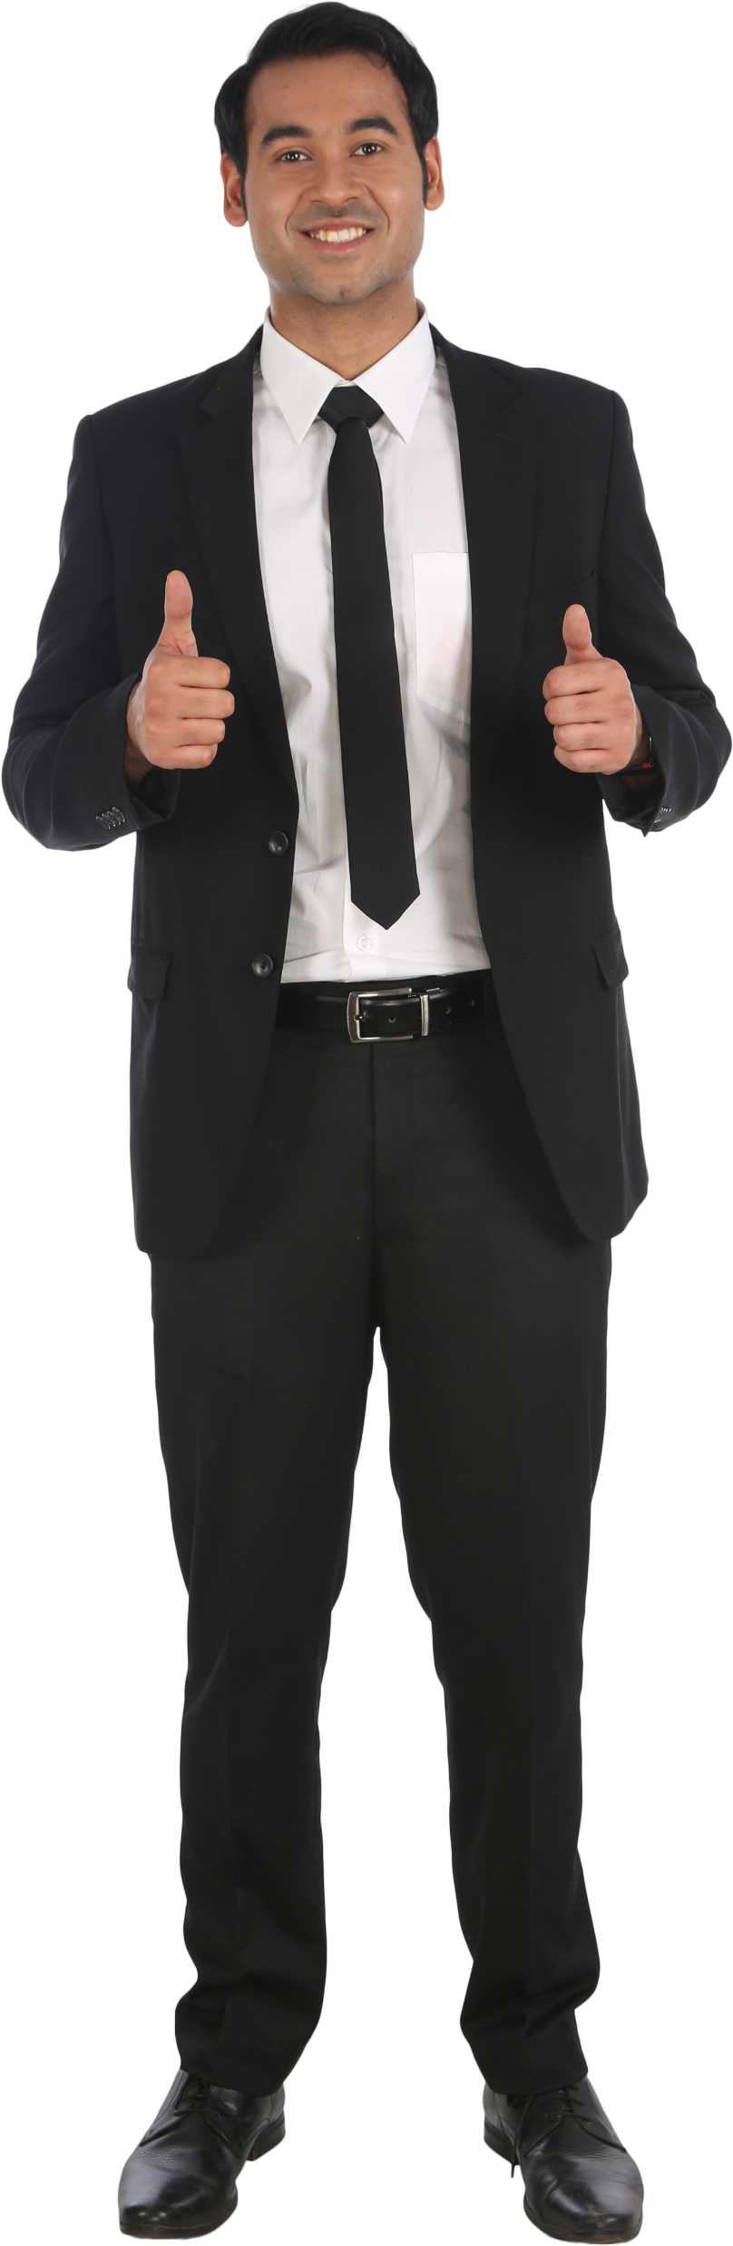
Guess what?
You’re Human Too!

Slide 5
Unique Potential as an Accessible Workplace
Our students needs are our needs:
Remote Working
Quiet Spaces
Clear and Direct Language
Screen Readers and Meeting Captions
The Ability to Speak about Specific Requirements
Makes a better workplace for everyone!

Slide 6
The Attention Dilemma
Some supports can draw unwanted attention or can cause disruption for others. How do we square the circle?
Accessibility as Default
Flexibility as a Standard
Disclosure without Interrogation
Notes:
Talk about dichotomy between workplace standards and student standards, how one is not as human-centred and respectful as the other

Slide 7
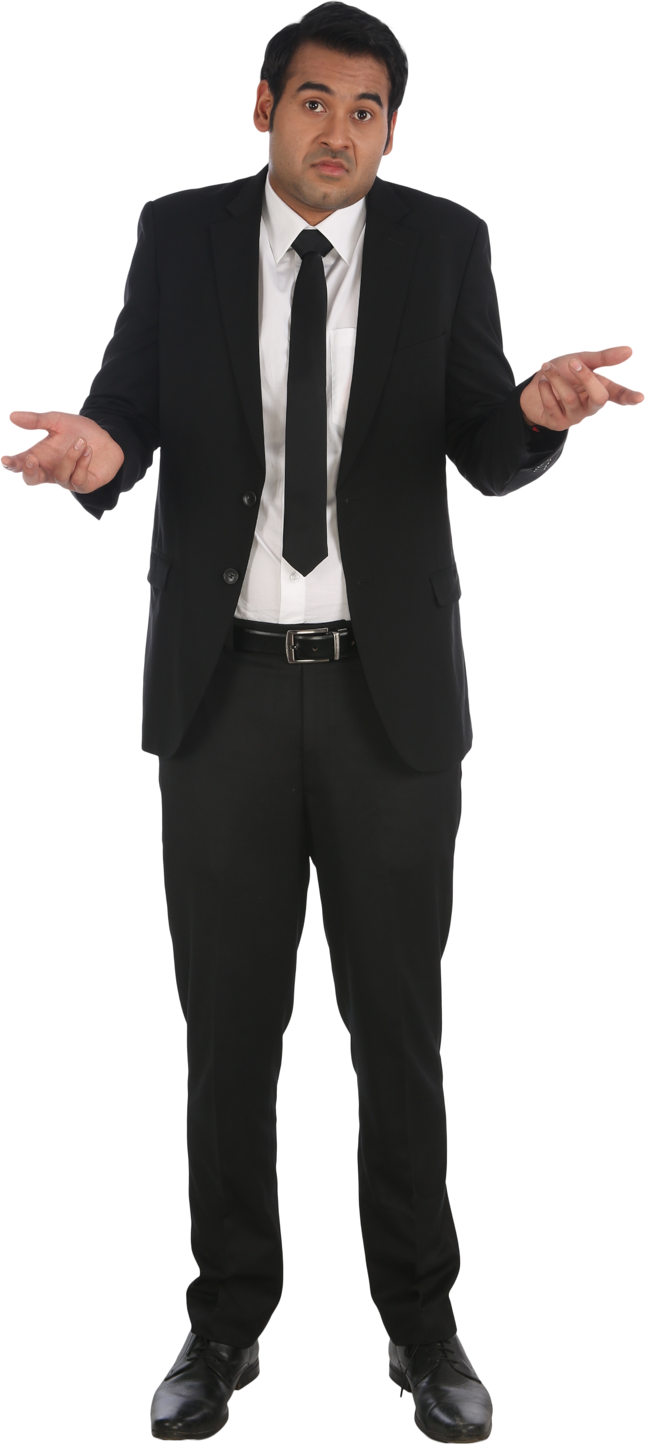
Conclusion
The same standards for Workers as for Students makes for a happier and more inclusive workplace.
Thanks for listening!

