Slide 1
Opening Slide
Access ucc DS EmployAbility programme:
a model of good practice in inclusive recruitment
AHEAD CONFERENCE
March 19th, 2025
Shay NOLAN & Elodie O’DONOVAN

Slide 2

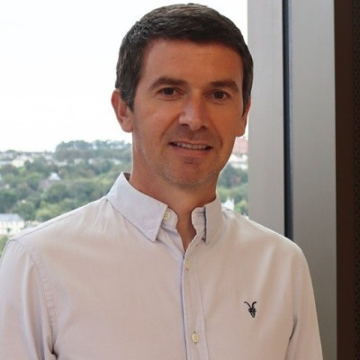
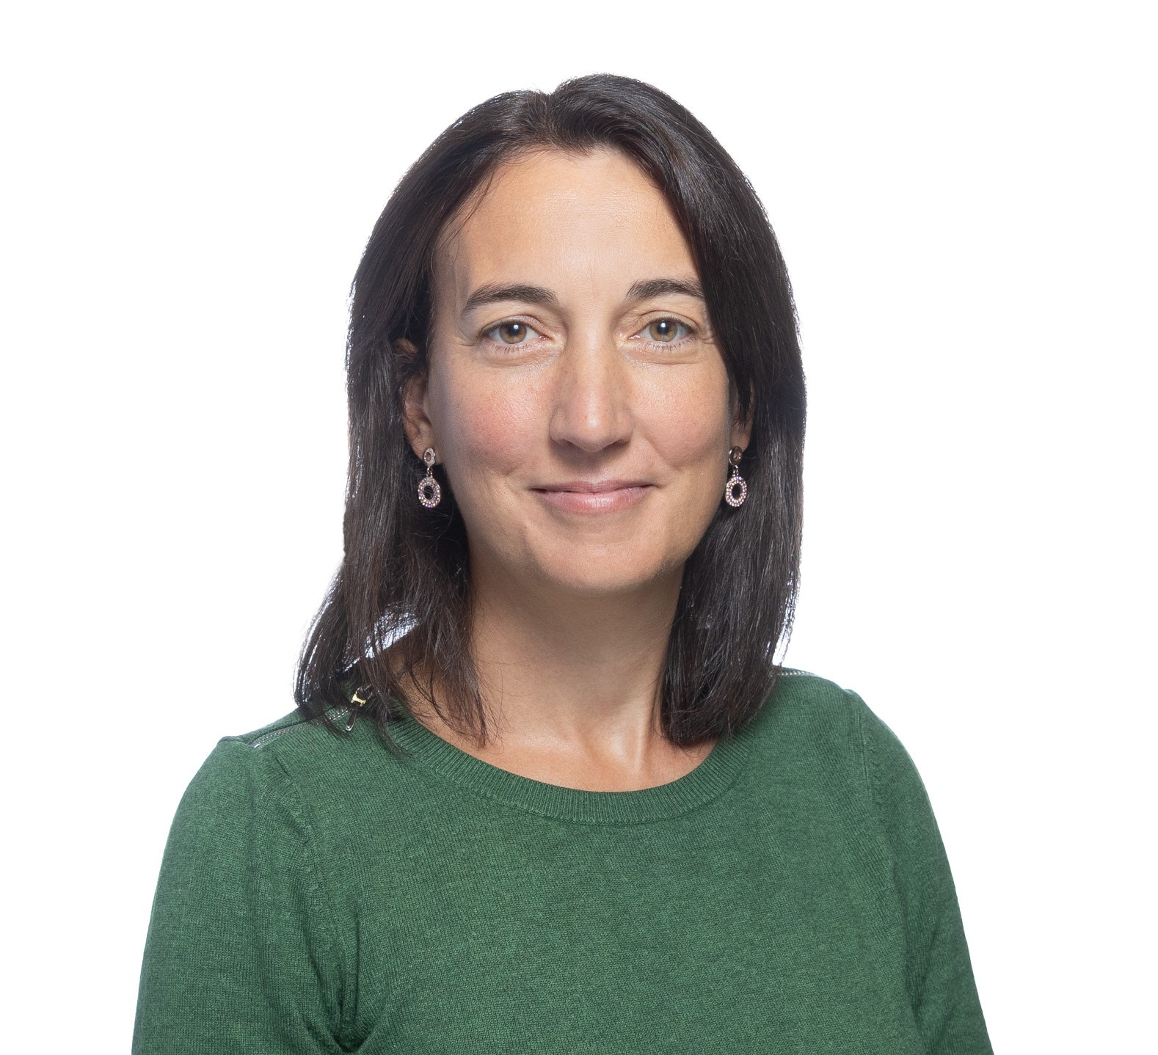

Access UCC EmployAbility Team
Shay Nolan
Elodie O’Donovan
Norma McEnery
EmployAbility Project Manager
shay.nolan@ucc.ie
EmployAbility Project Advisor
ElodieODonovan@ucc.ie
EmployAbility Project Advisor
nmcenery@ucc.ie

Slide 3

Agenda
Agenda
Context & Statistics
The Programme Today
DS EmployAbility Development Journey
Training for Employers and Students
Group Discussion

Slide 4
Disability Statistics in Ireland
2,000 students with disabilities graduate every year
22%
20’351
7.4%
50%
36%
Disabled people half as likely to be employed as others of working age***
of persons in Ireland have a disability*
(~1'110'000)
students registered with disability support**
(2’200 in UCC)
Of UCC DS graduates unemployed…
…of which, 50% never employed****
* Census of Population (CSO, 2022)
** Students with Disabilities Engaged with Support Services in Higher Education in Ireland 2022/23 (AHEAD, 2023)
*** Employment (National Disability Authority, 2023)
**** DSS Graduate Recruitment Report (UCC, 2014)
Notes:
Many students do not register with DS or register after year 1 (12.2% with a D vs 7.5 registered with DS) – 24% of new registrations with DS happen after year 1.
Postgraduate % is increasing by 33% vs previous year

Slide 5

What barriers do students with a disability face when seeking paid employment?

Slide 6

Aims of the programme
Aims Of The EmployAbility Programme
Student focus:
Equip students with a disability to progress from third-level education to the workplace
Employer focus:
Empower employers and managers to create disability-inclusive workplaces

Slide 7
Agenda
Agenda - 2
Context & Statistics
The Programme Today
DS EmployAbility Development Journey
Training for Employers and Students
Group Discussion

Slide 8
Programme Timeline
Mentoring Pre-Internship
March - May 2025
EmployAbility Programme
Structure
Mentoring During Internship
June - August 2025
Purpose
Prepare for the internship
Content
Professional communication
Meeting etiquette
Company / industry insights
Insights into hybrid working
At least one onsite visit to meet team & line manager
Mentor Profile
Employee of the team the intern will be with over the summer
Purpose
Support the internship experience
Prepare for upcoming applications
Content
Reflect on learnings
Review supports in place
CVs, Cover Letters, Interview skills
Introductions to industry contacts
Act as informal “buddy” during internship
Mentor Profile
Same mentor but some input from HR may be provided
Summer Internship
June - August 2025

Slide 9
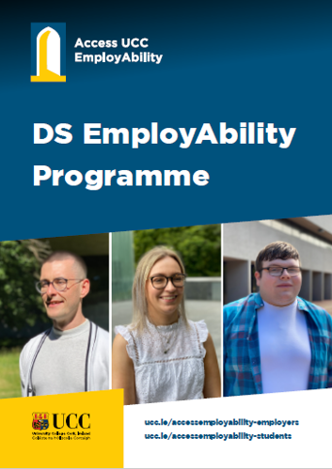
Benefits of the programme
Benefits to students
Benefits to employers
Opportunity to get relevant and meaningful professional work experience
A summer internship allows students to develop their professional workplace skills as well as significantly develop their confidence
Opportunity to avail of mentoring support from an experienced professional that will support their internship experience
Access to a highly skilled and diverse talent pool
Learning and development opportunity in the area of inclusive recruitment
Become more experienced and aware of the values in employing a person with a disability

Slide 10





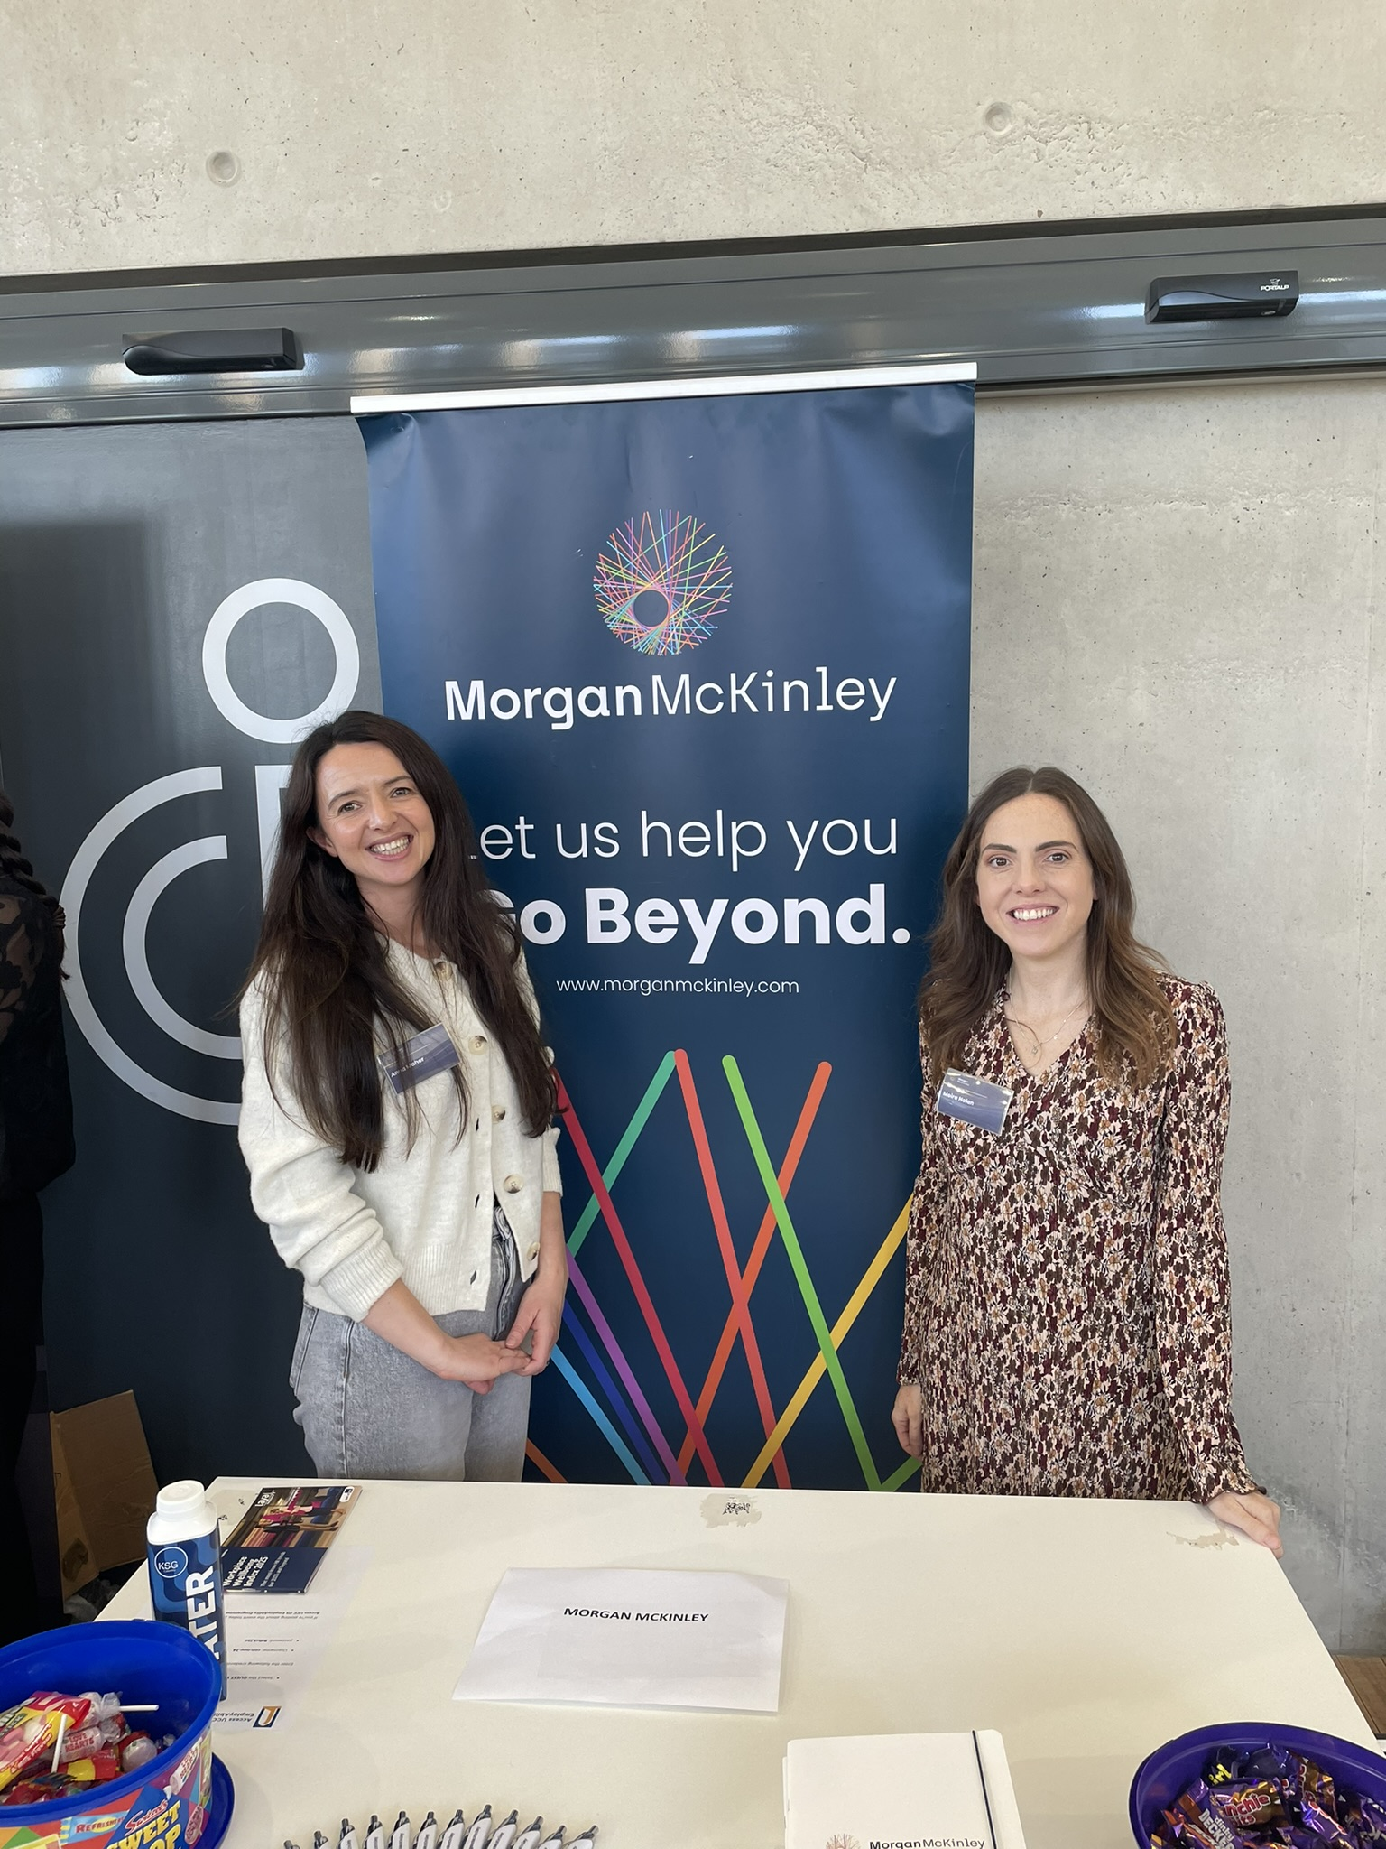
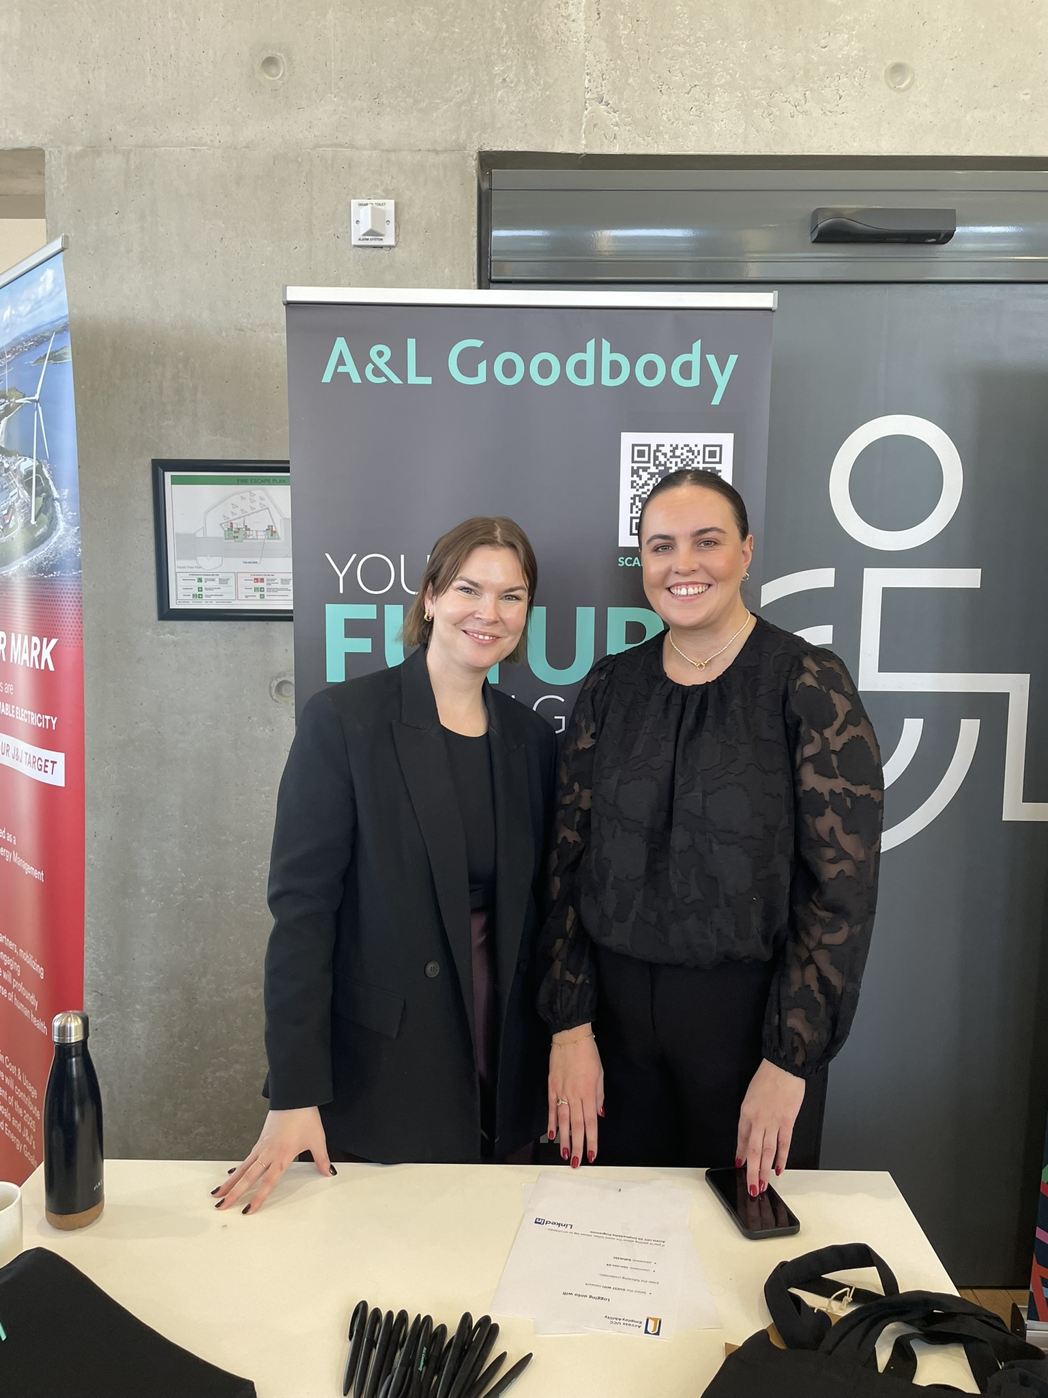
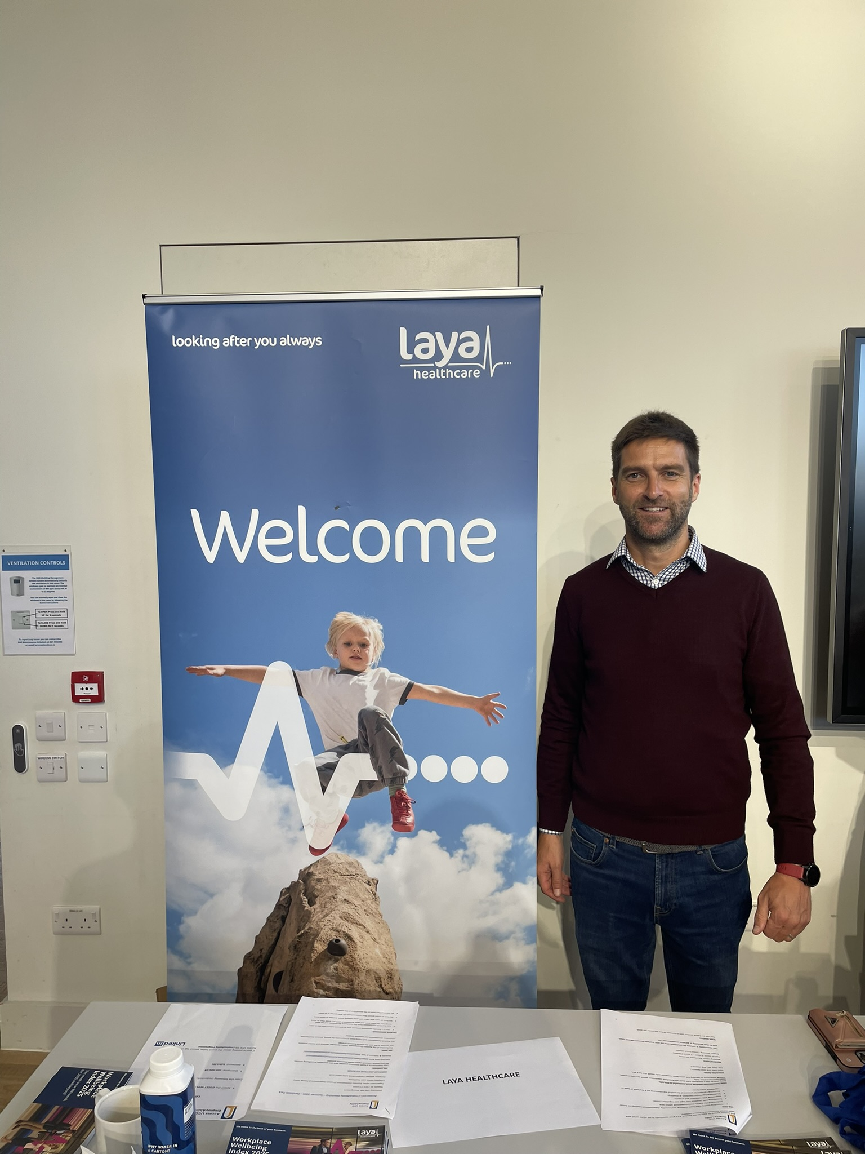
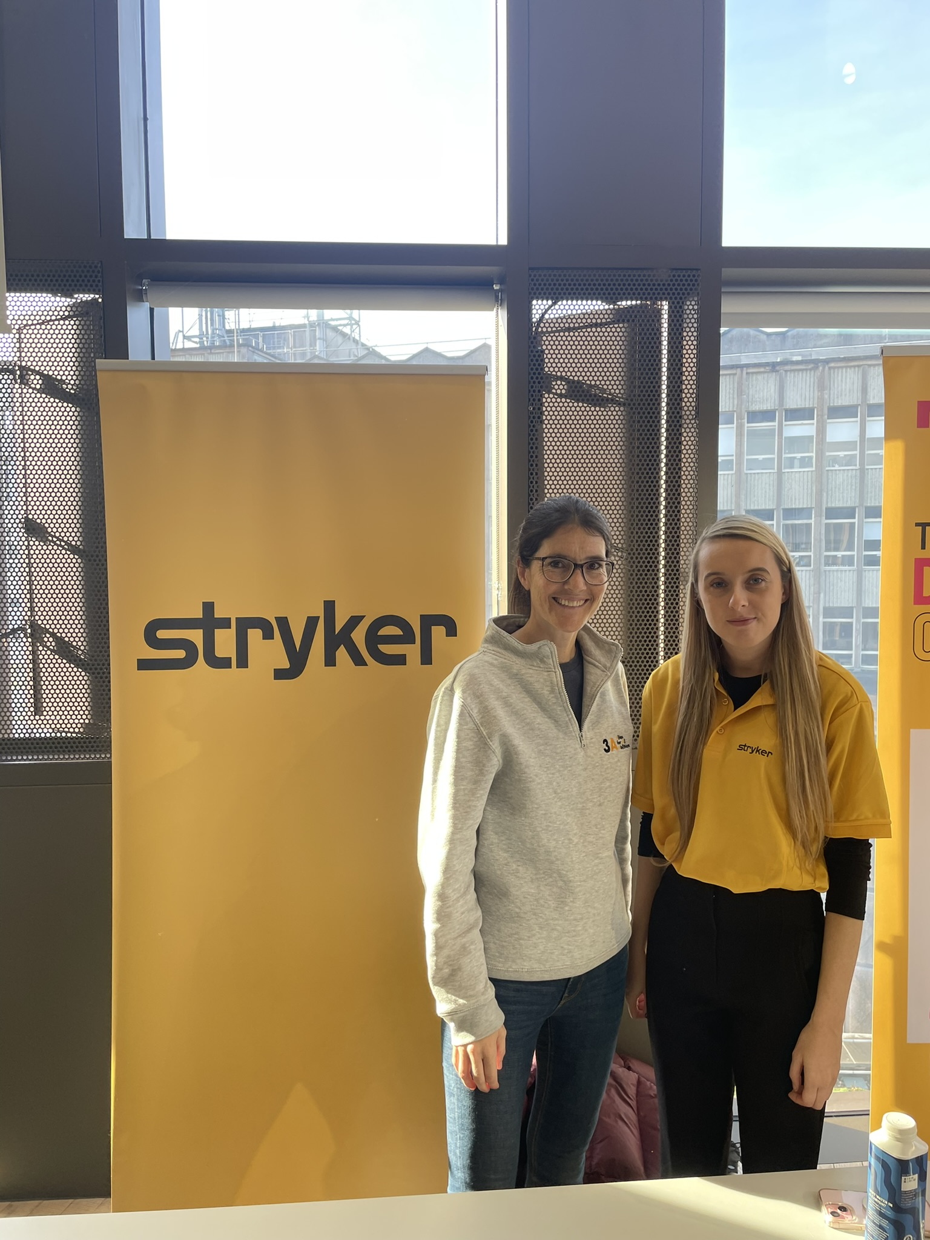




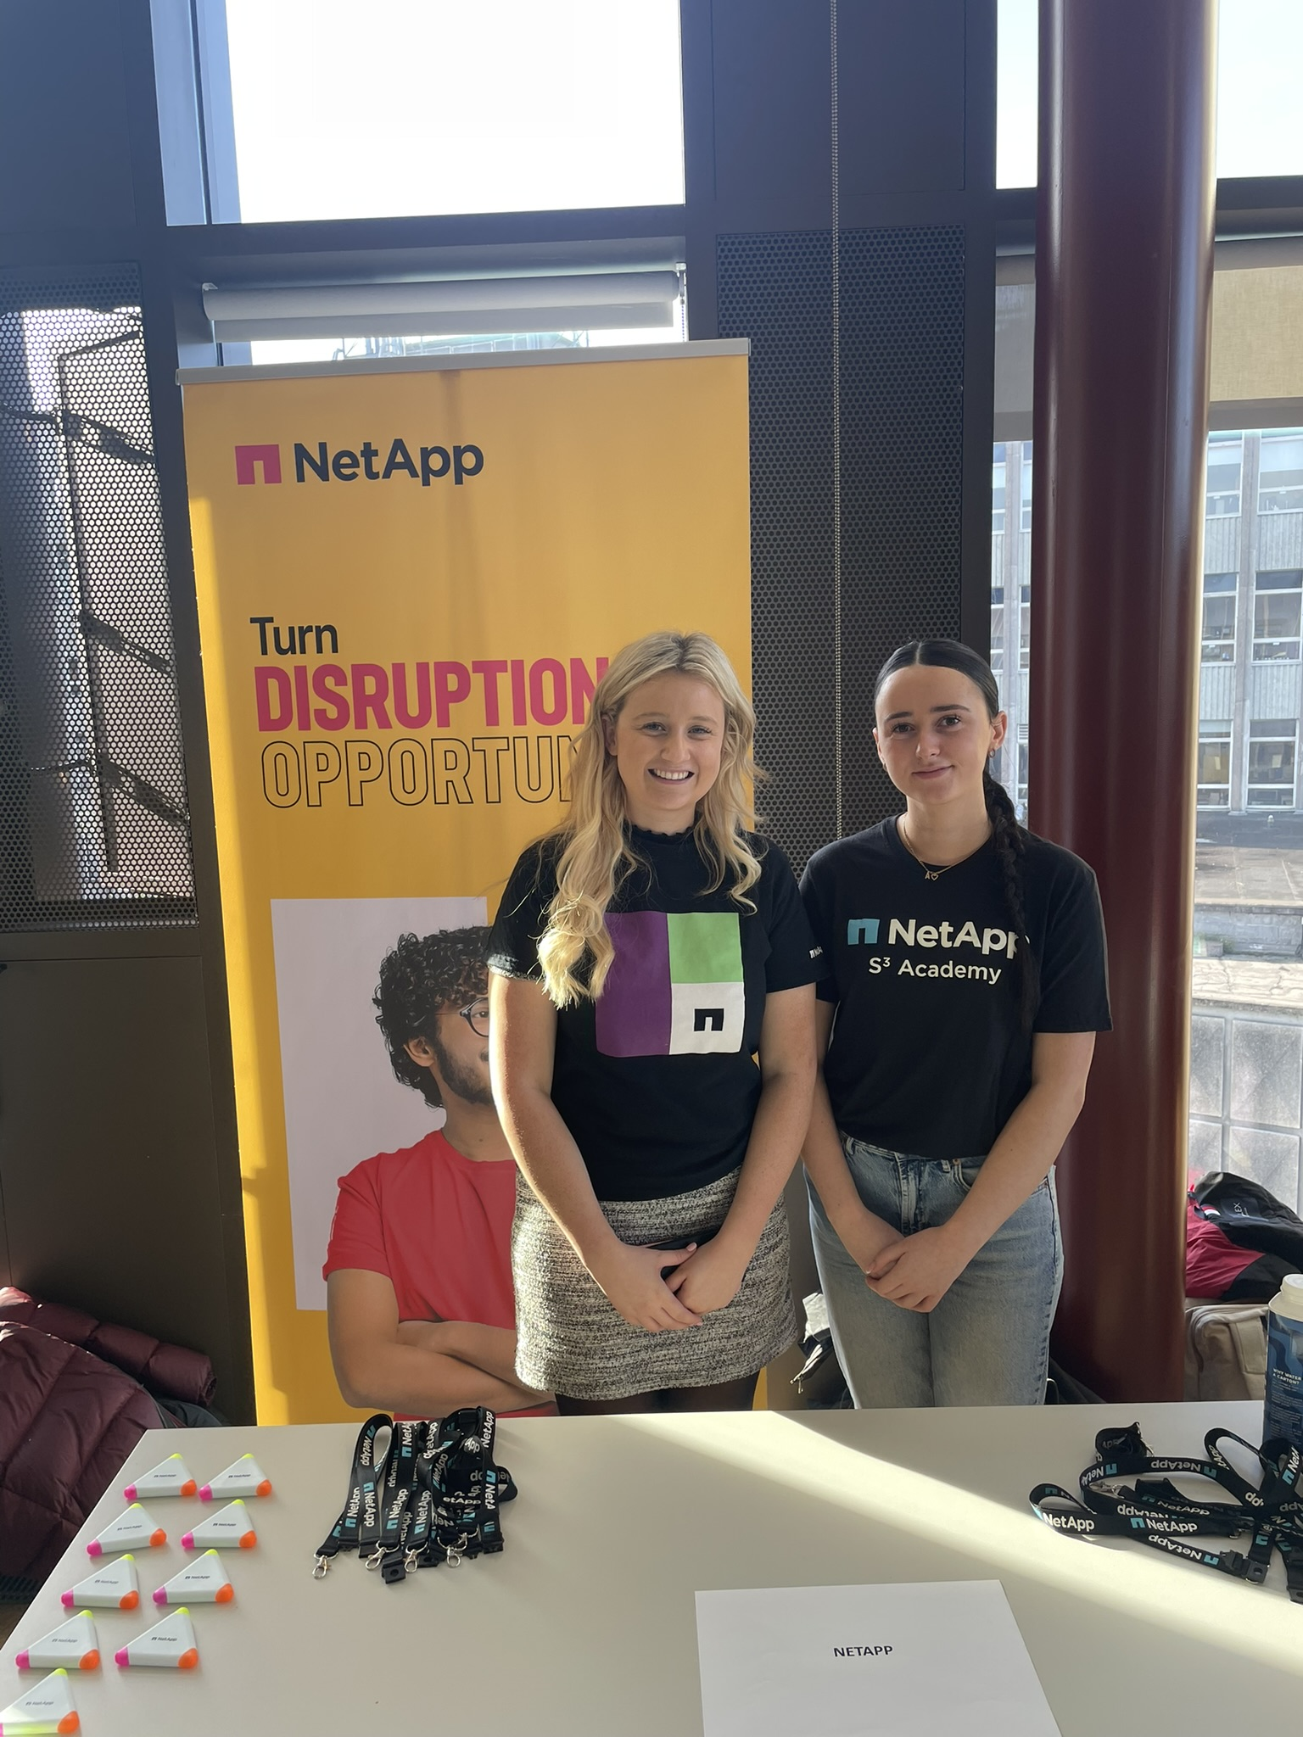
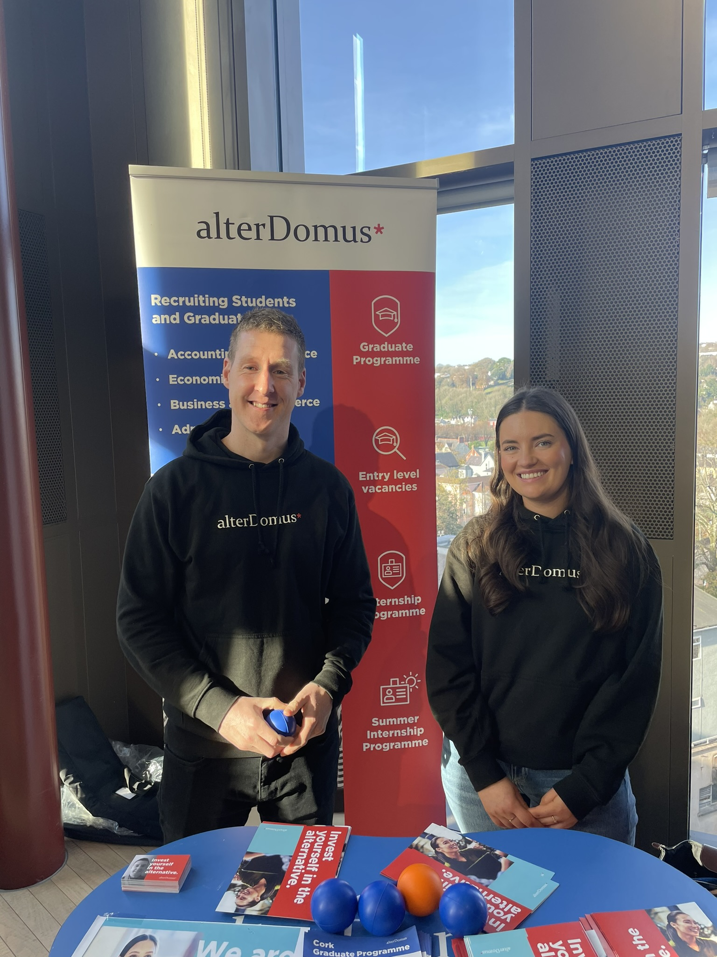
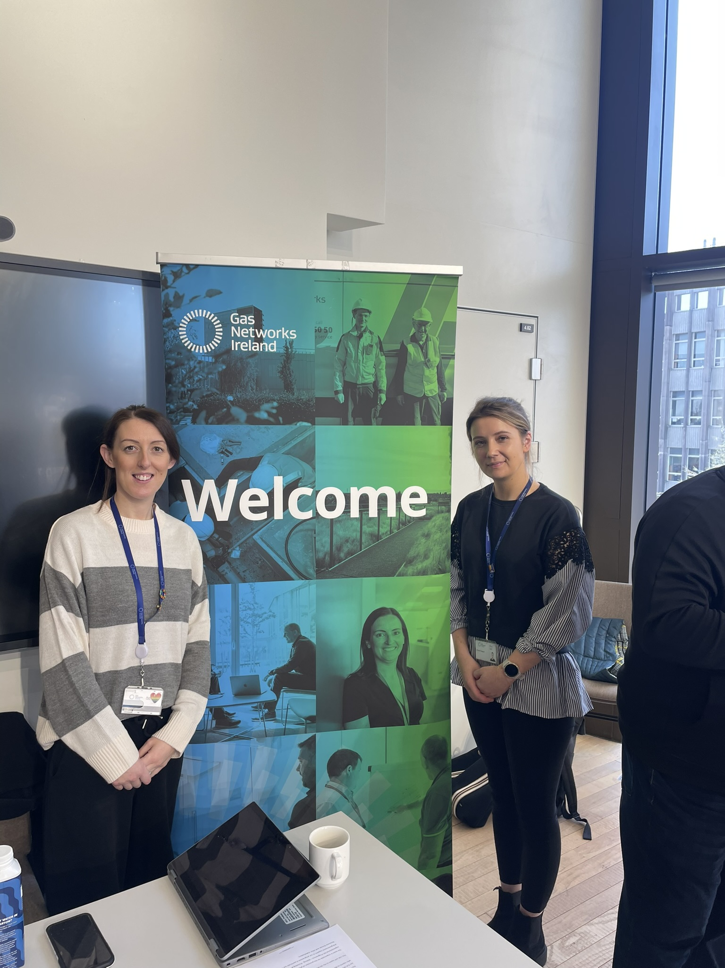
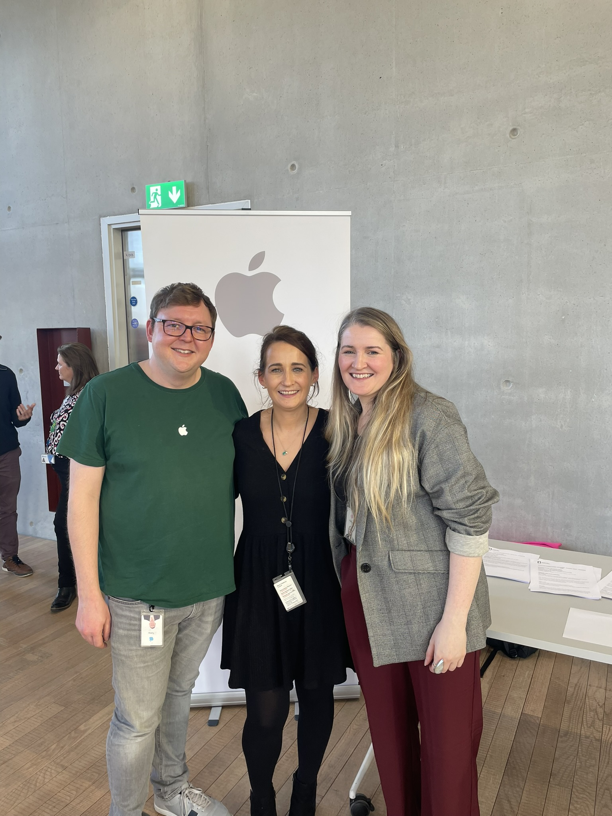







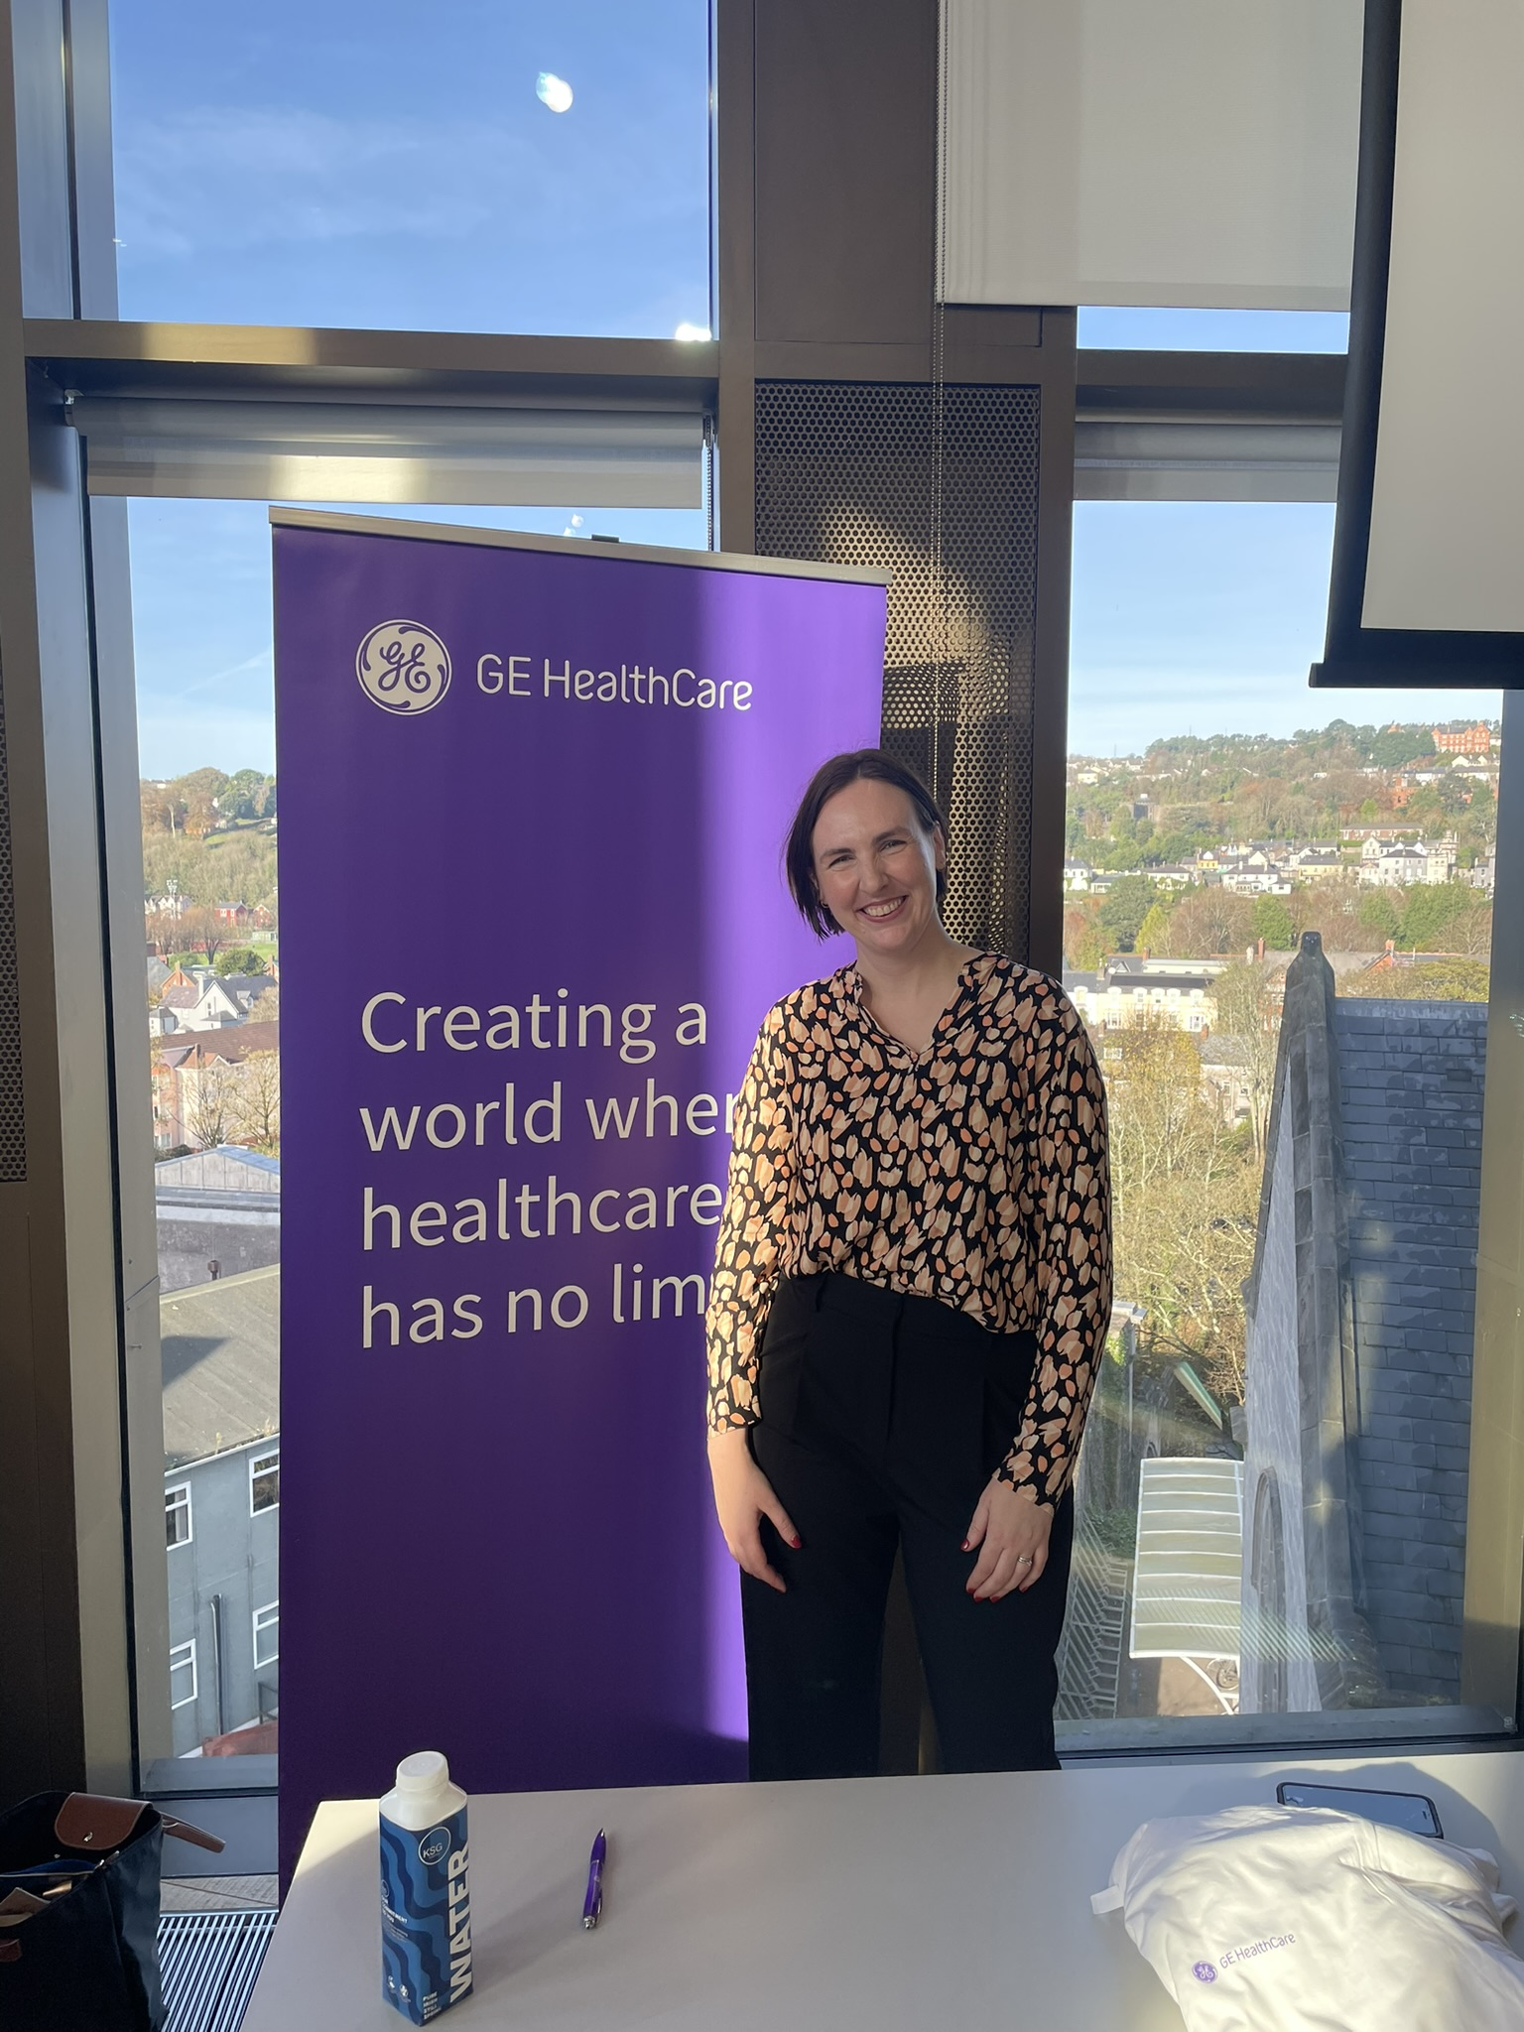
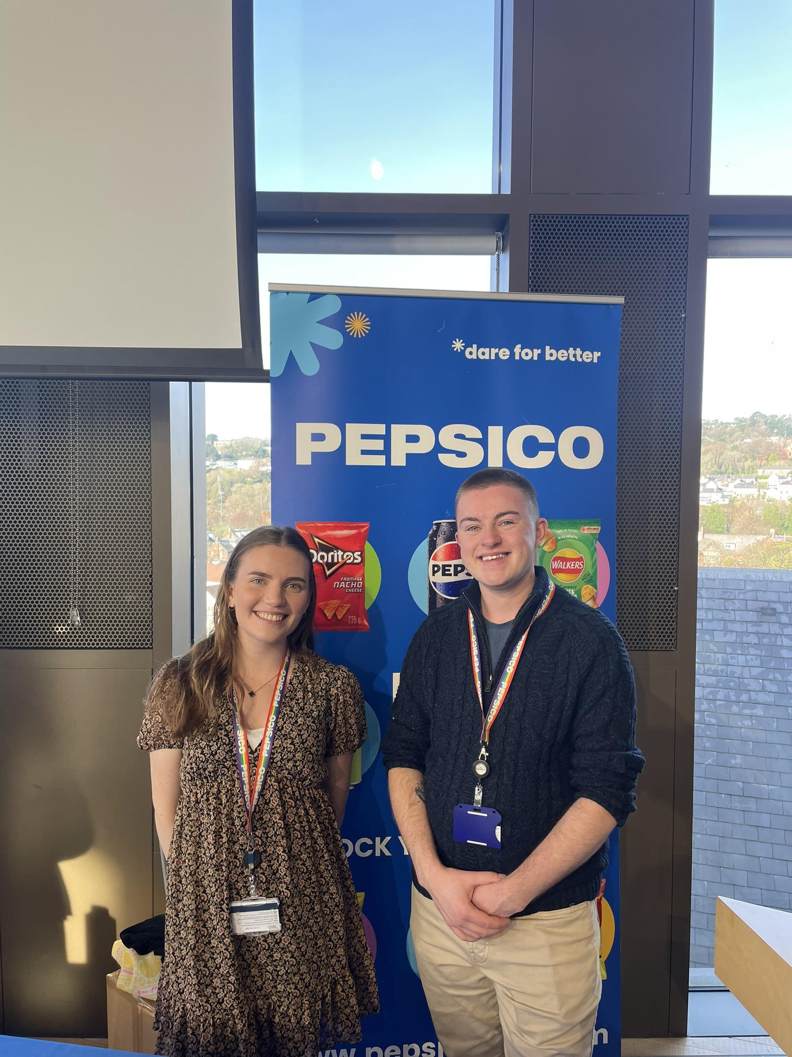
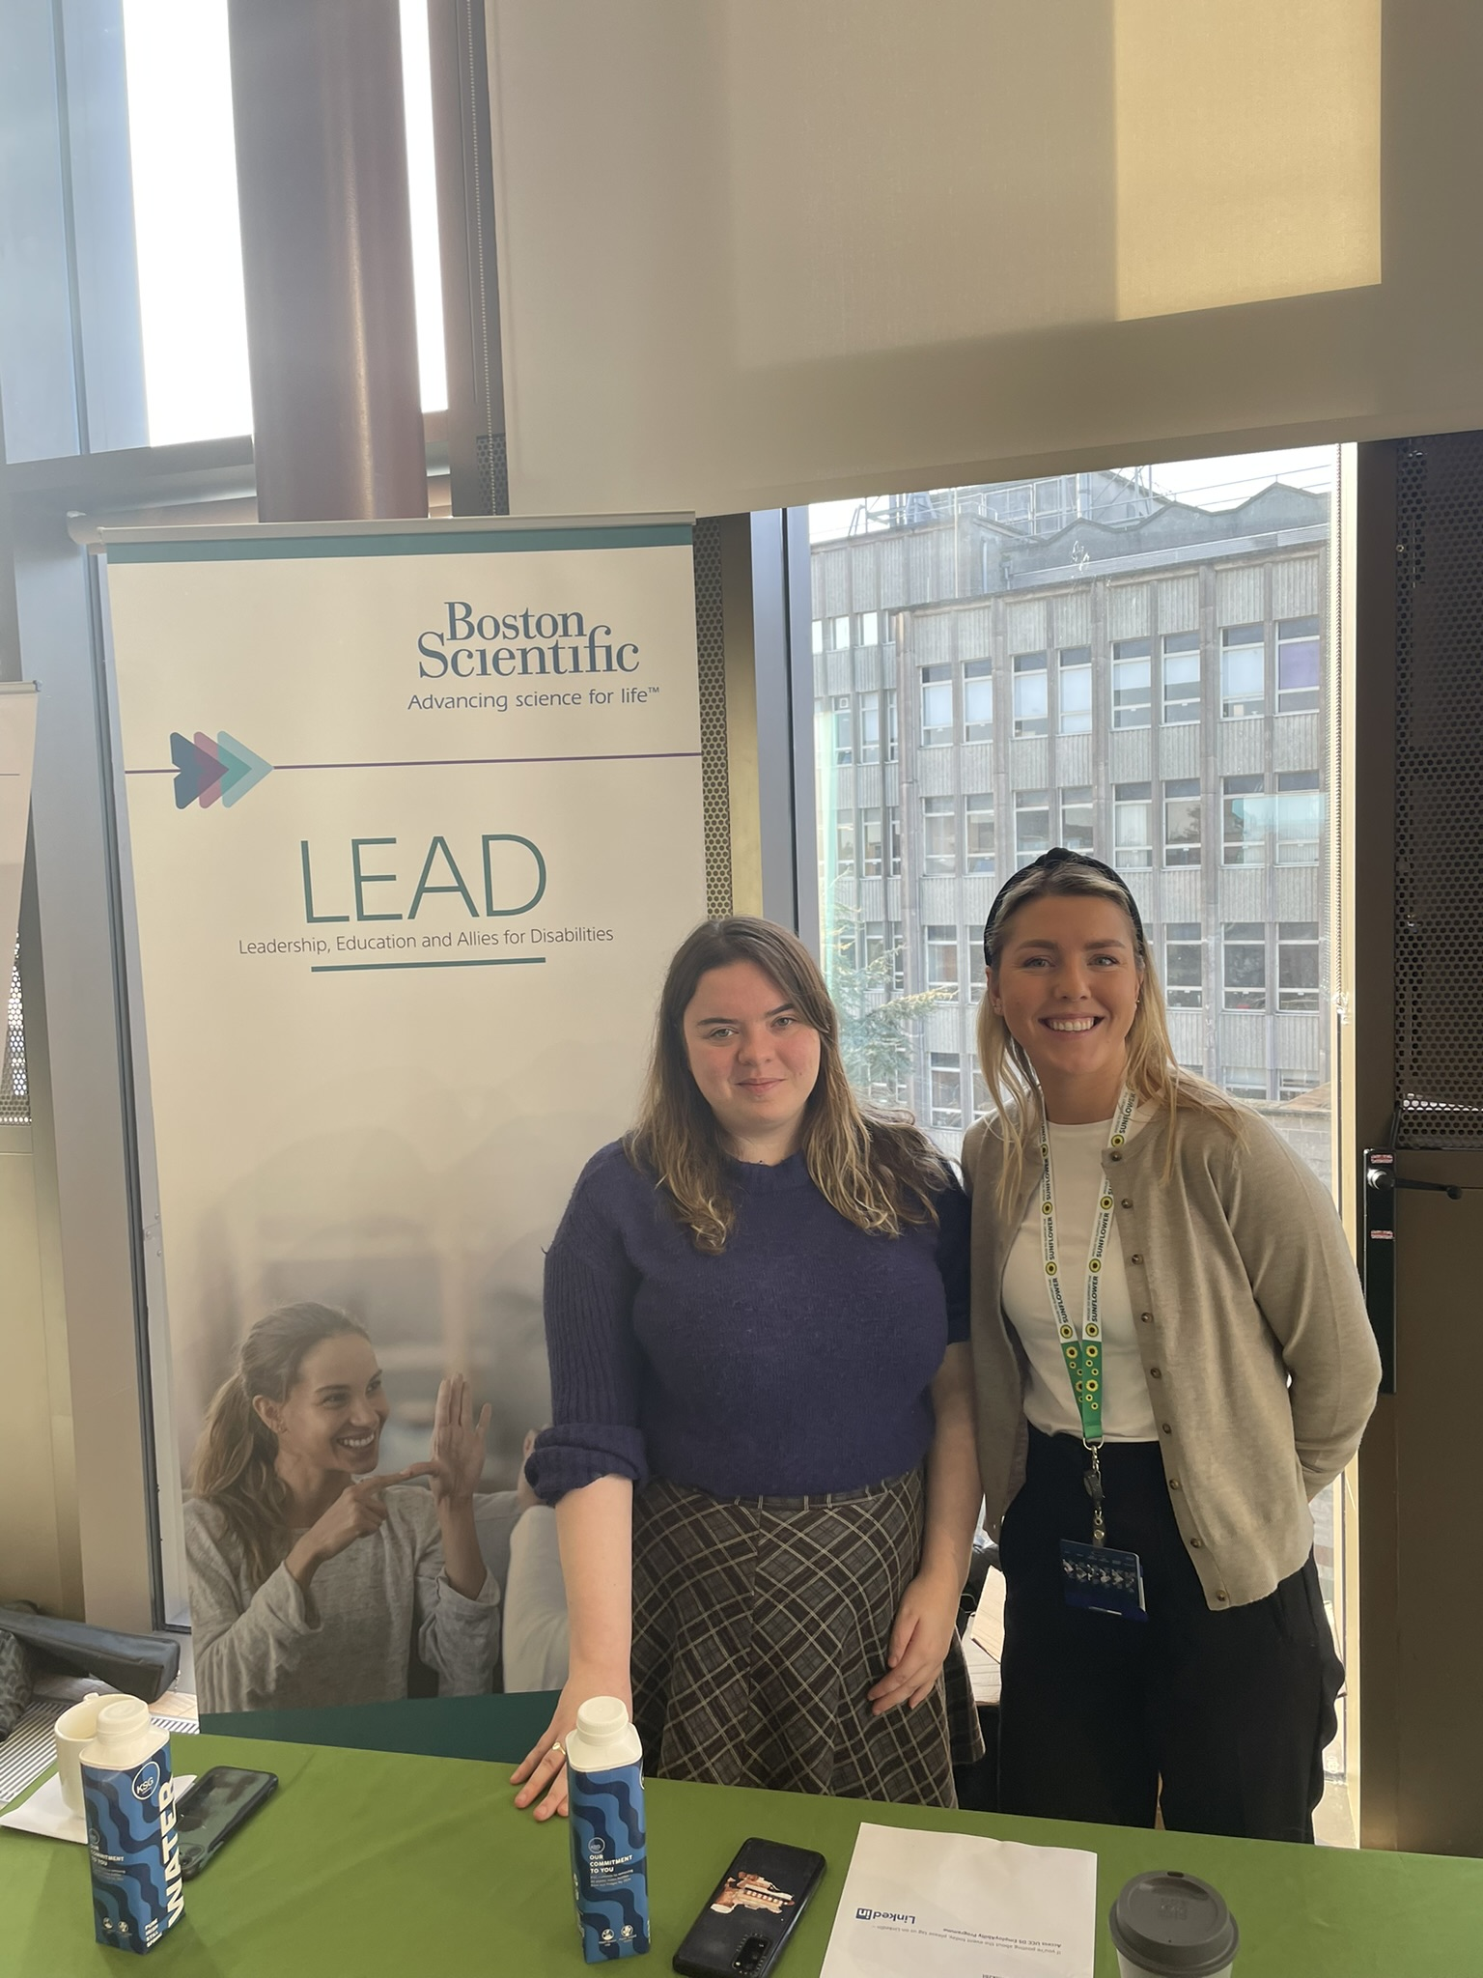
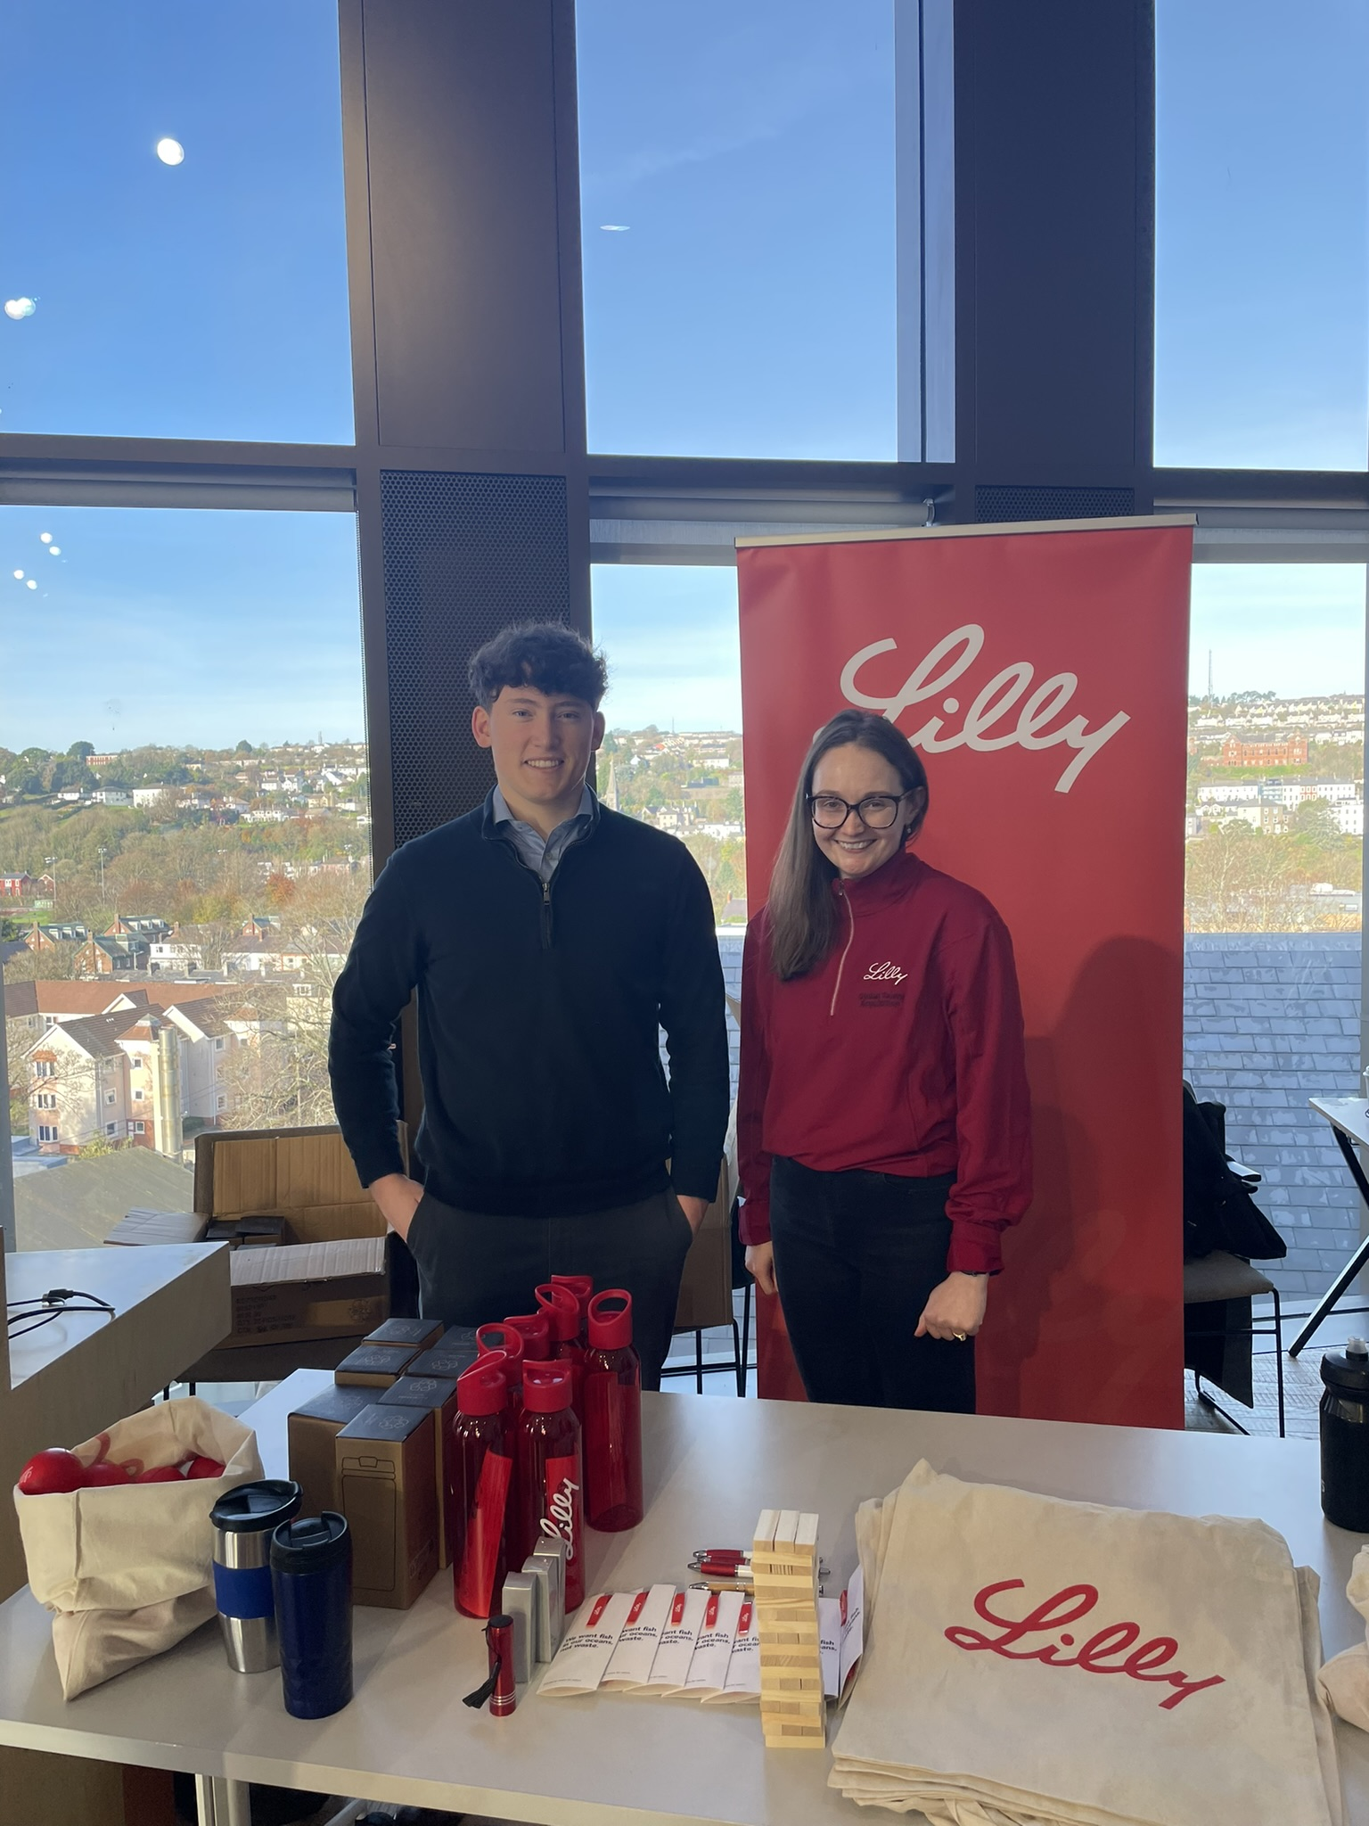




Our Employer Partners

Slide 11
Types of disabilities
What Do We Mean by “Interns with Disabilities”?
Not all DS students identify with the term “disability”
Wide range of conditions: some visible, most invisible
Many fall within the “neurodivergent” category (n35 – 48%)

Slide 12
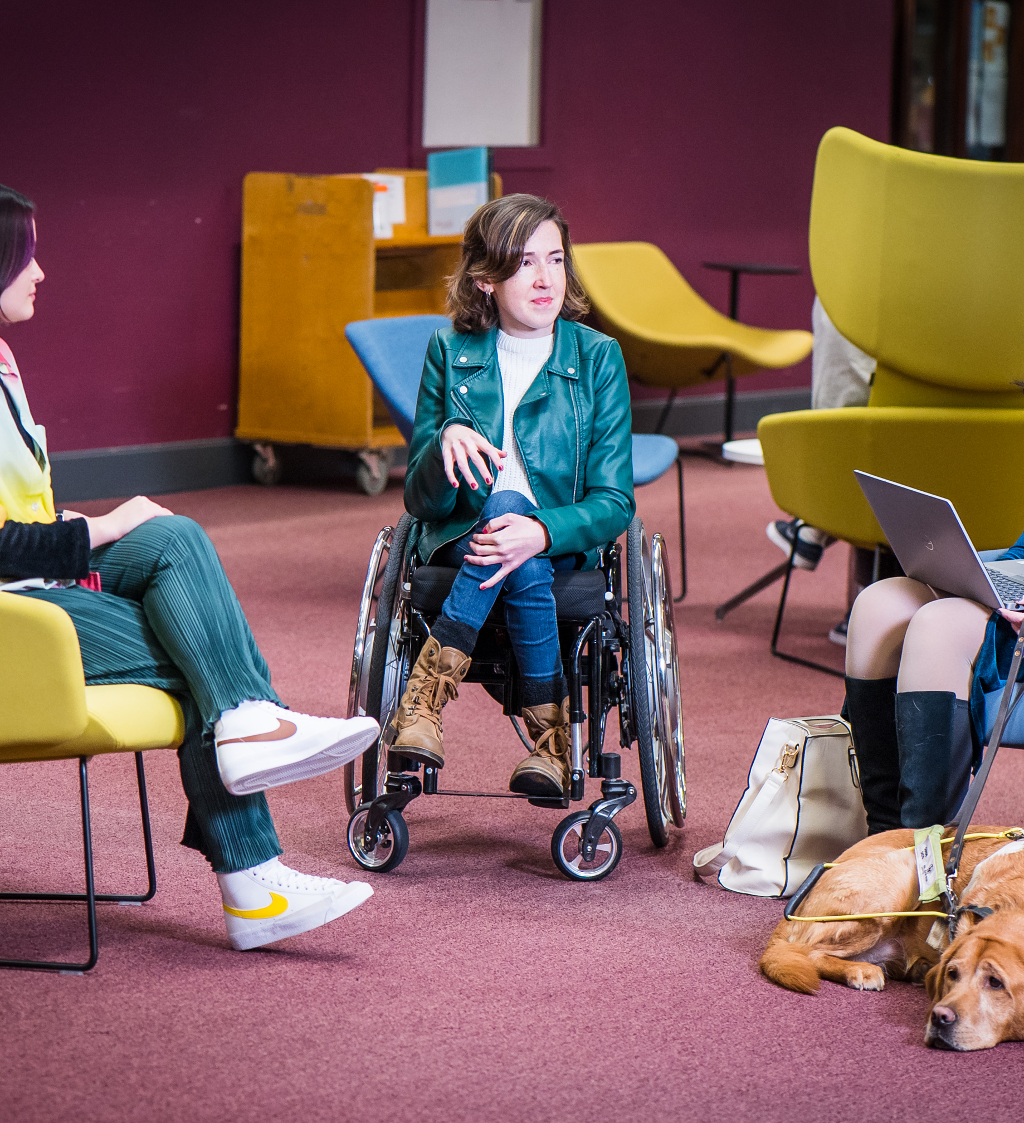
Outcomes
Student: “I thought I’d learn CV skills and interview skills. But in the end, I just got life lessons and that was way more important to me because I needed to improve on my confidence and getting myself out there.”
Manager: “The programme increased my awareness of the need to accommodate for additional needs in the recruitment and interview processes. I had a fantastic human connection with a talented young individual. I was reminded that it’s easy and rewarding supporting younger individuals in taking off on their career journey.”
Many students secure further employment opportunities:
  6-month college placements
  Graduate roles
  Industry employment while in college

Slide 13
Agenda - 3
Context & Statistics
The Programme Today
DS EmployAbility Development Journey
Training for Employers and Students
Group Discussion

Slide 14

Timeline - applications
EmployAbility Programme Genesis
2015
Pilot based on student feedback
Employer recruitment
Two separate programmes – Mentoring & Internship
1 company & 7 mentoring partnerships
3 companies & 3 internships

Slide 15
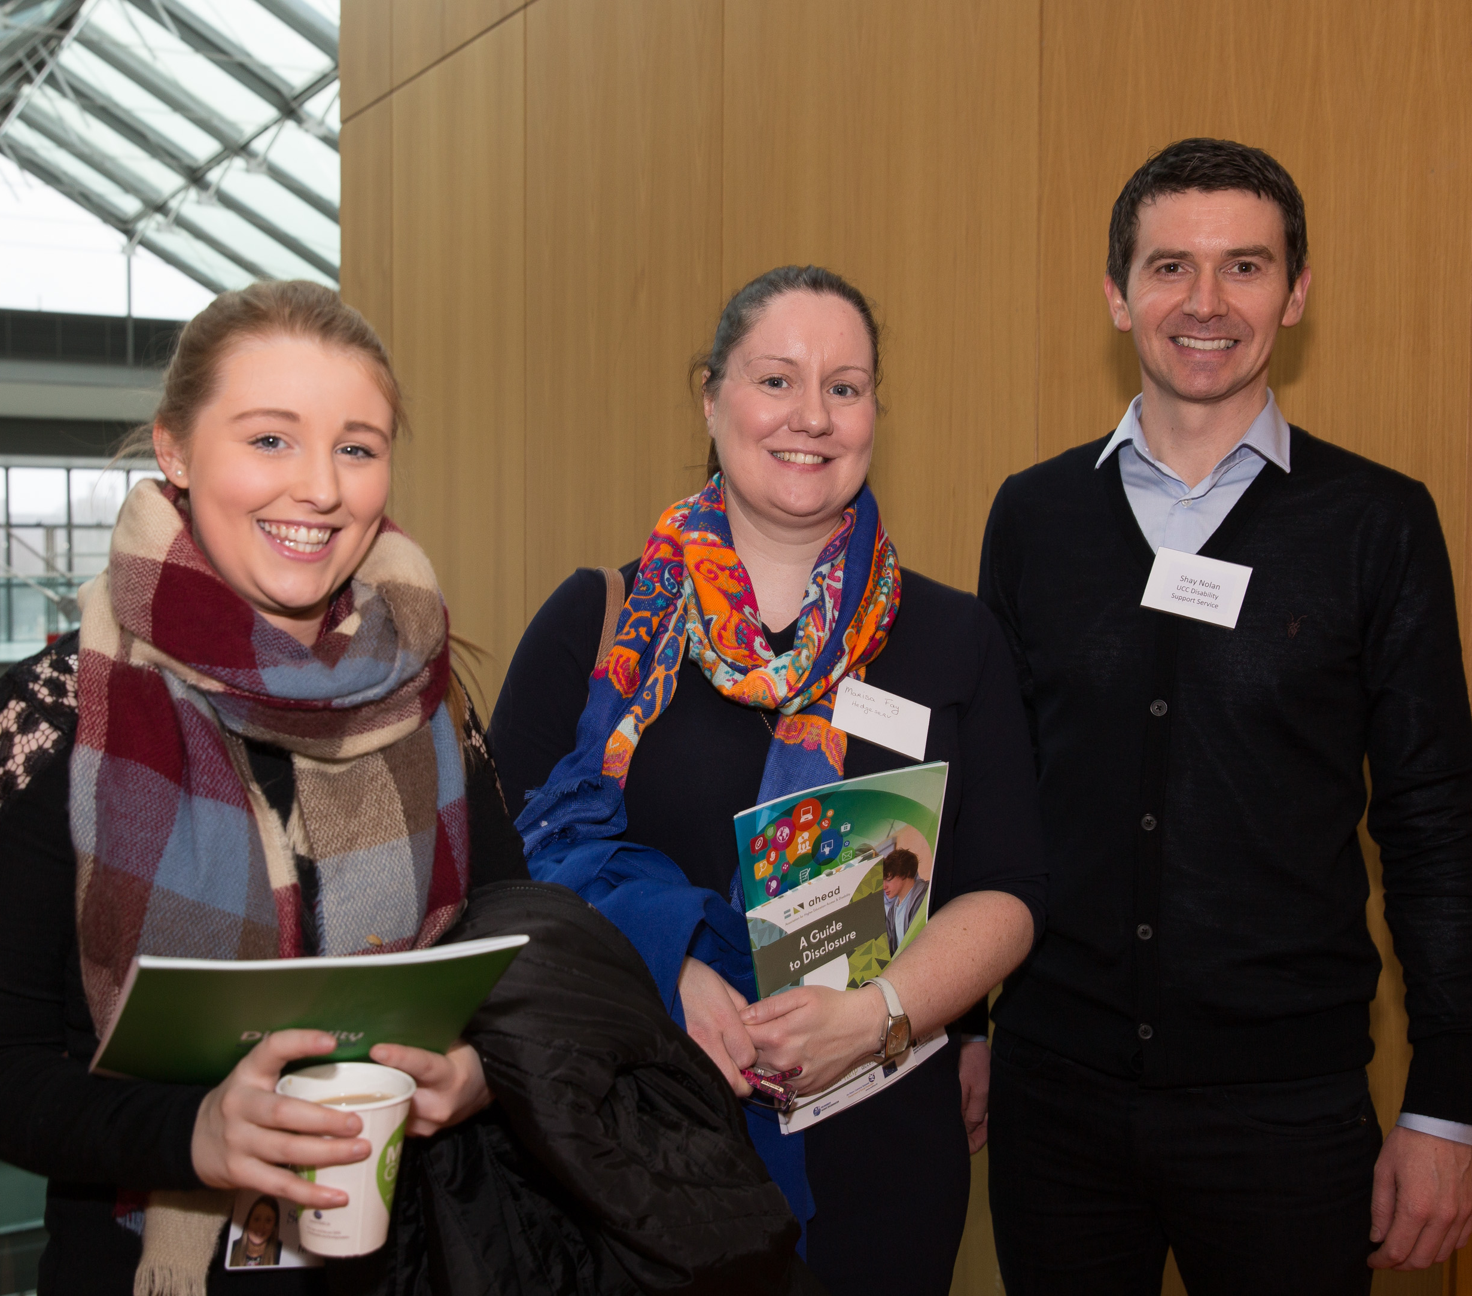
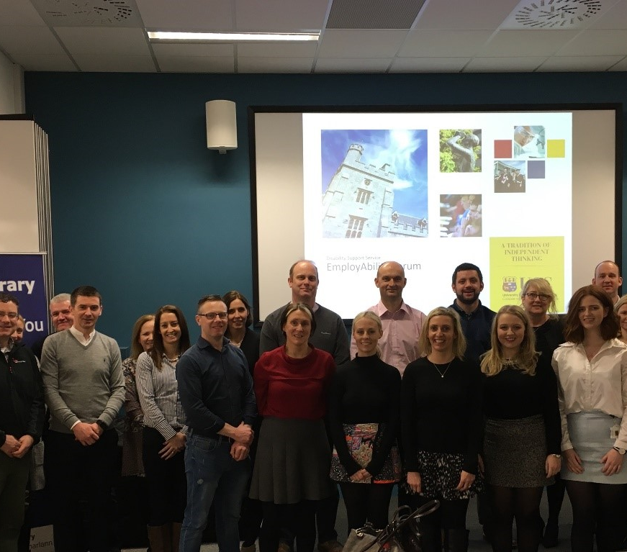
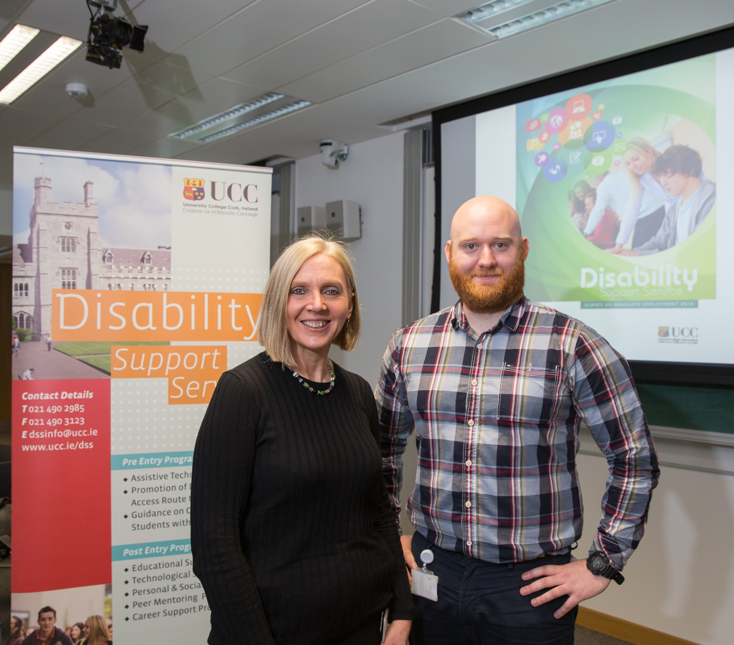
DS EmployAbility Forum & Employer Recruitment
2015 - 2019
Annual seminar for employers
Making your recruitment & selection processes more inclusive to disability
Disclosure – Challenges for students & employers
Employer Disability Initiatives
Outputs shared among the group

Slide 16
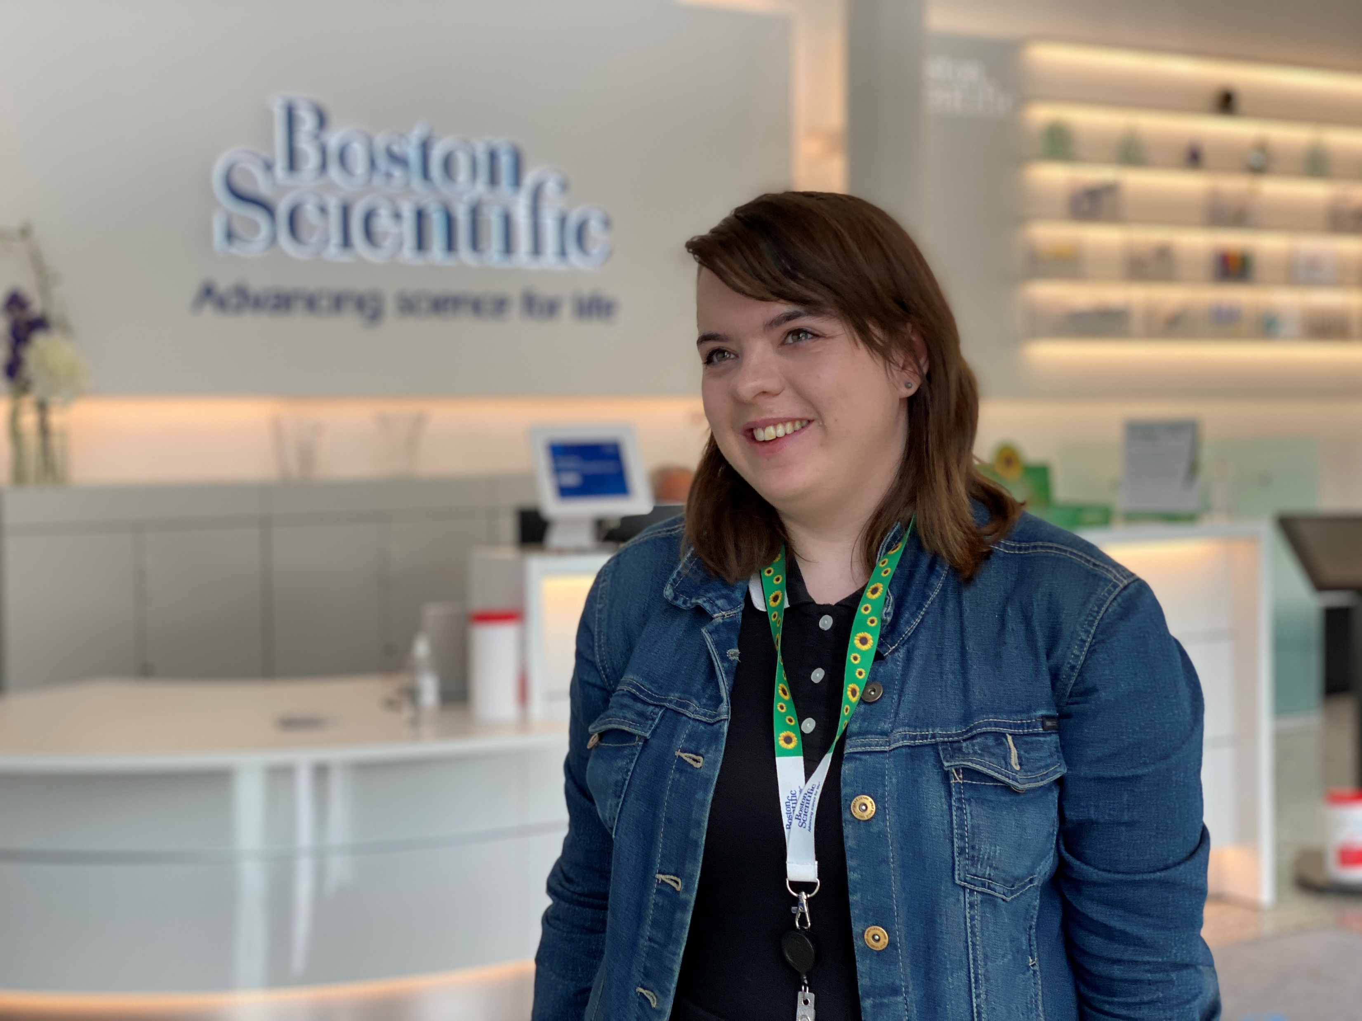
Timeline - internships
EmployAbility Programme – Rapid Growth
2019
By 2019 the programmes had grown significantly
11 companies and 70 mentoring partnerships
6 companies and 16 internships
Programme in need of further resources
Funding application

Slide 17
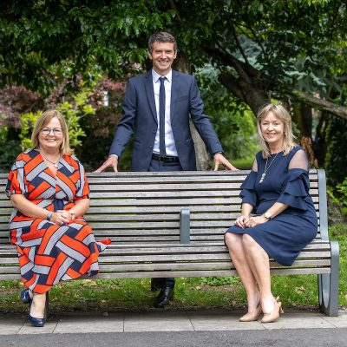
EmployAbility Programme Funding – ReThink Ireland
2020
Ability to work fund 2020 - 2023
Opportunity to develop EmployAbility Team
Training & consultancy support
Further growth:
19 employers & 135 mentoring partnerships
20 internships

Slide 18
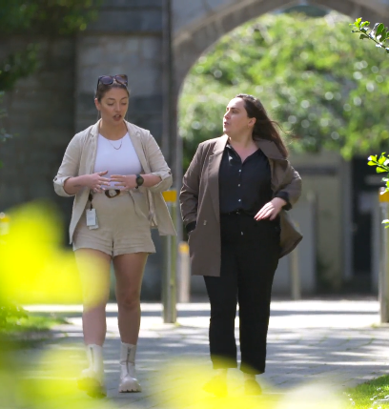
Timeline - onboarding
EmployAbility Programme - Remodel
2023
Amalgamate mentoring with internships
63 internships summer 2024
77 internships summer 2025
Higher impact programme for students and employers
Training for employers

Slide 19
Agenda - 4
Context & Statistics
The Programme Today
DS EmployAbility Development Journey
Training for Employers and Students
Group Discussion

Slide 20
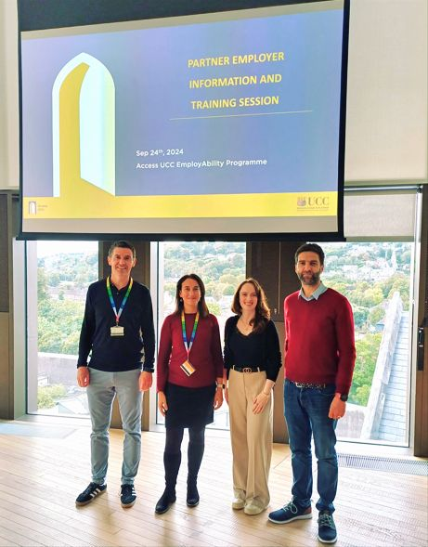
Training for employers
Training for Employers
Training provided to our partner employers on:
Disability Awareness
Disclosure & Reasonable Accommodations
Disability Inclusive Recruitment:
  Advertising and Applications
  Interviewing and Assessing
  Onboarding
Training developed based on:
The student voice (quantitative survey & focus group)
Employer feedback (piloted 4 workshops)

Slide 21



Tools to support inclusion
Inclusive Recruitment Training
To support open discussions on reasonable accommodations and disability inclusive recruitment, we developed three key documents:
A job description template
Inclusive interview guidelines
A support assessment form and process
Applications
Interviews
Onboarding

Slide 22
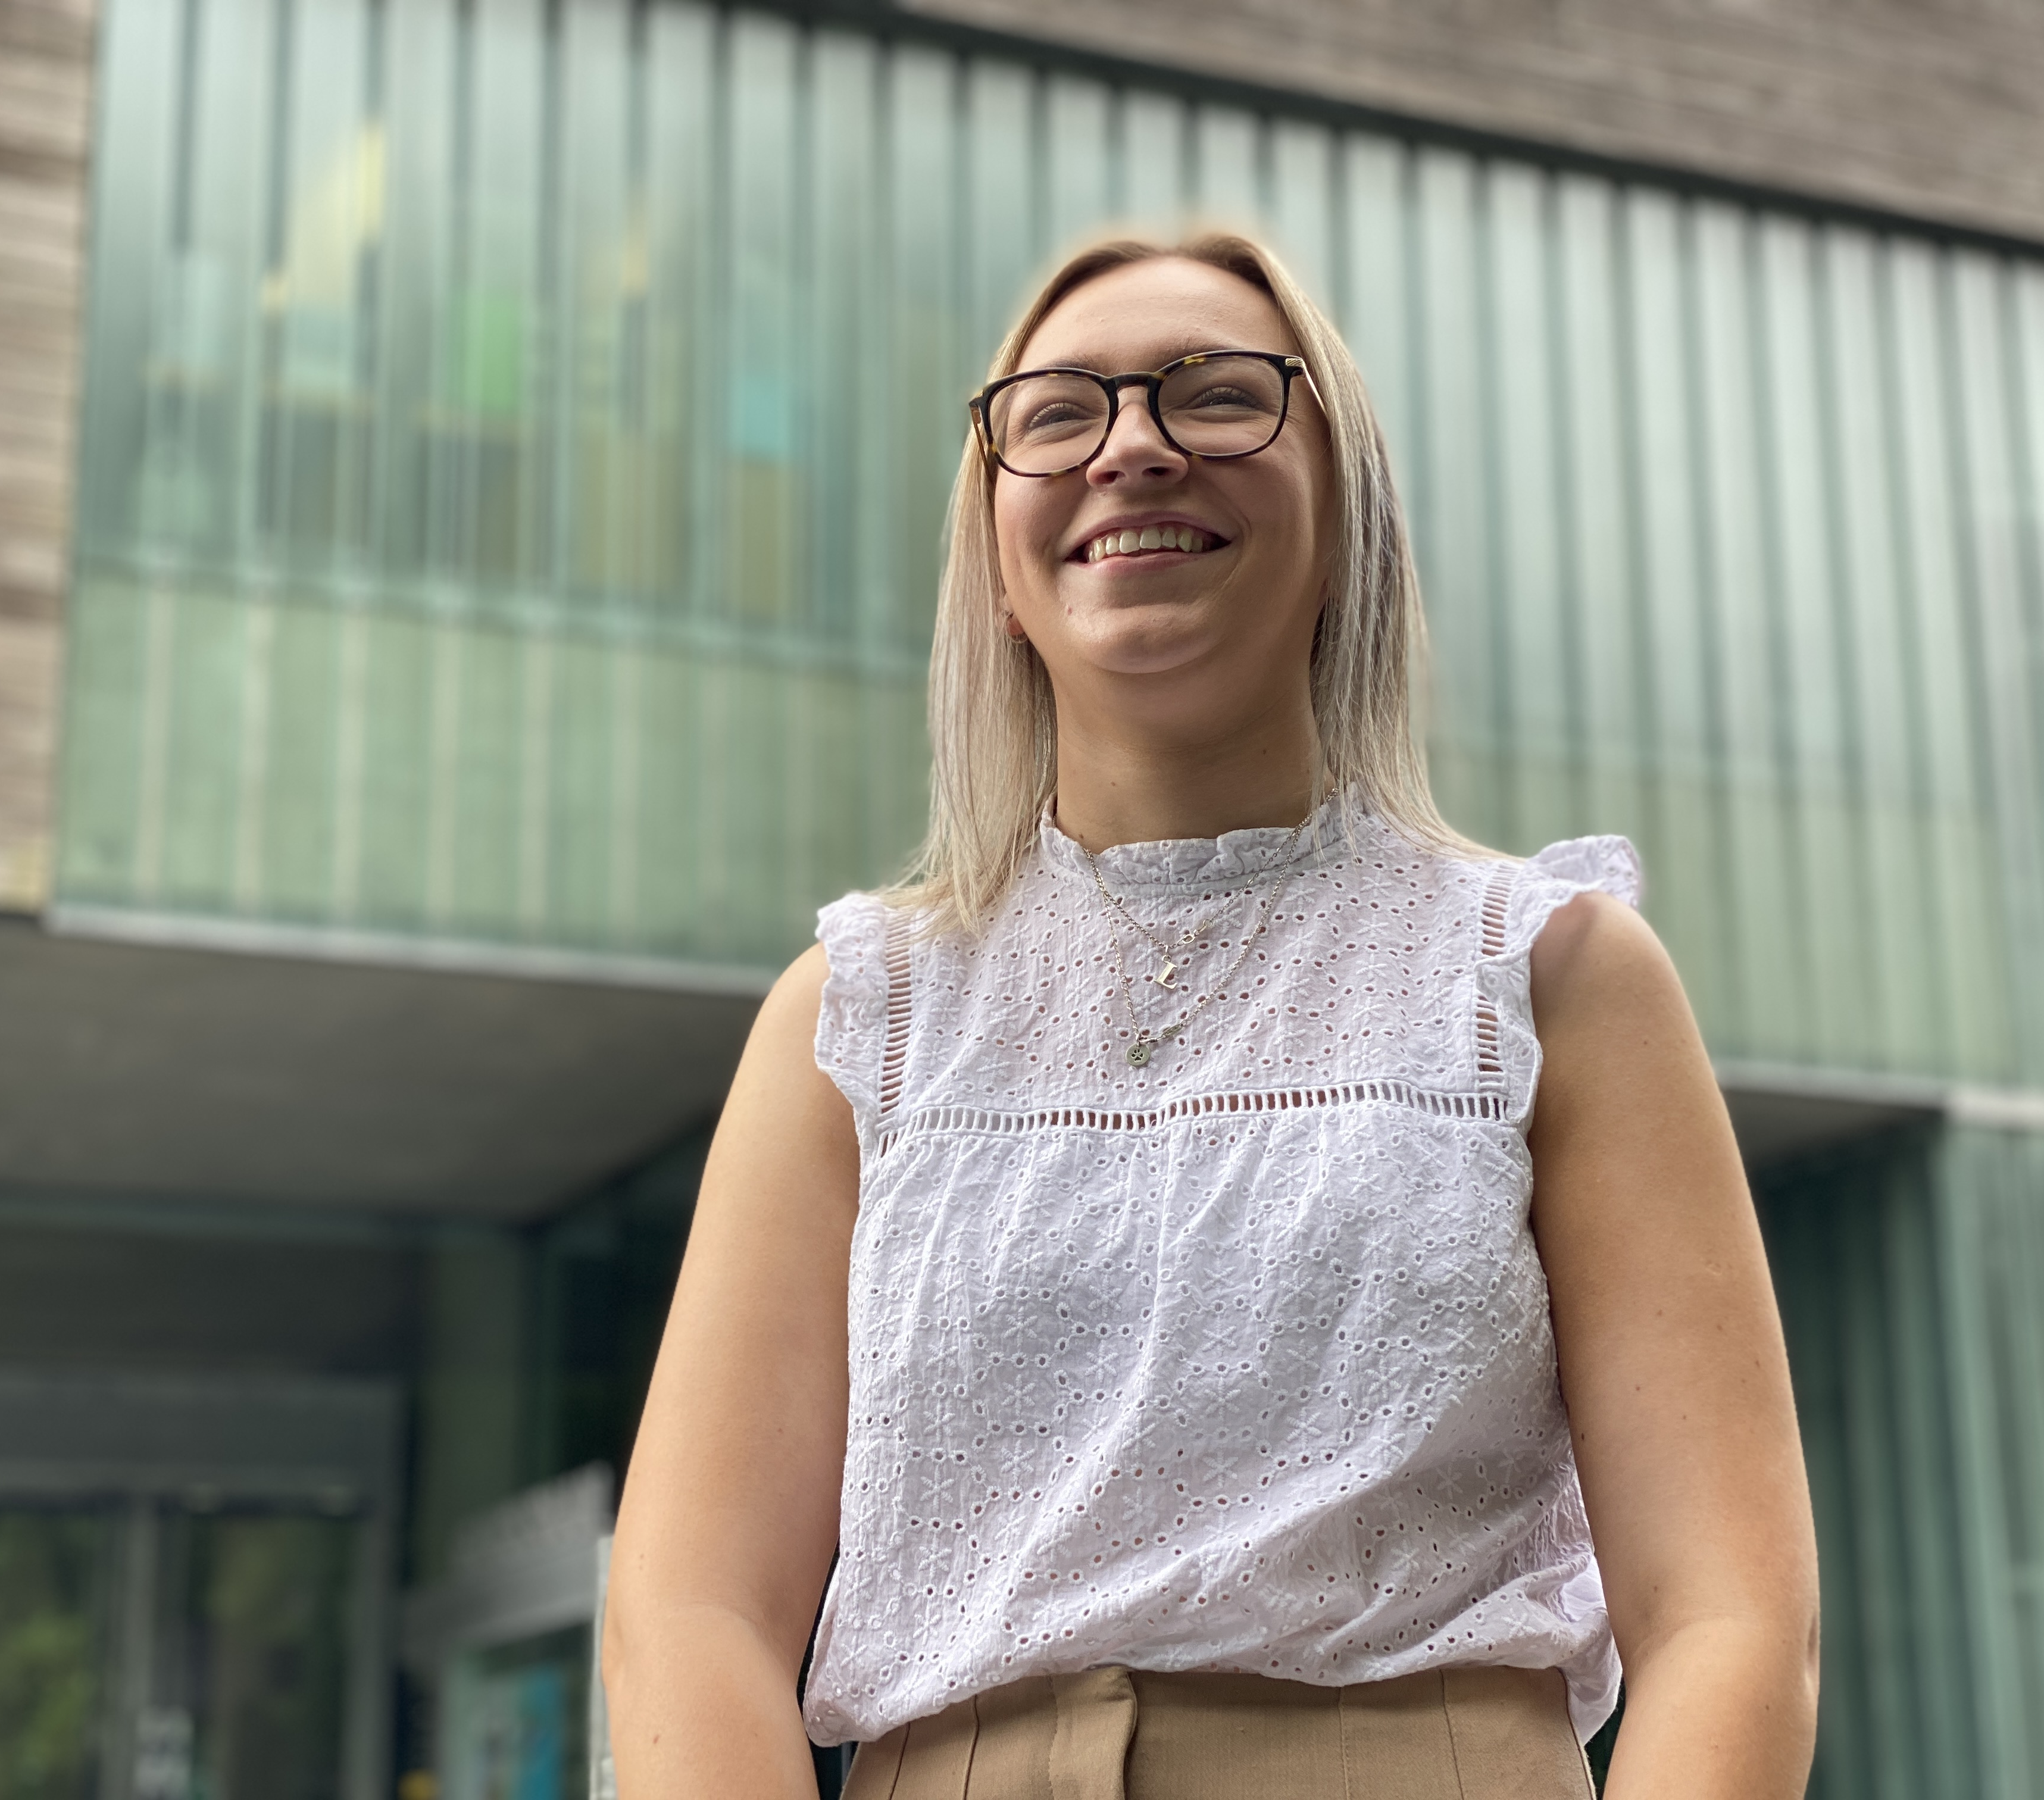
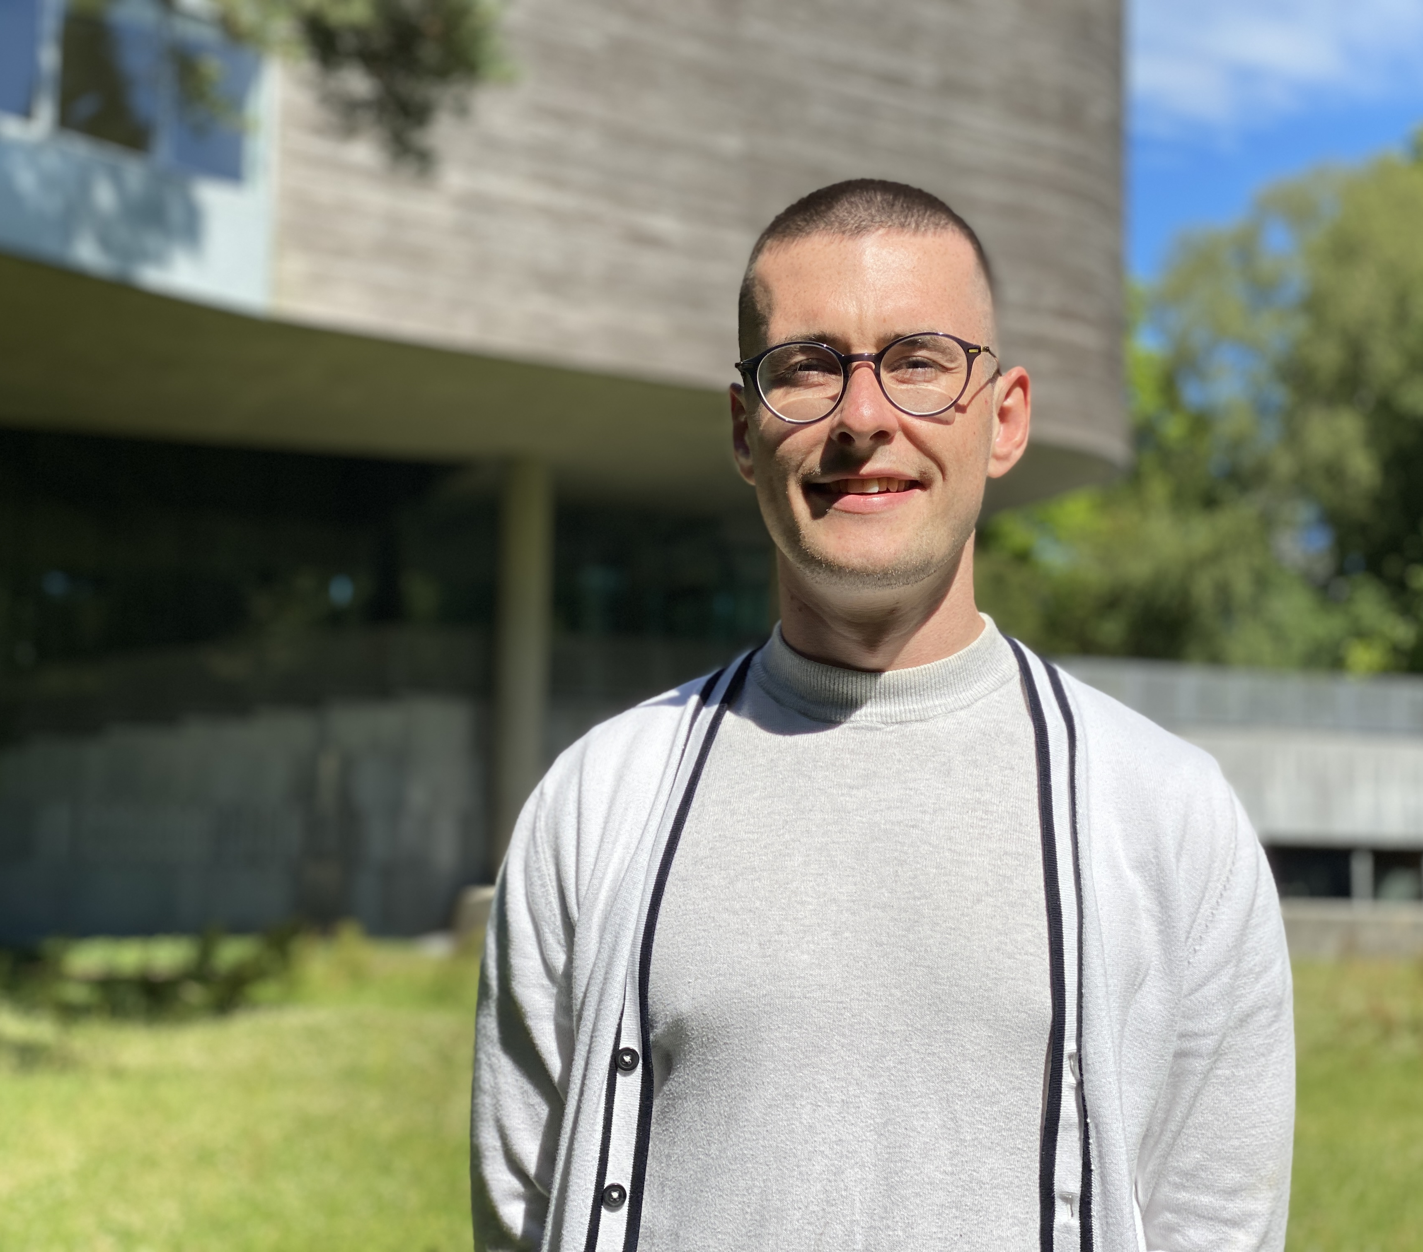
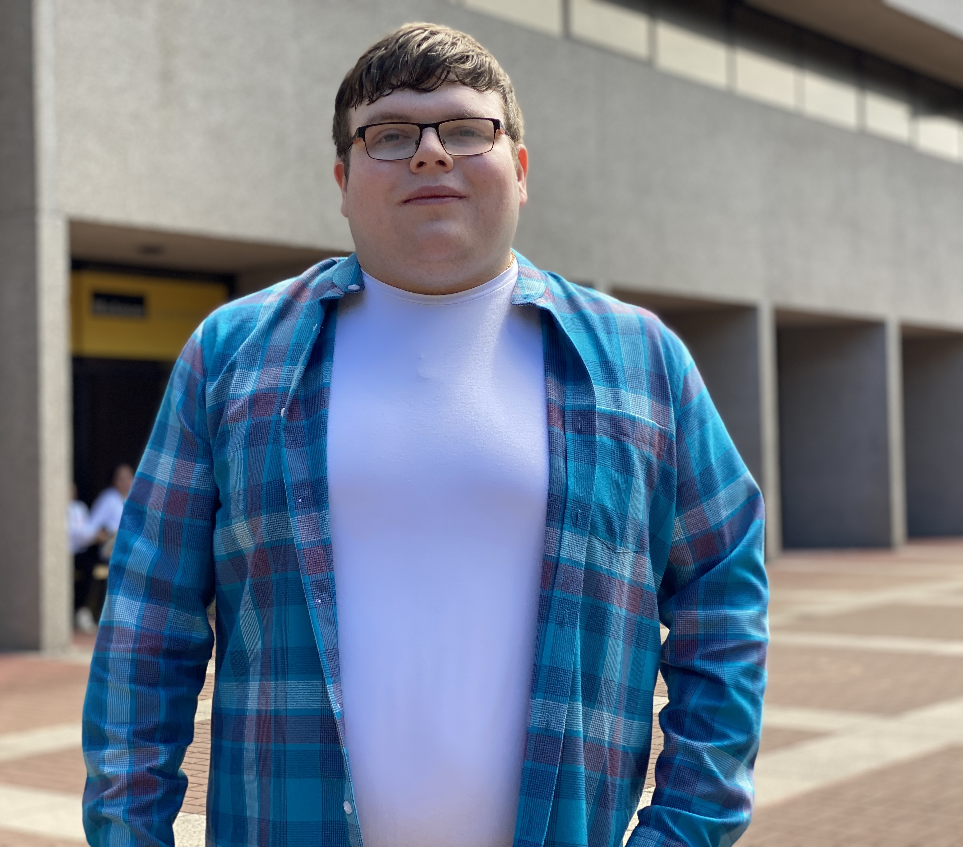
Training for students
Training for Students
Group workshops to support all DS students with their applications and internships:
  CV & Cover Letters
  Interview skills
  Disclosing a disability & requesting supports
  Mentoring
  Internship etiquette
1:1 meeting with a member of the EmployAbility Team for the successful interns

Slide 23
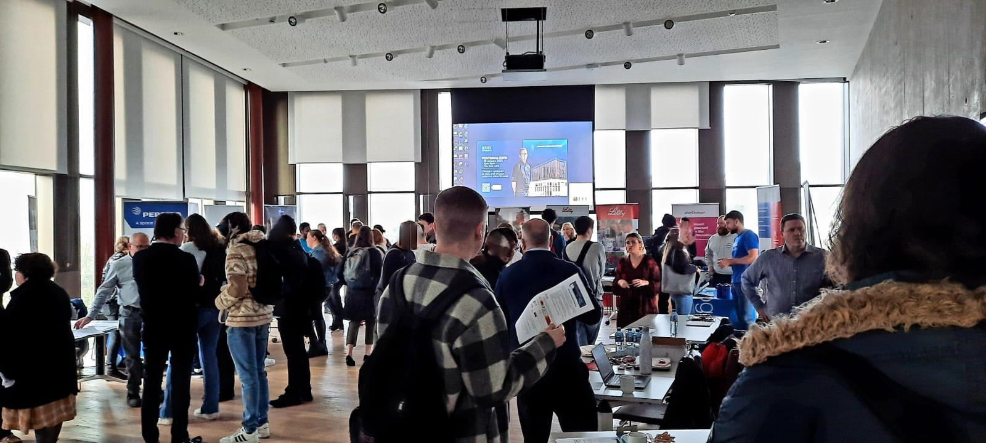
Or students
An opportunity for students and employers to interact
The Internship Fair

Slide 24
Group Discussion
GROUP DISCUSSION

Slide 25
Closing Slide
THANK YOU FOR YOUR PARTICIPATION!
AccessEmployAbility@ucc.ie

