Slide 1


Transform EDU: Employer collaboration to promote graduate employability.
Dr Aiden Carthy, Amanda Dixon and Margaret Kinsella, March 2025.

Slide 2

Transform-EDU Project
The Transformative Student-Centred Learning Record Project (Transform-EDU) is a four year, €1.4 million project that took place at TU Dublin between 2018 and 2022.
A rounded and innovative approach to learning was employed whereby students were offered a range of co- and extra-curricular events/workshops to enable them to develop dynamic 21st century graduate profiles.
Students could choose from events/workshops in the following areas:
Sustainable development emotional intelligence civic engagement academic integrity
leadership and teamwork entrepreneurship cultural awareness
Notes:
The project considers that, whereas key programme learning outcomes are achievable within any structured discipline-specific academic curriculum, the 21st century graduate profiles espoused by employers are dynamic, requiring an equally agile learning ecosystem, to ensure consistency in producing graduate who meet and/or exceed the technical and employability skills demanded in a wide spectrum of job-roles

Slide 3
Student Transformative Learning Record (STLR)
At graduation, alongside their standard parchment, students also receive a STLR parchment that lists all of the extra-curricular events and training they completed over the course of their studies. This may then be added to students’ CVs and/or presented to employers.
Students may be awarded STLR credit at one of three levels:
Exposure
Integration
Transformation.

Slide 4
Project Schematic

Slide 5
Social and emotional skills development
The emotional intelligence strand of Transform-EDU involved the design, delivery and evaluation of modules for undergraduates, which developed key social and emotional skills valued by employers in the modern workplace.
Modules were extra-curricular and offered on an opt-in basis.
First year students were offered a module in mindfulness.
Second year students were offered group-based coaching in emotional intelligence.
Final year students were offered an employer-led work-readiness module in socio-emotional skills for work (SES4Work).
The efficacy and impact of each module was assessed, both quantitatively and qualitatively.
As a consequence of the COVID-19 pandemic, participation rates were low and most workshops were offered online rather than face to face.

Slide 6
Mindfulness
A five-week mindfulness coaching module was delivered online to a cohort of first year students (n = 25).
Participants completed the Brief Resilience Scale and the Perceived Stress Scale before and again one month after completion of the coaching module.
Perceived Stress Scale - a dependent t test demonstrated there was a significant difference between the results from the pre-test scores (M = 22.4; SD = 6.6) and
post-test scores (M = 16.9; SD = 6.4), t(24df) = 4.61, p = .000, effect size (Cohen’s d) = 0.84.
Brief Resilience Scale - a dependent t test also demonstrated there was a significant
difference between the results from the pre test (M = 17.09; SD = 4.22) and post test
scores (M = 19.91; SD = 4.74), t(21df) = -3.29, p = .004, effect size (Cohen’s d) = .63.
Qualitative results, gleaned through focus groups, revealed that students valued the coaching as it increased awareness of mindfulness and encouraged development of personal mindfulness practice.

Slide 7
Emotional intelligence
A five-week EI coaching module was delivered online to a cohort of second year students (n = 19).
Participants completed the TEIQue test of EI prior to availing of coaching and once again one month after completion of the coaching module.
There was a statistically significant increase in EI scores post coaching (t = -5.194, p = .000 (two tailed), 95% CI = -.63 to -.26, effect size = .84.)
Qualitative results, gleaned through focus groups, revealed that students valued the EI coaching and stated it was most beneficial in terms of managing stress and their academic workload.
Students found coaching online made it easier to engage but that it stilted communication. Their preferred mode of delivery would have been hybrid - online/onsite.

Slide 8
Work readiness module design and implementation
Phase 1: Employer consultation
Online survey (n=128)
Interviews (n=21)
Phase 2: Student engagement
5 disciplines
Phase 3: SES4Work module
Post-testing: TEIque & EDP
Workshop design
Pre-testing TEIque & EDP
Phase 4: Project Evaluation
4 x 90-minute workshops
2 Fireside chats
1 Mock interview with feedback
Student feedback
Focus groups with employers & students
5 sectors
Exit year students
4 campuses

Slide 9
Collaboration with employers
Employers were consulted via an online survey (n = 128) and follow-up interviews (n = 21) regarding the specific socio-emotional skills required in five employment sectors which were:
1. Engineering (n = 30)
2. Professional services (n = 44)
3. Human health, social work, and education (n = 17)
4. IT and digital media (n = 20)
5. Manufacturing and pharmaceuticals (n = 17)

Slide 10
Project Instructions
Employers were given a list of ten social and emotional competencies drawn from the Emotional Competence Framework proposed by Goleman (1998), with abbreviated definitions of each competency and asked, on a five-point scale ranging from very unimportant to very important, to rate the importance of each skill in their workplace and the extent to which they believe graduates currently display each skill.

Slide 11
Social and emotional competencies
1. Emotional self-awareness (recognising own emotions and impact)
2. Emotional self-control (holding disruptive emotions in check)
3. Initiative (ready to act on opportunities)
4. Motivation (being goal oriented)
5. Adaptability (flexible, open to change)
6. Positive outlook (resilient, persistent despite setbacks)
7. Empathy (understanding other's feelings & perspectives)
8. Communication (listening openly, sending clear messages
9. Conflict management (negotiating and resolving disagreements)
10. Teamwork (working with others towards shared goals).

Slide 12
Results
93.3% of employers (n=119) deemed all ten competencies as being either ‘very important’ or ‘important’.
Notably, the pattern of socio-emotional skills rated important differed by sector. For example, on average, communication (m = 3.9), teamwork (m = 3.7) and motivation (m = 3.7) were rated most important for professional services, while for those working in human health, social care and education, the most highly rated skills were communication (m = 3.7), adaptability (m = 3.6), empathy (m = 3.6) and emotional self-control (m = 3.6). These differences informed the development of the workshops.

Slide 13
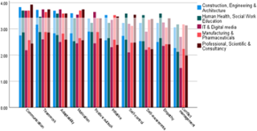
Mean ratings of the importance of social/emotional competencies in each sector, overlaid with current ratings by employers

Slide 14
COVID-19
The COVID-19 pandemic severely hampered our ability to
recruit students for the work readiness workshops.
As a result, only 24 students completed workshops.
A majority of the workshops were also delivered online
rather than being face to face as was originally planned.

Slide 15
Work readiness workshops
Teamwork
Listening & Speaking
Reading & Writing
Interview Preparation
Competency-based Interviews
Pedagogical principles
Student-centred
Tailored
Experiential
Interactive
Reflective
Authentic

Slide 16
Analysis
Prior to completing the five week work readiness module and again two weeks after having done so, participants completed the TEIQue (Petrides 2014) and the Employability Development Profile (Dacre Pool, Qualter and Sewell 2014) which measures work readiness.
Students were also invited to a mock competency-based interview with an employer in
their chosen field of study. The interviews focused on the EI component of the recruitment process e.g. motivation for applying for the position in question, teamwork, interpersonal skills.
Following the interviews, employers were asked just one question – If this had been a genuine interview for the position in question, would you have hired this candidate, yes or no? Students were not told whether they would have been hired or not but did receive feedback and advice on their interview performance.

Slide 17
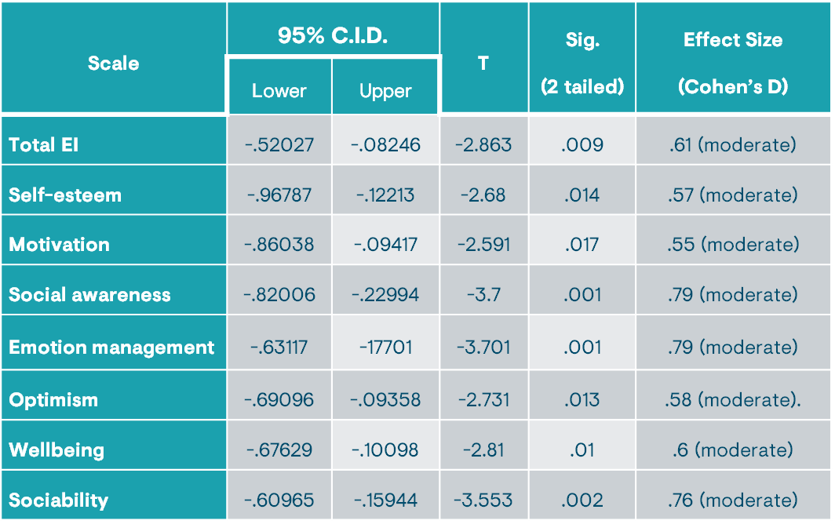
Results - EI
6.4% improvement on average.
Significant increases in target SES.
Improved self-efficacy.

Slide 18
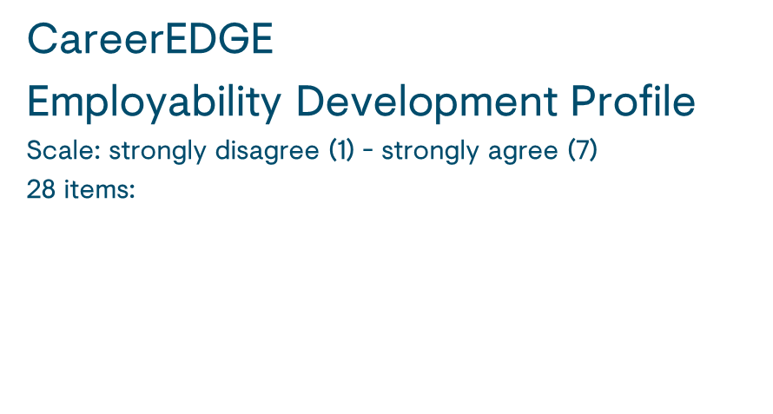
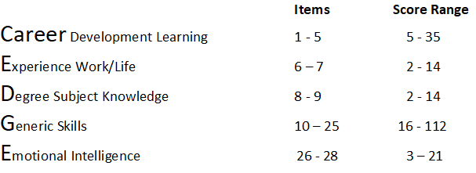
EDP Results
Large increase: 12.3% on average.
Pre-test average: 148.45/196.
Post-test average 164.45/196.
t = -4.183, p = <.001 (two tailed),
effect size (Cohen’s d) .89, large.
Post-test, 7 participants (31.8%) no longer had any scores below 4.
Improved self-perception of employability

Slide 19
Interview results
71% (n = 17) of students were successful at interview and would have been hired had the
positions being interviewed for been genuinely on offer.

Slide 20

Conclusion
High percentage of student hires.
Higher post-scores on the Employability Development Profile and the TEIque.
Improved self-perception of employability for students.
Direct access to work-ready graduates for employers.
Employer collaboration makes employability interventions more effective for everyone.
Recommendation
Embed the module in several final year courses to conduct a full randomised controlled trial with sufficient numbers.

Slide 21
Recent news
Recent news: A special event celebrating the achievements of 20 ambitious entrepreneurs took place this week as participants of the innovative online entrepreneurship course for persons with disabilities received their certificates of completion. The event also featured inspiring business pitches from the graduates, demonstrating the programme's impact in fostering new start-ups and entrepreneurial ambition.
Further information can be found at this link:
News and Opinion | Entrepreneurship Course for Persons with Disabilities Celebrates Success with Certificate Presentation and Business Pitches | TU Dublin

Slide 22
References
References:
Carthy, A. (2022) Transform-EDU: Increasing graduate employability through emotional and social skills development presentation at the International Conference of Education, Research and Innovation, Seville, Spain, November 2022.
Carthy, A., O’Regan M., Chalmers, W., O’Meara, A. and Nwankire, C. (2021) Mental Wellbeing And Emotional Skills Development For The Workplace Symposium for Transform-EDU week November 2021 https://transformedu.ie/media/
Carthy, A., Chalmers, W., Guiry, E. and Owende, P. (2022) An analysis of the impact and efficacy of online emotional intelligence coaching as a support mechanism for university students Frontiers In Education Volume 7:861564.DOI: 10.3389/feduc.2022.861564
Carthy, A., Chalmers, W., Guiry, E. and Owende, P. (2023) An analysis of the impact and efficacy of online emotional intelligence coaching as a support mechanism for university students, in Kohnke, L., Ulla, B. and Xie, H., Eds. (2023) Digital learning innovations in education in response to the COVID-19 pandemic. Frontiers Media, Lausanne, Switzerland DOI: 10.3389/978-2-83252-067-3
Chalmers, W., Carthy, A., Kenneally, M., Bruce, N., McGuinness, C. and Owende P. (2023) An Analysis of the Impact and Efficacy of an Online Mindfulness-based Intervention as a Support for First-year University Students The All Ireland Journal of Teaching and Learning in Higher Education Volume 15 (2) Available online at https://ojs.aishe.org/index.php/aishe-j/article/view/727/1083.
O’Regan, M., Carthy, A. and Owende, P. (2021) Socio-emotional skills for work and graduate employability Presentation at the Island of Ireland Symposium: Partenership for student success, developing graduates for the 21st century, June 2021, Online.
O'Regan, M., Carthy, A., McGuinness, C. and Owende, P. (2022) Employer collaboration in developing graduate employability: a pilot study in Ireland, Education + Training, DOI: 10.1108/ET-03-2022-0081
LINK TO FINAL REPORT AND ALL RESOURCES - Research | TU Dublin

